Slide 1
Protect the animal
初二（7） 梁策

Slide 2
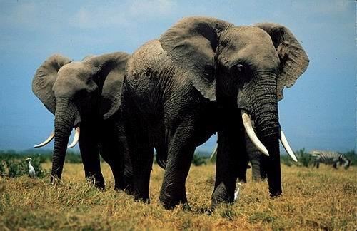
Animals are the members of the nature . But now animals have been killed for their fur and feathers, for food, for sport, and simply because they were in the way. Thousands of kinds of animals have disappeared from the earth forever. Hundreds more are on the danger list today.

Slide 3
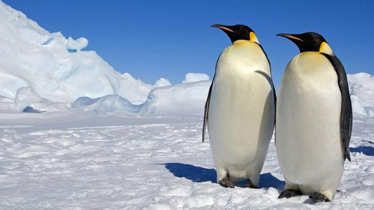
Why should people care? Because we need animals, and because once they are gone, there will never be any more . Animals are more than just beautiful or interesting. They are more than just a kind of food . Every animal has its place in the nature. If a kind of animal die out , it will cause many problems.

Slide 4
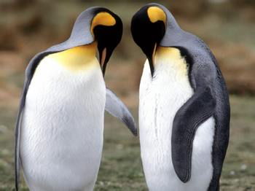
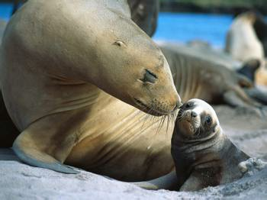
Luckily, some people are working to save the animals. Some groups raise money to let people know about the problem. And they try to get the governments to pass laws about protecting animals in danger , and a lot of countries have passed these laws . Slowly, the number of some animals in danger is growing.

Slide 5
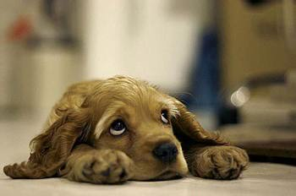
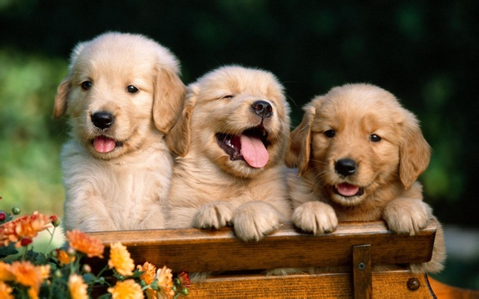
Here is some photos about some beautiful animals .

Slide 6
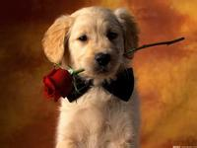
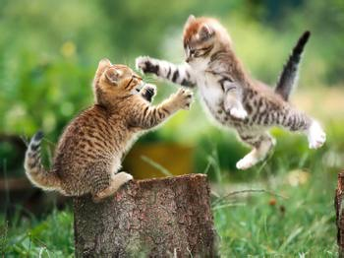
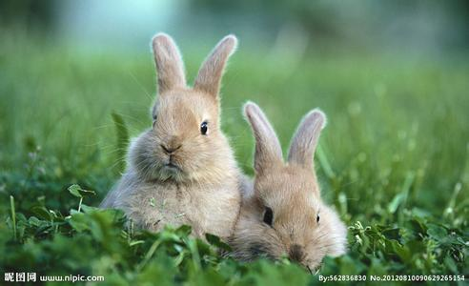

Slide 7
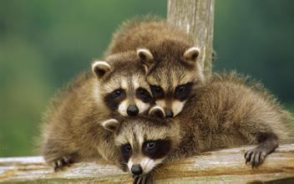
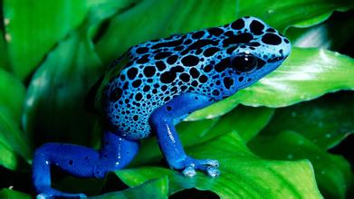
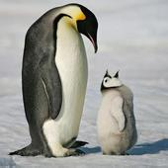

Slide 8
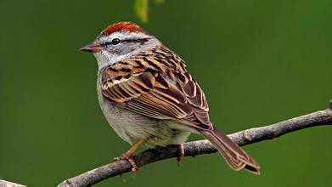
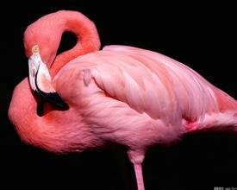
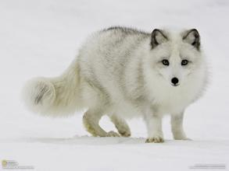
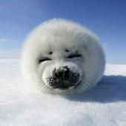
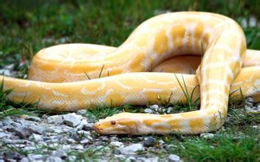
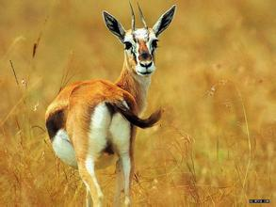

Slide 9
谢谢观赏

