Slide 1
Eyes open
--------Taylor Swift

Slide 2
Hunger Games
<Eyes open> is one of the most beautiful songs in the film called <The Hunger Game>. It is sung by Taylor Swift. Here are some photos of <The Hunger game>.

Slide 3
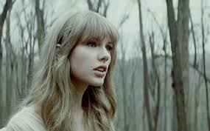
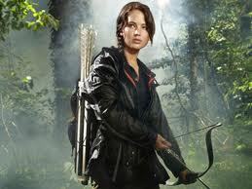

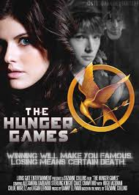
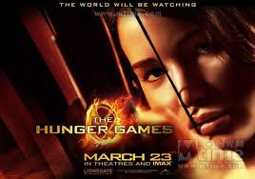

Slide 4
Everybody's waiting
Everybody's watching
Even when you're sleeping
Keep your ey-eyes open
The tricky thing
Is 1. we were just children
Playing soldiers
Just pretending
Dreaming 2. with happy endings
In backyards, winning battles with our wooden swords
But now we've stepped into a 3. world
Where everybody stands and keeps score
Keep your eyes open

Slide 5
Everybody's waiting for you to 4.
Everybody's watching to see the fallout
Even when you're sleeping, sleeping and
Keep your ey-eyes open
Keep your ey-eyes open
Keep your ey-eyes open

Slide 6
So here you are, two steps 5. and staying on guard
Every lesson 6. a new scar
They never thought you’d make it this far
But turn around, they‘ve surrounded you
It's a 7. , and nobody comes to save you now
But you've got something they don't
Yeah you've got something they don't
You've just 8. keep your eyes open

Slide 7
Everybody‘s waiting for you to breakdown
Everybody’s watching to see the fallout
Even when you're sleeping, sleeping and
Keep your ey-eyes open
Keep your ey-eyes open
Keep your ey-eyes

Slide 8
keyword
1.Yesterday
2.Dreams
3.Cruel
4.Breakdown
5.Ahead
6.Forms
7.Showdown
8.Gotta

