Slide 1
SKYLINE（天际浩劫）
By Zeng Jing
Class 7 Grade 8

Slide 2
The film is about unfriendly aliens.
Jarrod is a ordinary American , he goes to meet his friend Terry with his wife Elaine, but they have a quarrel. At night , they find that a kind of strong blue light shine and lots of people are attracted by it and die : the aliens attack the Earth! The three people try to escape. Jarrod is attack and nearly die, but his wife is pregnant（怀孕的）and he wants to be alive. At last he turns himself into an alien to be alive, and they finally escape successfully.

Slide 3
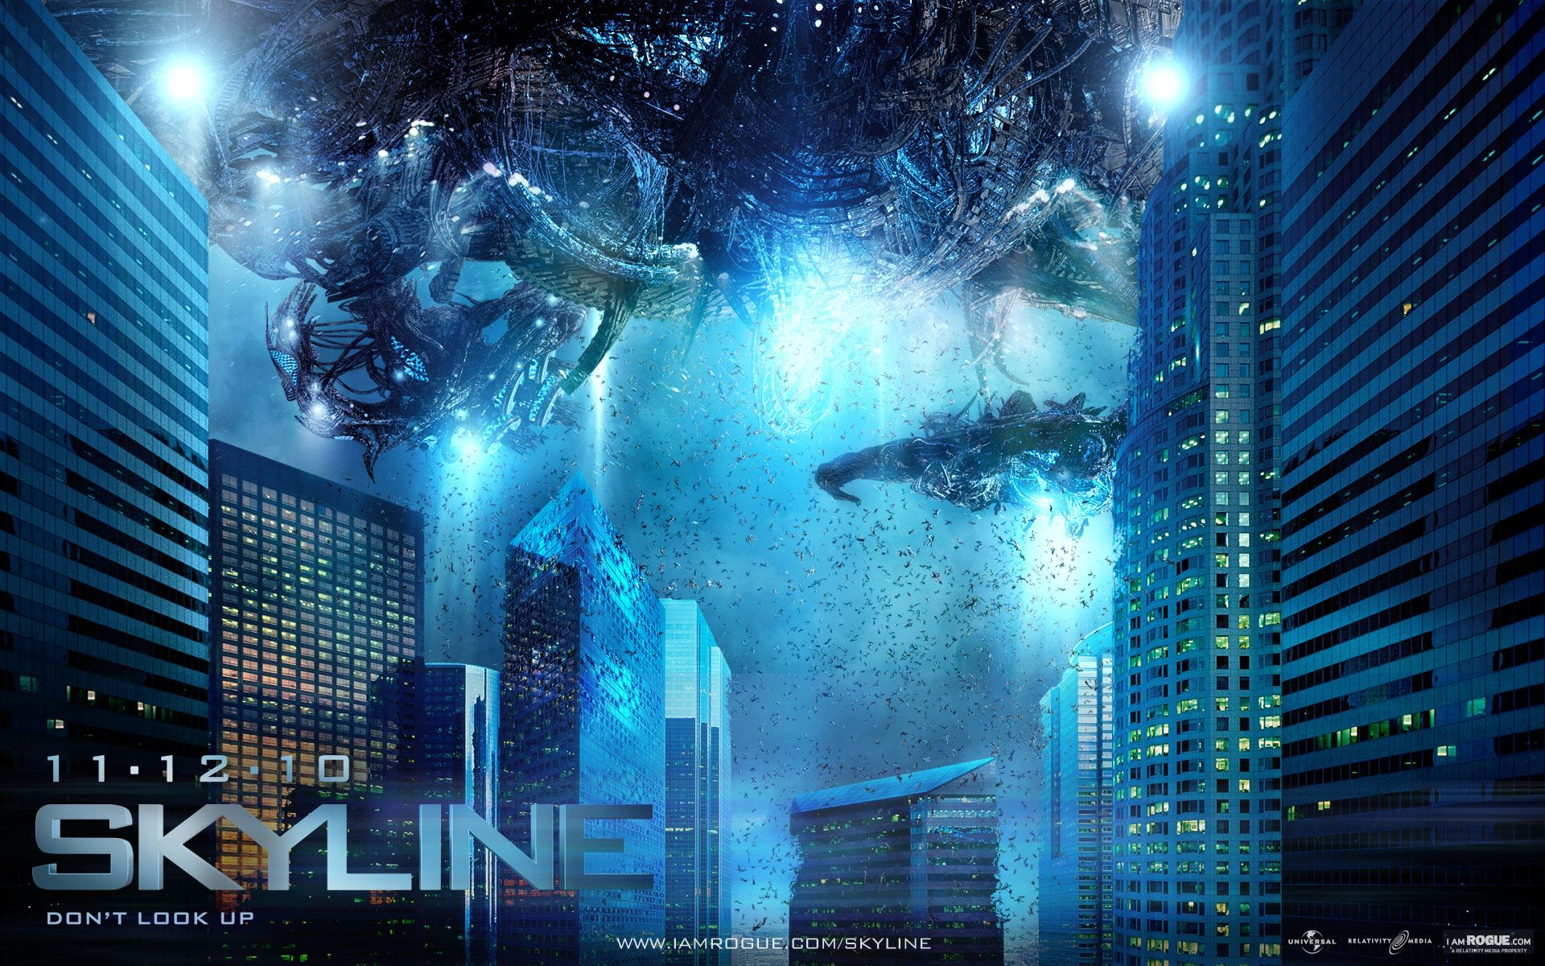

Slide 4
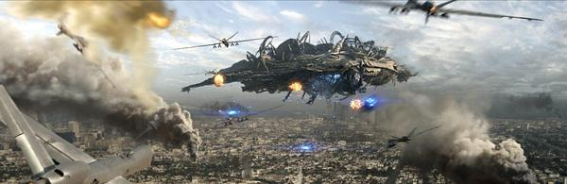

Slide 5
I don’t think the story of the film is good, but why and how Jarrod turn into alien is interesting, and the scenes in the films is so cool!
I think the aliens are unfriendly and dangerous.
Because what they think is different from us, and maybe they think we are stupid. I think there will be a war if one day we meet aliens.

Slide 6
3Q!

