Slide 1
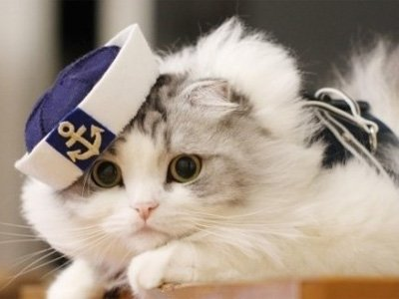
Keeping a cat as a pet

Slide 2
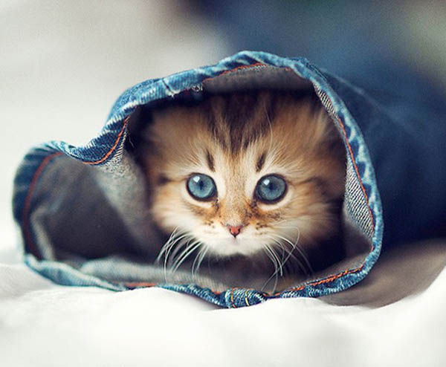
Something aboul cats
Also they are nocturnal [nɒk'tɜːn(ə)l] animals (夜行动物).
They sleep in the daytime and do most of their movements at night.
We should love cat, because cats are our friends.
Cats are very cute.
It has pointy ears, round eyes , little claws , and short but soft fur . Cats like eating fish and mice . They like to keep themselves clean, they do that by licking their fur .

Slide 3
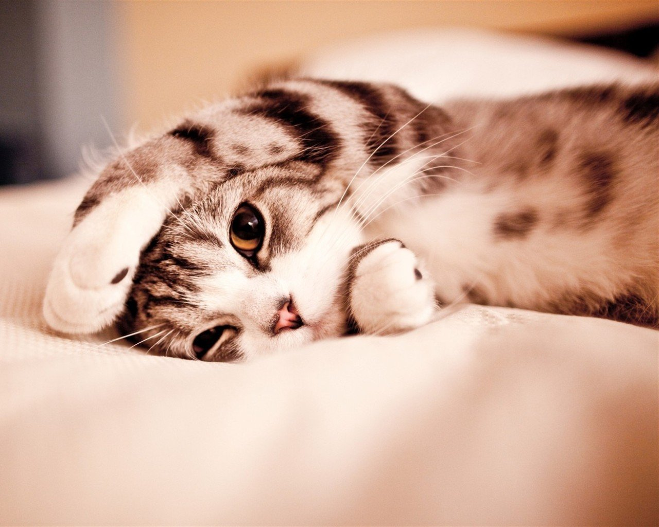
Why do people like to keep this pet
The cat is a kind of independent animal.
She will play with you when she happy, if not she will push you away.
Keeping a cat is much easier than keeping a dog.
You need not walk the cats.
Never need worry about it will felt bored. Just throw it a toy ,It can play for a long time.

Slide 4
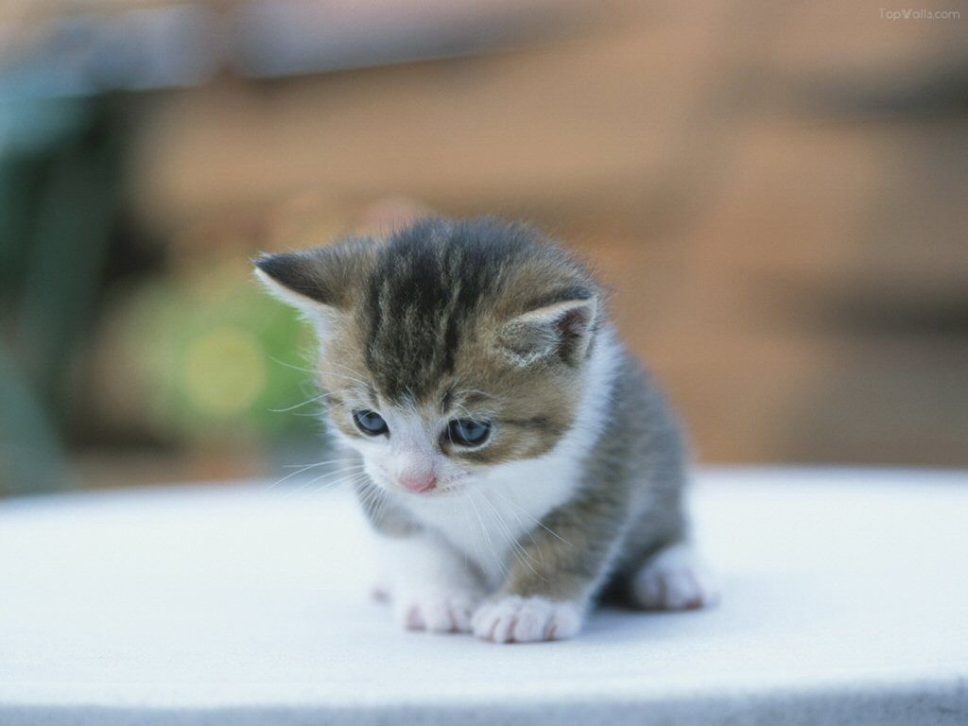
How should people take care of it
Cat care：clean the bowl which the cat use on time. You should often let the cat have a bath.
Cat health： take the cat to animal hospital to have a check
Cat nutrition：feed the cat with a balanced menu, so the cat will stay healthy.

Slide 5
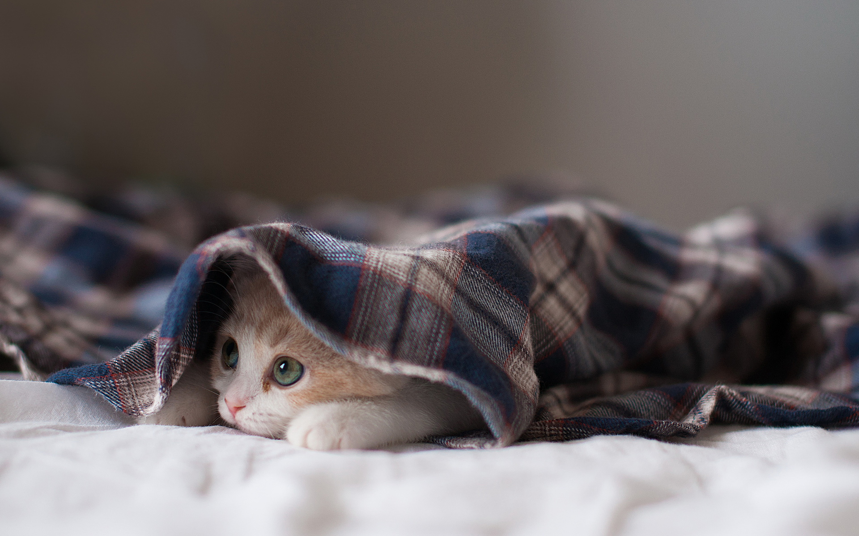
The proverb about the cat
blowing cat [美俚]爵士乐师
Cheshire cat 咧着嘴傻笑的人
copy cat 盲目的模仿者
dead cat 猛烈的指责或攻击 [美俚](马戏团中)不肯表演的狮子
Dog my cats! [美俚]见鬼! 他妈的; 我可以赌咒!
Has the cat got your tongue? [口]猫把你的舌头叼去了吗?为什么不吭声?
Has the cat got your tongue? [口]猫把你的舌头叼去了吗?为什么不吭声?
It rains cats and dogs. 下倾盆大雨, 大雨滂沱
singed cat [美俚]看起来不好, 其实并不坏的人
Holy cats! [口]哎呀! 好家伙! (表示强烈的惊讶, 愤怒或高兴)

Slide 6
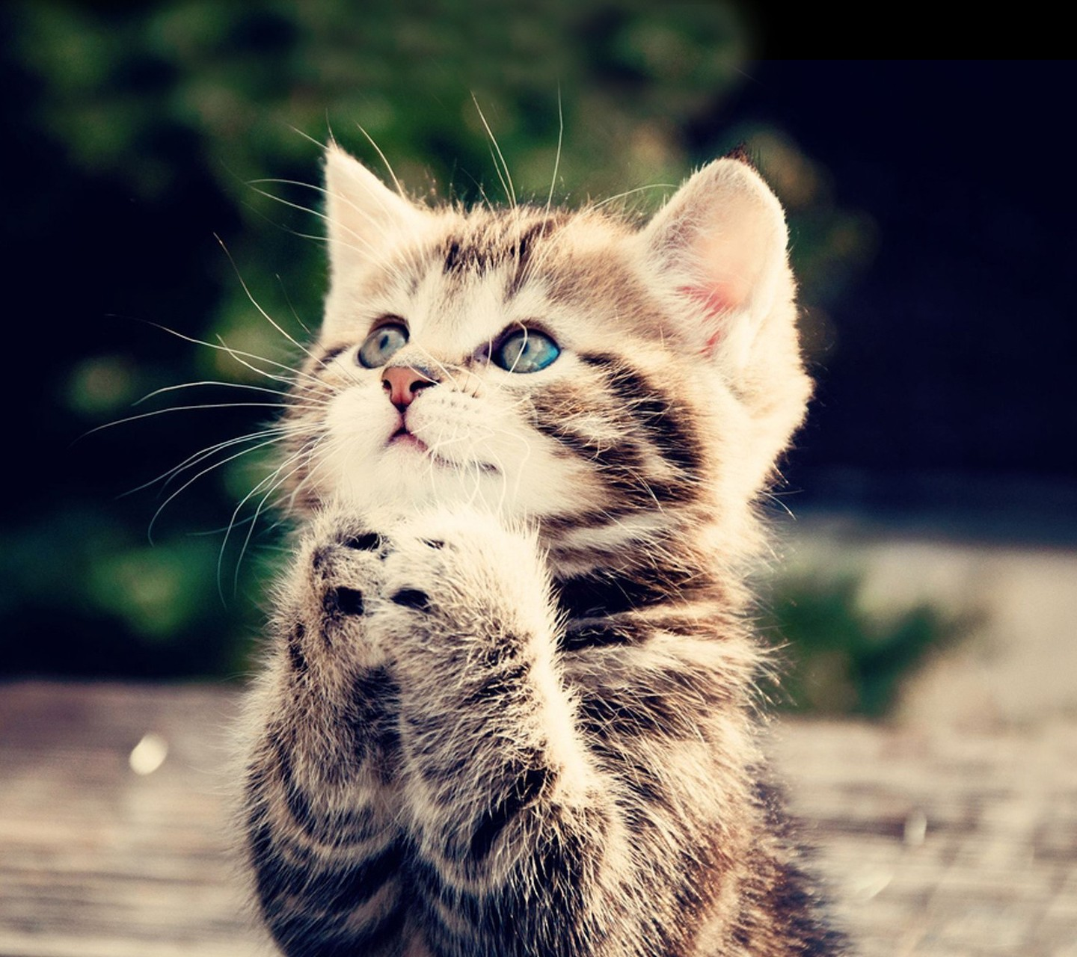
Funny cats

Slide 7
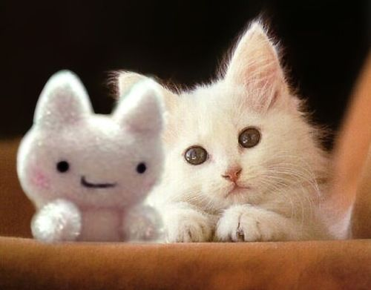
Thank you !

