Slide 1
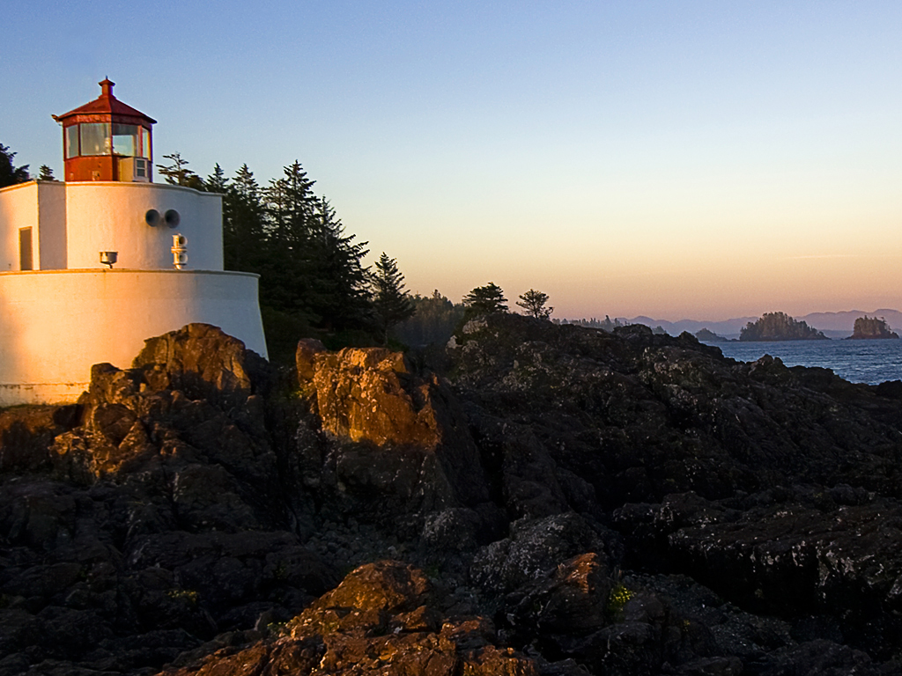
Passive voice

Slide 2
Tom broke the window.
The window was broken by Tom.
Tom broke the windows.
The windows were broken by Tom.
He broke the windows.
The windows were broken by him.

Slide 3
Fill in the blanks with the proper form of the words given in the brackets.
The bridge ( build) last year.
The Olympic Games (hold) every four years.
The problem (discuss) at the meeting now.
His new book (publish) next month.
was built
are held
is being discussed
will be published

Slide 4

The passive voice with modal verbs
Answer the questions with sentences from the article on page 51.
What should we do to the pictures if we want the characters and things to appear to move?
How should we add sound effects?
Each picture should be made a little different from the one before it.
Sound effects, like the noise of the underground,
must also be added separately.

Slide 5
Modal verbs
must
can (could)
may(might)
ought to
need
dare
shall (should)

Slide 6
Read the sentences on page 55 and complete “Work out the rule”.
Each picture should be made a little different from the one before it.
Each picture should not be made the same as the one before it.
Sound effects must be added.
Sound effects must not be forgotten.

Slide 7
Read the sentences on page 55 and complete “Work out the rule”.
Should each picture be made a little different from the one before it?
Yes, it should.
No, it should not/ shouldn’t.
Must sound effects be added?
Yes, they must.
No, they must not/ mustn’t.

Slide 8
Work out the rule
To make the passive voice with modal verbs, _____ is used between the modal verb and the past participle of the main verb.
be
肯定句：modal verb + be + past participle
否定句：modal verb + not + be + past participle
疑问句：modal verb + sb./sth. + be + past participle

Slide 9
Rewrite the sentences in the passive form.
Libo must complete the task today.
We should send the invitation to Mrs Ding.
They cannot solve the problem.
→ The task must be completed by Libo today.
→ The invitation should be sent to Mrs Ding.
→ The problem cannot be solved by them.

Slide 10
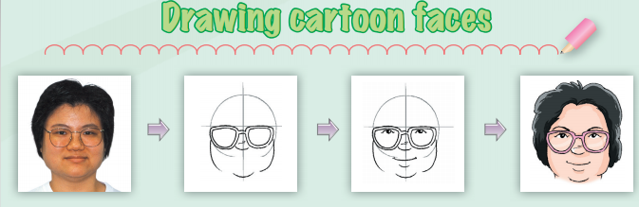
Complete the article below with the correct forms of the words in brackets.
When we draw a cartoon face, some parts of the face (1) _______________ (should/make) bigger to make the face look funny. So let’s start to draw a cartoon face for the woman!
should be made

Slide 11
A rough circle (2) ________________ (should/draw) first. Then a nose and big glasses (3) ______________ (should/add).
should be drawn
should be added
Next, a pair of small eyes and a smiling mouth (4) _____________ (must/draw). The mouth (5) ____________ (can/make) larger to make the woman look friendlier.
must be drawn
can be made
should be added
Finally, some hair (6) ________________ (should/add) to the cartoon. The face (7) _______________ (can/colour) with bright colours.
can be coloured

Slide 12
Exercises
1 . Mr Ding must take care of the books in the library.
The books must be taken care of in the library.
2. Peter may find this kind of trees everywhere.
This kind of trees may be found everywhere .
3 . You can’t see the stars in the daytime.
The stars can’t be seen in the daytime.
4 . Must Chuchu hand in his composition tomorrow?
Must Chuchu’s composition be handed in tomorrow?

Slide 13
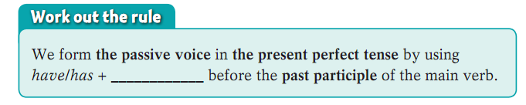
Read the sentences on page 56 and complete “Work out the rule”.
After everything has been checked, it is ready to be played for everyone to enjoy.
The cartoon characters have been drawn carefully by the artists.
been
肯定句：have/has + been + past participle
否定句：have/has + not + been + past participle
疑问句：Have/Has + sb./sth. + been + past participle

Slide 14
Exercises
1. Can you tell me whom the play _____in 1989.
was written by (B) was written
(C) is written by (D) is written
2.TV and radio programs ____the other side of the world.
(A) can send to (B) can send on
(C) can be sent to (D) can be send to
3. About 200 trees ___before I got there yesterday.
(A) were planted (B) have been planted
(C) would be planted (D) had been planted

Slide 15
Exercises
4. Middle School boys ____not to smoke.
always tell (B) are told always
(C) are always told (D) is always told
5. She was often heard ___the song in English.
(A) sing (B) sings
(C) to sing (D) sang
6. DO you like this piece of cloth?
Yes, It ____very nice
(A) was felt (B) felt
(C) is feeling (D) feels

Slide 16
Thank You!

