Slide 1

Welcome to class!
Media class, 08/03/2014

Slide 2
Our routine!
Routine (n): 常规 - Every week we will do:
Vocals
Vocabulary corner + “The Hot Seat”

Slide 3

Vocals
What: In class everyday. Each person will read or speak freely in the beginning of class.
Short story; song (or sing); poem; diary entry; article
of their choice
Who: Students in the class, one by one
Somebody will speak
each week.

Slide 4

Vocabulary corner
Celebrity (n)
a famous or well-known person.
Flattery (n)
a flattering compliment or speech; excessive, insincere praise.
Novel (adj)
A long, fictional narration
Plot (n)
Also called storyline. the plan, scheme, or main story of a literary or
dramatic work, as a play, novel or short story.
Compare (n)
to examine (two or more objects, ideas, people, etc.) in order to
note similarities and differences: to compare two films

Slide 5
Stunning (adj)
of striking beauty or excellence: What a stunning dress you're
wearing!
Touching (adj)
affecting; moving: a touching scene of farewell.
Popularity (n)
the quality or fact of being popular.
Strategy (n)
A plan, a tactic, a series of manoeuvres.
Recommend (n)
To advise, suggest is beneficial, make desirable, commend

Slide 6

The Hot Seat!
Use a word from the vocabulary corner in a sentence

Slide 7


Genre – type/style of film

Slide 8
Order the letters to make three genres of film
COYMDE
ROHRRO
CERONAM

Slide 9
Advertisements often use special language:

Slide 10



Alliteration

Slide 11


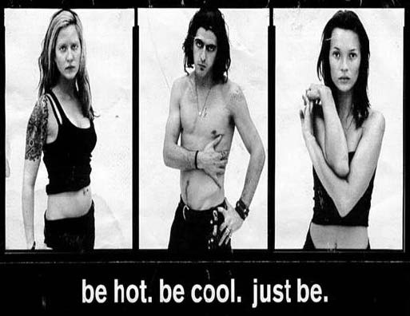
Commands

Slide 12


Guarantees

Slide 13



Slogans

Slide 14



Special offers

Slide 15
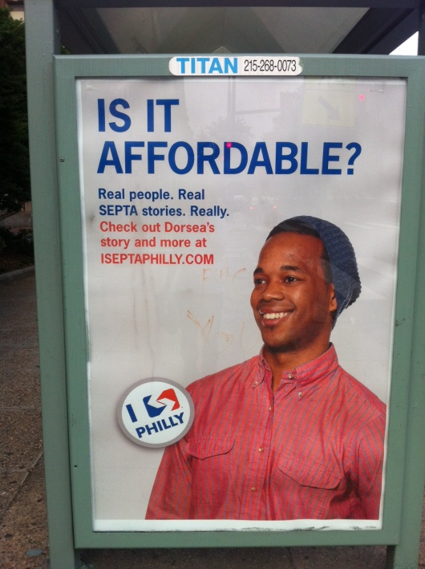


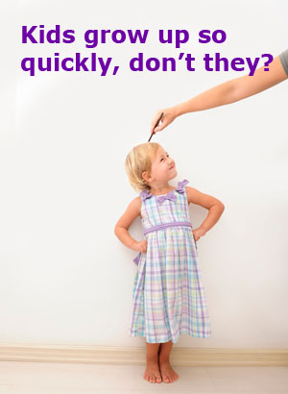
Rhetorical questions
(no answer is expected)

Slide 16


Rhyming

Slide 17

Thought of the day

