Slide 1

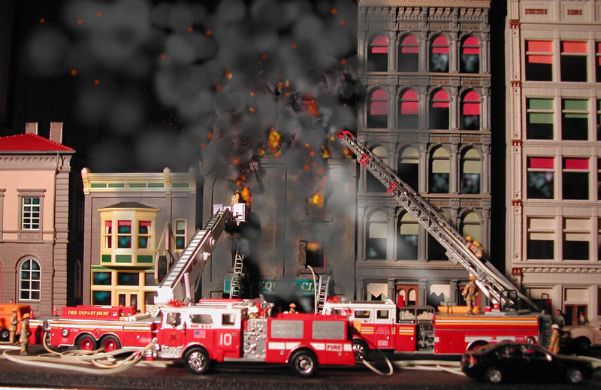


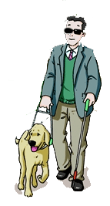

Checking-up
1
A blind man
and his “eyes”
in a fire
Look at the pictures and retell the story. Pretend that you are John and retell it in the first person.

Slide 2
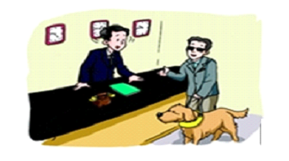
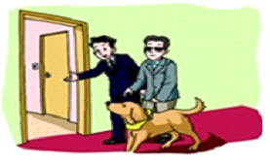
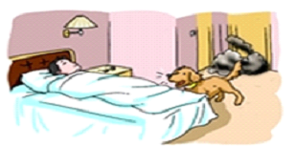
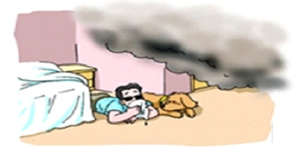
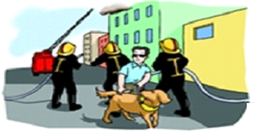
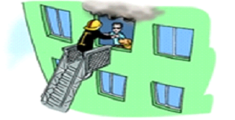


Slide 3
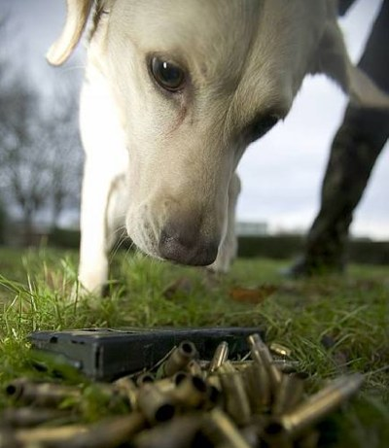
Strategy training
4
Where is the mistake?

Slide 4
Sentence 1
The firemen arrived in Beijing Airport.
Wrong sentence
Mistake
arrived in
arrive in后面一般加较大的地方，如国家，省份，城市等。arrive at后面一般加较小的地方，如车站、机场、村庄、学校等。若后面没有地点或跟方位副词则不需要加介词。
Why
The firemen arrived at Beijing Airport.
Correct sentence

Slide 5
Sentence 2
Wrong sentence
Most girls’ parents don’t allow them stay out late.
Mistake
allow them stay
allow与let意思相近，但在使用上有区别：let sb. do sth.；allow sb. to do sth.。
Why
Most girls’ parents don’t allow them to stay out late.
Correct sentence

Slide 6
Sentence 3
Ross hates Maths, and he always falls sleepy in Maths classes.
Wrong sentence
Mistake
falls sleepy
sleepy是形容词，意为“困倦的；瞌睡的”。可以说feel sleepy意为“感到有睡意，但没有睡着”。asleep是形容词，只能作表语，意为“睡着的”。fall asleep是动词词组，意为“睡着了”。
Why
Correct sentence
Ross hates Maths, and he always falls asleep in Maths classes.

Slide 7
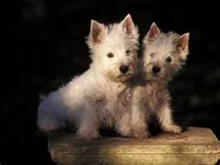
Sentence 4
Wrong sentence
I always like to sit next my best friend.
Mistake
sit next my best friend
next是形容词，单用表示 “下一个”。next to意为“紧靠……的旁边”。next to的近义词有beside和by，它们都属于方位介词。
Why
Correct sentence
I always like to sit next to my best friend.

Slide 8
Sentence 5
Wrong sentence
A blind man and his “eyes” in fire.
Mistake
in fire
火灾可数
Why
Correct sentence
A blind man and his “eyes” in a fire.

Slide 9
Sentence 6
Wrong sentence
Welcome you to stay.
Mistake
Welcome you to stay.
1.欢迎某人做某事 sb be welcome to do sth. (welcome在这里是形容词)
2.Welcome to someplace (welcome back/ home) (welcome在这里是招呼语)
Why
Correct sentence
You are welcome to stay.

Slide 10
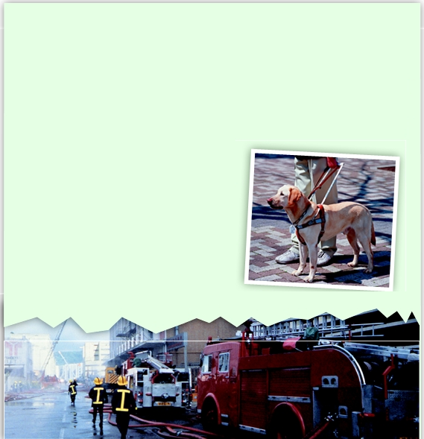
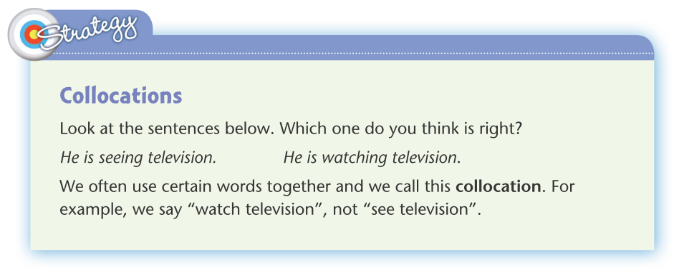

Conclusion
From these sentences, we’ve learnt that:

Slide 11
Homework
H
完成下列汉译英。
那条搜救犬很快就到达消防车那儿。
那位接待员最后终于允许服务员带领盲人和导盲犬来到他们的座位。
我今天在数学课上睡着了。老师叫醒我后，我向他道了歉。

Slide 12
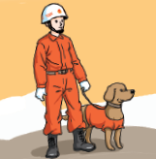
那条搜救犬很快就到达消防车那儿。
The rescue dog arrived at the fire engine quickly.

Slide 13
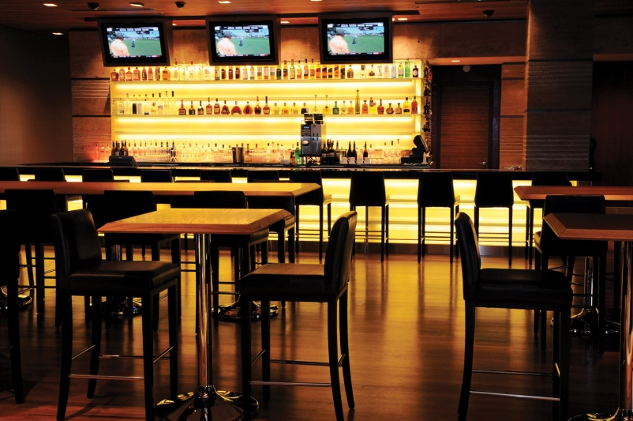
那位接待员最后终于允许服务员带领盲人和导盲犬来到他们的座位。
The receptionist finally allowed the waiter to lead the blind man and his guide dog to their seat.

Slide 14
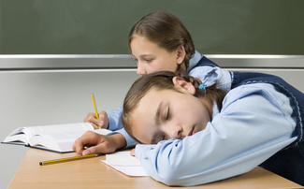
我今天在数学课上睡着了。老师叫醒我后，我向他道了歉。
I fell asleep in Maths class today. After the teacher woke me up, I apologized to him.

