Slide 1


Slide 2
People who think they are full of niubility like to play zhuangbility, which only reflect their shability.
No zuo no die, why I try.
gelivable
Long time no see.

Slide 3

every day
everyday
每天
日常的
blame
engineer
37-year-old
37 years old
central
centre，center
adj.
n.

Slide 4
为…做出了巨大的贡献
毕业于…
物理学博士学位
回国
make great contributions to…
contribute a lot to …
graduate from…
get/receive doctor’s degree on/for physics
return to/go back to China/motherland

Slide 5
Unit 2 Vocabulary

Slide 6
Consist
How many players does a football team consist of?
Water consists of oxygen and hydrogen.
True beauty consists in the lover’s eye.
Wealth doesn’t consist in what we have, but consist in what we are.
=be made up of 由…组成，构成
= lie in 存在于，在于

Slide 7
Theory should consist with practice.
His conclusions don’t consist with facts.
=be consistent with与…一致，相符

Slide 8
The cake is divided into 4 parts. And it will be divided among 4 children. The children are asked, “Divide 1 by 4, how much cake can you get?”
divide…into… : 把…分成，划分开
divide…among…: 在…中间分配
divide A by B: 用B来除以A

Slide 9

你能想出accomplish的同义词吗？
achieve
finish
accomplish
accomplish
accomplish
complete
conclude

Slide 10

finish 强调“结束”，最常用，后可接名词和动词的-ing形式，表示在一个活动的连续过程中完成了最后的一步或阶段。在做把什么东西“吃完、喝完”解时，不能用complete代替。如：
When he finished his speech, we all applauded.

Slide 11
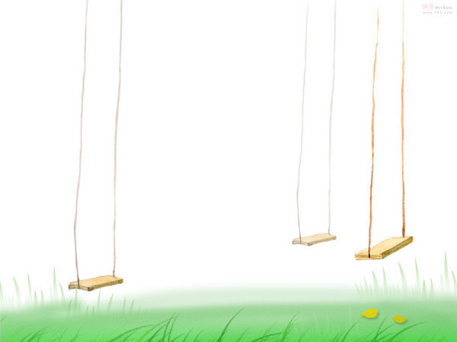
complete 强调“完整”，常跟建筑、工程、书籍等词语连用，指按预期目标把未完成的工作经过进一步的努力使之完成，语气比finish正式，但很多情况下可以和finish通用。complete后面只能接名词。如：
Lucy wanted to complete the first chapter of her book before going to bed

Slide 12

achieve “成功取得，实现美好的事物”，如：
achieve success/ dreams
accomplish “达到预期的目的，成功地完成，取得成绩或成就”，后面可接名词或动名词
Fred can accomplish more in a day than others in his class.

Slide 13
break v. (broke, broken)
习惯搭配:
break away 挣脱, 逃脱；脱离, 背叛
break down 抛锚, 出故障, 身体跨了
break into 闯入
break out (战争、瘟疫、火灾) 爆发
break off 中断
break the rules 违反规则
break the record 打破记录
break one’s word 食言

Slide 14
credit其常见意思是 “赊购；信任；称赞；学分。” 如：
This restaurant doesn't give any credit.
本店概不赊账。
I did not give credit to his story.
我没有相信他的话。

Slide 15
to one’s credit 值得赞扬/钦佩； 为某人增光。如：
It is greatly to your credit that you gave back the money you found.
你拾金不昧是非常值得赞扬的。
To her credit, she arrived on time despite the rain.
她冒着大雨按时到达，值得赞扬。

Slide 16
convenience n. 方便, 便利
I keep my dictionary near my desk for convenience.
为了图方便, 我把字典放在书桌前。
＜习惯搭配＞
at one’s convenience 在方便的时候
for convenience 为了方便起见
for the convenience of sb 为了方便某人

Slide 17
What first attracted me to her was her sense of humour.
她首先吸引我的是她的幽默。
The garden city attracts many tourists.
那个花园城市吸引许多游客 。
attraction n.
attractive adj.
attract/absorb one’s attention

Slide 18
Leave out
Life consists of various choices. You decide to gain something, and that means you are leaving out something.
We always leave out subjects and articles when chatting online.

Slide 19
leave A for B
leave…behind
leave… alone
离开A地去B地
落下，忘记带，丢下
不理，不管
leave me alone
1. I am so upset. Please _____________.
2. I went out in such a hurry that I _______ my purse ____________.
3. It is said that travelling means ____________ the place that you have been tired of ________ another place that others are bored with.
left
behind
leaving
for

Slide 20

delight
To my delight, the National Day is approaching.
My BFF always takes delight in making fun of me.
She announced with delight that she will be married.
I am very delighted to help you.

