Slide 1

Unit 3 Vocabulary

Slide 2

Impression
Chen Ming has left/made a deep impression on the judges. He impressed the judges because his speech was quite impressive.

Slide 3
take up
The telephone rang. John took up the phone. It was his friend who wanted to introduce a new job as a salesman to him. John said he couldn’t take up the job offer, because he had just taken up a job as a market surveyor and he had to take up the survey that he hadn’t finished.

Slide 4
拓展：与take相关的短语
office
apart
in
it easy
take over
down
notes
away
吸收，留宿
别着急
取下, 记下
就职
拆开
接管
拿走
做笔记

Slide 5
constantly adv. 连续不断地，持续地
Fashion is constantly changing.
时尚总是日新月异。
The constant noise has driven me crazy.
这反复的噪音真是让我崩溃。

Slide 6
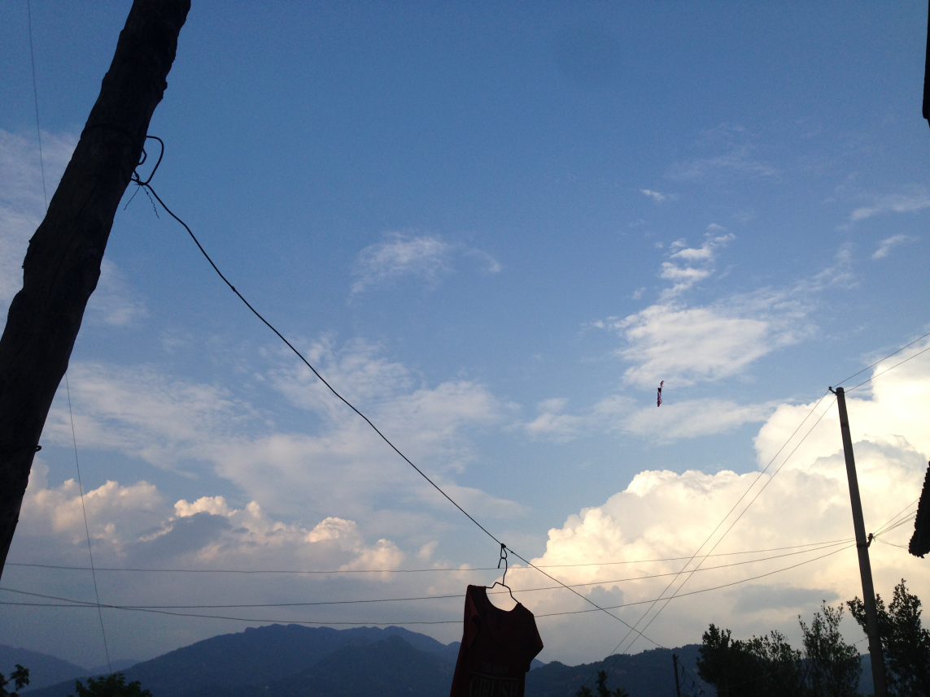
surroundings
The surroundings of my house are very nice. The surrounding scenery is very beautiful, especially the trees which surround my house.

Slide 7
lack
我缺钱。
I lack money.
I am lacking in money.
由于缺钱，我不得不卖掉了一个肾。
I have to sell one kidney for lack of money.
少了一个肾之后我整个人都不好了。
I am not myself because of a lack of kidney.

Slide 8





Slide 9
阅读下列句子，观察lose sight of 的意思和用法。
1.Ever time I lose sight of you, I feel at a loss.
2. Because of the heavy fog, the driver lost sight of the road ahead.
3. We can not lose sight of our duty.

Slide 10

Can you put them in right order?
speeded
belt
and
sight
I
the
of
fastened
the
lost
up
car.
Soon
her.
safety
She

Slide 11
She fastened the safety belt and speeded up the car. Soon I lost sight of her.

Slide 12
Can you put them in right order?
The guide
tolerate
she
us
an
that
on
patience,
impression
so
too long.
she
left
lacked
couldn’t
waiting for
us

Slide 13
The guide left an impression on us that she lacked patience, so she couldn’t tolerate waiting for us too long.

Slide 14




I constantly make adjustments about my previous attitude, and it’s getting closer to optimism.
When the robbers were sweeping up the money in the bank, they heard a shot of gun, so they slid into another house in an instant.

