Slide 1
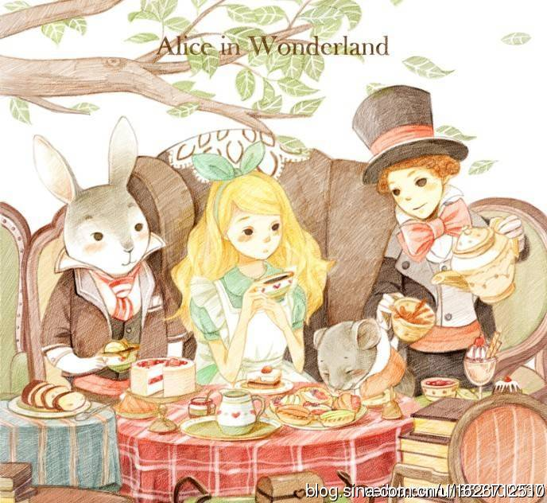
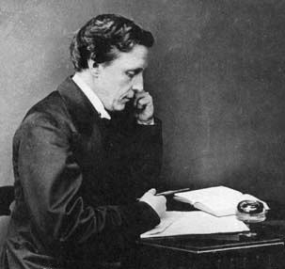
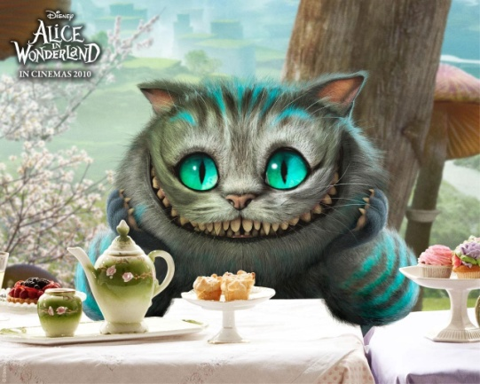
Alice's Adventures in Wonderland
It is on the bank, and Alice is sitting by her sister. Suddenly a white rabbit with pink eyes runs close by her. The rabbit says to itself, “Oh dear! Oh dear! I shall be too late!” Alice has never seen a rabbit with either a waistcoat-pocket, or a watch to take out of it. She runs across the field after it and pops down a large rabbit-hole under the hedge.
“Alice's Adventures in Wonderland” was written by Lewis Carroll(1832-1898). Lewis Carroll was from England. He was a famous mathematician. When he was young, he was considered as a genius. His fantasy shows that he had a great imagination.
“Alice's Adventures in Wonderland”:
is one of the most famous English stories.
has been translated into more than 125 languages.
is popular with people of different ages.
is well known for its fantasy and interesting language features.
Why not have a look at this interesting book?
Grace

