Slide 1


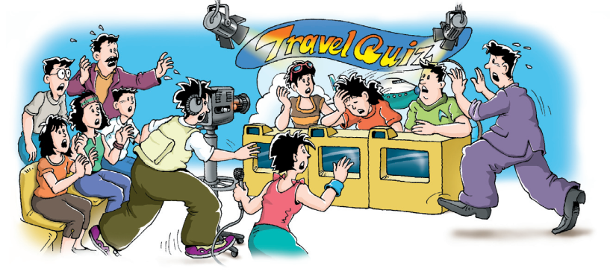
Revision

Slide 2

单词目标
高频单词： praise, view, director, make-up, artist, upon, among, onto, forward, second, relaxed, beat, still, single, victory, England, lucky, news, survey
拓展单词： script, studio, contestant
高频词组：pass out, keep still, on weekdays, ahead of, emergency exit, keep still, on weekdays, pass out
拓展词组： floor plan, talent show, emergency exit, shine down upon, put make-up on one’s face, win the prize, have a haircut, closing words, opening words, jump out of one’s skin, to cut a long story short, to be honest, a piece of cake

Slide 3
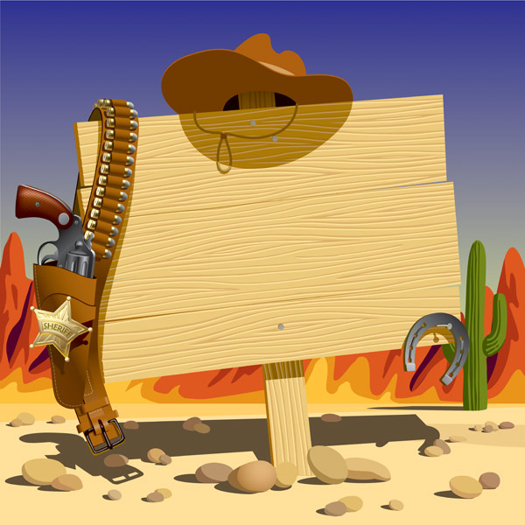
Review Reading A
Part one
A guseeing game

Slide 4


A guessing game!
Work in groups.
There are some words and phrases from U5.
Choose one boy/girl volunteer to stand back to the SCREEN.
Another boy/girl representative looks at the SCREEN and tells him/her who stands back to the screen the words, using only the other words , sentences or body language to explain the word. He or she will have to guess what it is.
There is only one minute.
ONE WORD TWO POINTS!
YOU CAN PASS ONLY TWO WORDS/PHRASES.

Slide 5
Group 1
artist
relaxed
single
victory
keep still
on weekdays

Slide 6
Group 2
second
among
studio
contestant
pass out
talent show

Slide 7
Review Reading A
Part Two
Who is faster?

Slide 8
BOYS VS GIRLS 抢答游戏
一．单词拼写。
1. All the students are r________ after the exam.
2. Go f_________, and you can find your way.
3. You must choose one number a________ the three.
4. Finally, Lin Dan b________ the other contestants and won the first prize..
5. Mr Bean is a great a_________, everyone likes him.
6. Miss Chen p_________ Linda because she helped her classmates with study.
7. Many people came to the Nest to v________ the Olympic Games.
8. It’s very l_______ that many people are saved in the earthquake.
9. Susan’s little brother is very clever, he can answer many difficult math questions in a s__________.
10. Zhang Yimou is a famous d_________ all over the world.
elaxed
orward
mong
eat
rtist
raised
iew
ucky
econd
irector

Slide 9
BOYS VS GIRLS 抢答游戏
二．完成句子。
1. 上课的时间到了，所有的学生都跑回教室里。
________ _______ ________class, all the students run back to the classroom.
2. 他上课的时候总是认真听讲，一动不动。
He listened to the teacher so carefully that he ________ _________.
3. 所有的球迷们都很低落，因为球队输了比赛。
The football fans are very sad because their team _____ ______.
4. 她在考试开始时，突然晕倒了。
She _____ _______ before the exam.
5. 银行只在工作日上班。
The banks open ________ _________.
It’s time for
kept still
was beaten
passed out
on weekdays

Slide 10
BOYS VS GIRLS 抢答游戏
6. 很多高楼总是把紧急出口关闭，这是非常危险的。
It is very dangerous for the buildings _____ close the _____ _______.
7. 看到房子的平面图之后，年轻的夫妇就买了这套房子。
The young couple bought the house as soon as they saw the ______ ______.
8.说实话，我认为你是错的。
________ ________ ________, I don’t think you are right.
9. 尽管这项工作艰巨，但他看起来很淡定。
_______ the work was difficult , he seemed _________.
10. 下周我们学校将举办一场达人秀。
There _____ ________ a _______ ________ in our school next week.
to emergency exit
floor plan
To be honest
Though calm
will be talent show

Slide 11
Review Reading A
Phrases
Part Three
Game: Cowboy

Slide 12

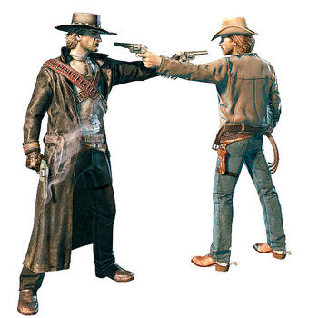
Rules
从两组同学中各选出5名同学
两组的5名同学排成竖行对峙
看到大屏幕上的中文短语，尽快
作出回答并说BANG
反应慢的那位同学退下，由后一
个同学顶上
剩下最多学生的那组为优胜组

Slide 13

fried food
体格检查
均衡饮食
例如
通常；大体上
stay away from
油炸食物
减肥
不同种类的
treat oneself to sth
plenty of
for example\ such as
lose weight
a balanced diet
大量;充足
medical examination
in general
给自己买某物
different kinds of
离开；不接近

Slide 14
Review Reading A
Phrases
Part Four
Grammar
although 和 although的区别和用法

Slide 15

Typhoon!
praise
view
make-up
onto
5 | 6 | 8
7 | 9 |  | 10
8 |  | 9 | 8
beat
news
England
forward
still
lucky
second
victory

Slide 16

1.选择最佳答案填空。
--Did you win the game yesterday? (2016长沙中考)
-- Not really. _______ we all tried our best, we lost it .
A. If B. Though C. Unless

Slide 17
2.选择最佳答案填空。
–How do you like the concert given by EXO ? (2016绵阳中考)
-- Exciting , _______ one piece of the music wasn’t played quite well.
A. though B. because C. so

Slide 18
3.选择最佳答案填空。
______ I live in a safe community, I still a little worried when I go out at night. (2015 佛山中考)
A. Although B. Since C. Until

Slide 19
4.选择最佳答案填空。
4 – What do you think of your junior middle school life ? (2015安徽中考)
--- I think it is colorful, _____ I am always busy.
A .if B. though C. while D. until

Slide 20
5.选择最佳答案填空。
Your parents love you very much _______ they seldom say, “I love you”.(2015滨州中考)
A. unless B. or C while D. although

Slide 21
6.选择最佳答案填空。
_______ he’s old, he can still carry this heavy bag.
A. Though B. Since C. For D. So

Slide 22
7.选择最佳答案填空。
________ the sun was shinning, ______ it wasn’t very warm
A. Although, but
B. Although, /
C. / , although
D. But, although

Slide 23
8.选择最佳答案填空。
-- Look! Some people are running the red lights.
-- We should wait ____ others are breaking the rule.
A. if
B. unless
C. although
D. because

Slide 24
9.选择最佳答案填空。
______ Lin Feng has to work late, she always wears a smile on her face.
A. Because
B. If
C. Until
D. Though

Slide 25
10
10. Though I was sick, but I went to work. (修改病句)

Slide 26
11
11. The work is difficult. We won’t give up although. (修改病句)

Slide 27
12
12 Because I like chocolate, I can’t eat it. (修改病句)

Slide 28
Review Reading A
Part Five
Grammar
固定搭配
Phrases

Slide 29




beans
beef
fish
milk
 |  |  | 220
potatoes
cola
chip
hamburger
bread
noodles
rice
chicken

Slide 30

选择最佳答案。
B
Mary is going to treat_____ to a new skirt ?.
A. her B. herself
C. hers D. she

Slide 31

根据首字母填空。
ecessary
It’s n _______ for us to keep a balanced diet.

Slide 32

完成句子。
为了保持健康，我父亲去年就远离了香烟。
In order to keep healthy, my father _____ _____ _____ last year.
stayed away from

Slide 33
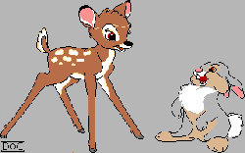
完成句子。
夏季,这个地方雨水多.
In summer, there is _________ _________ rain in the area.。
plenty of

Slide 34
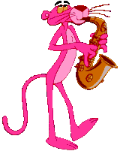
完成句子。
我们中国人每天吃许多不同种类的食物。
We Chinese have many _______ ________ _______ food every day..
different kinds of

Slide 35
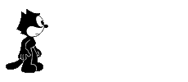
选择最佳答案。
C
The garden is filled_______ flowers.
of B. on
C. with D. at

Slide 36
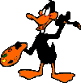
根据首字母填空。
at
I needed to lose a bit of weight by avoiding f , oil and sugar .

Slide 37

根据首字母填空。
ugar
Would you please add some s________ to my tea? I want it to be sweet..

Slide 38

根据首字母填空。
eview
The film r_________ says that it is worth watching.

Slide 39

根据首字母填空。
sual
This morning, she came to school early as u______.

Slide 40

完成句子。
总体上说，他是一个活泼的男孩？
_______ ______ ，he is an active boy.
In general

Slide 41
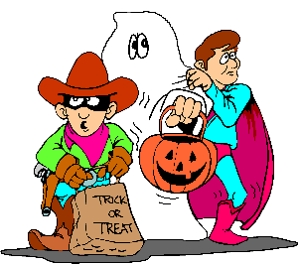
完成句子。
我们最好每年进行体检。
We’d better have ______ _______ every year.
medical examination

Slide 42
Thank you

