Slide 1

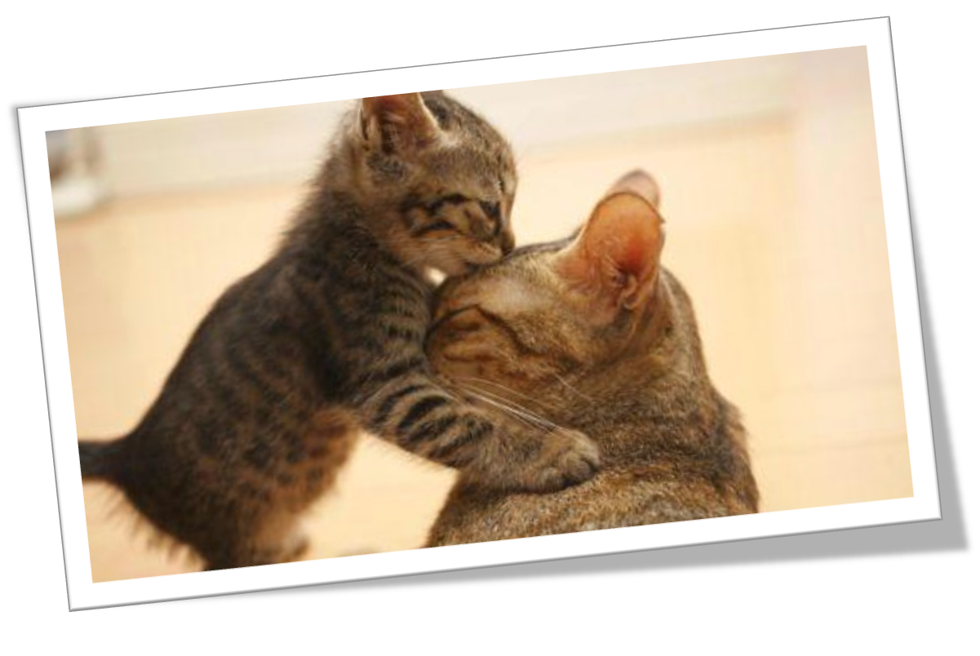
Oxford English
Module 1 People and places
Unit
1
People around us
Writing

Slide 2
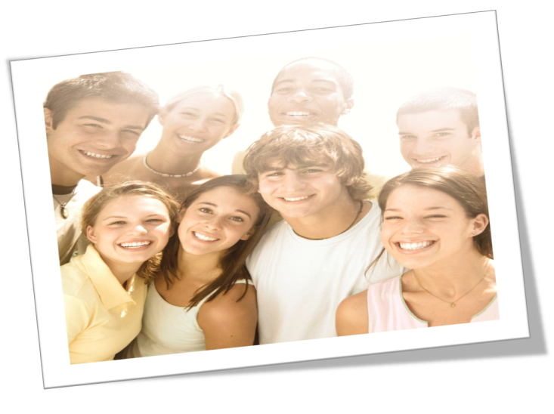
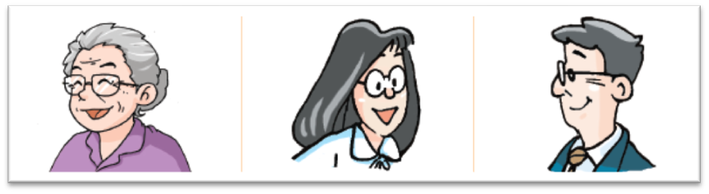
A person I love
Who are you going to talk about? Think about the following ideas.
a family member
a good friend
a teacher or a great person

Slide 3
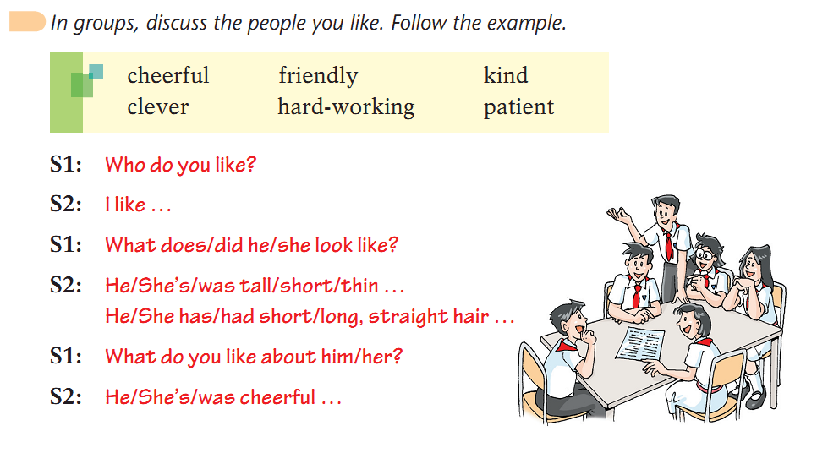

Pair work

Slide 4
How to write the article well?
The plan may help you.
Paragraph 1 | Who is this person? What does /did he/ she look like?
Paragraph 2 | What does /did he/ she do?
Paragraph 3 | Why do you love him/ her?

Slide 5
 | My dad | The person I love
Who is the person? | My dad.
What does he/she look like? | He is tall. He has black hair and wears glasses.
What does he/she do? | He is a doctor. Every day, he goes to work and helps sick people.

Slide 6
 | My dad | The person I love
What is his/her character(特点) like? | He is hard-working, patient and kind.
Why does the writer love him/her? | Because he is a great dad. Sometimes he has to work all day all night, but he still finds time to help me with my studies. He also plays ball games with me every weekend.

Slide 7
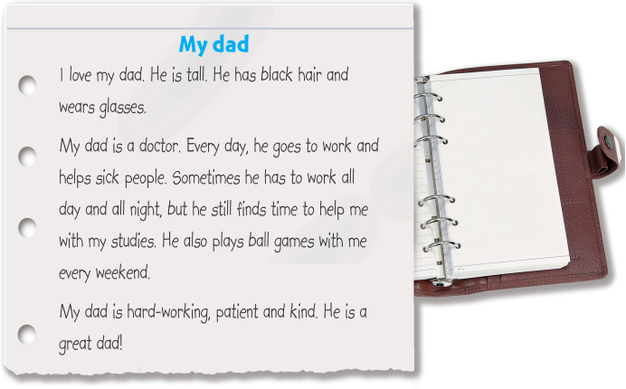
Read the following example.
all day and all night
夜以继日
help sb. with sth.
帮助某人做某事

Slide 8
Practice
Now, write something about the person you love!
PS: Prepare an oral presentation(口头呈现).
my father
short
I love _____________. he has _________ hair and _____________.
My _______ is ____________. Every day, he goes to work ________Sometimes he has to ___________, but he can still find time _______________. He also ________________every weekend.
My _________is ______, ______ and ______________.
He is a _____________________________.
big eyes
father
a teacher
by bike
work late
to talk with me
plays basketball
kind
hard-working
father
patient
good teacher and great father.

Slide 9
Homework
1. Remember these new words:
member，paragraph，person；all day and all night，go to work.
2. Correct and complete the writing
A person I love.

Slide 10
Thank you!

