Slide 1
Reading

Slide 2
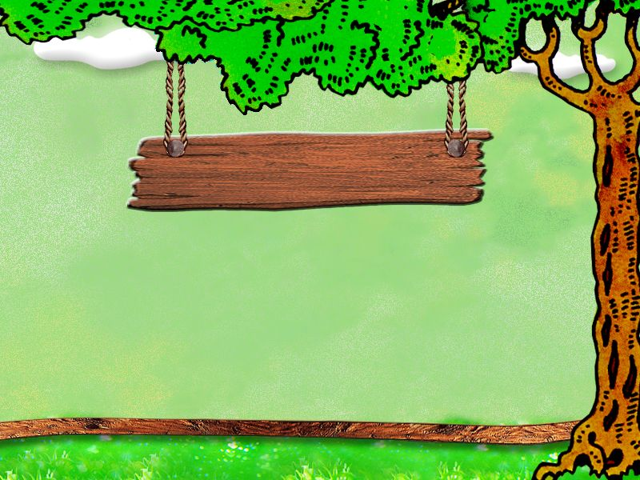

Reading
How Daisy learned to help wildlife

Slide 3
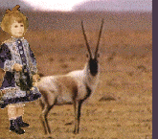
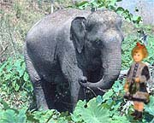
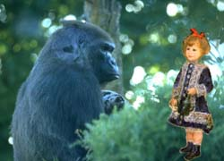
Fast Reading
1.Where did Daisy go? What kind of animal
did she meet in each place?
Tibet
an antelope para1
Zimbabwe
an elephant
Para.2.
rain forest
a monkey
Para.3-4
2. Who took her there?
A flying carpet.

Slide 4


Find out the main idea of the passage:
A : It is about some protection of wildlife.
B: It is about a journey of a flying chair.
C: It is about Daisy’s wonderful experience with some animals.

Slide 5
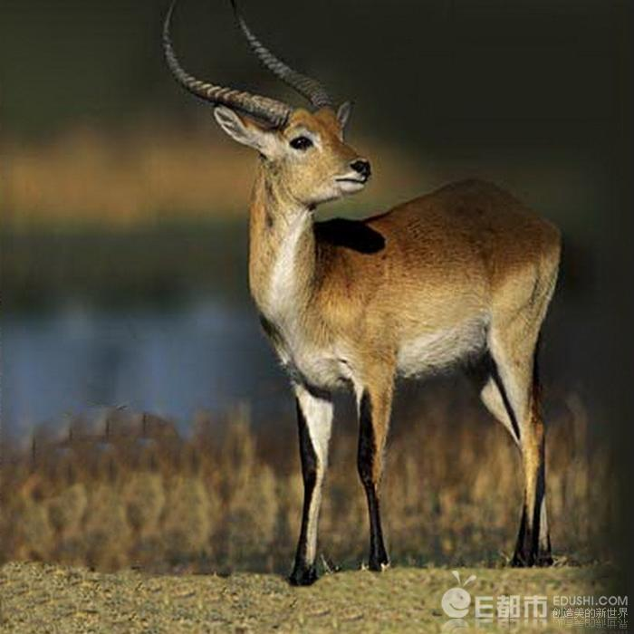
Careful Reading
Paragraph 1 ——Tibetan Antelope
1. Why are people hunting and killing the Tibetan antelopes?
To get the wool and make sweaters.
2. What was the result of over-hunting?
We are now an endangered species.
3. What’s the main idea ?
______we need wildlife protection.
Why

Slide 6
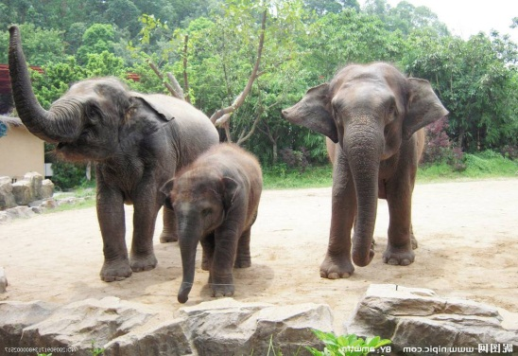
Careful Reading
Paragraph 2 ——elephant in Zimbabwe
1.What was the elephants’ situation before? Why?
Farmers hunted them without mercy.
They destroyed farms and money went to tour companies.
2. What’s the result now? Why?
Farmers, happy; elephants, increase.
The government, tourists, famers.
3. What’s the main idea?
A good________ of wildlife protection.
example

Slide 7
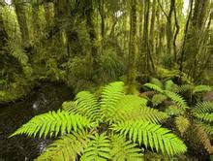
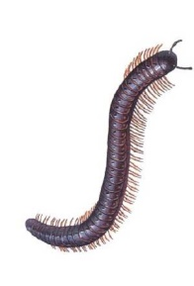
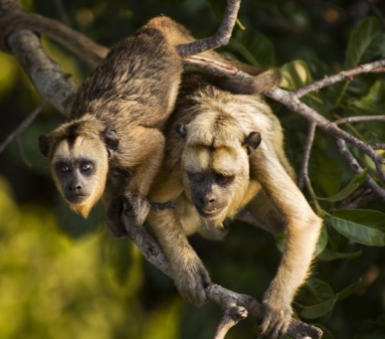
Careful Reading
Paragraph 3 ——monkey in rainforest
What’s the problem of the monkey?
Mosquitoes.
2. How did he solve it?
Rub an insect over its body.
3. What’s the main idea？
What
______we can get from wildlife protection.

Slide 8
Discussion
How Daisy learnt to help wildlife
1.How did Daisy learn to help wildlife?
Para1
An antelope
Para.2
An elephant
.
Para.3-4
A monkey
endangered
endangered
---safe
safe---how to live together
WWF

Slide 9
Discussion
How Daisy learnt to help wildlife.
2.What ways can we learn from each part to protect wildlife?
We should
Part 1 ___________________________
Part 2________________________.
Part 3_________________________.
stop killing animals
build a protection zone
protect their habitat

Slide 10
Retelling
One day Daisy went to see the animals that gave fur to make her _______ in a flying chair. It flew away to _____ in China first, where she saw an ________. The antelope told her that they were killed for the ____ that was taken from their ________.
sweater
Tibet
antelope
wool
stomachs

Slide 11
Then the carpet flew away to __________, where Daisy saw an ________. The elephant said they were endangered in Zimbabwe. _______ used to hunt them without _______.
Zimbabwe
elephant
Farmers
mercy

Slide 12
Now they allowed tourists to hunt only a _______ number of animals if they paid the farmers. The flying carpet rose again and almost at once they were in thick rain _____.
certain
forest

Slide 13
A _______ was rubbing a millipede _____ which contains a powerful ____ over his body because it could protect him from __________. So Daisy decided to produce this new drug with the help of _____. The carpet rose and flew home.
monkey
insect
drug
mosquitoes
WWF

Slide 14
Learning about language
1.Distant
2.Decrease
3.Powerful
4. Affect
5. Appreciate
6. Hunt
7. Protect…from
8. Respond
9. Relief
wild
reserve
hunt
species
powerful
appreciated
relief
protecting
from

Slide 15
Exercise 2
请用适当的介词填空。
1. Whales will die ___, if we don’t protect them.
2. Nowadays every woman is dying ___ fair skin.
3. The trees are dying __ because of the drought.
out
for
off

Slide 16
4. The weak light is dying _____.
5. His anger died _____ after being given some money.
6. About 10 million people die __ cancer every year.
7. Some people die ____ the lack of water in the dry areas.
away
down
of
from

Slide 17
Exercise 3
用括号中所给动词的适当形式填空。
1. He failed to ________ (respond) to the medicine.
2. When I came in, he ___________ (rub) the window with a cloth.
3. The children ____________ (employ) in weeding the garden.
4. If you work hard, you ___________ (succeed).
5. There was a fire in our street, but our house wasn’t _______ (harm) at all.
respond
was rubbing
are employed
will succeed
harmed

Slide 18
Exercise 4
用适当的介词填空。
1. A smile _______ pleasure passed across his face.
2. The house __________ the lake is a restaurant.
3. Tom is _______ trouble, but his father doesn’t know what to do.
4. _______ the sun, nothing would grow.
5. He wore a thick coat _______ his ordinary coat.
of
by / across
in
Without
over

Slide 19
Exercise 5
每空填一词， 使该句与所给句子的意思相同。
1. It’s certain that he will come together with his wife tonight.
He will come together with his wife tonight ___ ____.
2. When the old lady finished the joke, all the people present burst out laughing.
When the old lady finished the joke, all the people present ______ ___ ______.
for sure
burst into laughter

Slide 20
3. At school they laughed at the boy without mercy because of the way he talked.
At school they laughed at the boy _______ because of the way he talked.
4. The advertising campaign didn’t have much effect on sales.
The advertising campaign didn’t _______ sales much.
5. She felt that she would not be able to live in peace.
She felt that she would not be able to live ________.
mercilessly
affect
peacefully

Slide 21
Exercise 6
根据括号内所给的提示将下列句子翻译
成英语。
他举起手臂，保护他的孩子免受伤害。(protect ... from)
2. 尽量避免吃高脂肪的食物。(contain)
He raised his arms to protect his child from being hurt.
Try to avoid foods which contain a lot of fat.

Slide 22
3. 请注意这两个词之间的区别。(pay attention to)
4. 辛苦工作一年之后，我们都十分珍惜这个假期。(appreciate)
Please pay attention to the difference between the two words.
We all appreciate the holiday after a year of hard work.

