Slide 1
U5 Reading

Slide 2


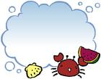
Remember:
They are all famous bands .
Who are they?

Slide 3
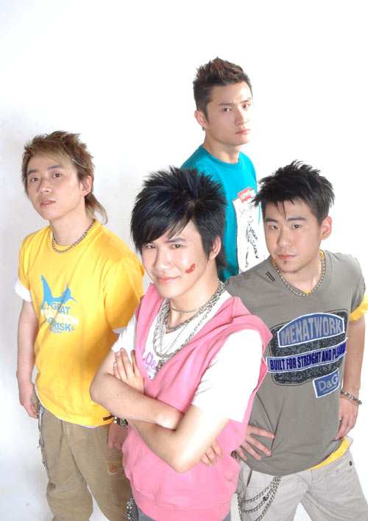
Music & band
Do you know these singers or bands?
The Flowers

Slide 4
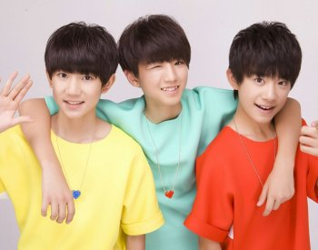
Music & band
Do you know these singers or bands?
TFboys

Slide 5

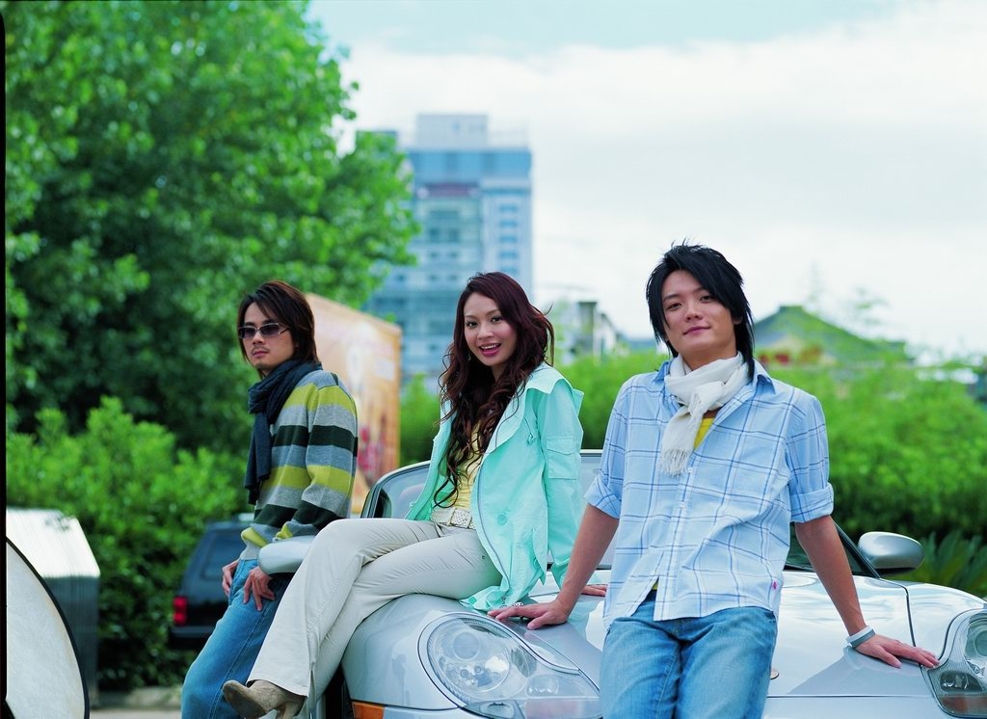
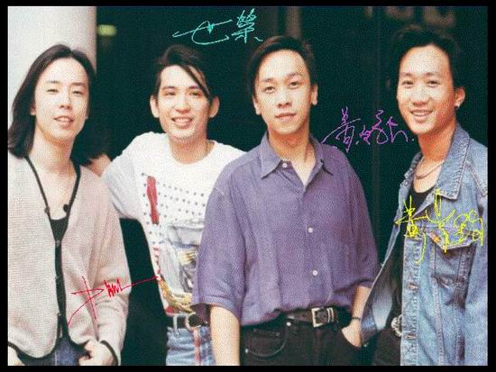


Slide 6
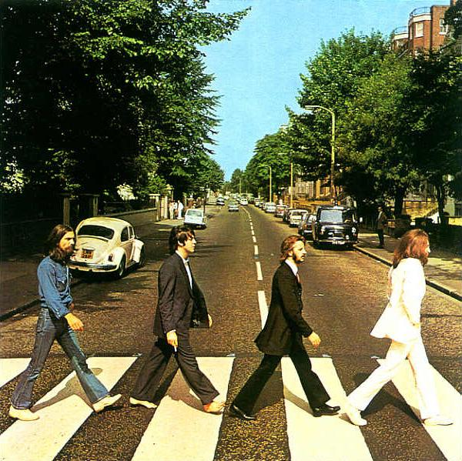
The Beatles

Slide 7
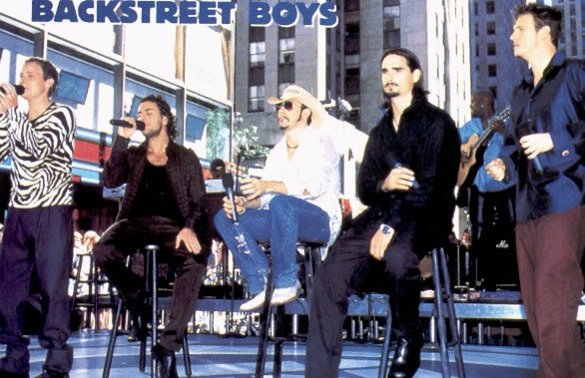
Music & band
Do you know these singers or bands?
Backstreet Boys（后街男孩）

Slide 8
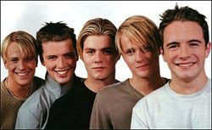
Westlife（西城男孩）

Slide 9
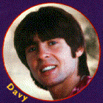
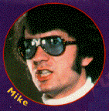
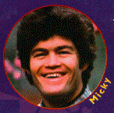
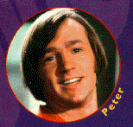
Do you know the Monkees?

Slide 10
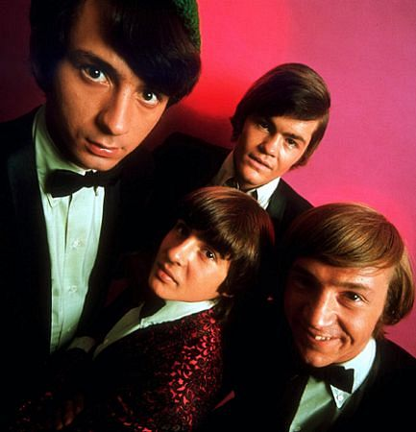
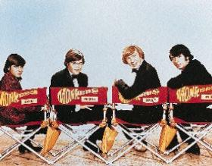
A different band
the Monkees

Slide 11
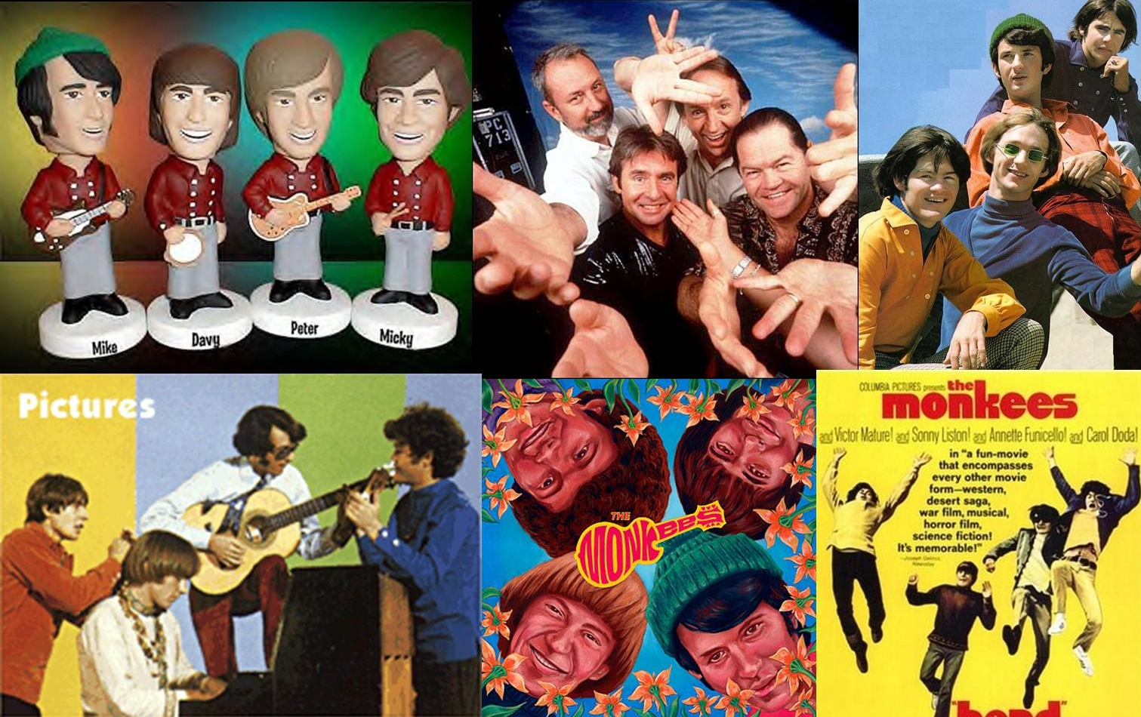
A big hit!
The Monkees —
the most popular
band in the USA
from 1966 to 1968!

Slide 12
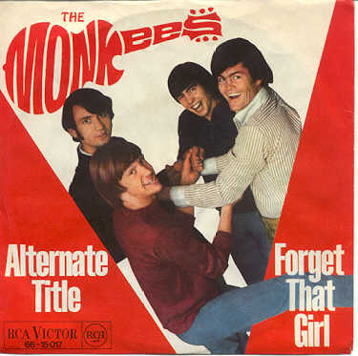
the Monkees
Different: wasn’t a real band at first; played jokes on each other when playing music

Slide 13
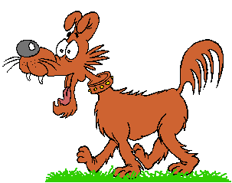
Task 5
Comprehending
First reading:
Read the passage quickly and match the general meaning of each paragraph.

Slide 14
The Band That Wasn’t
Main idea of each paragraph
Paragraph 1: Dreaming of being a famous
musician or singer.
Paragraph 2: How the Monkees became serious
about their business.
Paragraph 3: How musicians form bands.
Paragraph 4 How the band got their start.

Slide 15
Para. 1
What’s the function of para. 1？
Have you…?
Have you…?
Do you…?
Suspense, arouse interest,…

Slide 16
Para. 2
How do people get to form a band (usual)?
Members(who)
High school students
Reasons(why)
They like to write and play music.
Places
They practice their music in someone’s house.
(The first step to fame)
They may play to passers-by in the street or subway, and give performances in pubs or clubs.
Forms(how)
They can earn some extra money.
Results(hope)
They hope to make records in a studio and become millionaires.

Slide 17
Read paragraphs 3 and 4 and fill in the blanks with proper words.
The Monkees
How to began?
How do they get the chance?
TV show
What did they do?
TV organizers,4 musicians
play jokes, play music
How do they find them?
How did they sing?
ad, 1 musician+3 actors
not well, pretend
Are they famous & Why?
Popular, humorous
Not a real band

Slide 18
Read paragraphs 3 and 4 and fill in the blanks with proper words.
However
The Monkees
After a year or so
What happened?
Produced own records
Toured and played own music
Serious, real band
1970
What happened?
Broke up
Mid-1980s
What happened?
reunited
1996
What happened?
A real band
New record

Slide 19
Dream of becoming a band
A typical band
Not A real band
A real band

Slide 20

Join the correct parts of the sentences together.
1 They produced a new
record in 1996
2 Most musicians get
get together and
3 They put an ad in the
newspaper looking
for four rock musician
4 The first TV show
5 However, the band
broke up about 1970
(D)
(C)
(A)
(E)
(B)

Slide 21
Discussion
The Band That Wasn’t
What does it mean?

Slide 22

Post reading
Consolidation (Fill in the blanks)
If we are ______ _____ ourselves, most of us have ________ __
being famous sometimes in our lives. Most musicians often meet and _____ a band.
honest with
dreamed of
form

Slide 23
Sometimes they play in the street to __________ so that they can earn some ______ money and this also gives them a _______ to realize their dreams. There was once a band started in a different way.
passers-by
extra
chance

Slide 24
The musicians of whom the band was formed ______ _______ ______ each other as well as played music, whose music and jokes were loosely _____ ___ “The Beatles”. Their exciting performances were copied by other groups.
played jokes on
based on

Slide 25
“The Monkees” played their own ___________ and wrote their own music. Though it _____ __ in 1970, it reunited in the mid-1980s and it is still popular today.
instruments
broke up

Slide 26

Unit 5 Music
Learning about language
back

Slide 27

Discovering useful words and expressions
1._________________ something used to make music
2.________ person whose job is to play or
write music
3._________ to imagine something would come true
4._________ person going past
5.___________ to tell exactly what one thinks.
6._________ to go away in different directions
7. ______ to connect something with another
8. _____ to receive money for what you do
9._______ paid in money but not by cheque
musical instrument
musician
dream of
passer-by
to be honest
break up
attach
earn
in cash

Slide 28
Answer keys to exercise 2 on page 36
Pretend | To make believe To imagine something is real as in a game
Extra | In addition Not include in the price so you have to pay more
Rely | To trust someone or something to do what you need To depend on someone or something to continue to live
Familiar | (a person) well-known to you Having a good knowledge of something or somebody
broadcast | To send out radio or television programmes To tell something to a lot of people
2
1
1
1
1

Slide 29
Complete the passage with the words and phrases below in their proper forms:
extra millionaire pub humorous studio broadcast dream of familiar play a joke on

Slide 30
dreamed of
Susan and I loved jazz and we __________ becoming musicians. We decided to form a band so that we could earn some _____ money by playing and singing in a ______. The regulars there were very kind to us. They suggested we go to record our songs in a _______. We wondered if they were ________________us as they were often very _________ to each other. However, to our great surprise , everything was organized and we made our record. Imagine our excitement when we heard it _________ on the radio for the first time! It was almost as exciting as later when we became___________. Now whenever we go to the pub, we play our songs and buy drinks for the regulars. Although we are famous, we still like to play in _______ places.
extra
pub
studio
playing a joke on
humorous
broadcast
millionaires
familiar

Slide 31
Answer key to exercise 1 on page 70
sensitive
Marian was shy and_________ did not want to give a performance.
John worked hard as an actor so that he could ______ money for his family.
You may be able to_____ out all that mess but I am not relying on it.
Jackie Chan is an ______ whose fame has spread as far as Hollywood.
Two days is a very______ visit if you are not familiar with our town or the countryside.
earn
sort
actor
brief

Slide 32
In England it is fun to go to the local ______ for lunch on Sunday and for a walk afterwards.
Freddy’s ______ changed when he grew from a tadpole into a frog.
Watson liked to pretend he was spy when he wore a hat, a ______ and sunglasses.
George enjoys playing jokes on me but I find them _______ .
Kate broadcast her new CD on the radio; in_________, she gave performances on TV.
pub
form
beard
painful
addition

Slide 33
Answer key to exercise 2 on page 70
One day Freddy the frog was given an _________ to hear another famous frog, Jeremy Green, ________ his songs. Freddy felt very excited as he was Jeremy’s friend and was ____________ his performances. He decided to pretend to be a devoted fan and ________ on him. He put on a ______ , a hat and sunglasses. He felt quite _________ that Jeremy would not recognize him. After the ____________ Freddy went to the bank of the lake and waited for Jeremy. As the singer was near, Freddy waved, _______ his legs in the water, slipped on a lily leaf and disappeared.
invitation
perform
familiar with
play a joke
beard
confident
performance
dipped

Slide 34
Jeremy looked horrified and then throwing off his clothes he jumped into the water at once. They both reappeared with Jeremy holding Freddy in his arms. __________ when they were back on dry land Freddy apologized. “It was not a good joke,” he said. “Thank you Jeremy. I hit a rock in the water and it was so_______. I might not still be alive if it were not for you!”
Afterwards
painful

Slide 35
Answer key to exercise 3 on page 70
This is the home I have always dreamed of! When can we move in?
You can be honest with me since I am familiar with the situation.
He likes playing jokes on others but is very sensitive if others play jokes on him.
For a brief moment /I forgot the pain in my leg/ as I laughed at the humorous jokes of the actor.

Slide 36
There are many reasons for his success. Afterwards we agreed that (above all/ the love and devotion of his fans had made his career successful).
For the next year or so I will have to rely on my son to support the family.

Slide 37
Without music, life is a journey through a desert.

