Slide 1

Enjoy the video
What is the video about？
Use some words to describe the dinosaur.

Slide 2

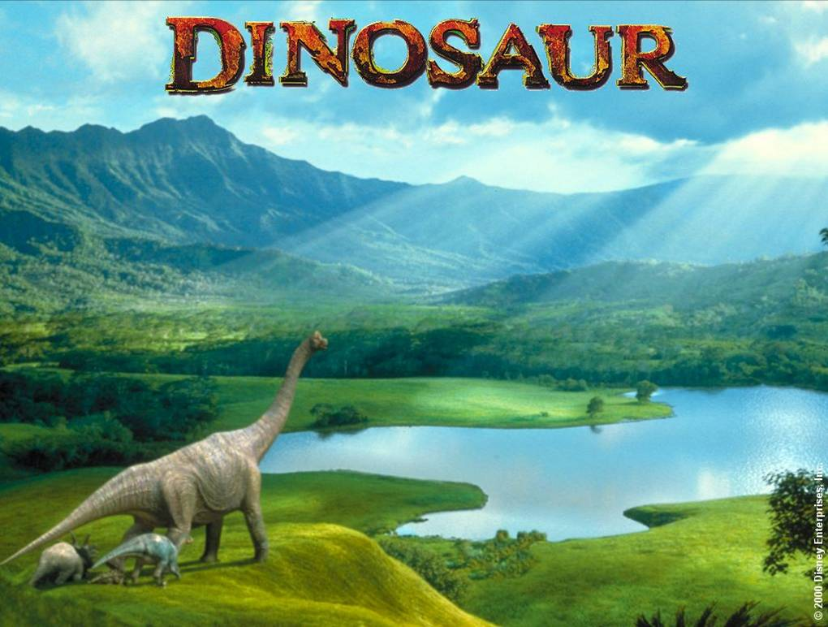
Reading II

Slide 3
Dinosaur is an animal that we can not see on the earth now. What we see in the museum are the fossils of many kinds of dinosaurs. They were found by the people at home and abroad. Some dinosaurs have long necks and tails, while others look like birds.

Slide 4
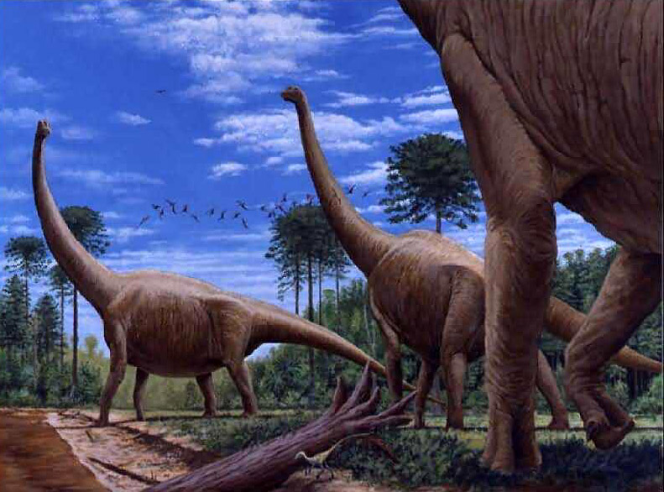

Slide 5
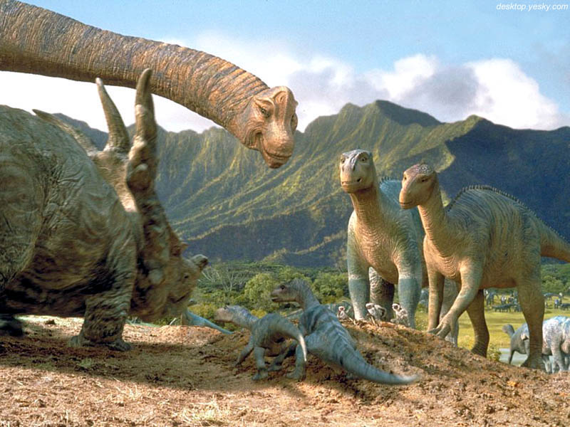

Slide 6
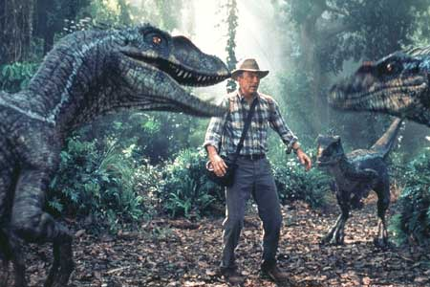

Slide 7

Using language
Reading
1. When did dinosaurs live?
Tens of millions of years ago.
2. When did dinosaurs die out?
About 65 million years ago.
3. How did dinosaurs die out?
A large rock hit the earth and put too much dust into the air.
The earth got too hot to live on.

Slide 8
True or false
F
There are many different species of dinosaur and all of them have been found in China.
Not long ago, a rare new species of bird-like dinosaur was discovered in Henan Province.
several
F
Liaoning

Slide 9
think
3. Some scientists are sure
dinosaurs died out because the
earth got too hot for the
dinosaurs to live on any more.
4. Dinosaurs died out quickly about
65 million years ago and many
animals have died out in the
same way.
F
T

Slide 10

Language points
1. long before在……之前很久
before long 不久以后
They lived on the earth tens of millions of years ago, long before humans came into being and their future seemed secure at that time.
本句是一个由and连接的并列句，其中，long before 引导时间状语从句，进一步解释说明tens of millions of years ago

Slide 11

e.g.
1)I knew Tom____________________.
我在认识你之前很久就认识汤姆了。
2)We hope to __________________________.
我们希望不久就把实验做完。
long before I knew you
finish our experiment before long
3)It ___ long before we___ the result of
the experiment.
A. will not be; will know B. is; will know
C. will not be; know D. is; know
拓展：it won’t be long before不久之后就

Slide 12
2. on the earth 在地球上。
在earth, sun, moon等表达世界上独一无的名词前, 要加the。
3. come into being开始存在;发生
1)我们不知道这世界是什么时候存在的。
We don’t know______________________
when the world came into being.

Slide 13
4. be surprised to do 做某事吃惊
不定式用来表原因时，常修饰表示情感、心理状态、性格等的形容词
When scientists inspected the bones, they were surprised to find that these dinosaurs could not only run like the others but also climb trees.
本句中的to find that ...是不定式作原因状语。

Slide 14
1)We were surprised________.
我们真想不到会见到他。
2)We are proud _______________________.
作为新中国的青年，我们感到很骄傲。
3)You were foolish______________. 你那样做很愚蠢。
to see him
to be young people of new China
to act like that

Slide 15
5. according to 根据, 据…说
According to a UN report,….
According to John, the bank closes at 4 p.m.
Each man will be paid according to his ability.

Slide 16
6. Some scientists think it came after an unexpected incident when a huge rock from space hit the earth and put too much dust into the air.
[点拨] 本句中when引导定语从句，其先行词为incident。关系副词when 的先行词一般是表时间的名词。

Slide 17
1)He came last night ____I was out.
我昨晚出去的时候他来了。
2)In 1921 Einstein won the Nobel Prize, and was honored in Germany until the rise of Nazism _____he was driven from Germany because he was a Jew.
1921年爱因斯坦获得了诺贝尔奖，他在德国很受尊敬。纳粹上台后由于他是犹太人而被赶出了德国。
when
when

Slide 18

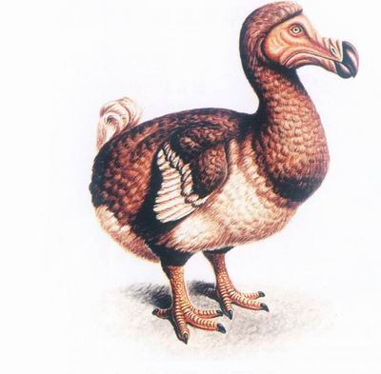
Listening
dodo
渡渡鸟

Slide 19
DoDo鸟是一种不会飞的鸟，仅产于毛里求斯。拥有肥胖的身子和巨大的嘴。
16世纪后期，欧洲殖民者来到了毛里求斯。不会飞又跑不快的DoDo鸟很快成为欧洲人来到岛上后主要的食物来源。人们开始大量的滥捕滥杀可怜的DoDo鸟，有时每天可以捕杀到几千只到上万只。
由于过度的捕杀,很快岛上DoDo鸟便得越来越少。1681年，最后一只DoDo鸟被残忍的杀害后，从此，地球上再也见不到这种东西了，除非是在博物馆的图片中。

Slide 20
Ex 3 Choose the sentence which gives
the main idea of the story. Say what is
wrong with the other three.
Number 2 is correct.
Number 1 is wrong. It is not fair to blame the dodo for his disappearance.

Slide 21
Number 3 only explain half the story. The dodo and man did become friends but only because man wanted to kill all the dodos as easily as possible.
Number 4 is wrong because the other animals and birds did not do much to save the dodo. They warned him but did not help him.

Slide 22
Listen to the tape and choose the correct answer to complete each sentence.
1. The dodo is_____.
A. fierce B. unkind
C. friendly D. foolish

Slide 23
2. He wants to believe that Man is telling the truth because _____.
A. Man is friendly
B. he think Man is friendly
C. he thinks the bears and monkeys lie
D. Man is his best friend

Slide 24
3. He didn’t realize who had killed many of his friends until _____.
A. Man told him the truth
B. the other birds told him
C. he saw how his friend was being killed by Man
D. the monkeys told him

Slide 25
fierce adj.
凶猛的, 好斗的
The house is guarded by a fierce dog.
激烈的,猛烈的
The competition for jibs is fierce.

Slide 26
Learning about language
1.Distant
2.Decrease
3.Powerful
4. Affect
5. Appreciate
6. Hunt
7. Protect…from
8. Respond
9. Relief
wild
reserve
hunt
species
powerful
appreciated
relief
protecting
from

Slide 27
One day Daisy went to see the animals that gave fur to make her sweater in a flying carpet. It flew away to Tibet in China first, where she saw an antelope, whose wool was used to make sweaters. As a result, they are now an endangered species.

Slide 28
Then the carpet flew away to Zimbabwe, where Daisy saw an excited elephant. The elephant said they were endangered there. Farmers used to hunt them without mercy. The farmers didn’t want to protect them even if tourists love to see them because they were considered to have destroyed the farms. Thanks to the government’s help, farmers were paid, so they felt happy and the elephants’ number were increasing.

Slide 29
Then the flying carpet rose again and almost at once they were in a thick rainforest. A monkey was rubbing a millipede insect which contains a powerful drug over his body because it could protect him from mosquitoes. So Daisy decided to produce this new drug with the help of WWF. The carpet rose and flew home.

Slide 30
Exercise 2
请用适当的介词填空。
1. Whales will die ___, if we don’t protect them.
2. Nowadays every woman is dying ___ fair skin.
3. The trees are dying __ because of the drought.
out
for
off

Slide 31
4. The weak light is dying _____.
5. His anger died _____ after being given some money.
6. About 10 million people die __ cancer every year.
7. Some people die ____ the lack of water in the dry areas.
away
down
of
from

Slide 32
Exercise 3
用括号中所给动词的适当形式填空。
1. He failed to ________ (respond) to the medicine.
2. When I came in, he ___________ (rub) the window with a cloth.
3. The children ____________ (employ) in weeding the garden.
4. If you work hard, you ___________ (succeed).
5. There was a fire in our street, but our house wasn’t _______ (harm) at all.
respond
was rubbing
are employed
will succeed
harmed

Slide 33
Exercise 4
用适当的介词填空。
1. A smile _______ pleasure passed across his face.
2. The house __________ the lake is a restaurant.
3. Tom is _______ trouble, but his father doesn’t know what to do.
4. _______ the sun, nothing would grow.
5. He wore a thick coat _______ his ordinary coat.
of
by / across
in
Without
over

Slide 34
Exercise 5
每空填一词， 使该句与所给句子的意思相同。
1. It’s certain that he will come together with his wife tonight.
He will come together with his wife tonight ___ ____.
2. When the old lady finished the joke, all the people present burst out laughing.
When the old lady finished the joke, all the people present ______ ___ ______.
for sure
burst into laughter

Slide 35
3. At school they laughed at the boy without mercy because of the way he talked.
At school they laughed at the boy _______ because of the way he talked.
4. The advertising campaign didn’t have much effect on sales.
The advertising campaign didn’t _______ sales much.
5. She felt that she would not be able to live in peace.
She felt that she would not be able to live ________.
mercilessly
affect
peacefully

Slide 36
Exercise 6
根据括号内所给的提示将下列句子翻译
成英语。
他举起手臂，保护他的孩子免受伤害。(protect ... from)
2. 尽量避免吃高脂肪的食物。(contain)
He raised his arms to protect his child from being hurt.
Try to avoid foods which contain a lot of fat.

Slide 37
3. 请注意这两个词之间的区别。(pay attention to)
4. 辛苦工作一年之后，我们都十分珍惜这个假期。(appreciate)
Please pay attention to the difference between the two words.
We all appreciate the holiday after a year of hard work.

Slide 38

Speaking
In pairs choose another endangered animal which you know about. Analyse why this animal is endangered.

Slide 39

练习
I. 根据下列各句句意及所给单词的首字母或汉语提示，写出该单词的正确形式。
1. The natural history museum has a special exhibition of _________ (恐龙).
2. The car raised quite a lot of _______ (尘土) as we drove off.
3. The police are connecting this _______ (事件) with last week’s terrorist bombing.
dinosaurs
dust
incident

Slide 40
4. Because there is so much unemployment, the competition for jobs is f_______.
5. I quite enjoyed the book except the dull e_______.
fierce
ending

Slide 41
II. 根据括号内所给的提示将下列句子翻译成英语。
一个新规则很快就要出台了。(come into being)
2. 很奇怪，上火车前，竟然没有人查看我的车票。(inspect)
A new rule will soon come into being.
It was strange that nobody inspected my ticket before I got on the train.

Slide 42
3. 根据专家的意见，他们马上放弃了这项试验。(according to)
4. 把它拿近点儿，让我好好看看。(so that)
According to expert opinions, they gave up the experiment immediately.
Bring it closer so that I can see it better.

Slide 43
III. 将下面方框中表示时间的短语填入短文中，使短文连贯。
long before, not long ago, at that time, after, in such a short time, recently
The story happened 1__________. Old Joe and his son Tony were on their way to White River to catch some fish. They started on the trip 2__________ the sun came up. 3_______ they had driven for a while, they saw a big tortoise (龟) on the road.
not long ago
long before
After

Slide 44
long before, not long ago, at that time, after, in such a short time, recently
recently
“I haven’t seen such a big tortoise 4_______,” Old Joe said to his son. When I was young, there were a lot of tortoises in White River. They lived happily in the river 5_________. We hadn’t thought they nearly disappeared 6________________.”
“Let’s help it return to the river, shall we?” said his son.
“That’s a good idea,” said Old Joe.
So they carried the tortoise into their car and put it in the river finally.
at that time
in such a short time

Slide 45

Intention
Purpose
I’m going to
to help/save
I intend/ mean/ plan to
to protect…from…
I will
so that…

Slide 46
I’d like to
in order to…
I’d rather not…
but do…
I’m ready to
to teacher them a lesson.
I feel like…
to punish those who do harm to wildlife.

Slide 47

Writing
Write a letter to WWF based on what you have discussed, asking them to help you save your endangered animal.

Slide 48


Sample letter
Dear WWF,
My friend, Chen Ting, and I have been doing some research on endangered animals. We found that the habitat of polar bears is disappearing because the ice at the North Pole is getting warmer. I worry that when is disappears altogether, there will be nowhere for the polar bears to live.

Slide 49
First, I suggest we are very careful with the energy we use. Global warming happens because we are putting too much carbon dioxide into the air. One of the ways we do this is by driving everywhere by car. So I suggest we think carefully before using our cars unnecessarily.

Slide 50
Second, instead of using our cars we should think about traveling by bus or by train. These forms of transport are more environmentally friendly and do not put so much carbon dioxide into the atmosphere.

Slide 51
Third, we can join WWF which is fighting to save the habitat of the polar bear. We can raise money to help them by making and selling cakes, selling crafts or giving talent shows and charging money for our parents to watch.

Slide 52
I hope you will support us in our fight to save the home of the Polar Bears.
Yours sincerely,
Wu Xiaoxin

