Slide 1

Brainstorm
What do friends mean to you?
when you are sad...
happy...
angry...
鼓励、安慰
分享
建议

Slide 2
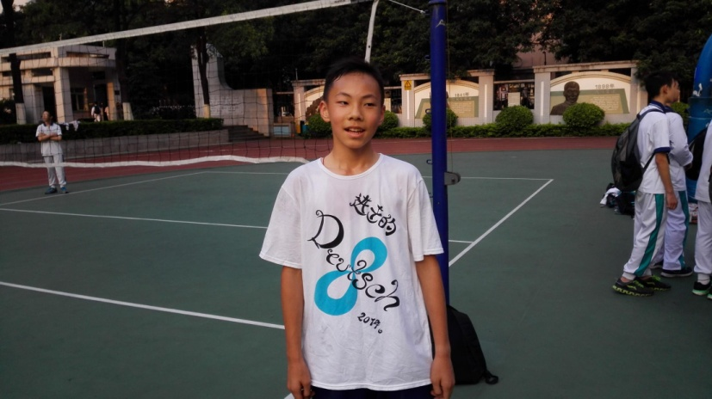
Warming up
  他来自广州。
He _____ ____ Guangzhou.
2. 他高大约170cm。戴眼镜。他看起来像他妈妈。
He is about 170 centimeters _____ _____ ____ . He _____ _____ his mother.
3. 他是一个中学生。
He ____ a middle school student.
4. 他擅长打篮球。
He ____ _____ ____ playing basketball.
comes from
tall with glasses
looks like
is
is good at

Slide 3

Warming up
5. 他学习很好。对自己要求严格。
He _____ ____ ____ his study and ____ _____ _____ himself.
6. 长大了他梦想成为一名工程师。
His dream ____ ____ ___ an engineer when he _____ _____.
7. 他与同学们相处融洽。
He ____ _____ ____ _____ classmates.
8. 他是多么好的朋友！
_____ ____ _____ friend he is!
does well in
is strict with
is to be
grows up
gets on well with
What a nice

Slide 4
Writing
“友谊的小船说翻就翻”是最近主流社交网络上流行的网络语言，看后同学们有何感想？
相信同学们都有自己的朋友，如何使“友谊的小船不会说翻就翻”？请你根据下面的写作要求，写一篇短文谈谈你的看法。
内容包括
1.我们为什么需要朋友？
2.我们该如何与朋友相处？(两点建议)
3.呼吁同学们与朋友和睦共处。

Slide 5

写作指导
Writing
1.审题:人称，要点，时态
本文共有 _个要点
  时态主要采用 __________
  —主要人称是____________
2.思路：表明观点——提出建议(2点)——发出呼吁。
3.高分技巧：
1）表明观点时，可用“In my opinion...because...”“As for me...because...”句型；
2） 提建议时可用We should...，we’d better...等句型，列举时可用First，second...等过渡词。
4
一般现在时
第一人称

Slide 6
自我检查
Checking
1）检查时态： 全文是否用了一般现在时？
2）检查内容点：内容点是否全齐？有没有分段？
3）检查单词拼写（主谓一致，单复数、大小写、动词形式等）、词组搭配（介词是否正确）和丰富表达（连接词、形容词、副词及短语；there be 句型、倒装、感叹；状语从句、宾语从句、定语从句等）
4）检查句子准确度：每个句子是否具备主语、谓语？有没有be+动词原形的错误形态？

Slide 7
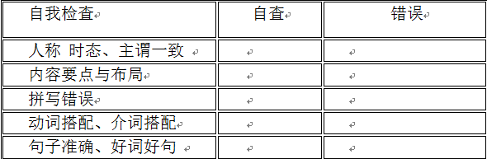
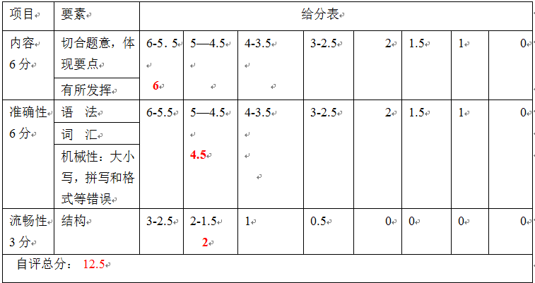
自我检查
Checking

Slide 8
Sample
In my opinion, it’s nice to have friends because we can talk, laugh and do things together. It’s said that people who have friends are happier than those who don’t.
Nowadays, many people want to know how to make friendship last forever. Here are my suggestions. First, we should be kind to our friends. When friends are in trouble, we should try our best to help them. Second, we must try to understand each other and think of others more than ourselves.
Above all, friendship is kind of treasure. We must get on well with friends.

Slide 9
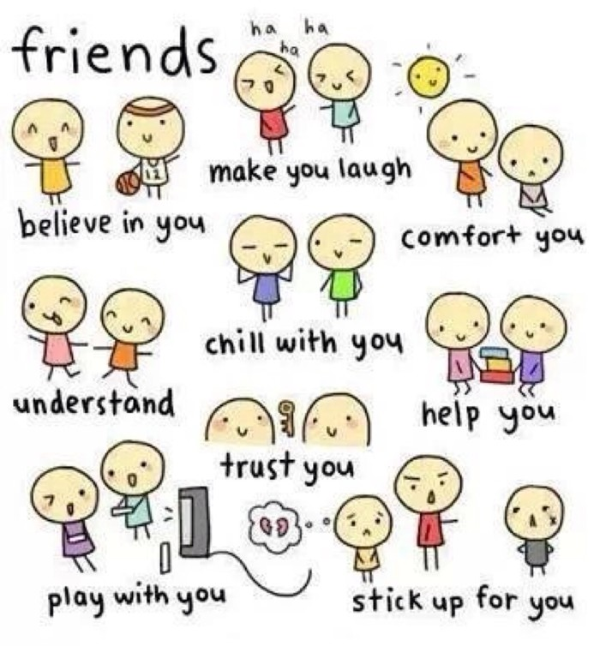

Slide 10
写作要点
1.我们为什么需要朋友?
如：In my opinion, it’s nice to have friends because we can talk, laugh and do things together.
2.我们该如何与朋友相处？(可用we should/must ...)
用Nowadays, many people want to know how to make friendship last forever. Here are my suggestions.作为过渡句，然后提出建议，可用句型：First, we should... Second，we must...
3.号召同学们与朋友和睦相处。(可用句型I hope...)
如：Friendship is a kind of treasure. I hope everyone can get on well with their friends.

