Slide 1

Reading:
He for she
welcome!

Slide 2

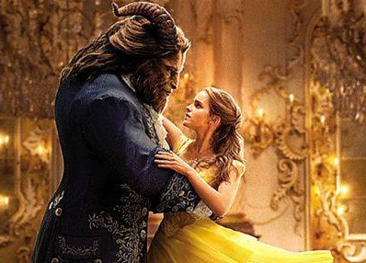
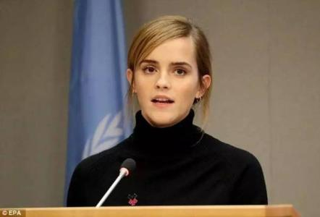
1. Lead in
Put up your hand if……
Emma Watson
feminism
He for she

Slide 3
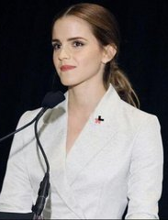
2. 1st reading
Preview check
Feminism
…the more I have spoken about feminism the more I have realized that fighting for women’s rights has too often become…(para.2, sentence1)
feminism
fighting for women’s rights
Multiple choice
CDA
The aim is to call on all people to struggle for the end of _________.
gender inequality

Slide 4
3. 2nd reading
Teach others
Step 1. Each group studies two paragraphs by yourselves, make sure every member fully understands it (meaning, logic 逻辑) .
Get yourself ready for the questions from other groups.
Ask & answer
Step 2. If you finish step 1, then go through the other paragraphs, prepare a question to ask (write it down).
Put up your hand if you need help!

Slide 5
4. Comprehension
Learn from others
Q1: Emma Watson uses a lot of examples, from which paragraphs can we see that? What are the purposes of these examples?
8: girls bossy
Para..3
gender inequality
feminist
14: girls sexualized
15: girls masculine

Slide 6
4. Comprehension
Learn from others
Q1: Emma Watson uses a lot of examples, from which paragraphs can we see that? What are the purposes of these examples?
Other women
Emma Watson
sadly
lucky
Para..4--6
No other country achieved gender equality
My parents love me
My school don’t limit me
My mentors didn’t assume...

Slide 7
4. Comprehension
Learn from others
Q2:Why does the author want to invite men to this campaign?
Mental illness
No equal pay
Fear to ask for help
Get married young
Men’s issue
Women’s issue
No equality
Education
He for he
He for she
He for freedom

Slide 8
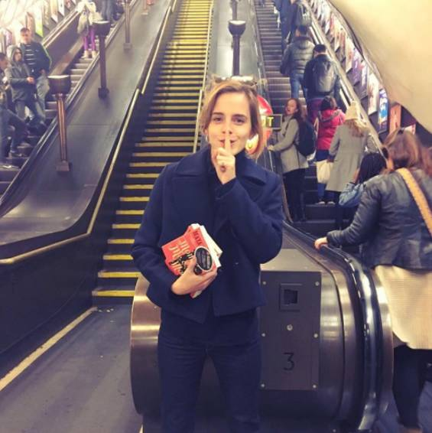
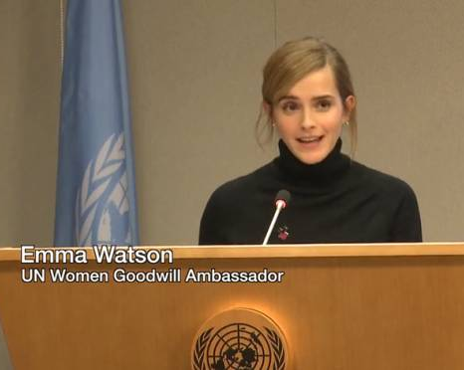
He for she
5. Discussion
I am inviting you to step forward, to be seen and to ask yourself: if not me, who? If not now, when?
What can we (men, women) do for gender inequality?

Slide 9
Assignment
What can we (men, women) do for gender inequality?

