Slide 1
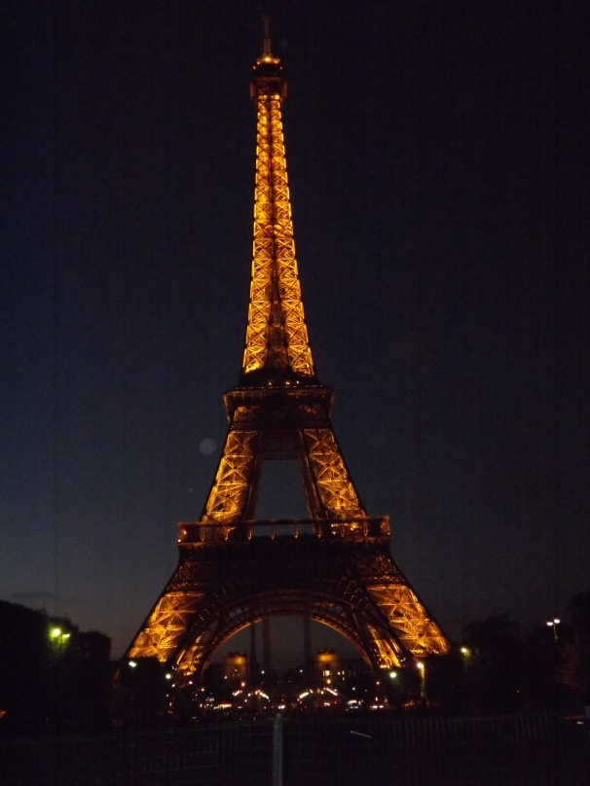
My Winter Holiday
初一六班 梁智尧
201680617

Slide 2
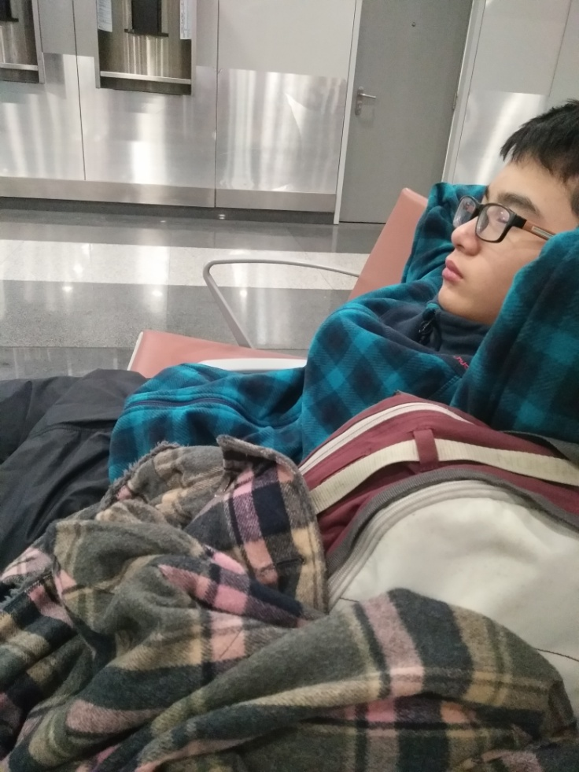
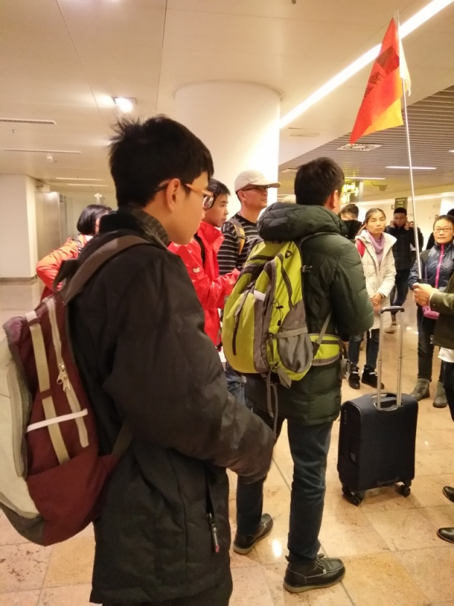
In this winter holiday, I travelled to Europe. I had a good time there.
On Sunday morning, about 00:00, I was waiting the airplane to brussels in the Capital airport in Beijing. I was so tired that I even fell asleep!

Slide 3
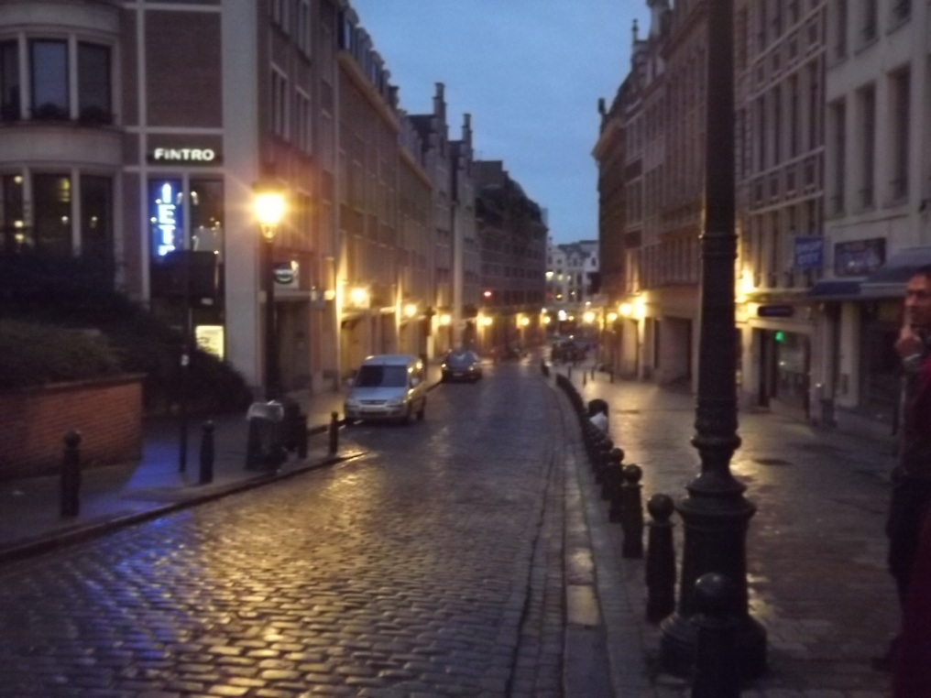
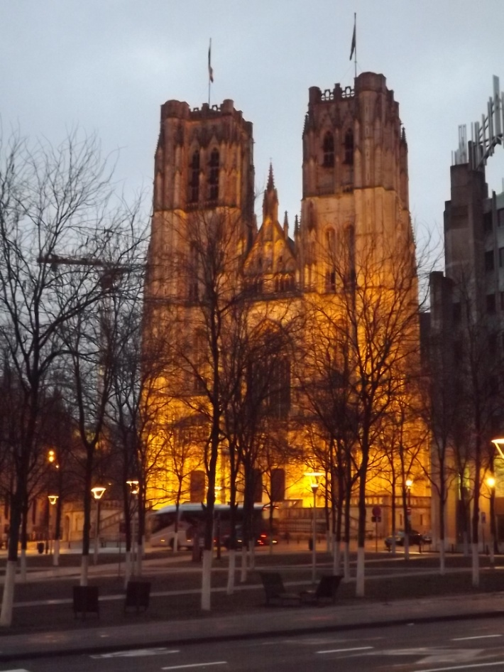
At 2:00, the plane was taking off. I slept in the airplane all the time. The Belgian time at 5:30, I was in a travel bus in brussels, the capital of Belgain. It was in the early morning, the street lamps were still on. After a time, the bus stopped and we walked on the street.

Slide 4
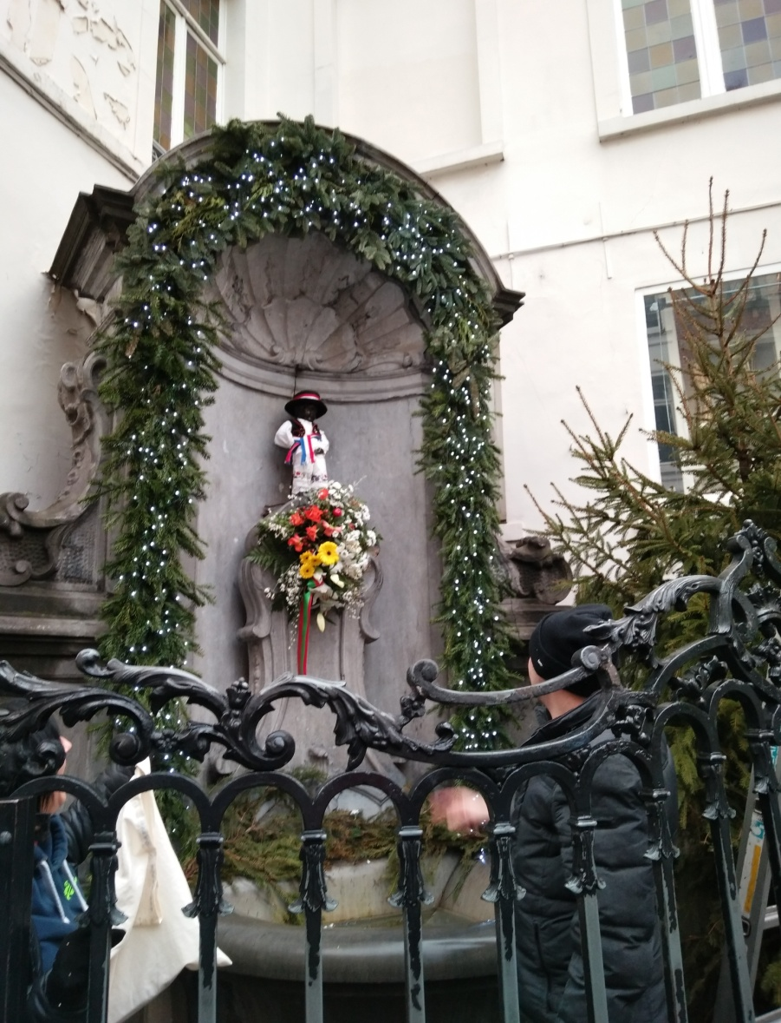
This is a copper sculpture of Julien’s. He is a great boy. Before, the foreign army wanted to bowb out the Brussels, but Julien found it. He extinguished the blasting fuse and saved the people in the whole city.

Slide 5
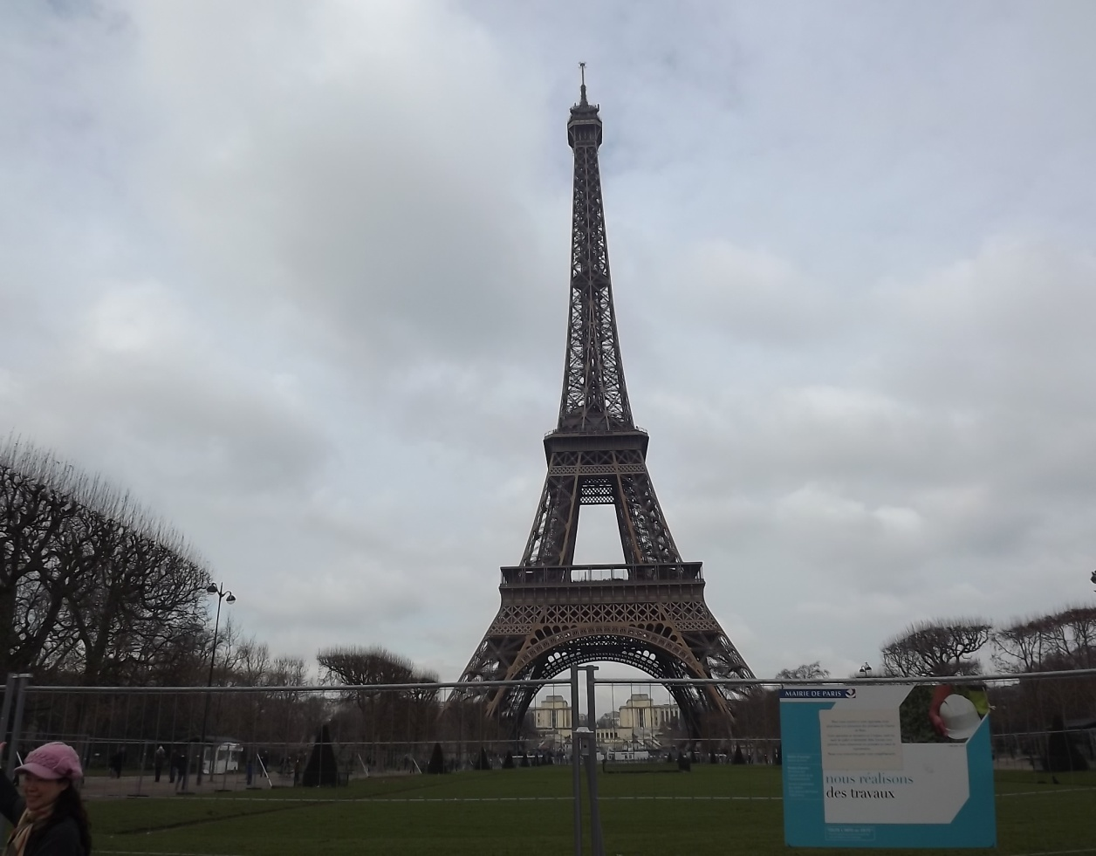
I stayed at France for a whole week and saw many buildings, palaces, and rivers. I played very happy. This is the Eiffel Tower.

Slide 6
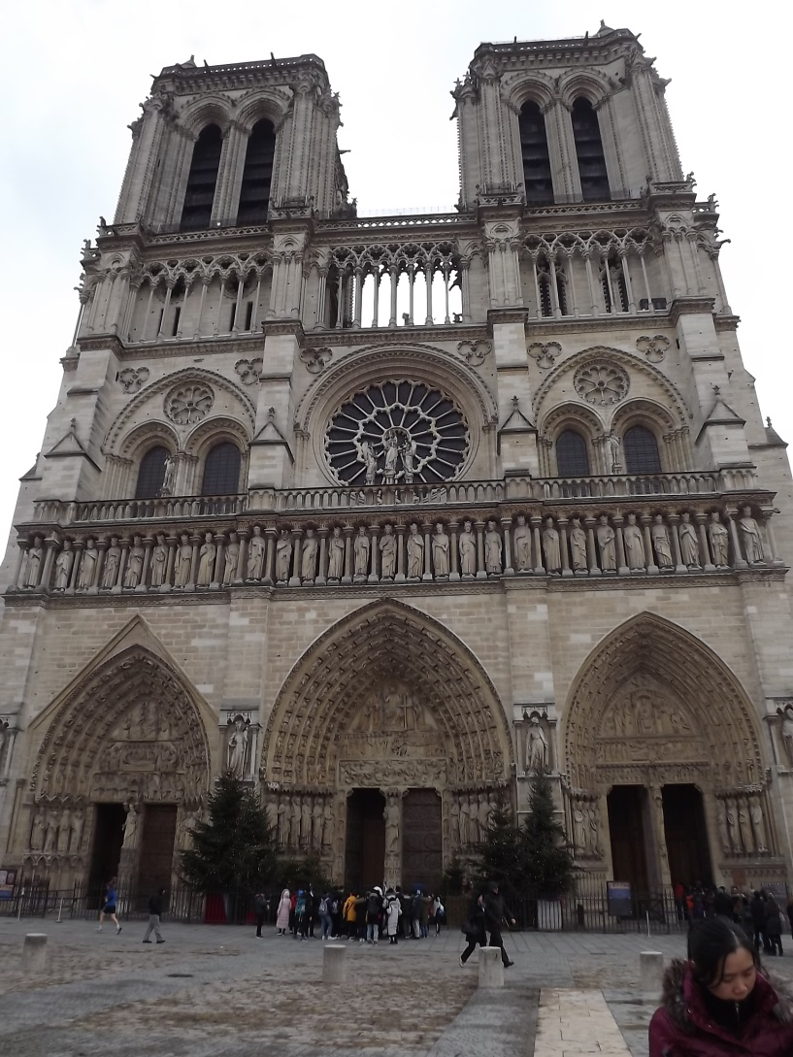
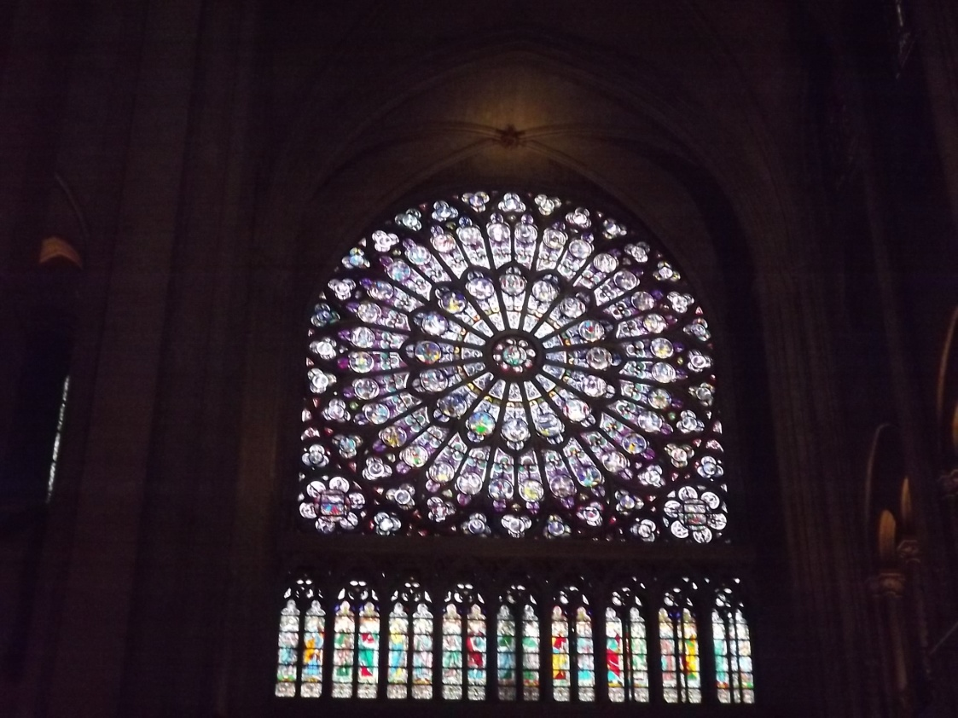
Notre Dame de Paris

Slide 7
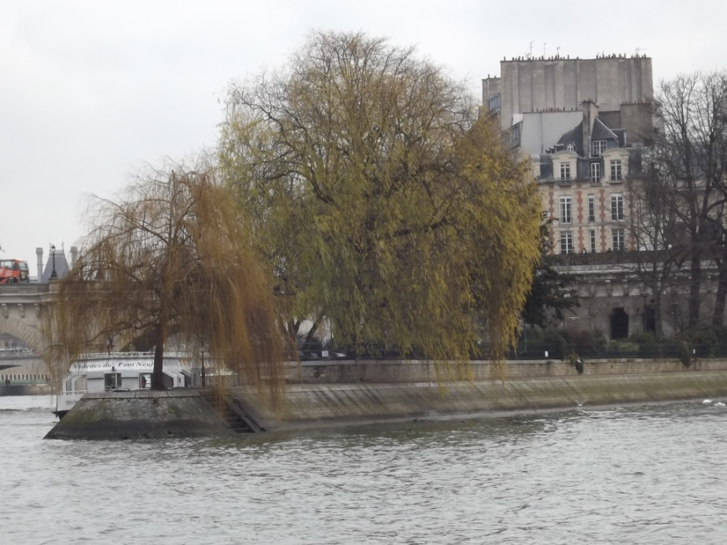
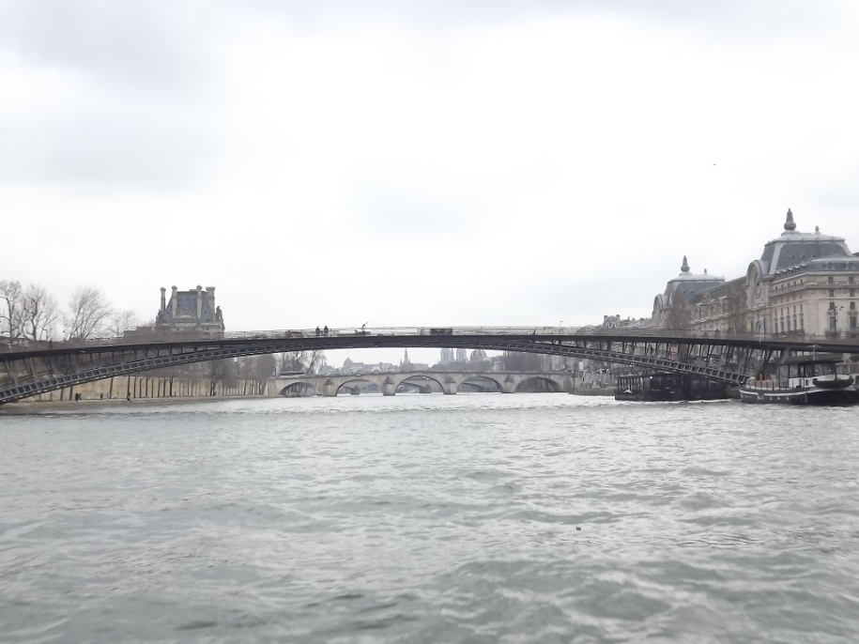
Seine

Slide 8
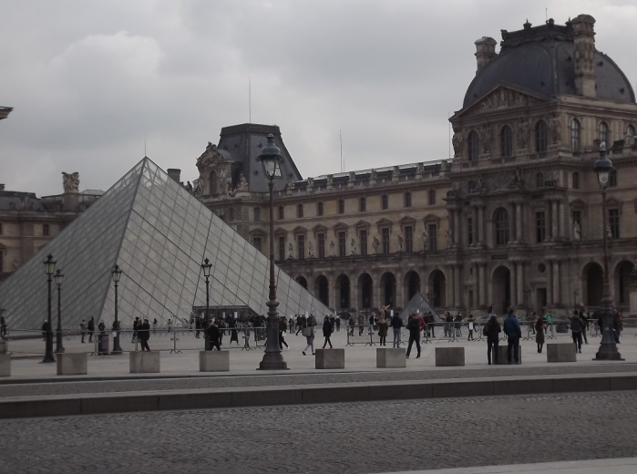
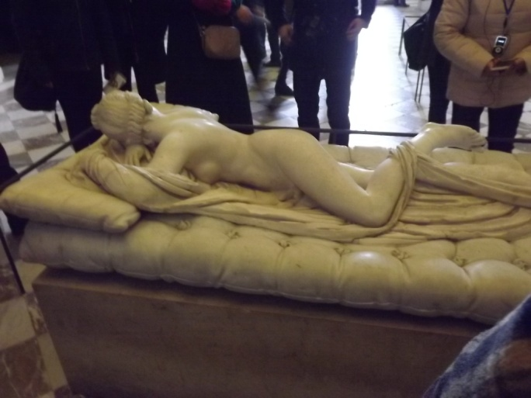
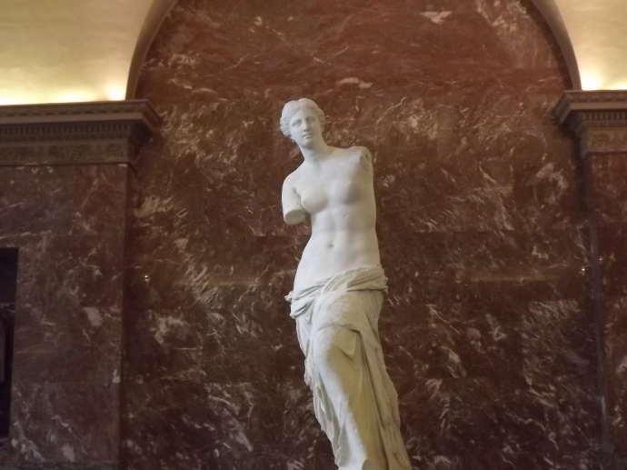
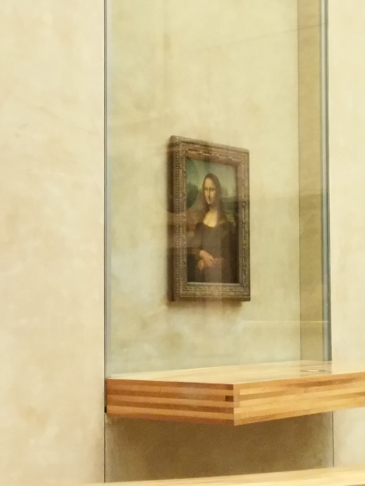
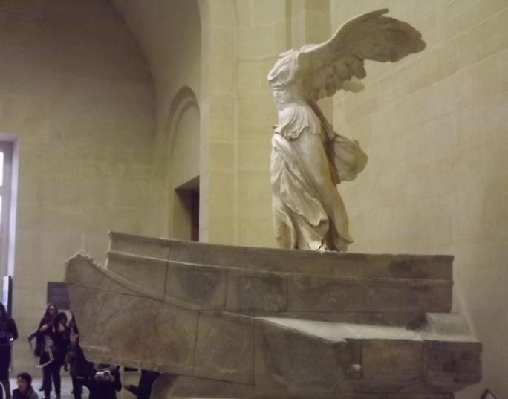
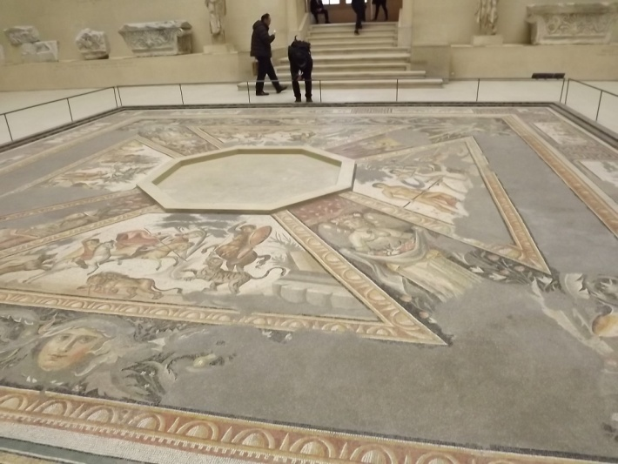
Louvre

Slide 9
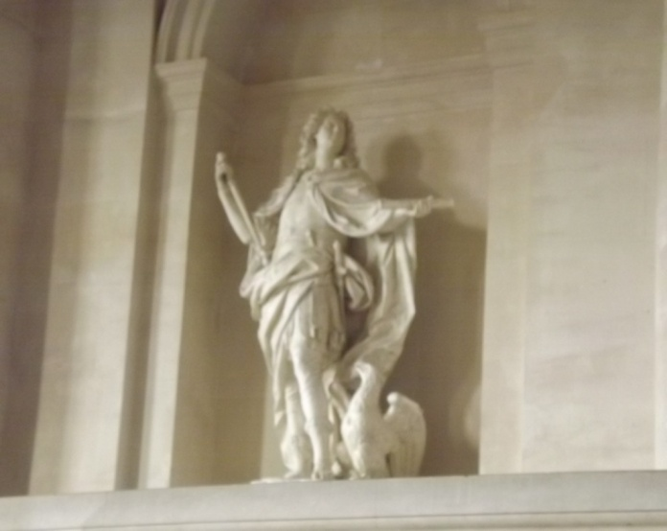
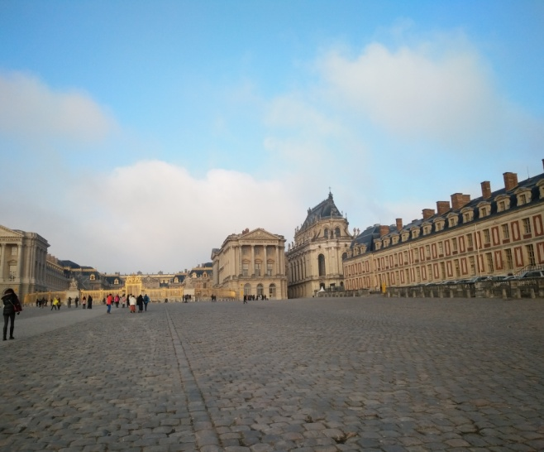
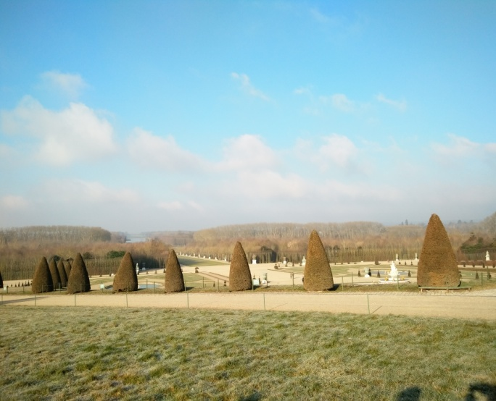
Versailles

Slide 10
The above is the introduction of my trip to Europe. If you want to learn more about my winter holidays, please ask me.Thanks for your listening.

