Slide 1

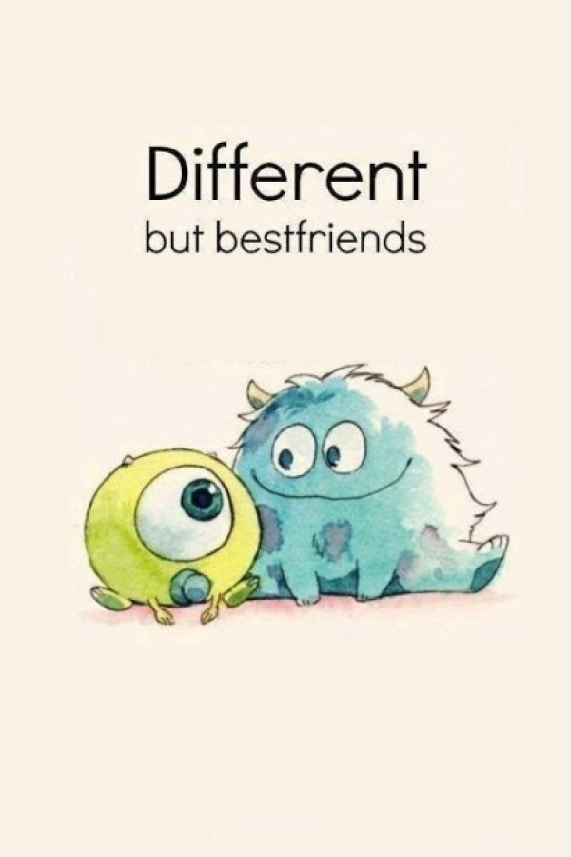
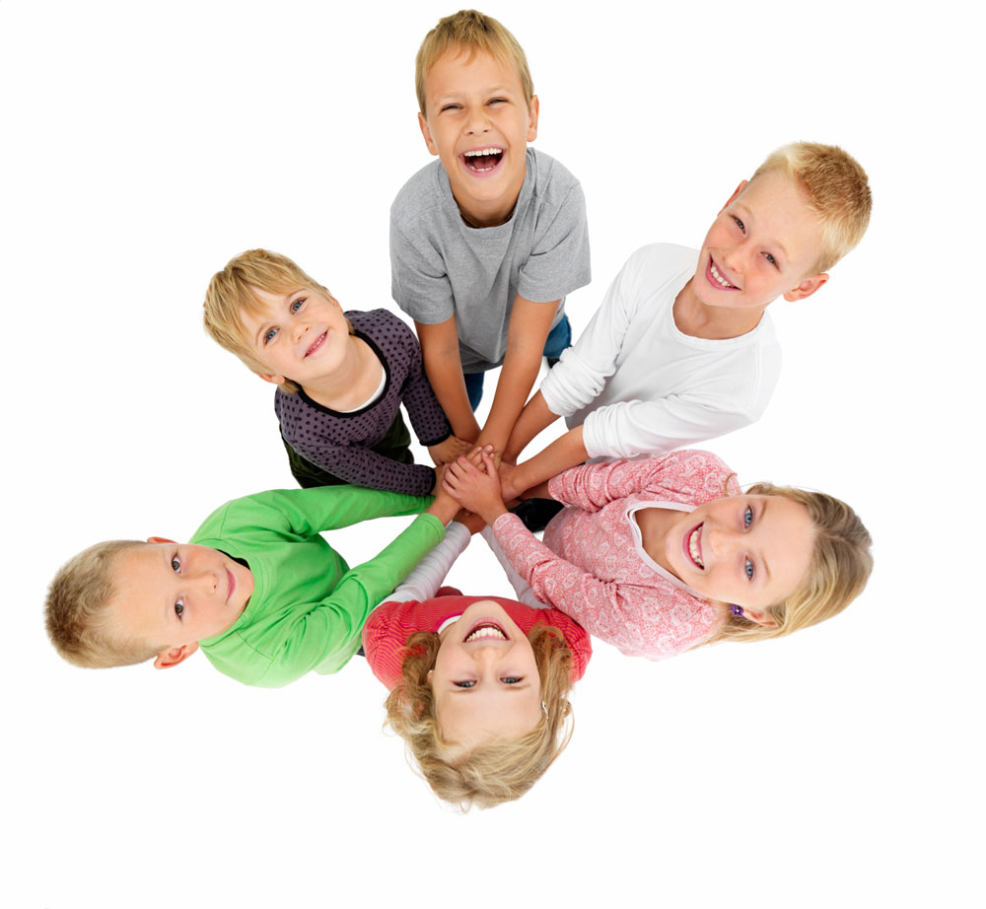
Module 1
Unit 1 Making friends
Reading(1)

Slide 2
two new friends
Lo
Hi

Slide 3
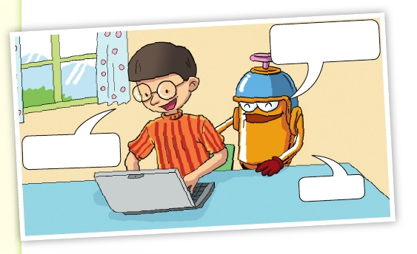
What does “e-friend”
mean, Hi?
It means
“electronic friend”.
Oh, like me!

Slide 4
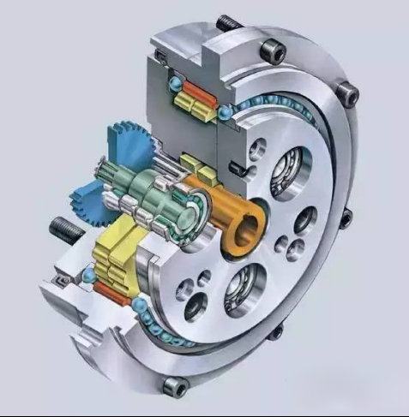
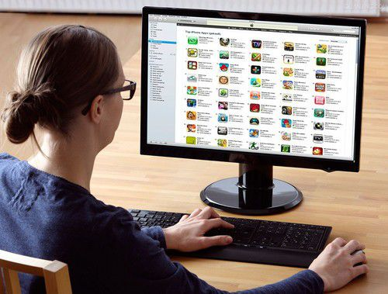
1. Does Lo understand Hi's words?
No.
2. What does “e-friend” mean to Lo?
It means a friend who is made of electronic parts.
3. What does “e-friend” mean to Hi?
It means a friend from the Internet.

Slide 5
Notes:
electronic: 电子器件的
e-: something is done on the Internet
（表示通过互联网做某事）

Slide 6




How to make friends with others?
1. You can make friends through some social media（社交媒体）.
QQ
Wechat
Blog
Facebook
2. You can share same hobbies with your friends.
Notes:
5分钟。

Slide 7

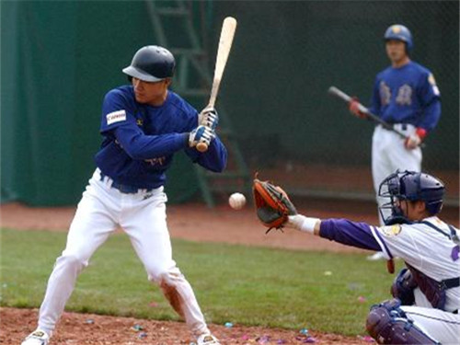

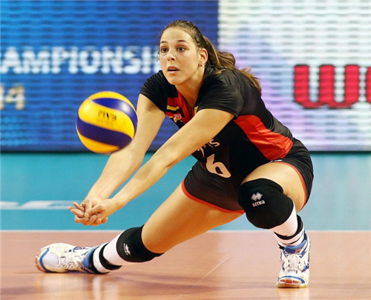
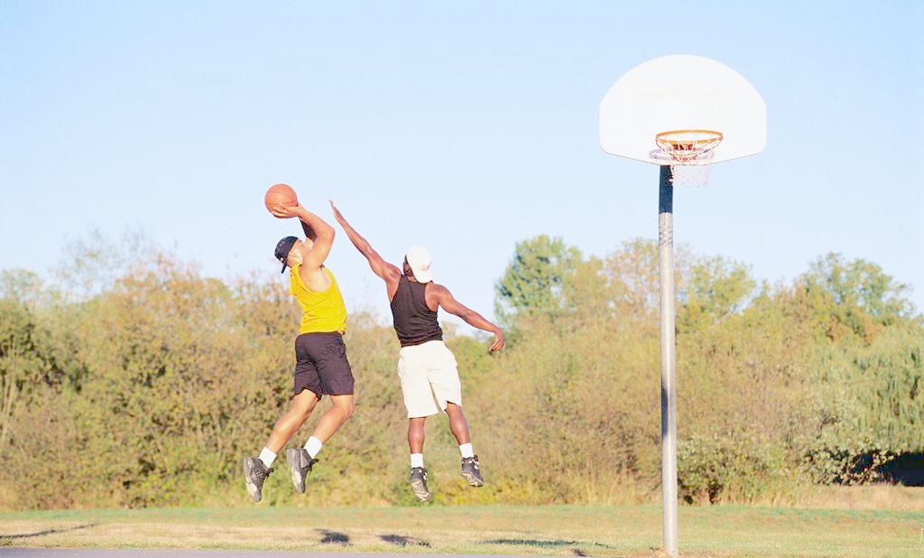
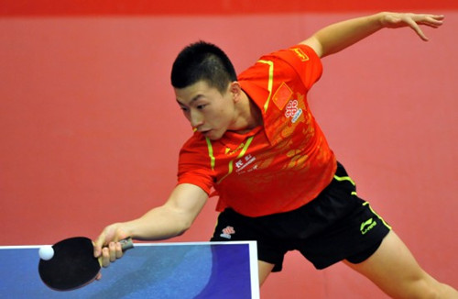
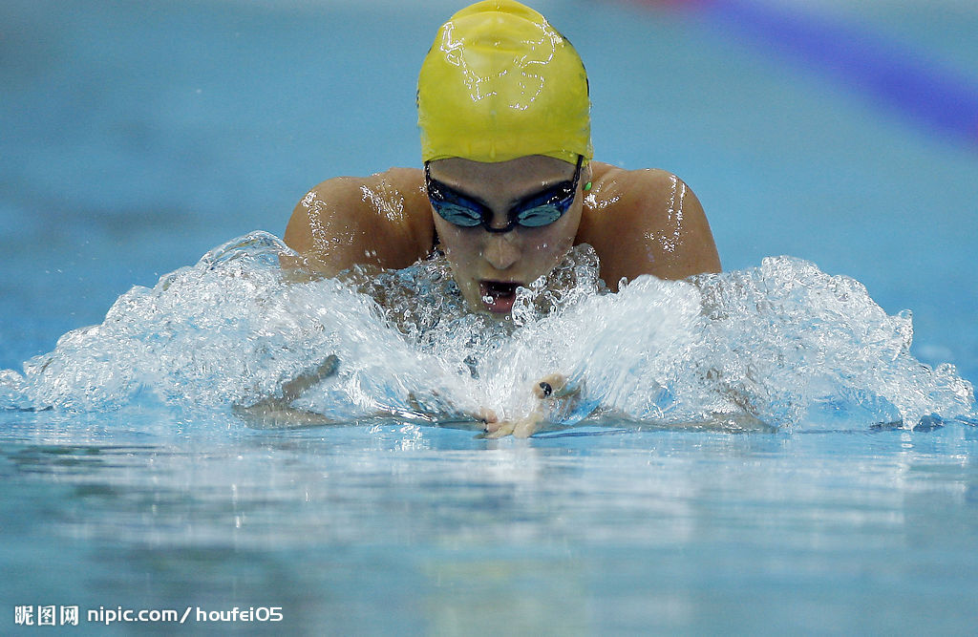
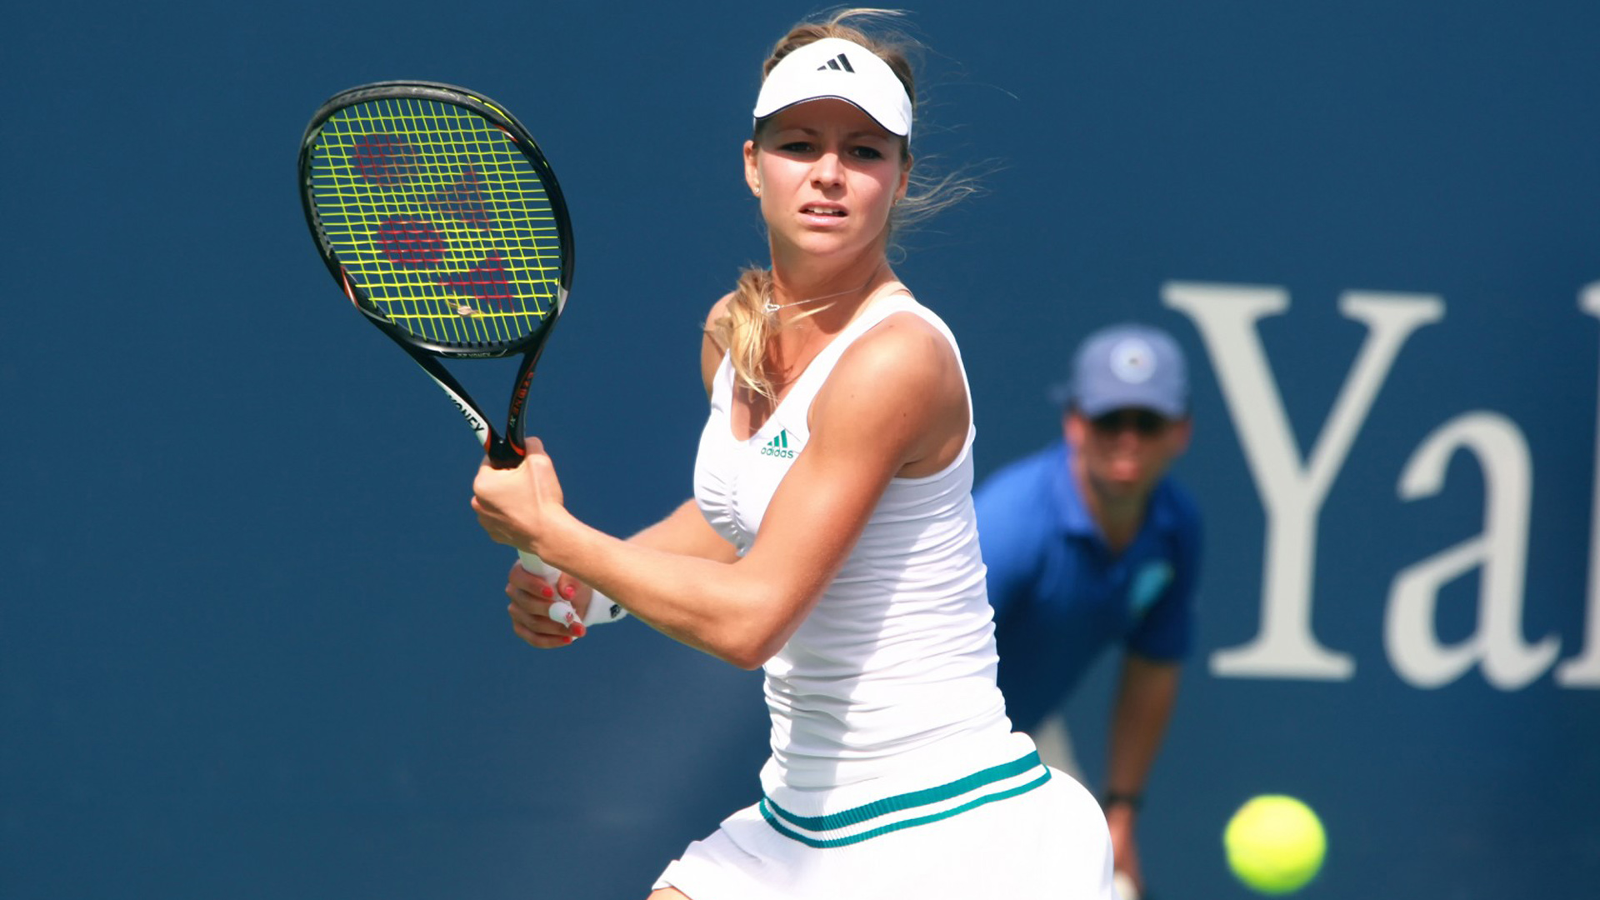

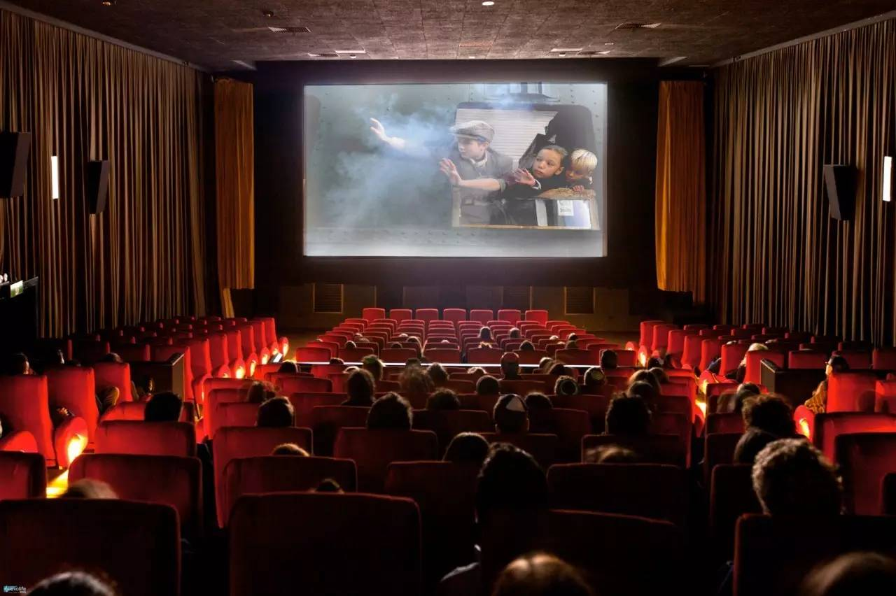

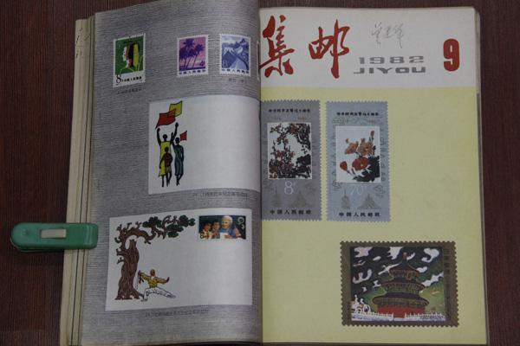
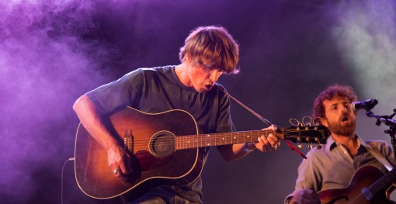
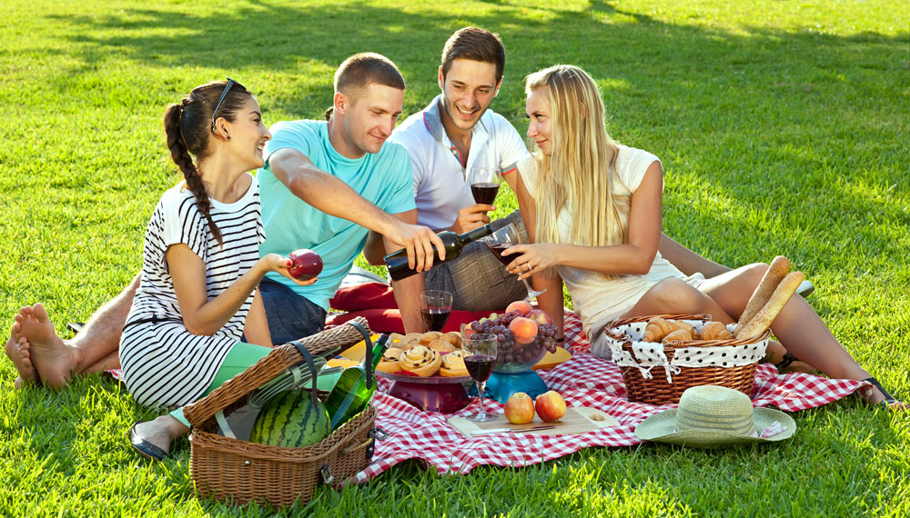
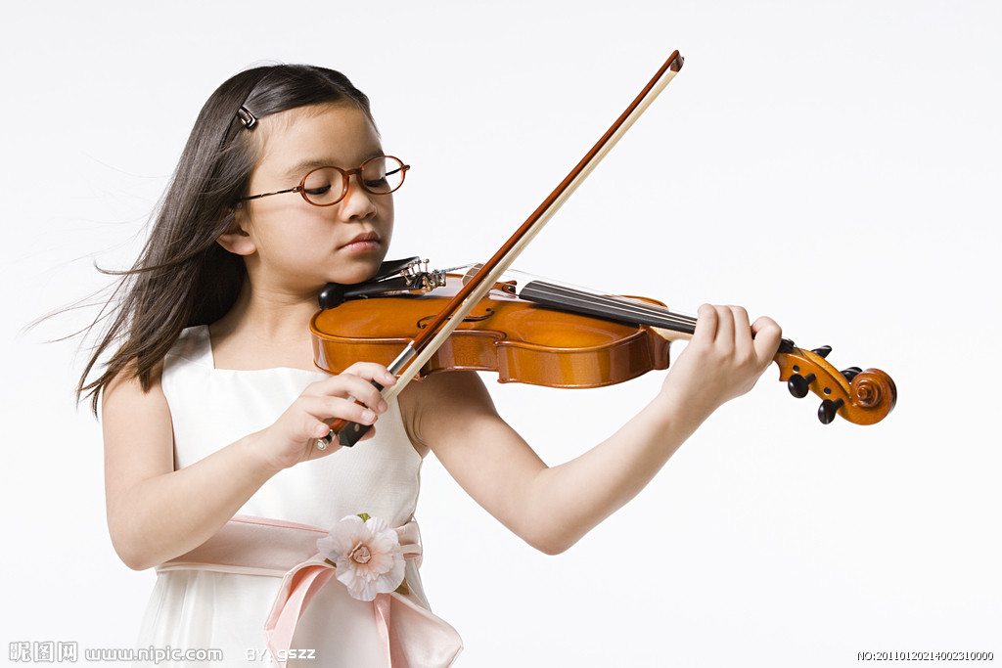
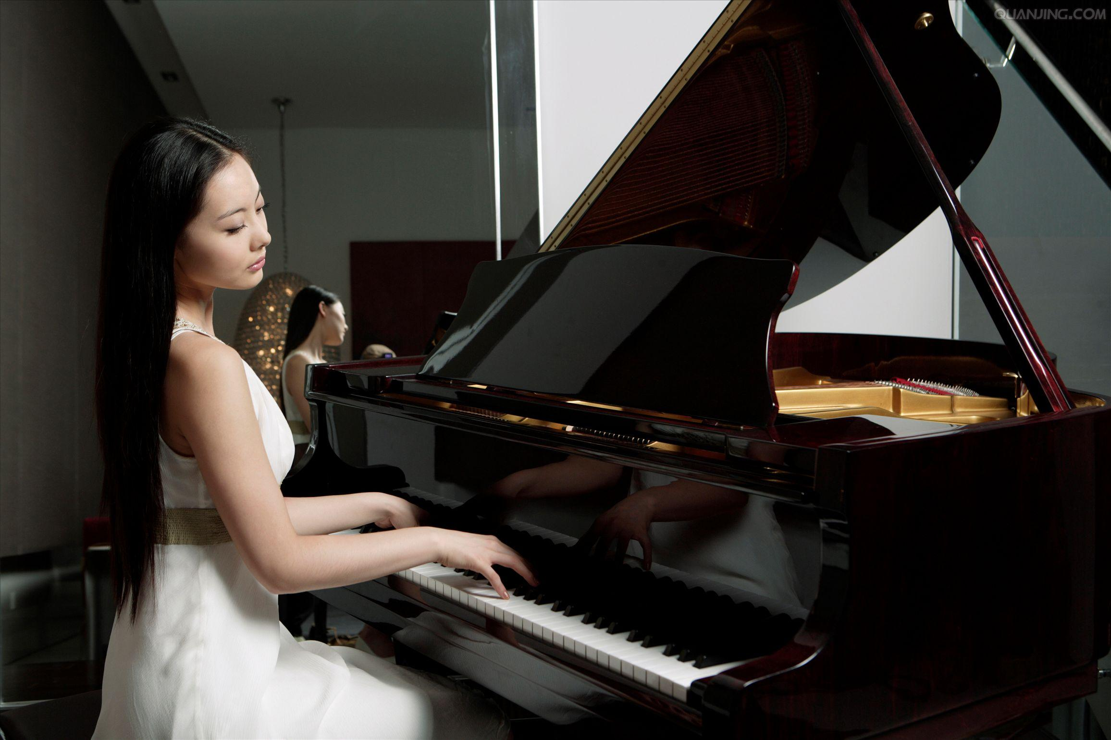
What hobbies do you know about...?
Notes:
5分钟。

Slide 8
playing basketball
playing football/soccer
playing volleyball
playing table tennis
swimming
playing baseball
playing tennis
running
playing the guitar
playing the violin
playing the piano
listening to music
reading books
going to the cinema
collecting stamps
going on a picnic
Notes:
2分钟。

Slide 9
Comparison（对比）
Group A
playing basketball
playing football
playing volleyball
Group B
playing the guitar
playing the violin
playing the piano
Notes:
表示进行某种球类运动时，直接用“play+球类运动”即可，在表示球类运动的名词前不加任何冠词。表示演奏某种乐器时，用“play+the+乐器”。
Notes:
2分钟。

Slide 10
Brainstorming
What’s your hobby?
playing basketball
My hobby is ________________.
listening to music
My hobbies are________________ and ________________.
reading books
Notes:
3分钟。

Slide 11
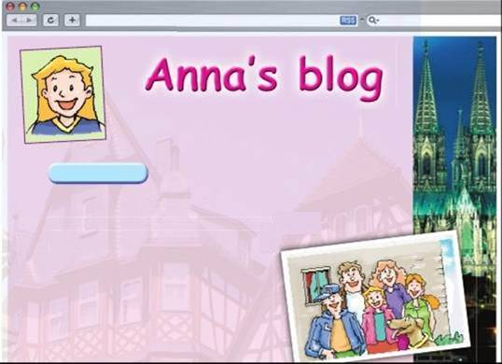
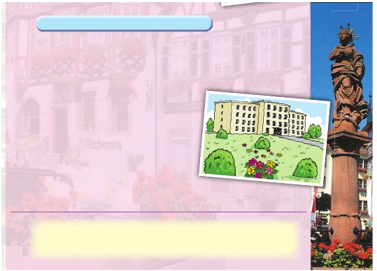
Prediction（做预测）
About me
main title
Can you guess what Anna will talk about in her blog? Why do you think so?
About my school and my hobbies
sub-headings
eg. According to this picture, I guess Anna will talk about her family.
pictures
Notes:
5分钟。

Slide 12
1st reading: read and tick
Look at the pictures, the title and the sub-headings on page 3. Then tick (✓) the things that you may find in Anna’s blog.
1.her country
2.her age
3.her parents’ names
4.her brother and sister
5. her favourite subjects
6. her English teacher
7. her dream
8. her hobbies
Notes:
3分钟。

Slide 13
2nd reading：read and answer questions
1. Whose blog is it?
2. Where is Anna from?
3. How old is Anna?
4. Where does Anna live?
5. What job does Anna's mother do?
6. What job does Anna's father do?
7. How many brothers and sisters does Anna have?
Notes:
7分钟。

Slide 14
2nd reading：read and answer questions
8. How does Anna go to school everyday?
9. What are Anna's favourite subjects?
10. Why does Anna like her school?
11. Where is Anna's dream?
12. What is Anna good at?
13. What are Anna's favourite hobbies?
14. What does Anna want to do?
Notes:
7分钟。

Slide 15
1. Answer these questions in a complete sentence.
2. Write the answers down on paper.
3. Discuss with your partners to check your answers.
1. Whose blog is it?
2. Where is Anna from?
3. How old is Anna?
4. Where does Anna live?
5. What job does Anna's mother do?
6. What job does Anna's father do?
7. How many brothers and sisters does Anna have?
8. How does Anna go to school everyday?
9. What are Anna's favourite subjects?
10. Why does Anna like her school?
11. What is Anna's dream?
12. What is Anna good at?
13. What are Anna's favourite hobbies?
14. What does Anna want to do?

Slide 16
2nd reading：read and answer questions
1. It is Anna's blog. /It is Anna's. /This blog is Anna's.
2. Anna is from Germany.
3. Anna is 11 years old.
4. Anna lives in a house close to some mountains.
5. Anna's mother is an Art teacher.
6. Anna's father is a doctor.

Slide 17
2nd reading：read and answer questions
8. Anna goes to school by bus every day.
9. Anna's favourite subjects are Maths, Art and Science.
10. Anna likes her school because the teachers are all very friendly.
11. Anna lives in a house close to some mountains.
12. Anna's(Her or She's) dream is to be an engineer.
13. Her favourite hobbies are swimming and playing basketball.
14. Anna wants to make friends with young people from all over
the world.

Slide 18
Post-reading
Do you want to become Anna's e-friend? Why or why not?
Requirements:
1. Discuss with your partners.
2. List at least 3 reasons why you want to or don't want to become Anna's e-friend.
3.Tell your reasons to the whole class.

Slide 19
Homework
1. 完成 C1, C2, D1 and D2.
2. 抄写p.1-p.3的单词和短语并背诵。
（每个单词英文抄写四次，中文抄写一次）
3. 熟读reading部分。

