Slide 1


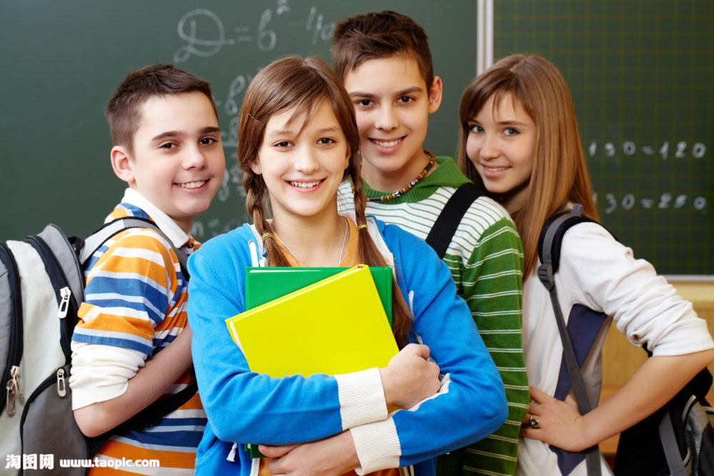
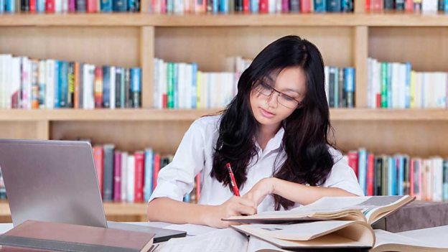
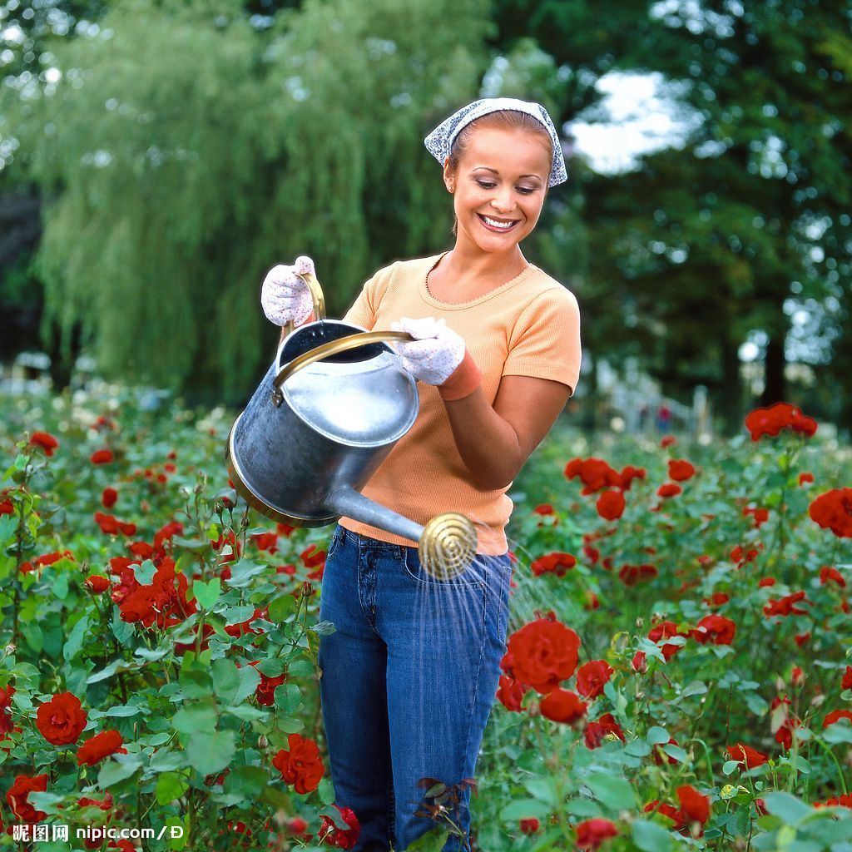
Unit2 Daily Life
Reading (1)

Slide 2
Talk about your daily life
Things |  | Time
I get up I eat breakfast I go to school Morning classes begin Morning classes end I have lunch Afternoon class begin School ends I have dinner I finish homework I go to bed | at | 1.__________________ 2.__________________ 3.__________________ 4.__________________ 5.__________________ 6.__________________ 7.__________________ 8.__________________ 9.__________________ 10._________________ 11._________________

Slide 3
Similarities and differences（相同点与不同点）
I get up at 6:30. She gets up at 6:45. (difference)
Both of us go to school at 7:10. (similarity)

Slide 4

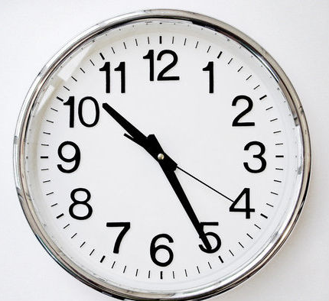

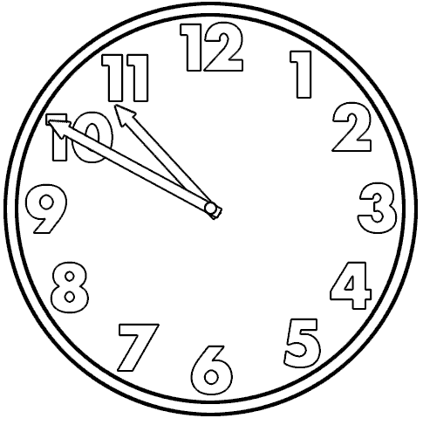
When to use “past” and when to use “to”?
What time is it?
eight o'clock
ten twenty-five
three thirty
ten fifty
twenty-five past ten
half past three
ten to eleven
Formal but easier way: say the hours first and then the minutes
More popuar way: say the minutes first and then the hours

Slide 5
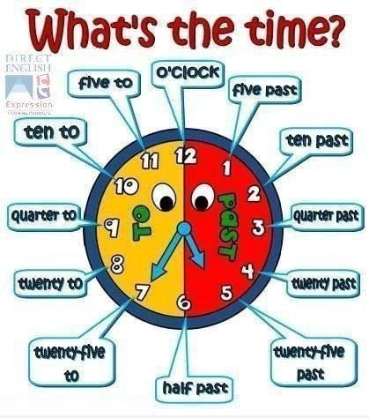
past: 超过
to: 到...还差
Work out the rule:
1. 30分以内,分在前,点在后,past在中间；
2. 30分以外,分用60减,点要加上1,用to来连接.

Slide 6
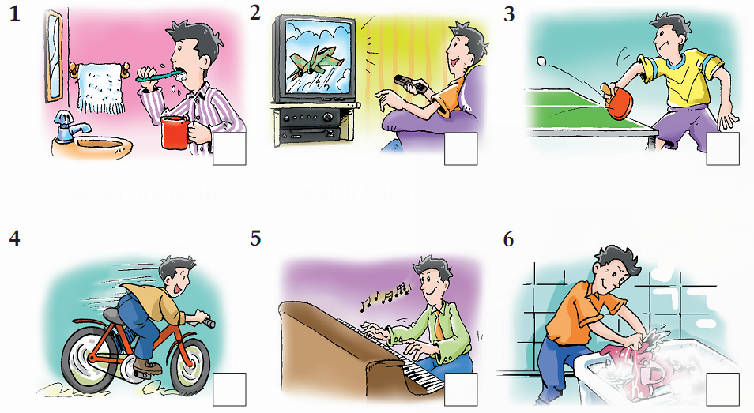
What do you know about...?
Which of these things do you …
a do every day? b do once or twice a week? c never do?
brush my teeth
watch television
play table tennis
ride a bicycle
play the piano
wash my clothes

Slide 7
Make sentences about your daily life.
I … every day.
I … once or twice a week.
I never…

Slide 8
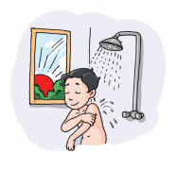
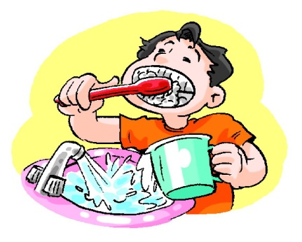
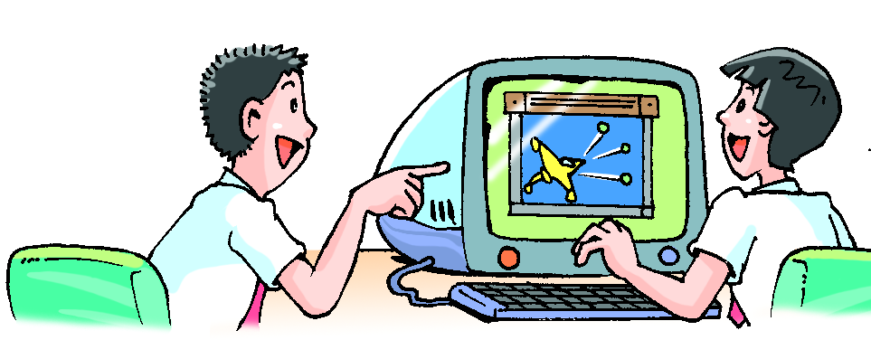
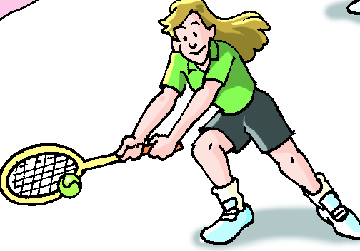
What else do you do every day?
What do you usually do?
What do you never do?

Slide 9
fast reading
Reading tip:
The first sentence and last sentence of a paragraph sometimes can give important information.

Slide 10
Homework
1. p.18-19页的所有练习。
2. 抄写p.15-17页的单词与词组。
3. 将上周五听写中错误的单词每个单词抄4遍，中文抄一遍。（抄在听写本上，下次听写本收上来的时候检查）

Slide 11
Unit2 Daily Life
Reading (2)

Slide 12
careful reading
activity one: match the paragraph with the main idea.
para. 1
Sam's morning activities
para. 2
Sam's afternoon activities
para. 3
About Sam's school and his favourite subject
para. 4
Sam always has a good time at school.
para. 5
About Sam

Slide 13
careful reading
activity two: fill in the table.
Classes start at _________.
Favourite subject: _________
Reason: _________________________________
_________________________________
Morning: Morning break starts at ________ and ends
at ________.
Sam and his friends usually _________.
Lunch time: from _________to __________.
Afternoon: Classes end at __________
Sam takes part in ___________________
with his friends
8 a.m.
Geography
He enjoys learning about different places
in the world.
9:50 a.m.
10:10 a.m.
play games
11:50 a.m.
12:30 p.m.
3:30 p.m.
the school band practice

Slide 14
Activity 3: group work
Four facts about Sam:
1. Sam likes his school.(2 sentences)
2. Sam likes sport very much.(2 sentences)
3. Students in Sam's school go home early
in the afternoon. (1 sentence)
4. Sam, Tom and Jack do well in the
school band. (1 sentence)

Slide 15
Activity 3: group work
1. I love going to school.
Sam likes his school.
2. I always have a good time at school.
Sam likes sport.
1. When the bell rings, I run to the playground......
2. We often play games.
Students in Sam's school go home early in the afternoon.
Afternoon classes end at 3:30 p.m.
Sam, Tom and Jack do well in the school band.
We make great music together.

Slide 16
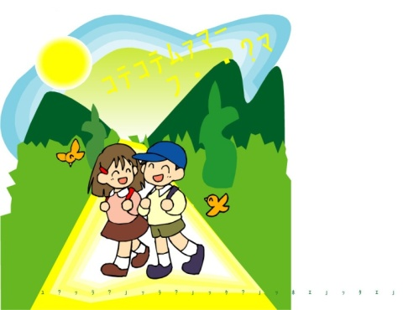
Sam's day at school
Activity 4: Retell the text
junior high school student
Sam is a ____________________. He loves going
to school. Sam's school is ______ to his home, so
he always ____________ on foot. His classes
__________ 8 a.m. His ____________ is Geography.
He ___________________ different places in the
world.
close
goes to school
start at
favourite subject
enjoys learning about

Slide 17
In the morning, he usually ______ Chinese, Maths
and English. He ________________ at 9:50 a.m. When
the bell rings, Sam __________________ with his best
friends Tom and Jack. They often __________. Break
__________10:10 a.m. His ______ is usually from 11:50 a.m.
to 12:30 p.m. His ______________ end at 3:30 p.m. Then
Sam, Tom and Jack take part in _____________________.
They make __________ together. Sam always
_____________ at school.
studies
has morning break
runs to the playground
play games
ends at
lunch
afternoon classes
the school band practice
great music
has a good time

Slide 18
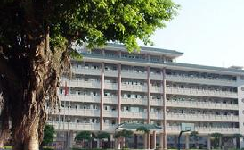
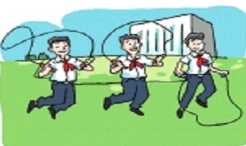
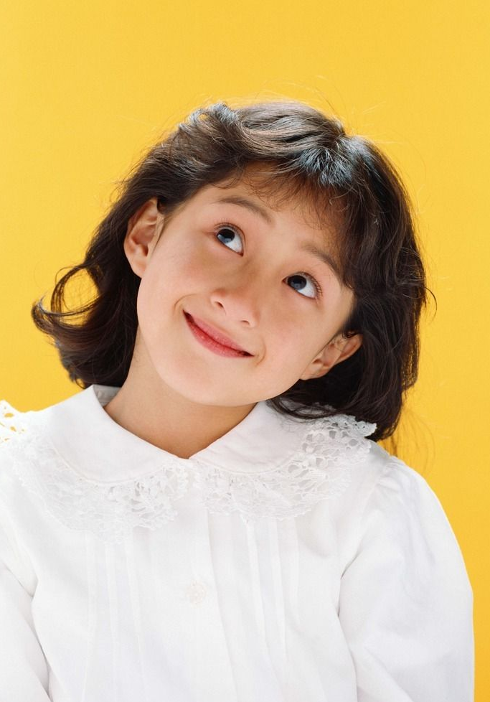
Discussion
Do you want to study in Sam's school or do you want to study in this school（Middle School Attached to Sun Yat-sen University）?
I want to study in Sam's school because ......
I'd like to study in this school because...

Slide 19
Homework
1. 复习unit1，周四单元测试，一定一定把课文背熟。
2. B册Unit2 reading部分。

