Slide 1

Unit 6
Travelling around Asia
Grammar
conditional stences(1)

Slide 2

conditional stences
the if-clause
初中英语语法
If 引导的真实条件状语从句

Slide 3
if I were you...
高中内容
if I could fly...
非真实条件句
If引导的条件状语从句
if you hadn't married him...
1.主从句的位置
真实条件句
2.If的两面性
3.时态呼应

Slide 4
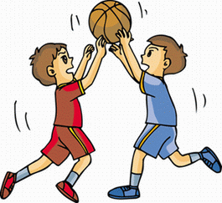
Using if to make sentences according to the given words and picture.
be free tomorrow, play basketball
If I am free tomorrow, I'll play basketball.
I'll play basketball if I am free tomorrow.

Slide 5
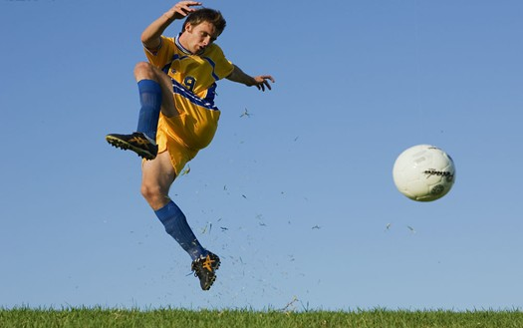
doesn't rain tomorrow, play football
If it doesn't rain tomorrow, I'll play football.
I'll play football if it doesn't rain tomorrow.

Slide 6
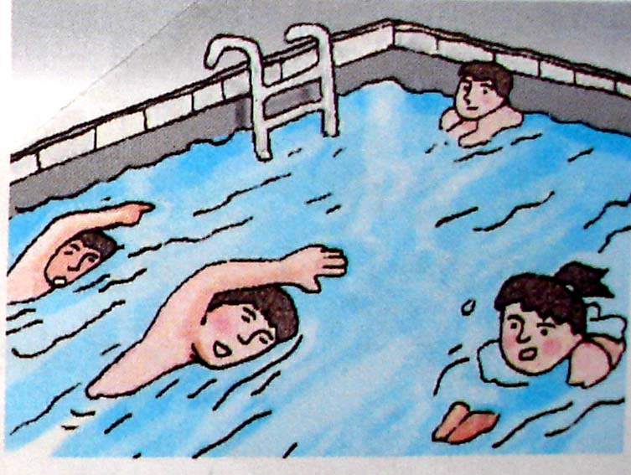
finish one's homework, go swimming
If I finish my homework, I'll go swimming.
I'll go swimming if I finish my homework.

Slide 7
1.主从句的位置
Observe the example sentences and try to work out the rule.
If I finish my homework, I'll go swimming.
if-clause
Main clause
I'll go swimming if I finish my homework.
Main clause
if-clause
用
Rule one:当 if 引导的从句在主句之前时，____（用/不 用）逗号隔开两个句子；当主句在从句之前，则____（用/不用）加逗号。
不用

Slide 8
2.if的两面性
Observe the example sentences and try to figure out the meaning of if.
We will go out if it is fine tomorrow.
2) I want to know if he is a teacher.
↓
如果
↓
是否（=whether）
Rule two:if在条件状语从句中翻译为“如果”,在宾语从句中翻译为“是否”。

Slide 9
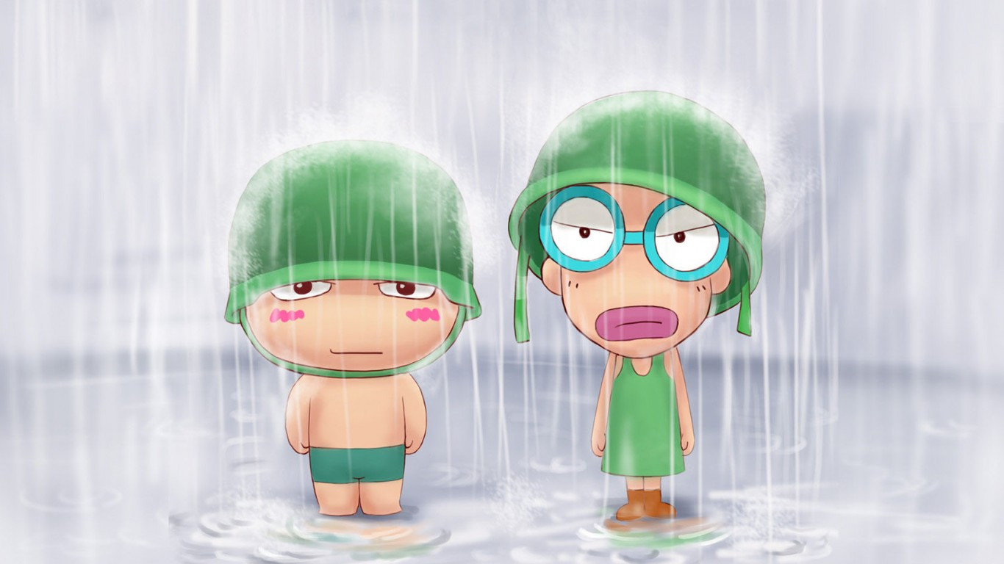
3.主从句的时态问题
主现从现：由if引导的条件状语从句，当主句动作表示真理或必然的结果时，主句和从句都用一般现在时。
1) If you stand in the rain, you get wet.
2) If you heat ice, it turns to water.
3) If you drop the glass on the floor, it breaks.

Slide 10
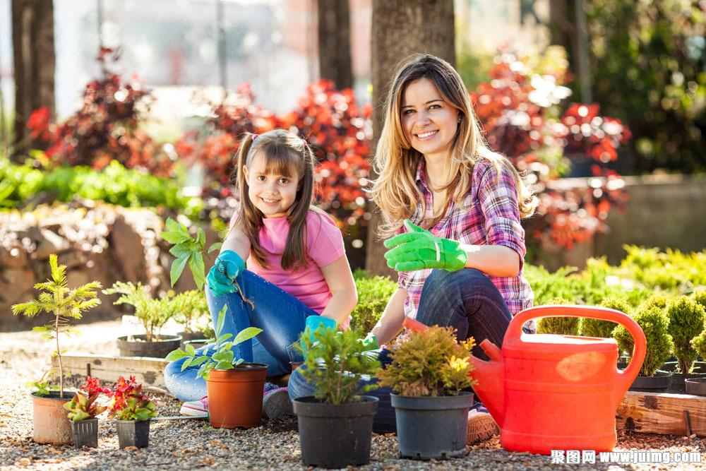
3.主从句的时态问题
主将从现：当主句动作表示可能的结果时，主句用一般将来时，if引导的条件状语从句用一般现在时。
4) I will plant some flowers in my garden if it doesn't rain tomorrow.
5) We are going to stay at home if it rains tomorrow.
X
注意
在if引导的条件状语从句中，当主句是一般将来
时，不能够使用be going to结构，而要用will/shall。

Slide 11
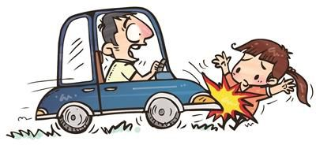
3.主从句的时态问题
主情从现：主句的谓语动词可根据句子的实际情况用其他情态动词替换will，如must, can, may等。
6) If you finish your homework, you can go home now.
7) If you drive too fast, you may have an accident.

Slide 12
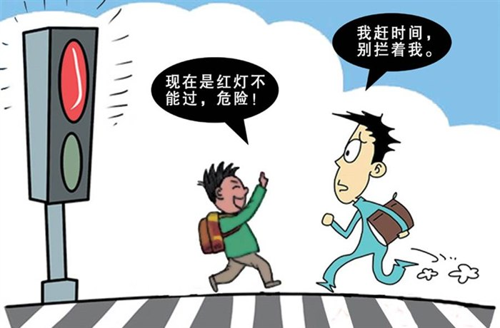
3.主从句的时态问题
主祈从现：主句中用祈使句，if从句用一般现在时。
8) Stop if the traffic is red.
9) Don’t wait for me if I am late.

Slide 13
记住这个顺口溜吧！
“if条件句不一般, 几个要点记心间；
条件句，放在前, 逗号要放句中间；条件句
表可能，主句多用将来时；条件句表事
实，主句常用现在时。”

Slide 14
If引导的真实条件句用法巧记忆：
从主有逗，
主从无逗；
主将从现，
主祈从现，
主情从现；
是否如果，
要分清楚。

Slide 15
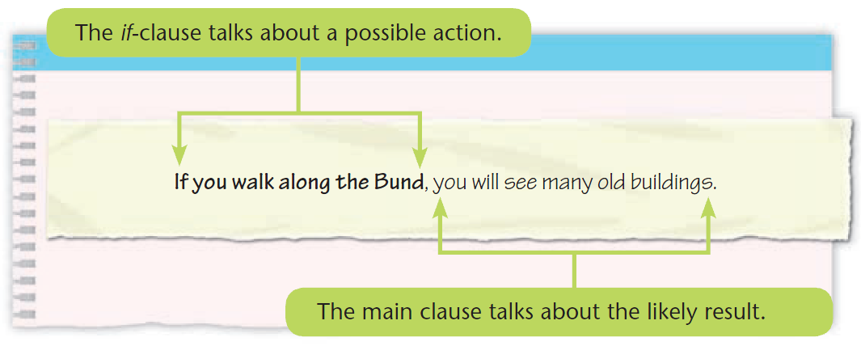
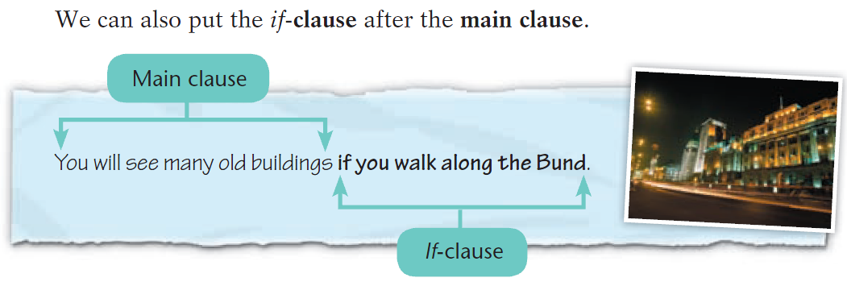
Conditional sentences (1)
We use conditional sentences to talk about possible actions and the results of these actions.
p77

Slide 16
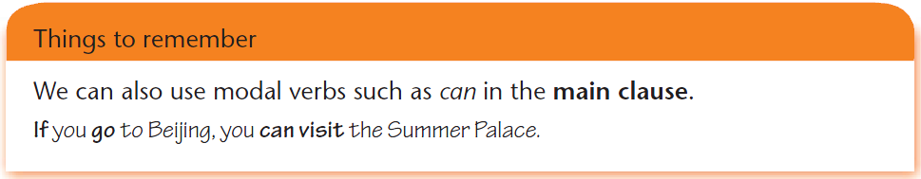
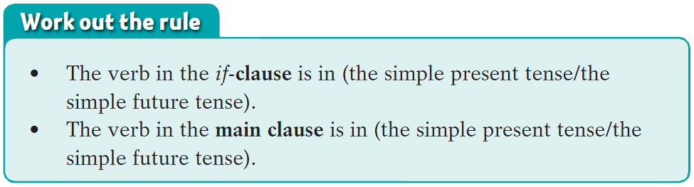

Slide 17
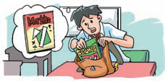
A William's mum is giving him advice about his problems. Match the half-sentences from the boxes to complete her advice for him.
William's problems
1. I sometimes bring the wrong books to school.
If you check your timetable every night，you will know which books to bring.

Slide 18
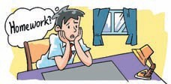
2. I was away from school today. I do not know what homework to do.
If you call your friends, they will tell you what homework to do.

Slide 19
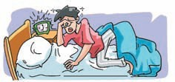
3. I hate getting up. I always feel tired in the mornings.
If you go to bed early, you will not feel tired in the mornings.

Slide 20
4. I do not know what this word means.
If you look it up in the dictionary, you will find out its meaning.

Slide 21
B Carol is giving advice to Henry. What is she saying? Use the pictures and the words in brackets to help you.
__________________ the wheels round, they_______________ easily. (make/turn)
If you make
will turn

Slide 22
2.The seeds ______________________ in the soil. (grow/plant)
will grow if you plant them

Slide 23
3. ____________ another wing, it ____________. (put on/ fly)
If you put on
will fly

Slide 24
4. ________________ your coat, you
__________ so cold. (put on/not feel)
If you put on
will not feel

Slide 25
5. The meat _______________________
in the fridge. (not go bad/put)
will not go bad if you put it

Slide 26
6. You __________________________
your classes. (see clearly/wear)
will see clearly if you wear

Slide 27


Let's learn the new words and expressions.

Slide 28
advice
[U] 意见；劝告；建议
一则建议
give advice on/about sth
你能给我一点关于买房子的建议吗？
Could you _________________________ buying a house?
听从某人的意见
advice & advise
advise v. 建议
advise sb to do sth 建议某人做某事
a piece of advice
就...给出建议
give me some advice about/on
take/follow one's advice

Slide 29
I hate getting up.
hate v. 讨厌，不喜欢
hate doing sth
hate to do sth
hate sb/sth
他讨厌他的工作。
He hates his job.
我讨厌洗衣服。
I hate washing clothes.
她讨厌我。
She hates me.

Slide 30
一. 用括号内所给单词的正确形式填空。
1. If he ______(be) free tomorrow evening,
he will come to your birthday party.
2. I will tell her the answer if she ______(ask) me.
3. If we talk loudly in class, our teacher
______(be) unhappy with us.
is
asks
will be

Slide 31
二. 合并句子。
1. It is going to rain tomorrow.
We will not go out.
If it rains tomorrow, we will not go out.
2. She is going to post the letter now.
Her grandparents will receive it in three days.
If she posts the letter now, her grandparents will receive it in three days.

Slide 32
3. They are going to do more exercises.
They will be in better health.
If they do more exercises, they will be in better health.
4. You are going to play with a knife.
You will hurt yourself.
If you play with a knife, you will hurt yourself.

Slide 33
三. 选择最佳答案填空。
( )1. If it stops raining, we ____ out.
A. are go B. can go
C. goes D. to go
( )2. If you don't water the flowers, they ____.
A. died B. die
C. dying D. to die
( )3. We will go climbing ____ the weather is
fine.
A. while B. where
C. so D. if
B
B
D

Slide 34
( )4. My family and I will plant some trees in the
garden if it ____ tomorrow.
A. didn't rain B. isn't going to rain
C. won't rain D. doesn't rain
( )5. If you don't work hard, you ____ the exam.
A. can't pass B. can pass
C. will pass D. pass
( )6. If my father ____ back next Saturday, we will
go on a picnic together.
A. will come B. comes
C. is coming D. should come
D
A
B

Slide 35
will come
7. I want to know if he _________(come) tomorrow. If he _______(come), I __________(give) the message to him.
8． I ____ her the answer if she ____me.
A.am going to tell, asks B. will tell, asks
C.am going to tell, ask D. will tell, ask
comes
will give

Slide 36
Homework
完成E听说的作业
完成B册Grammar、Integration（不要空题）
背诵Unit6课文
翻译，写在笔记本上

