Slide 1
Reading

Slide 2
Proof writing
1. I will be gladly to join in any discussions that enriches my knowledge of the world.
2. A hobby is something that you never get tired of it. The more time you devote to it, the more fun you have.
3. Believe it or not, we have gradually became able to express ourselves fluently in English.
glad
enrich
become

Slide 3
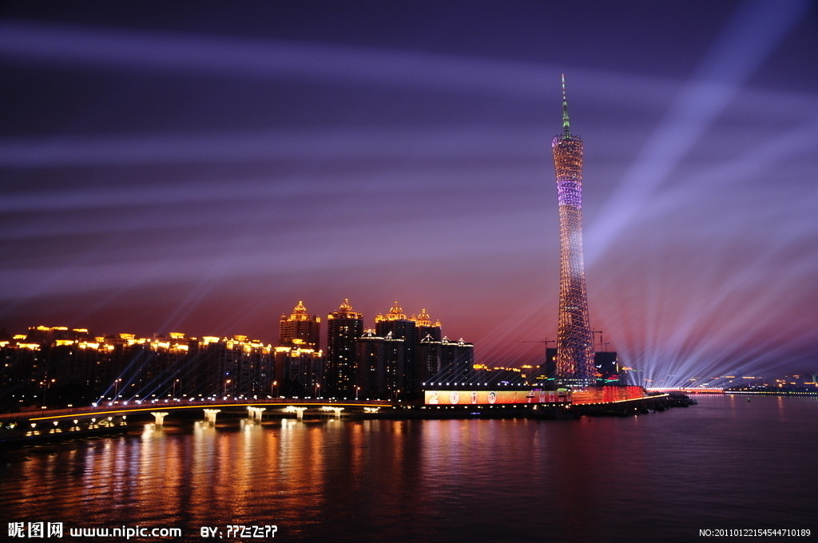
Pre-reading 1.Do we live beside a river?

Slide 4
Brain
Storming
travel along a river
……
to make electricity
2.How do people who live beside
a river make use of it?
to irrigate (灌溉) their fields
go swimming

Slide 5
The great rivers in the world
3.The great rivers in the world
Names of river | Location(位置)
Lancang River Seine [sein]塞纳河 Nile Kongo 刚果河 Amazon 亚马逊河 Mississippi Thames [temz]泰晤士河 | England Egypt Central Africa the US France China Brazil

Slide 6
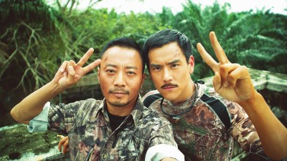


Slide 7
Can you tell the differences between the Mekong River and the Lancang River?
Can you tell the differences
between the Mekong River
and the Lancang River?
The Chinese part of the river is called
the Lancang River and after flowing
in other countries the river is called
the Mekong River.

Slide 8
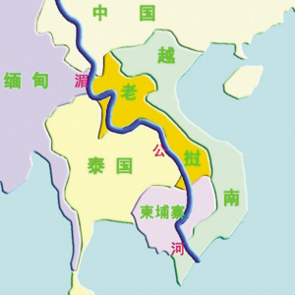
4.Look at the map and list the countries
that the Mekong flows through.
China
Myanmar
Laos
Thailand
Cambodia
Vietnam

Slide 9
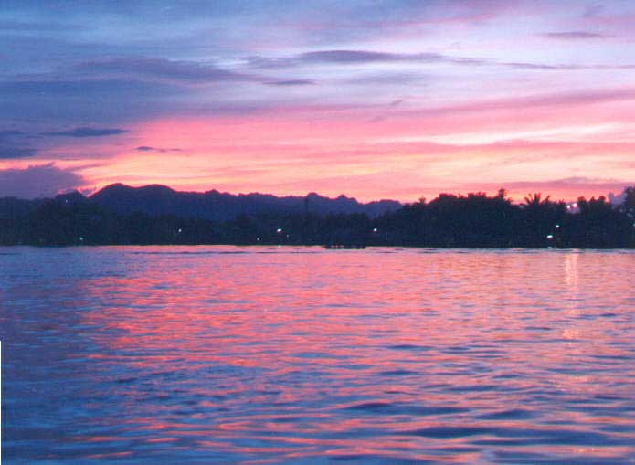
While-Reading
Journey down the Mekong
Part 1 The dream and the plan

Slide 10



1.skimming
Skim the text and choose the main idea for each paragraph.
Information about the Mekong river.
Wang Kun and Wang Wei’s dream.
Wang Wei plans the schedule for the trip.

Slide 11
2.scanning
Paragraph 1: Dream
ever since 自从
persuade vt. 说服
cycle vi.骑自行车
graduate vi.毕业 n.毕业生
schedule v.为某事安排时间
finally adv. 最后

Slide 12

Who and What
2.scanning
Paragraph 1: Dream
Who and What
Wang Kun and ___ _____ Wang Wei are
dreaming about _____________________.
his sister
taking a great bike trip

Slide 13
Q：How is their dream developed ?
Since middle school
2.Two years ago
3.Last year
4. After graduation
We have dreamed about ____________________
taking a bike trip
She and I bought ____________________
expensive mountain bikes
Wang Wei visited our cousins who grew up in western _______ _______ near ___________
Yunnan
Province
the Lancang River
We finally had a chance to_______________, and decided to cycle along ____________________
take a bike trip
the Mekong River

Slide 14

scanning
Paragraph 2: plan/schedule
be fond of 喜欢
change one’s mind 改变主意
make up one’s mind 下定决心
care about 关心
journey n. 旅行
altitude n. 海拔
shortcoming n. 缺点
stubborn adj. 顽固的
determined adj. 坚决的
organize vt. 组织

Slide 15
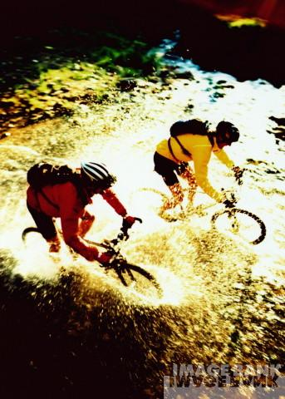
scanning
Paragraph 2: plan/schedule
Q:Who organizes the trip?
My sister Wang Wei.

Slide 16
Why is she stubborn?
Wang Kun’s opinions
1. Wang Wei didn’t know the best way of getting to places.
2. Wang Wei should look at a map first.
3. The source of the Mekong is in Qinghai Province.
4. The journey would begin at an altitude of more than 5, 000 meters.
5. It would be hard to breathe the air.
Wang Wei’s reactions
A. She said she could organize the trip properly.
B. She would not change her mind.
C. She seemed to be excited about it.
D. She does not care about details.
E. She said it would be an interesting experience.

Slide 17
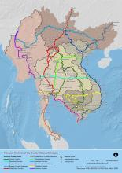
scanning
Paragraph 3: the Mekong River
Q：Where do they find information about the Mekong River?
They went to the library and found a large atlas with good maps.

Slide 18

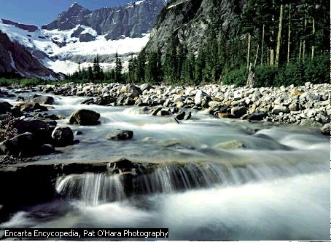
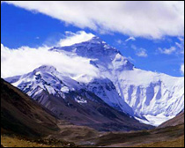
What can they see during the journey?
glacier
It begins in a _______ on a ________ _________.
mountain
in Qinhai Province

Slide 19
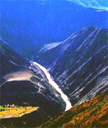
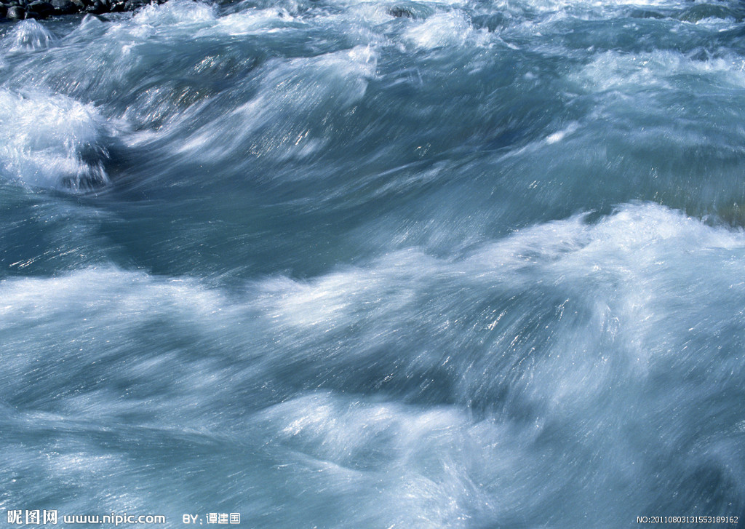
moves
Then, it ______ quickly. It becomes
______ as it passes through deep ______.
rapids
valleys

Slide 20
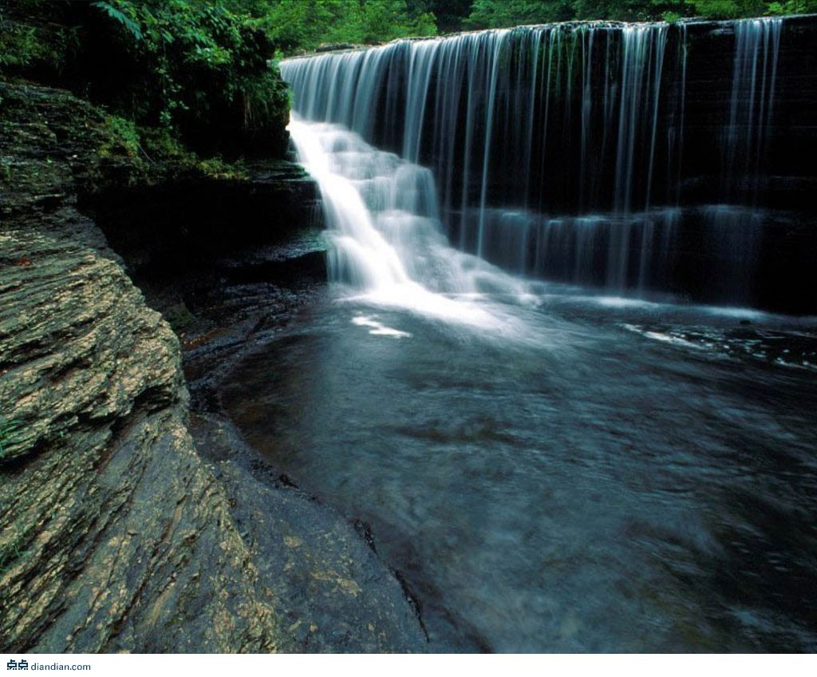
Sometimes, the river becomes a ________ and enters ____ ________.
waterfall
wide valleys

Slide 21
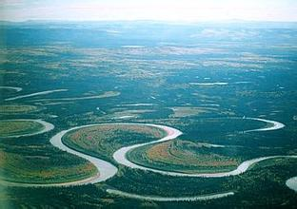
As it enters Southeast Asia, it makes wide________ or ________ through low valleys to plains.
bends
meanders

Slide 22
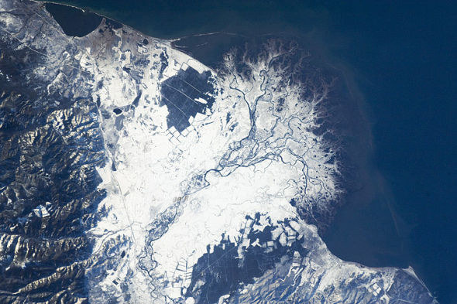
delta
At last, the river _____ enters
the South China Sea.

Slide 23

Retelling (Rational cloze)
P34 of Blue Book

Slide 24
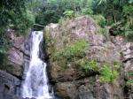
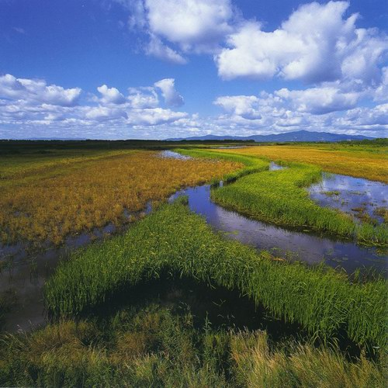
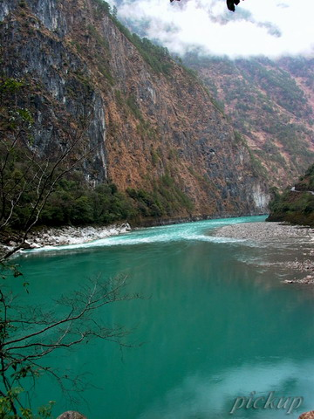
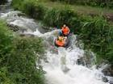
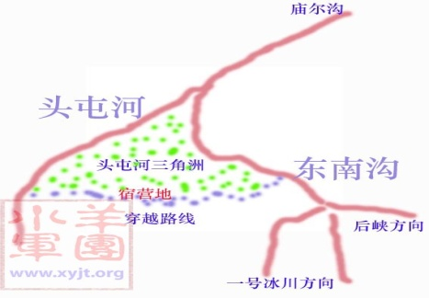
1. What can you see when you travel along
the Mekong?
You can see glacier, rapids, hills, valleys,
waterfalls and plains.
glacier
waterfall
plain
delta
valley
rapids

Slide 25
2. What is Wang Kun’s and Wang Wei’s
attitude towards/to the trip?
Wang Kun’s attitude towards the trip:
enthusiastic(热情的), rational(理性的),
considerate(考虑周到的)
Wang Wei’s attitude:
Imaginative（有想象力的）, organized,
stubborn, risk-taking（勇于冒险的）

