Slide 1
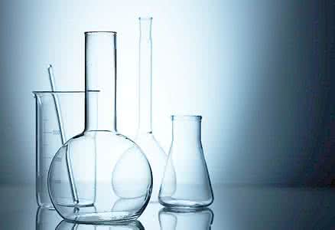
Unit 1 Great scientists

Slide 2

Reading

Slide 3


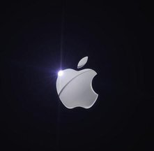

Warming Up
There are some great scientific achievements that have changed the world. Can you name some of them?

Slide 4

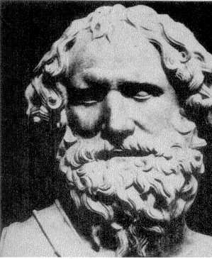
Who is he?
Which scientist discovered that objects in water are lifted up by a force that helps them float?
He is …
Archimedes (阿基米德)

Slide 5
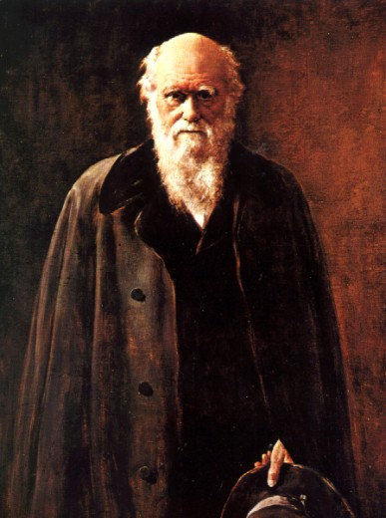
Who is he?
Who wrote a book explaining how animals and plants developed as the environment changed?
He is …
Charles Darwin.

Slide 6
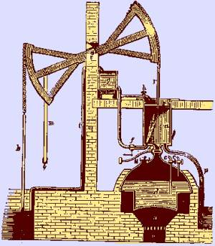
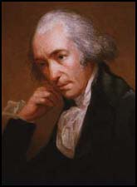
Who is he?
Who invented the first steam engine?
He is …
Thomas Newcomen.

Slide 7
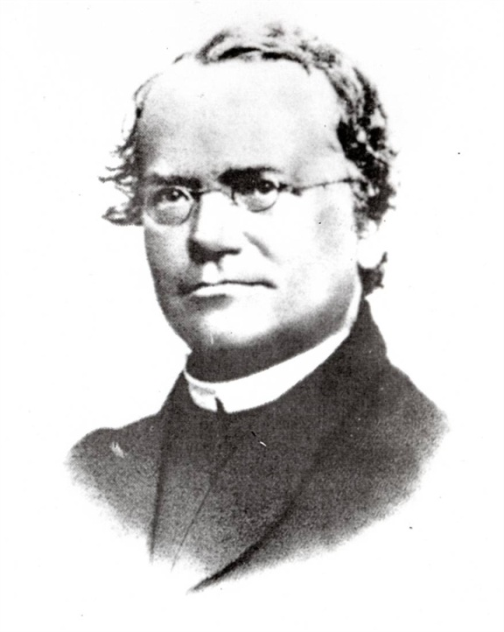
Who is he?
Who used peas to show how physical characteristics are passed from parents to their children?
He is …
Gregor Mendel

Slide 8
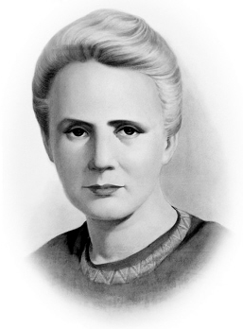
Who is he?
Who discovered radium(镭)?
She is …
Marie Curie

Slide 9
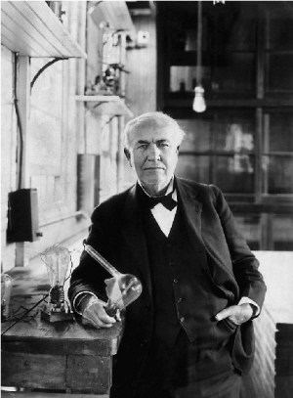
Who is he?
Who invented the way of giving electricity to everybody in large cities?
He is …
Thomas Edison

Slide 10
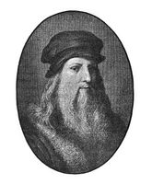
Who is he?
Who was the painter that studied dead bodies to improve his painting of people?
He is …
Leonardo da Vinci

Slide 11
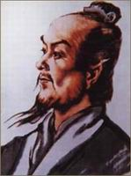
Who is he?
Who invented the earliest instrument to tell people where earthquakes happened?
He is …
Zhang Heng

Slide 12
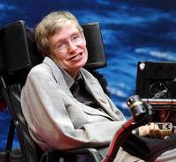
Who is he?
Who put forward a theory about black holes?
He is …
Stephen Hawking

Slide 13
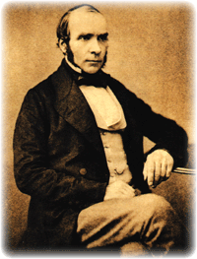
Reading: John Snow defeats King Cholera
York
London
(1813-1858)
John Snow was born in York on March 15th, 1813, the oldest of nine children.

Slide 14

Pre-reading
1. What do you know about infectious diseases? What do you know about cholera?
What is Cholera?
Cholera is a disease caused by Vibrio Cholerae, a form of bacteria that attacks
the intestine ( 肠).

Slide 15
The disease is not always serious, but 1 in 20 patients suffer from severe diarrhea(腹泻), vomiting(呕吐) and muscle pains. Without treatment, such patients can die within a few hours if their bodies lose too much water.

Slide 16
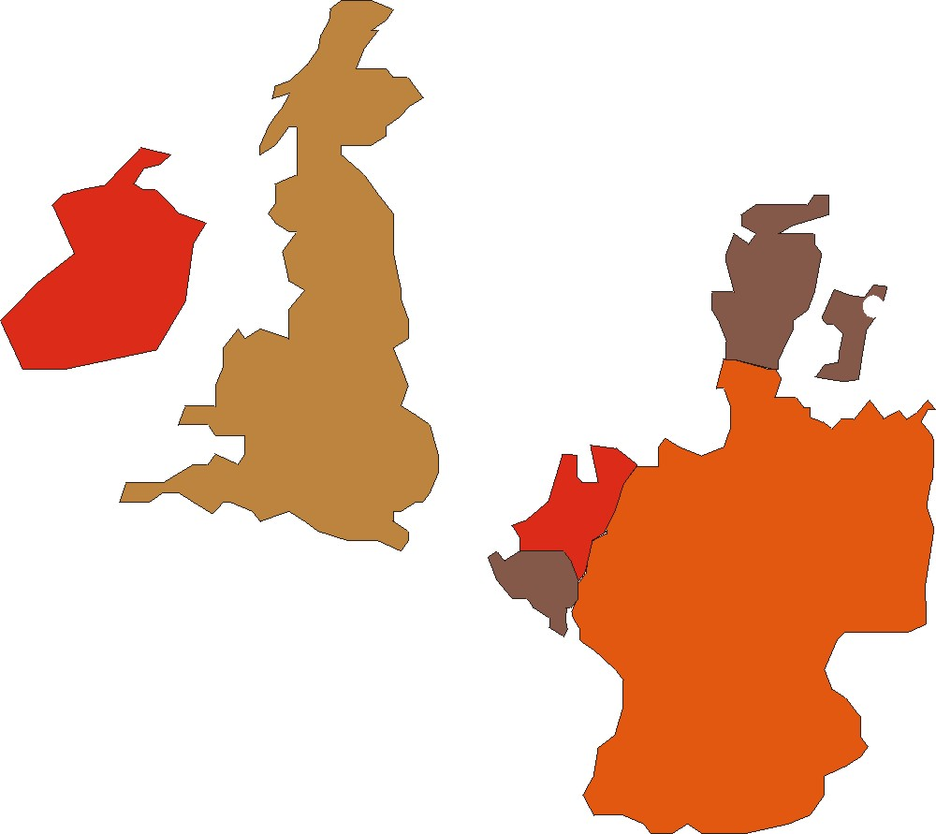
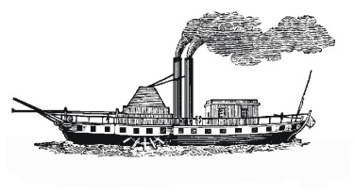
The spread of cholera
Previous cholera epidemic in Great Britain in 1831-32
Great Britain
London
Germany
Death of first cholera case in London during the 1848-49 epidemic

Slide 17
Expert n. 专家
Attend v. 参加
Physician n.医生
Expose v.暴露
Cure v.治愈
Challenge n.挑战
Victim n.受害者
Absorb v.吸收
Suspect v.怀疑
Enquiry n.调查
Neighborhood n.邻居
Severe adj.严重的
Pump n.泵
Foresee v.预见
Blame v.责备
Pollute v.污染
Handle n.把手

Slide 18


The text is mainly about _____
______ and how he _______________.
John
Snow
defeated cholera

Slide 19

Careful reading
I. Read the text “John Snow Defeats
‘King Cholera’”, and fill in the
blanks.

Slide 20
doctor
About John Snow | He was a famous ________ and Queen Victoria’s personal physician. He made up his mind to solve the problem of ________.
Two theories | Theory 1: Cholera was spread by ______. Theory 2: The disease went into people’s bodies through their _______.
His suspicion | He thought that the ________ theory was correct.
cholera
air
meals
second

Slide 21
What he did to prove his assumption | Evidence 1: He ________ the places on a map where the dead people lived and found the deaths were near the water pump in Broad Street. Evidence 2: He looked into the source of the water and found it came from a(n) ________ river. When the water was cut off, the disease _____________. Evidence 3: A woman and _______ _________ used the water from Broad Street pump and died.
marked
polluted
slowed down
her
daughter
Conclusion | Polluted water carried the ________
virus

Slide 22
Draw a conclusion
Think of a method
Match the stages of scientific research with what John Snow did to solve the problem of cholera.
Collect results
Make a question
Find a problem
Analyse the results
Find supporting evidence

Slide 23
II. Read the text again and tell whether
the following statements are true (T) or false (F).
1. Many people died of cholera before its cause was found. ( )
2. It was a fact that cholera spread in a cloud of gas. ( )
3. When cholera broke out in 1854, it spread quickly through poor neighbourhoods. ( )
T
F
T

Slide 24
4. The people who drank beer instead of water did not catch cholera. ( )
5. The water companies were asked to stop supplying polluted water to people. ( )
T
T

Slide 25
Read the text quickly and finish exercise 1 on page 3.
2 1 4 7 3 8 5 6

Slide 26

Post reading
Below is a summary of the text with some words missing. Choose the words from the box and make the summary complete. Then try to retell the story to your partners.
most, river, London , John Snow, companies, pump, water, sources

Slide 27
most, river, London , John Snow, companies, pump, water, sources
No one understood cholera and every time it came, thousands died. Queen Victoria’s doctor, ____________, wanted to find out how it was caused. When the disease came to ________ again in 1854, Snow noticed that ________ of the 500 people who died had drunk water from a water pump in Broad Street.
John Snow
London
most

Slide 28
most, river, London , John Snow, companies, pump, water, sources
He concluded that the ________ was to blame and found that the pump’s
water came from a dirty ________. After he stopped people from using the ________, people gradually stopped dying.
water
river
pump

Slide 29
most, river, London , John Snow, companies, pump, water, sources
Snow suggested all ________ of water be checked and water ____________ take care not to supply people with dirty water. In this way, cholera was defeated.
sources
companies

Slide 30
What should you do if you’re travelling to a country that has a cholera outbreak?
Drink only water that you have boiled or treated with chlorine or iodine. Other safe drinks include tea or coffee made with boiled water and carbonated, bottled beverages with no ice.

Slide 31

Eat only food that’s been thoroughly cooked and is still hot, or fruit that you’ve peeled yourself.
Avoid undercooked or raw fish and shellfish.
Avoid raw salads and vegetables.
Avoid food and drinks from street
vendors.
"Boil it, cook it, peel it, or forget it."

Slide 32


Finish the exercises 1 and 2 on page 3.

Slide 33


Slide 34
put forward 提出
e.g. He put forward a valuable suggestion
at the meeting.
Josh put forward a plan for an outing
this weekend.
【拓展】
★ 我们在以前还学过表示“提出”的短语，它们是 ________ 和come up with。
bring up

Slide 35
★ 常见的put短语还有：
put away 收起来；存蓄
put off 推迟，延期
put on 穿上，戴上；上演
put out 使熄灭；生产；出版
put through 接通电话；使经历；使通过
put up 举起；修建；张贴

Slide 36
选用以上短语的适当形式填空。
The suggestion ___________ by Mr.
Wang at yesterday’s meeting was a
wonderful one.
2. They decided to ______ the picnic
because of the rain.
put forward
put off

Slide 37
Match the stages of scientific research with what John Snow did to solve the problem of cholera.
1. Find a
problem.
2. Make a
question.
He noticed two possible theories which explained how cholera spread.
He wanted to face the challenge of cholera and find the cause.

Slide 38
He found that the water came from a polluted river and cholera was spread by germs.
He thought the second idea was correct and decided to prove it.
He marked the death places on a map and found out many deaths occurred near the water pump.
3. Think of a
method.
4. Collect
results.
5. Analyse the
results.

Slide 39
6. Find supporting
evidence.
7. Draw a
conclusion.
He found that the family who used piped water from Broad Street died.
He announced that polluted water
carried the virus.

Slide 40
Do you know how to prove a new idea in scientific research?
What order would you put them in?

Slide 41
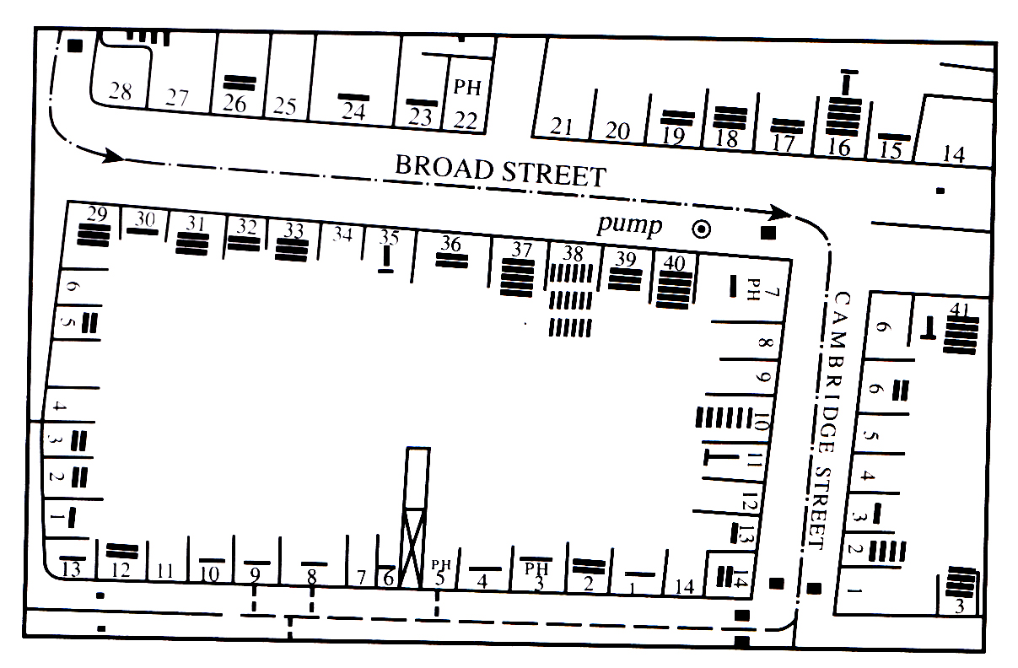
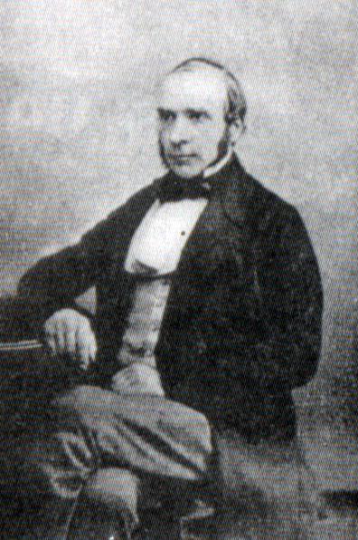
3. Look at the picture, the map and the title and predict the content of the reading passage. Then skim it quickly to see if you are right.

