Slide 1
I have seen amazing things

Slide 2
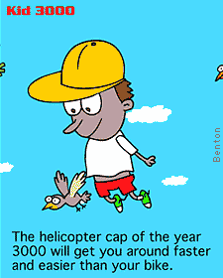

Slide 3
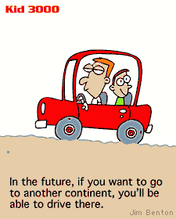

Slide 4
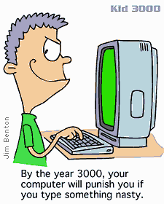

Slide 5
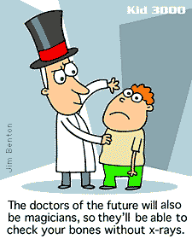

Slide 6

key words
enormous adj. 巨大的；庞大的
imitate vt. 模仿；仿照
up-to-date adj. 现代的，最新的
moveable adj. 可移动的；活动的
citizen n. 公民；居民；市民
thoughtpad n. 思想仪
greedy adj. 贪吃的；贪婪的；贪心的
swallow vt. 吞下；咽下
recycle vt. 回收利用；再利用

Slide 7
instant n. 瞬间；片刻
adj. 立即的；立刻的
limitation n. 限制；局限，极限
efficient adj. 有能力的；效率高的
dustbin n. 垃圾箱
ribbon n. 丝带； 带状物
ecology n. 生态；生态学
dispose vt. 布置；安排
manufacture vt. （用机器）大量生产；
motivation n. 动机

Slide 8
I have seen amazing things
What are the three amazing things the writer see during the visit?
thought pad
A waste machine
Manufacturing robots

Slide 9
Modern inventions of the 31st century
Communication
Waste disposal
Manufacturing
A waste machine
Manufacturing robots
Thought pad
invention
1 disposes of all waste
2 turns them into three grades of useful material
efficient
Environmentally friendly
1no waste
2no pollution
3no environ
mental damage
advantages
Thoughts must be clear
People must live on a space station to monitor the robots
disadvant-ages
None

Slide 10
Summary
It was my first visit to a space station.
Described as an ________ round plate, it spins slowly in space to _______ (模仿) the pull of the earth’s gravity. The _______showed us three stops. In the first stop, I saw the thoughtpad used for _______ messages.
enormous
imitate
guide
sending

Slide 11
Next stop, we are in the environment area. There is a ______ machine which can ________all the waste available. The _____stop showed us how the goods are ____________ by _______.
waste
swallow
third
manufactured
robots

Slide 12
1. My first visit was to a space station considered the most modern in space.
considered 过去分词作后置定语, 表被动
consider doing sth. 考虑去做某事
be considered to be 被认为是 ……
1) I am considering____________ (出国).
2) He _________________________
_____________(被认为是最伟大的艺术家)
in the world.
going abroad
is considered to be one of the
greatest artists

Slide 13
2. Inside was an exhibition of the most up-to-date inventions of the 31st century.
方位介词、副词放在句首时，句子完全倒装。
老师来了。
Here comes the teacher.
大树下坐着一个老农夫。
Under the big tree was sitting an old farmer.
注意：当主语为代词时，不倒装。
e.g. 他冲出了教室。
Out _________ the classroom.
he rushed

Slide 14
3. Greedy adj.贪婪的
渴望得到权利
Be greedy for power
渴望获得更多知识
Be greedy to have more knowledge
A giant machine, always greedy for more, swallows all the waste available.

Slide 15
补充短语
Be representative of 是……的代表
With efficiency 有效地
Dispose of 处理
Up to date 最新的
Reach a settlement解决问题

Slide 16

I. 根据句意及提示，写出单词的正确形式。
1. This country r______ more than half its waste paper last year.
2. The _______ (货物) will be delivered within ten days.
3. She is German by birth but is now a French c_____.
recycled
goods
citizen

Slide 17
4. He put a grape into his mouth and __________ (吞下) it whole.
5. Brick was used as the main building m_______ for local churches.
6. We can’t promise ________ (立刻的) solutions, but we can promise to listen.
swallowed
material
instant

