Slide 1
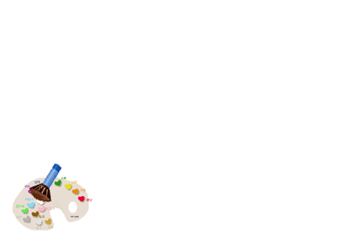

Slide 2
Fill in the blanks using the words with their right forms.
materials
1. Remember to dispose of the used _____________(原料).
2. I was so hungry that I s__________ a cake in an i____________.
3. To protect our e_________, rubbish needs to be r_____________ properly.
4. They were chosen as ________________(代表) to attend the meeting.
5. I hope a _____________（解决方案） can be reached after
the talk.
6. Nowadays, g____________ can be bought on the internet conveniently.
swallowed
instant
ecology
recycled
representatives
settlement
goods

Slide 3
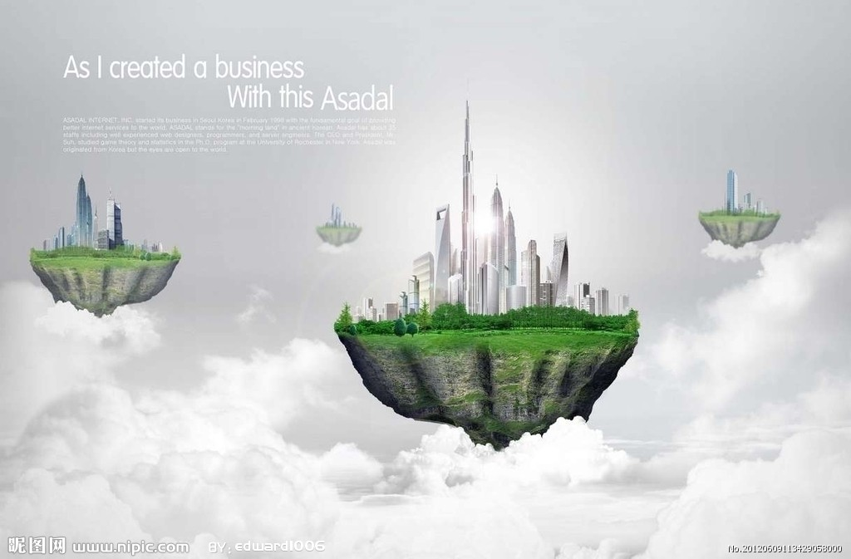
Module 5 Unit 3
Notes:
本资料来自于资源最齐全的２１世纪教育网www.21cnjy.com

Slide 4
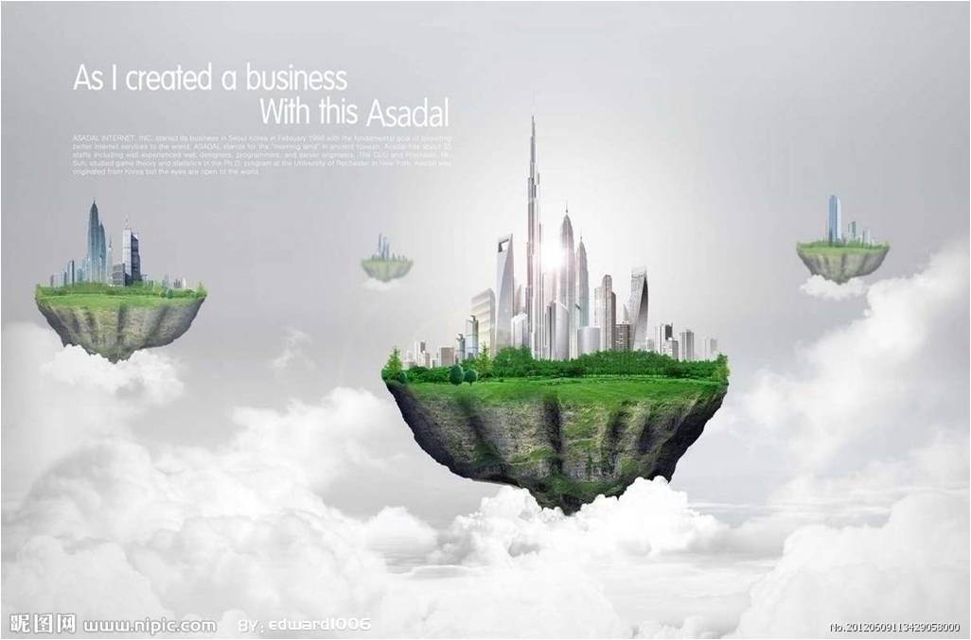
Life in the future
I have seen amazing things

Slide 5
Step1 warming up
When do you think the movie scene take place?
What is different from today?

Slide 6
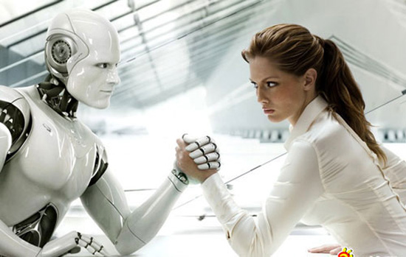
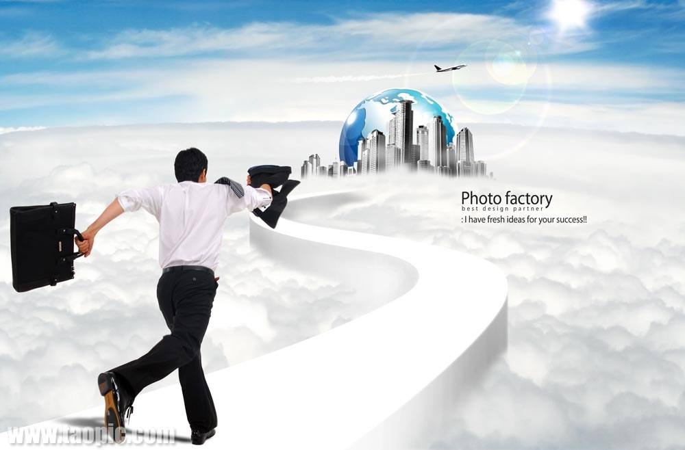
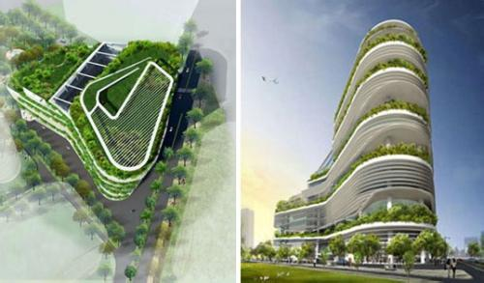
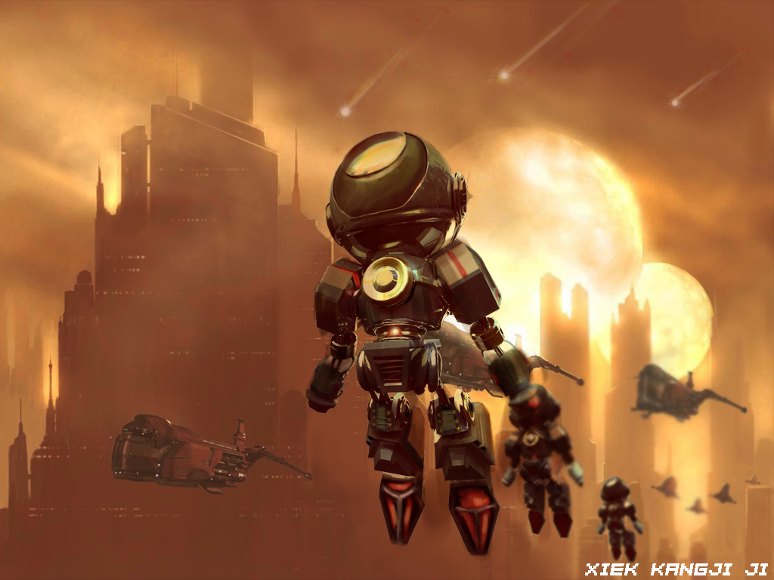
How amazing!!!

Slide 7
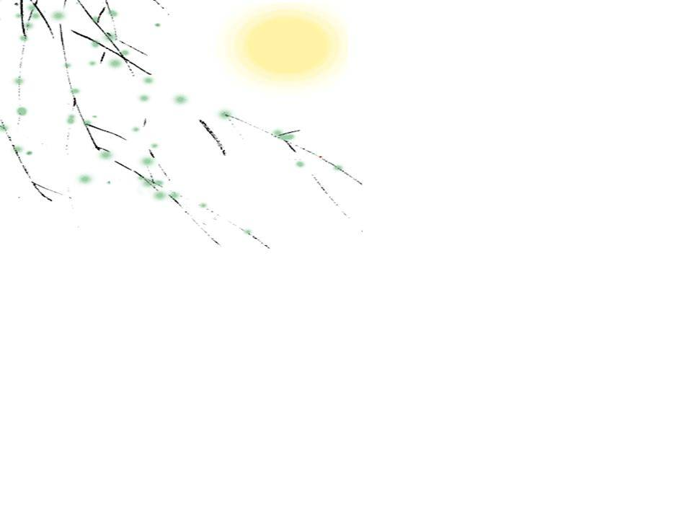
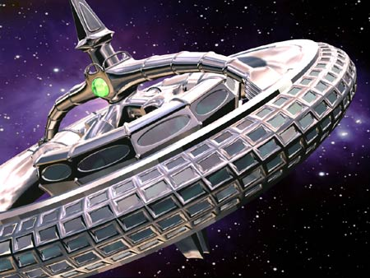

Task1 Fast-Reading
1.What’s the main idea of the text ?
The modern inventions of the 31st century.
B. The development in communication.
C. Manufacturing robots in the 31st century.
D. The history of modern technology
2. How many stops did they visit?
A. One B. Two C. Three D. Four

Slide 8

3. What invention is NOT mentioned in the text?
A. A thoughtpad.
B. A waste machine.
C. An energy bicycle.
D. A manufacturing robot.

Slide 9
4. Which is the most important step when using the “thoughtpad”?
A. Place the metal band over your head.
B. Clear your mind.
C. Press the sending button.
D. Think your message clearly.
5. What attitude do you think the writer has towards future?
A. Positive B. Pessimistic C. Critical D. Unclear

Slide 10

Task 2 Detailed reading
The advantages and disadvantages of the three amazing things?
A thoughtpad. (思想仪)
A waste machine. (垃圾分解器)
A manufacturing robots (批量生产机器人)

Slide 11
para.2 | thoughtpad
advantages | 1. 2.
disadvantage | the ____must think his or her message _______, or an ________ message may be _____
quick & efficient
environmentally friendly
user
clearly
unclear
5分
sent

Slide 12
para.4 | _______________
advantages | 1. __________ all waste 2. turns them into several grades of ______________ 3. _________ is wasted 4. everything is _______
disadvantage | None
a waste machine
disposes of
useful material
nothing
recycled

Slide 13
para.6 | manufacturing robots
advantages | 1.no_____________ 2. no_____________ 3. no______________________
disadvantage | People must live _______________________ to _____________ the robots.
waste
pollution
environmental damage
and work in space settlements
monitor

Slide 14
Post reading: Finish the summary. (语法填空)
I visited the space station __________ (consider) the most modern in space. It has ______exhibition of the most up-to-date inventions of the 31st century. The first invention that the guide showed us was a thoughtpad, ________ can send messages _________(instant). The second invention is a waste machine which is used __________(swallow) waste. The last invention that the guide introduced to us is a manufacturing robot. _____ performs tasks in space without pollution. ___________, the companies have to train their _____________(represent) to live and work in space settlements. After ________(see) the amazing things, my motivation increased ____________ I thought of the wonderful future.
considered
an
which
instantly
to swallow
It
However
Representatives
seeing
as/when

Slide 15
Discussion
What other problems do you think will be solved in the future?
Thoughtpad
A waste machine
Manufacturing robots

Slide 16
The problems we are facing today:
Housing
Population
Pollution
Global warming
Traffic
Hunger
Education
Food safety
…

Slide 17
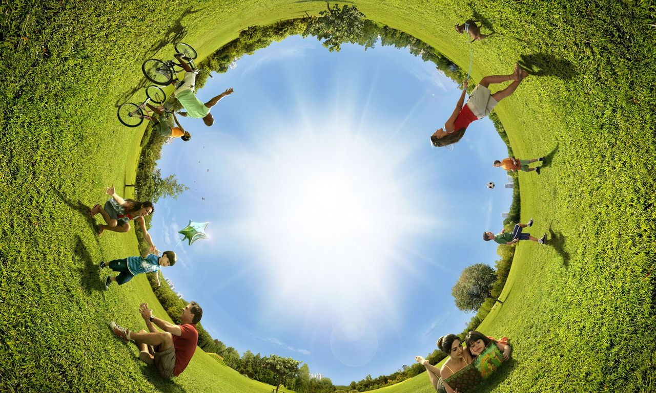

What amazing things can you create to solve the problems?

Slide 18

1.choose one amazing thing as the title
2.the content should include its advantages and disadvantages
3.think out a slogan
Discuss and make a poster

Slide 19
Your name _____
Assessment
 | Excellent （优秀） | Good （良好） | Average （一般） | Need Improvement (有待提高)
Answer questions
Contribute ideas
Cooperation
Enjoy discussion

Slide 20
Where there is imagination,
there is motivation.
Wish you good luck
and a bright future!

Slide 21
Homework
1.Practice reading the passage.
2.In groups, explain important language points.

Slide 22


Thanks for your attention!

