Slide 1
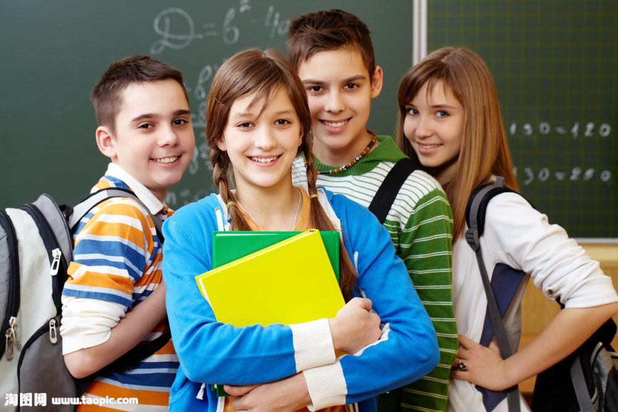
Unit 2 Daily life
Grammar

Slide 2
目录
Lead-in
1
While-Learning
2
Post-Learning
3
Review
4

Slide 3
Part I Lead-in

Slide 4
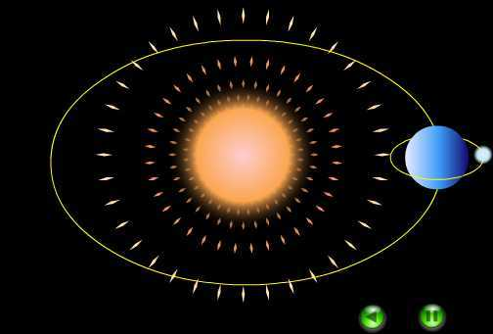
观察这些句子
1. She keeps a diary every day.
2. I enjoy learning about different places in the world.
3. The Sun rises in the east.
4. The Earth goes around the Sun.

Slide 5
Part II While-Learning

Slide 6

Grammar A
The Simple Present Tense

Slide 7
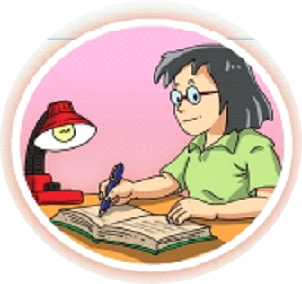
A The simple present tense
We use the simple present tense to talk about regular
actions.
My mother gets up at 6 o'clock every day and has breakfast at 6:30 a.m.

Slide 8

1. Statements:
I
You
We
They
He
She
It
plays the guitar.
does not play the guitar.
goes to the park.
does not go to the park.
play the guitar.
do not play the
guitar.
Pay attention to the third-person singular form of the verbs.

Slide 9


2. Questions and answers:
I
you
we
they
play the
guitar?
he
she
it
play the guitar?
go to the park?
Do
Does
I
you
we
they
Yes,
No,
do.
don't.
Yes,
No,
does.
doesn't.
he
she
it

Slide 10
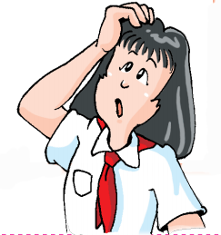
Work out the rule
In statements, we add -s or ________ to verbs after he/she/it.
In questions, we use ________ before I/you/we/they and ________
before he/she/it.
-es
do
does

Slide 11
Summary
The Simple Present Tense
一般现在时
1. 表示目前阶段经常发生的动作或存在的状态。
2. 表示客观真理。
3. 时间标志：every...always, usually, often, sometimes, seldom, never, 次数。

Slide 12
1.be动词的一般现在时
肯定句：主语 + be + 其他
否定句：主语 + be + not + 其他
一般疑问句：be + 主语 + 其它？
肯定回答：Yes，主语+be 否定回答：No，主语+be+not
1. 玛丽是一个学生。
Mary is a student.
2. 玛丽不是一个学生。
Mary isn't a student.
3. 玛丽是一个学生吗？
Is Mary a student?
4. 是的，她是。 5. 不， 她不是。
Yes, she is. No, she isn't.
注意：
主语是单数时，用is，主语是复数时，用are，主语是I，用am。

Slide 13
2.实义动词的一般现在时
肯定句：主语＋实义动词＋其他
否定句：主语 + 助动词（do/does）+not +实义动词原形 + 其他
一般疑问句：助动词 + 主语 + 动词原形 + 其它？
肯定回答：Yes, 主语+ do/does.否定回答：No, 主语+do not/does not.
1. 玛丽每天阅读。
Mary reads books every day.
2. 玛丽不是每天阅读。
Mary doesn't read books every day.
3. 玛丽每天阅读吗？
Does Mary read books every day?
4. 是的，她是。 5. 不， 她不是。
Yes, she does. No, she doesn't.
注意：
当主语为第三人称单数时，实义动词要加s或者es。
助动词后用动词原形。

Slide 14
Exercise
Change the following verbs into their third-person singular forms.
listen |  | talk
listens
talks
We add -s after most verbs.
passes
pushes
pass |  | push |  | watch
mix |  | go |  | do
watches
mixes
goes
does
We usually add -es after verbs ending in -s, -x, -o, -ch, -sh.
fly |  | study
flies
studies
We usually change the -y into i and add -es to the words ending in a consonant and -y.

Slide 15
给出下列动词的第三人称单数
talk_____ forget_____ hope_____
stop_____ perform_____ play_____
say_____ buy_____ worry_____
fly_____ study_____ like_____
make_____ take_____ love_____
recite_____ become_____ come_____
drive_____ shine_____ leave_____
wake_____ ride_____ write_____
talks
forgets
hopes
stops
performs
plays
says
buys
worries
flies
studies
likes
makes
takes
loves
recites
becomes
comes
drives
shines
leaves
wakes
rides
writes

Slide 16
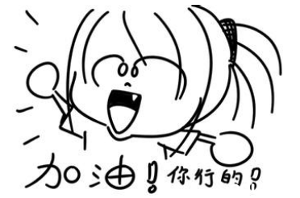
肯定句 一般疑问句
be动词的一般现在时: 一调二改三问号
一调：即把句中的be动词调到主语前；
二改：改换主语称谓，即将句中的主语I my mine we our ours等第一人称分别改为相应的第二人称you your yours等；
三问号：句末的句号改为问号 。
肯定句：
Mary is good at singing.
一般疑问句：
Is Mary good at singing?
肯定句：
I am a good student.
一般疑问句：
Are you a good student？

Slide 17
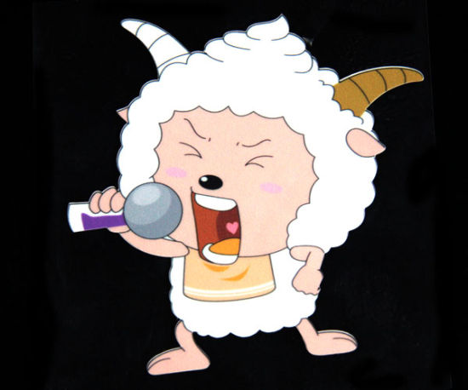
肯定句 一般疑问句
实义动词的一般现在时: 一加二改三问号
一加：即在句首加助动词Do或Does；
二改：1. 把谓语动词改为原形；2. 改换主语称谓；
三问号：句末的句号改为问号。
肯定句：
Mary likes singing.
一般疑问句：
Does Mary like singing?
肯定句：
I go to school by bus.
一般疑问句：
Do you go to school by bus？

Slide 18
按照要求改写句子
1. Daniel watches TV every evening.(改为否定句)
2. I do my homework every day.(改为一般疑问句，并作否定回答)
3. She likes milk.(改为一般疑问句，并作肯定回答)
Daniel doesn't watch TV every evening.
Do you do your homework every day?
No, I don't.
Does she like milk?
Yes, she does.

Slide 19
按照要求改写句子
4. Amy likes playing computer games.(改为一般疑问句，并作否定回答)
5. She is always a good student.(改为一般疑问句)
6. He speaks English very well.(改为否定句)
Does Amy like playing computer games?
No, she doesn't.
Is she always a good student?
He doesn't speak English very well.

Slide 20
用括号内动词的适当形式填空
1. He often ________(have) dinner at home.
2. Daniel and Tommy _______(be) in Class One.
3. We _____________(not watch) TV on Monday.
4. Nick ___________(not go) to the zoo on Sunday.
5. _____ they _______(like) the World Cup?
6. What _______they often _______(do) on Saturdays?
has
are
don't watch
doesn't go
Do
like
do
do

Slide 21
用括号内动词的适当形式填空
7. _______ your parents _______(read) newspapers every day?
8. The girl _________(teach) us English on Sundays.
9. She and I ________(take) a walk together every evening.
10. There ________(be) some water in the bottle.
11. Mike _______(like) cooking.
12. They _______(have) the same hobby.
Do
read
teaches
take
is
likes
have

Slide 22
A1 Use the information in the article on Page 17 to complete the conversation below.
go
S1: (1)_______ Sam ______(go) to school by bus?
S2: No, he (2)________. He (3)______(go) to
school on foot.
S1: (4)______ Sam and his friends _____(play)
games during the morning break?
S2: Yes, they (5)______.
S1: What (6)______ Sam _____(do) after school?
S2: He (7)_______(take) part in the school band
practice.
Does
doesn't
goes
Do
play
do
does
do
takes

Slide 23
改错
1. Is your brother speak English?
2. Does he likes going fishing?
3. He like playing games after class.
4. Mr. Wu teachs us English.
5. She don't do her homework on Sundays.
Does
like
likes
teaches
doesn't

Slide 24
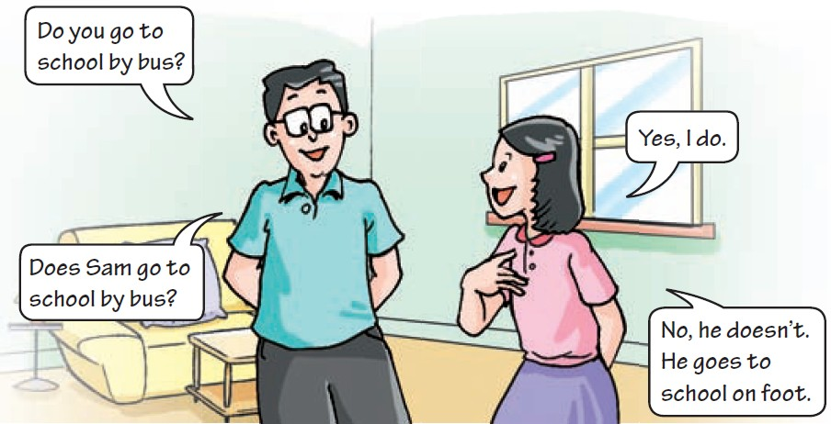
A2 In pairs, talk about the things in the box.
go to school by bus
study Chinese, Maths and English in the morning
take part in after-school activities

Slide 25
S1: Do you study Chinese, Maths and English in the
morning?
S2: Yes, I do./No, I don't.
S1: Does Sam study Chinese, Maths and English in the
morning?
S2: Yes, he does.
S1: Do you take part in after-school activities?
S2: Yes, I do./No, I don't.
S1: Does Sam take part in after-school activities?
S2: Yes, he does.

Slide 26
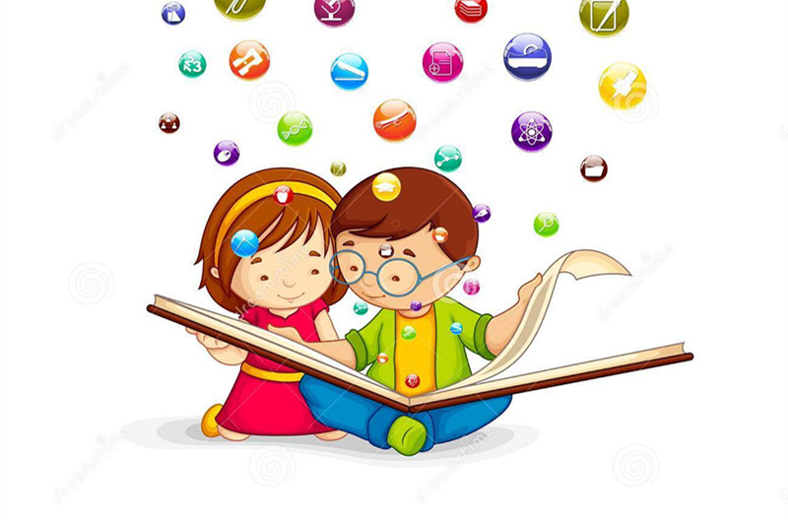
Grammar B
Adverbs and adverbial phrases of frequency

Slide 27
B Adverbs and adverbial phrases of frequency
always | 100%
usually | 80-90%
often | 60-70%
sometimes | 50%
seldom | 10-20%
never | 0%
总是
通常
经常
有时
不常；很少
从不

Slide 28
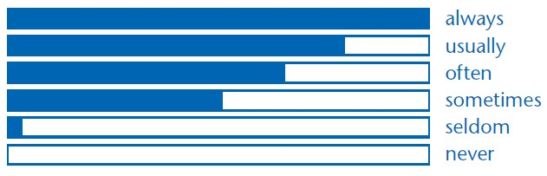
We use adverbs and adverbial phrases of frequency to talk about how often things happen.
I always/ usually/ often/sometimes/
seldom/ never go to school on foot.

Slide 29
Adverbial phrases of frequency
I go to the English Club | every day. twice a week.
On Saturdays, Once a month, | I go to the park.
Work out the rule:
1. Adverbs of frequency come (before/after) the main verbs.
2. Adverbial phrases of frequency often come (in the middle/at the end) of a sentence. Sometimes they come at the beginning.

Slide 30
根据提示填空，用 once 和 twice 分别代表“一次”和“两次”。两次以上可用“基数词+times”来表示。
1. Mary tidies her room __________ a week. (Everyday)
2. Bill tidies his room ________a week. (except Sunday)
3. Lily tidies her room _________ a week. (Monday, Wednesday, Friday)
4. Sam tidies his room ______ a week. (Saturday, Sunday)
5. Mike tidies his room ______ a week. (Sunday)
seven times
six times
three times
twice
once

Slide 31
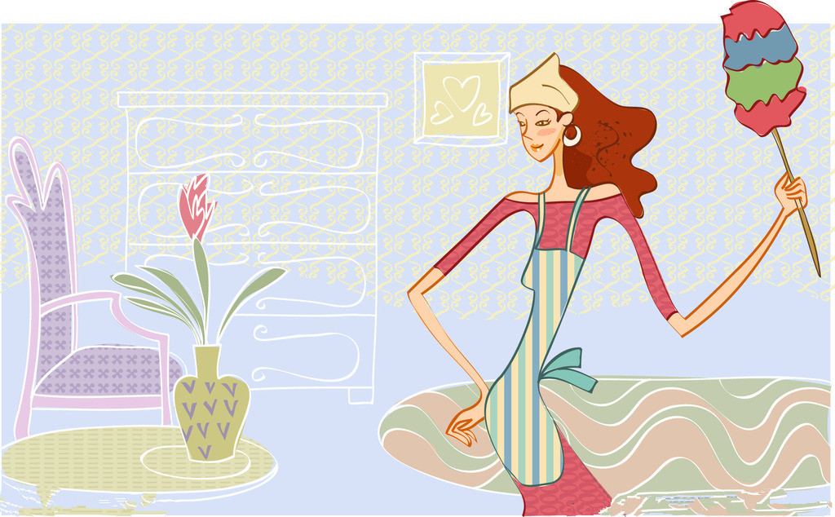
根据上述句子进行对话。
S1: Does Mary tidy her room on Mondays?
S2: Yes, she does.
S1: Does Sam tidy his room on Mondays?
S2: No, he doesn't. He tidies it on Saturdays and
Sundays.

Slide 32
Part III Post-Learning

Slide 33
My chat room
Mandy: How often do you watch television?
Sam: (1) __________________________
(every night)
Mandy: How often do you eat out?
Sam: (2) _______________________
(sometimes)
Mandy: How often do you play table tennis with
your father?
Sam: (3)_______________________________
(once a week)
I watch television every night.
I sometimes eat out.
I play table tennis with my father once a week.

Slide 34
Mandy: How often do you win?
Sam: (4)______________________(seldom)
Mandy: How often do you visit other cities?
Sam: (5) ______________________________
(four times a year)
Mandy: How often do you play computer games?
Sam: (6)_______________________(never)
I seldom win.
I visit other cities four times a year.
I never play computer games.

Slide 35
Part IV Review

Slide 36
一. 根据中文意思完成句子。
1. 山姆每晚睡觉前都刷牙。
Sam _____ _____ _____ before going to bed every night.
2. 我的父母经常步行去上班。
My parents often _____ to work _____ _____.
3. 杰克通常在周末做什么？
What _____ Jack usually _____ at weekends?
brushes his teeth
go on foot
does do

Slide 37
二. 根据题目要求，完成下列句子。
Sun Yang swims very well.
(改为一般疑问句)
_____ Sun Yang _____ very well?
2. The twins clean their bedroom on Sundays.
(改为否定句)
The twins _____ _____ their bedroom on Sundays.
3. My father usually reads newspapers in the
morning. (就划线部分提问)
_____ _____ _____ father _____ _____ newspapers?
Does swim
don't clean
When does your usually read

Slide 38
三. 选择最佳答案填空。
( )1. --Does Anna play baseball on Sundays?
--No, she ____.
A. is never B. never is
C. never does D. does never
( )2. Alan ____ to work by bike.
A. usually go B. go usually
C. usually goes D. goes usually
( )3. Bobby always gets up early, but Mary and Amy____.
A. doesn't always B. always doesn't
C. don't always D. always don't
C
C
C

Slide 39
( )4. Mr Zhang is ____ very busy with his business,
so he ____ has time to go travelling.
A. always, seldom B. always, sometimes
C. usually, often D. sometimes, never
( )5. We usually have dinner at home in the evening,
but we ____ eat out.
A. sometimes B. seldom
C. never D. always
A
A

Slide 40
四. 根据中文意思完成句子。
1. 我叔叔从不抽烟。
My uncle ______ smokes.
2. 我很少在早上大声读英语，但我妹妹总是在早上这样做。
I ______ read English loudly in the morning, but my sister ______ ______ so.
3. 刘先生通常在周末去爬山。
Mr Liu ______ ______ climbing ______ ______.
never
seldom
always does
usually goes at weekends

Slide 41
Thank you!

