Slide 1

Unit 4 Seasons
Grammar

Slide 2
目录
Lead-in
1
While-Learning
2
Post-Learning
3
Review
4

Slide 3
Part I Lead-in

Slide 4
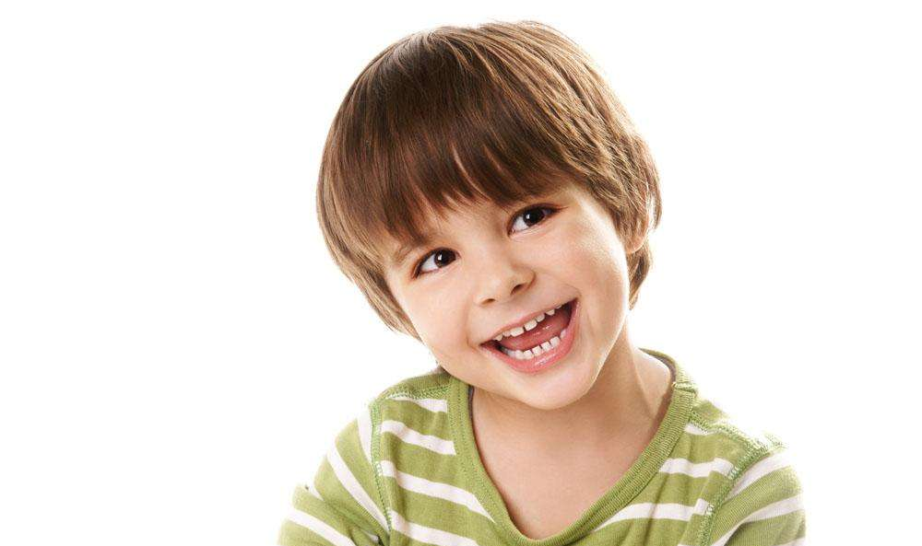

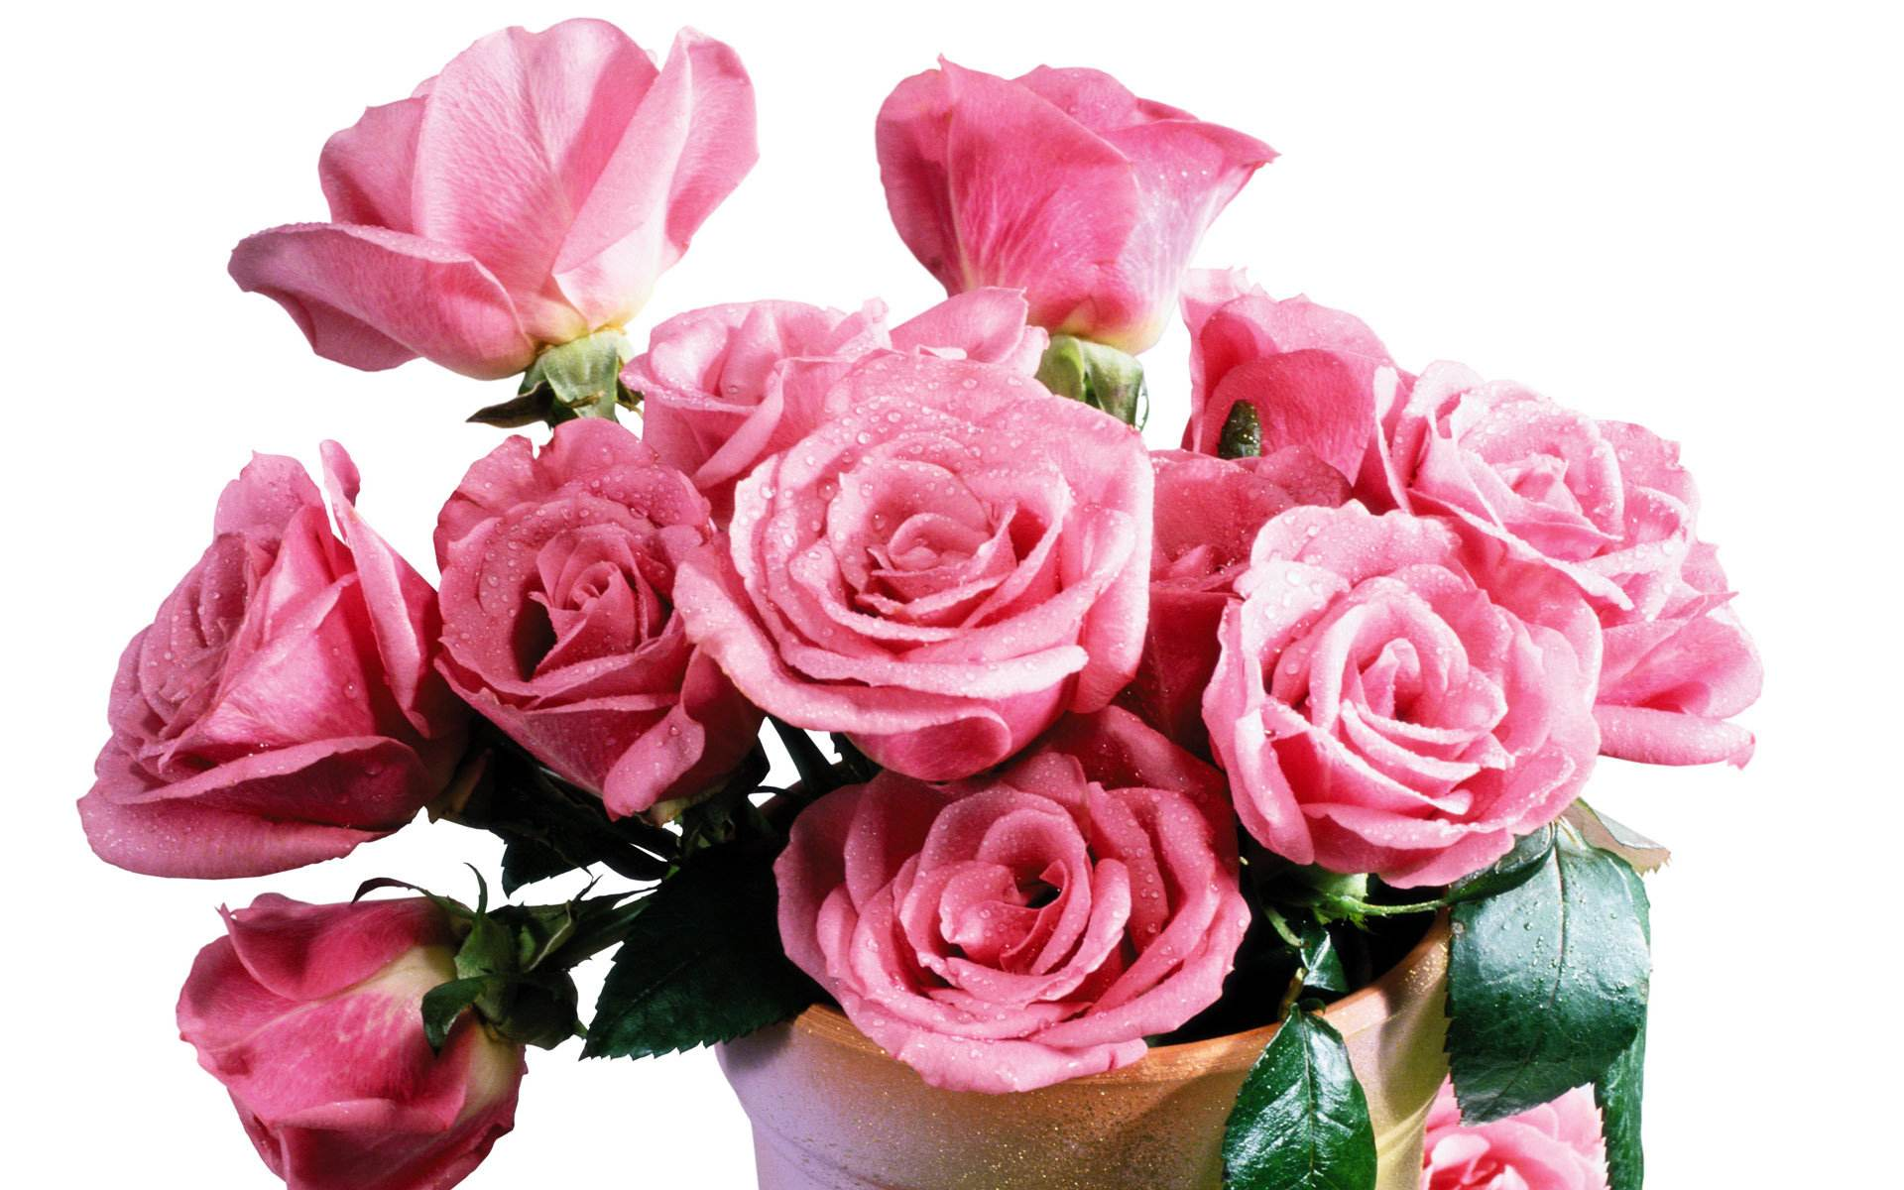
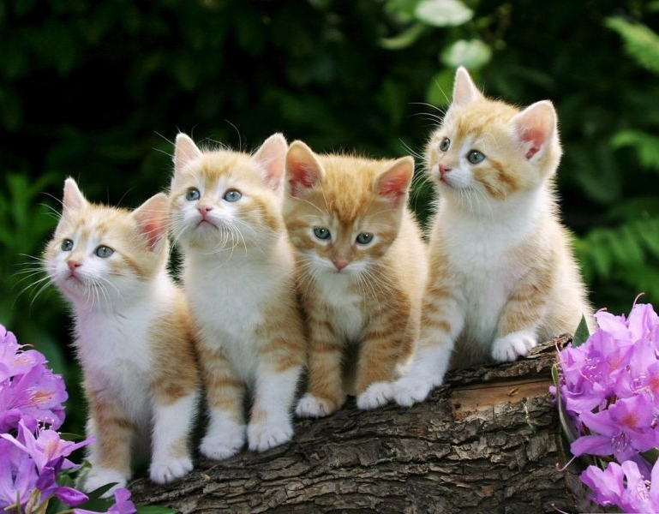
What are these?
a happy boy
a blue hat
some beautiful flowers
some cute cats

Slide 5
Part II While-Learning

Slide 6

Grammar A
Using adjectives before nouns

Slide 7
A Using adjectives before nouns
We use an adjective before a noun to describe a thing or a person.
Adj. Noun
bright star
lovely children
close relative
old umbrella
funny snowman
warm coat
heavy rain
windy day
a bright star
lovely children
a close relative
an old umbrella
a funny snowman
a warm coat
heavy rain
a windy day
Notes:
Find out the N. and Adj.

Slide 8
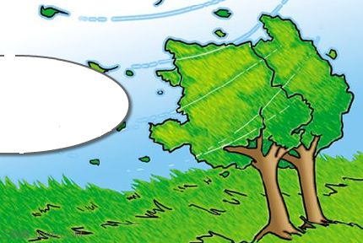

What can you see in the picture?
What's the weather like?
Blowing wind.
Windy.
Some clouds.
Cloudy.

Slide 9
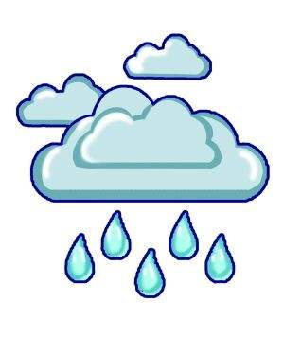
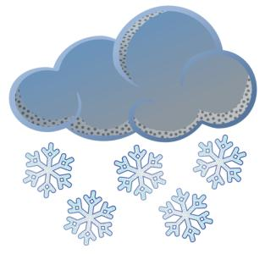
What can you see in the picture?
What's the weather like?
Some rain drops.
Rainy.
Snow.
Snowy.

Slide 10


What can you see in the picture?
What's the weather like?
The Sun.
Sunny.
Fog.
Foggy.

Slide 11
Things to remember
Sometimes we form an adjective like this:
wind (n.) windy (adj.)
rain (n.) rainy (adj.)
But note the spelling change with:
sun (n.) sunny (adj.)
fog (n.) foggy (adj.)
Work out the rule
Sometimes we can turn a ______ into an
________ by adding -y to the word.
noun
adjective

Slide 12
Summary
Using adjectives before nouns
形容词修饰名词
形容词是修饰名词或代词，说明事物或人的性质或特征的词。
形容词放在名词前面，修饰名词，做定语，译成“…的(人或事)”

Slide 13
形容词的构成
名词后+y变形容词，若该名词为重读闭音节则双写后面的辅音字母再加y。
snow — snowy wind — windy
rain — rainy cloud — cloudy
fog — foggy sun — sunny

Slide 14

Look the pictures. Complete the sentences with the words from the box.
rainy snowy sunny windy
1.The Sun is shining brightly. It is a ______ day.
sunny

Slide 15

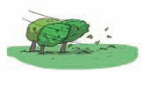
2.It is raining heavily.
It is a ________day.
rainy
3.The wind is blowing strongly. It is a ______ day.
windy

Slide 16

4.It is snowing heavily.
It is a ______ day.
snowy

Slide 17
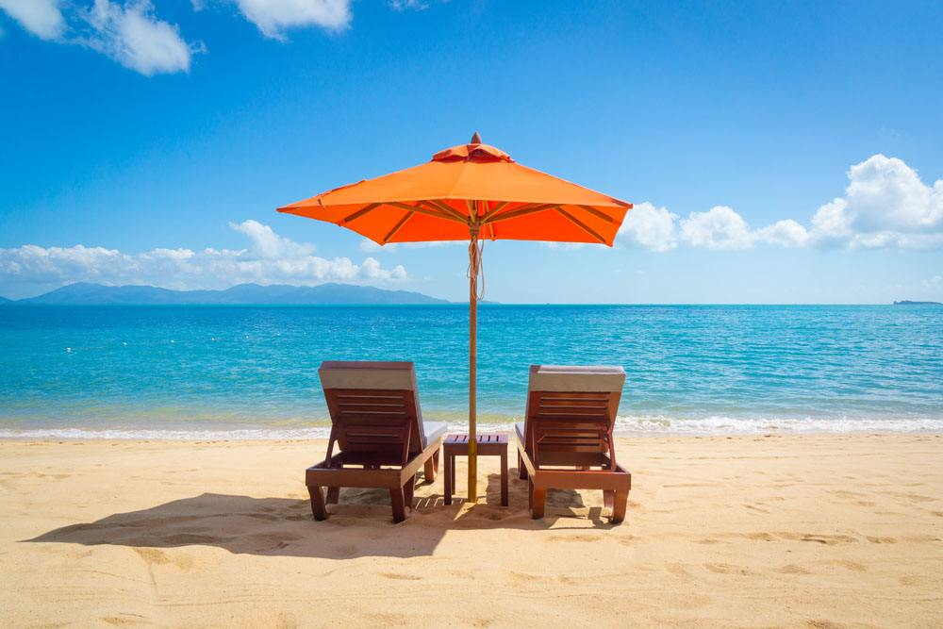
Complete the senences with the adjectives forms of the words in brackets.
1. This plant needs a warm and ______ (sun)place.
2. It is a ______ (snow) winter this year.
3 Jimmy told us about his ______ (interest)trip to Hong Kong
4. Jenny often wears a ______ (fun)hat.
5. The Greens spent ______ (love)day by the sea.
sunny
snowy
interesting
funny
lovely

Slide 18
Can you find our the Adj. (Adjective,形容词)?
1I have short, black hair. I like flying kites in my free time.
I like hot weather, but we often have cold day in winter.
Sometimes we also have snowy weather in winter.
It also rains. But we don't have heavy rain.
We wear thick clothes in winter. They are warm clothes.
Here we put an adj.___________________
before a noun
形容词放在名词前面，修饰名词，做 定语，
译成“…的(人或事)”

Slide 19

Grammar B
Using adjectives after the verb to be

Slide 20
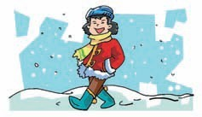
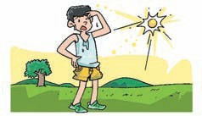
B Using adjectives after the verb to be
We cab also use adjectives like this:
Winter is cold. Sometimes it is snowy. Winter clothes are warm.
I'm hot. It will still be
sunny tomorrow.

Slide 21
Work out the rule
We can use adjectives (before / after) the verb
_________
(e.g. am, is and are).
to be
结构：be (am / is / are) + adj.

Slide 22
Summary
Using adjectives after the verb to be
形容词放在be动词后面，做表语，表示人或事性质。

Slide 23




In pairs, ask and answer questions about the weather. Follow the example.
cloudy cold hot snowy sunny warm windy
S1: What's the weather like in Beijing in July?
S2: It's hot and sunny
Beijing
July
Shanghai
April
Hangzhou
January
Harbin
February

Slide 24
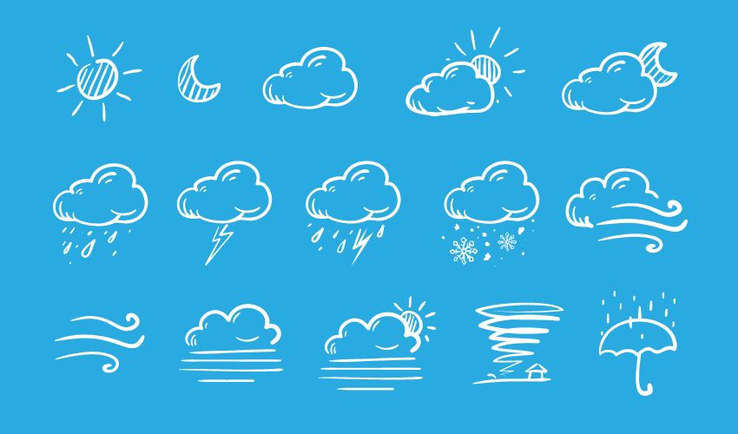
S1: What's the weather like in Shanghai in April?
S2: It's warm and windy.
S1: What's the weather like in Hangzhou in
January?
S2: It's cold and cloudy.
S1: What's the weather like in Harbin in February?
S2: It's cold and snowy.

Slide 25
Can you find our the Adj. (Adjective,形容词)?
I'm tall and thin. The teachers are all friendly.
It is warm in spring. The weather is hot in summer. Autumn is cool and dry. Winter is cold and snowy.
It is interesting to make snowmen.
Here we put an Adj.___________________
after be (am, is, are)
形容词放在be动词后面，做表语，表示人或事性质，

Slide 26
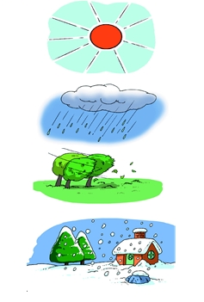
Using adjectives after the verb to be
rainy snowy sunny windy
The weather is ____.
sunny
The weather is ____.
rainy
windy
The weather is_____.
snowy
The weather is______

Slide 27
Grammar C
Adjectives with It is and to + a verb

Slide 28
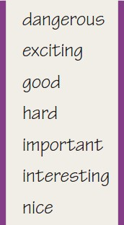
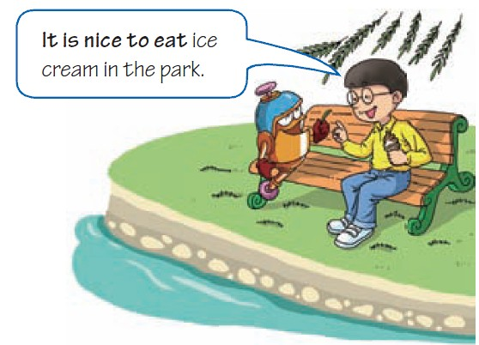
C Adjectives with It is and to + a verb
We can use the adjectives below with It is and to followed by a verb.
What does Hi like to do in the park?
He likes to eat ice cream in the park.
Why do you think he likes to do that?
Because he says it is nice to eat ice cream in the park.

Slide 29
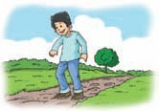
Here are some pictures of different seasons. Write a caption for each picture by using the words below it.
hard / walk /
on muddy roads /
spring
It is hard to walk on muddy roads in spring.

Slide 30
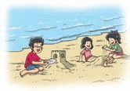
exciting / play /
on the beach /
summer
It is exciting to play on the beach in summer.

Slide 31
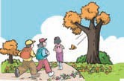
nice / take a trip /
autumn
It is nice to take a trip in autumn.

Slide 32
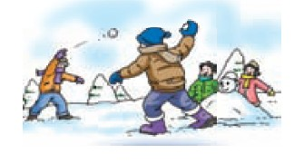
interesting /
play in the snow /
winter
It is interesting to play in the snow in winter.

Slide 33
Part III Post-Learning

Slide 34
What do you like about the four seasons? Cpmplete the first four sentences. Then add your own sentences to the list.
Feeling about the four seasons.
1. It is ______ to see plants start to grow in spring.
2. It is ______ to go to the beach in summer.
3. _________ to look at the colours of the leaves in autumn.
4. _________ to put on thick clothes in winter.
_______________________________________________________________________________________________________________________________________________

Slide 35
Part IV Review

Slide 36
一. 用括号内所给单词的正确形式填空。
1. The accident happened on a ________(snow)
cold night.
2. Mr. Chan is ________ (friend) to us.
3. We should give more help to the ________(oldly).
4. It's ________ (danger) to play basketball
on the road.
5. It is ________ (easily) to understand the story.
snowy
friendly
old
dangerous
easy

Slide 37
二. 选择最佳答案填空。
( )1. I love to go around the garden in spring
because the flowers smell so ______.
A. well B. nice
C. wonderfully D. nicely
( )2. There is ______ in the film. It is boring.
A. interesting nothing B. interesting anything
C. anything interesting D. nothing interesting
( )3. He is ______ to carry the heavy box.
A. strongly enough B. enough strong
C. strong enough D. enough strongly
B
D
C

Slide 38
A
( )4. ______ is ______ things like that. You may hurt yourself.
A. It, dangerous to cut
B. That, dangerously to cut
C. It, dangerous cutting
D. This, dangerously cutting
( )5. My father is busy today. He has to do ______.
A. anything important
B. something important
C. important anything
D. important something
( )6. It's very nice ______Mary to help me with my
Maths.
A. in B. to C. of D. for
B
C

Slide 39
三. 根据中文意思完成句子。
1. 难道你们不知道横过这条繁忙的马路是危险的吗？
Don't you know that ____ ____ dangerous ____ ____ across the busy road?
2. 多读书是有益的。
It ____ ____ ____ ____ more books.
3. 听到这个消息时，汤姆感到伤心。
Tom ____ ____ when he heard the news.
4. 每天做运动是很重要的。
It ____ ____ ____ ____ exercise every day.
5. 这个雪糕真美味。
The ice cream ____ so ____ .
it is to go
is good to read
felt sad
is important to take/do
tastes good/delicious

Slide 40
Thank you!

