Slide 1
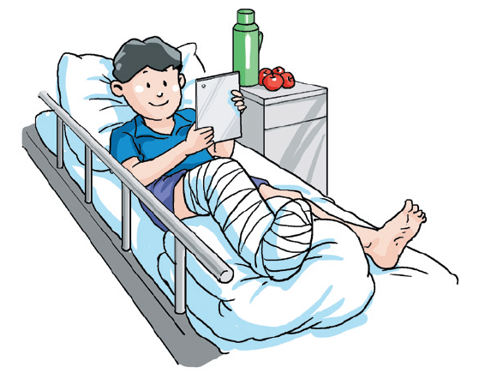
Unit 6 Caring for your health
Writing

Slide 2
目录
Review
1
Pre-Learning
2
While-Learning
3
Post-Learning
4

Slide 3
Part I Review

Slide 4

信件常用单词
reply answer question
however difficult important
survey
信件常用短语
thanks for 谢谢……
write to 给……写信
best wishes 万事如意
good luck 祝你好运
as for me 对我来说
yours sincerely 你忠诚的
in my opinion 在我看来
look forward to 期望
what’s more 而且

Slide 5
信件常用句型
Let's keep in touch.
I'm writing to you to …
Thank you for your letter.
I'm looking forward to your reply.
I am sorry for not writing to you sooner.
It's a long time since I saw you last time.
Please accept my sincere congratulation on …
Send my love to … /Please give my regard to ...

Slide 6
Part II Pre-Learning

Slide 7
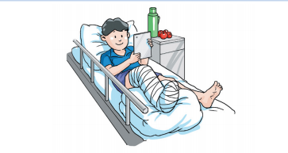
Brainstorm
Discuss the following question in groups of four.
What will you do if one of your friends or classmates is sick?

Slide 8
Part III While-Learning

Slide 9
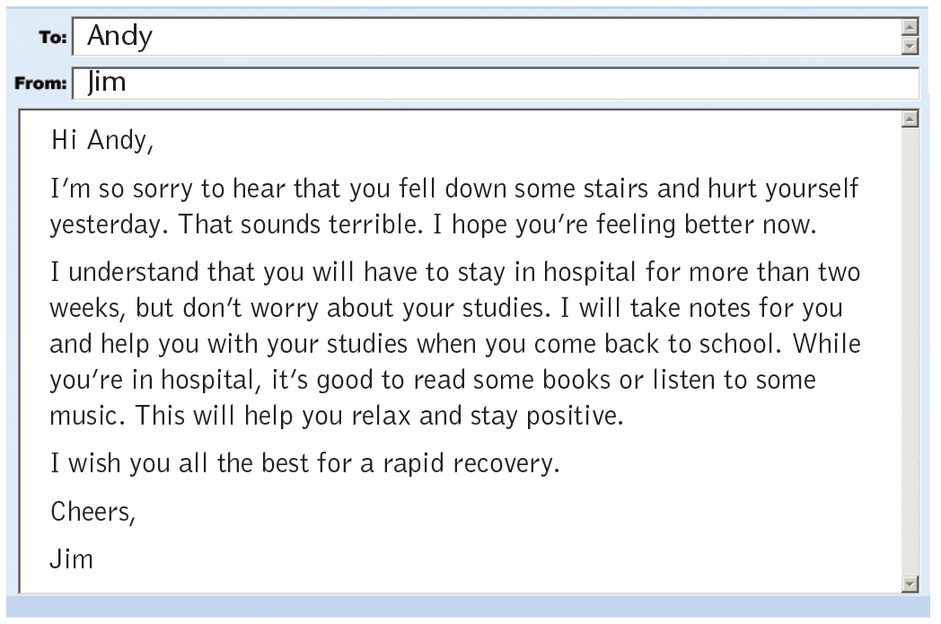
Writing
An email to a sick classmate
Read the email in A and answer the questions below.

Slide 10
Read the email in A and answer the questions below.
Who is this email from?
Who is this email to?
What happened to Andy?
What will Jim do to help Andy?
What does Jim advise Andy to do?
What is Jim’s wish for Andy?
Jim.
Andy.
He fell down some stairs and hurt himself yesterday.
He will take notes for Andy and help him with his studies when he comes back to school.
He advises Andy to read some books or listen to some music.
He wishes Andy all the best for a rapid recovery.

Slide 11
Read the email in A and tick what is talked about in it.
What does Jim write about in the email?
（ ）How Jim will help Andy with his studies.
（ ）Questions about Andy’s illness.
（ ）Jim’s suggestions to Andy.
（ ）How Jim’s school life is now.
（ ）That Jim cares about Andy.
√
√
√

Slide 12
Discuss the following questions in groups of four.
What else can Jim do to help Andy with his studies?
What other suggestions can Jim give Andy about his illness?

Slide 13
Read and learn how to express concern, suggestions and wishes.
表示关心：I’m sorry to hear that .../I’m so upset to hear that ...
表示建议：It’s good to ...
表示祝愿：I wish you all the best for a rapid recovery./
I hope you’ll get well soon./I hope you will get over it soon.

Slide 14
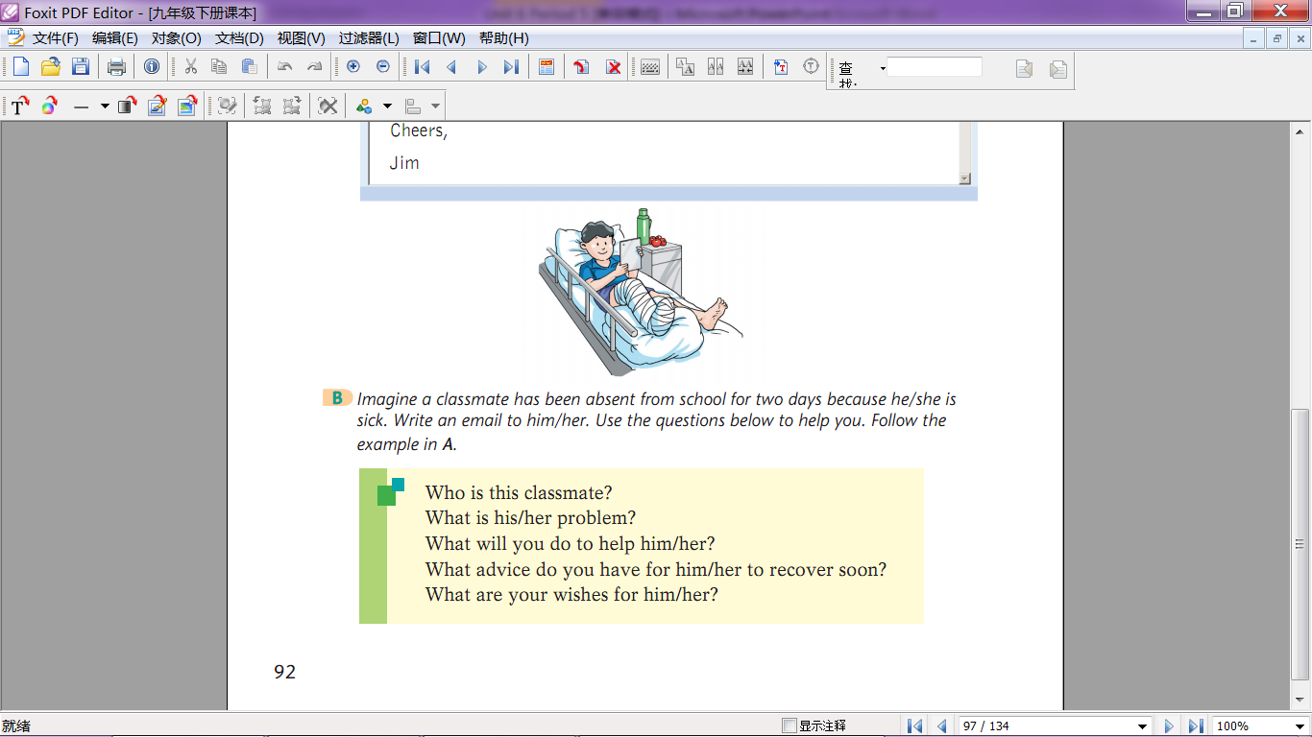
Imagine Mary has been absent from school for two days because she is sick. Write an email to her according to the situation and questions below. Follow the example in A.
Mary is a 15-year-old girl. She is going to take the senior high school entrance examination. But recently, she found that she could not sleep well at night and often felt nervous in the daytime. She once fell asleep in class. Sometimes she felt like crying but no tears came out. The doctor told her to stay at home for several days.

Slide 15
Paragraph 1 | Who are you going to write the email to?
 | What is his/her problem?
 | What do you think of his/her problem?
Paragraph 2 | What is his/her situation now?
 | What will you do to help him/her?
 | What advice do you have for him/her to recover soon?
Paragraph 3 | What are you wishes for him/her?

Slide 16
Part IV Post-Learning

Slide 17
Language Points
I’m so sorry to hear that you fell down some stairs
and hurt yourself yesterday.听到你昨天从几层楼梯上
摔下来并伤到了自己，我很难过。
hurt用作及物动词，意为“使疼痛；弄伤”。
住手。你弄疼我了。
Stop it. You’re hurting me.
hurt用作不及物动词，意为“感到疼痛”。
我背疼。
My back hurts.
hurt用作不可数名词，意为“心灵创伤；委屈”。
她的声音显得很委屈。
There was hurt in her voice.

Slide 18
I wish you all the best for a rapid recovery.
我希望你快速痊愈，一切顺利。
recovery此处用作可数名词，意为“恢复；痊愈”，
后常接介词from。
我父亲手术后已完全康复了。
My father has made a full recovery from the
operation.
手术后安康复得很快。
Ann made a quick recovery from her operation.

Slide 19
Thank you!

