Slide 1
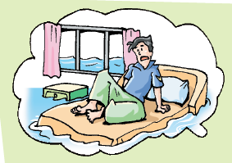
Unit 4 Natural disasters
Grammar

Slide 2
请说出各句中it的作用。
1. It is important to stick with my work.
代替动词不定式短语(to stick with my work)
2. It seems that nobody is paying attention to the flood. 代替that从句
3. It is winter now.
表示季节
4. It is a ten-minute walk from my home to the school.
表示距离
5. It is hot in summer and cold in winter in that city.
表示天气
6. It was nine o’clock in the morning.
表示时间

Slide 3
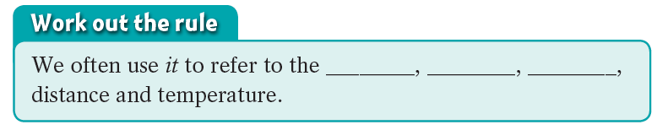
It’s nine o’clock in the morning. My bedroom floor is a pool of water.
time
season
weather

Slide 4
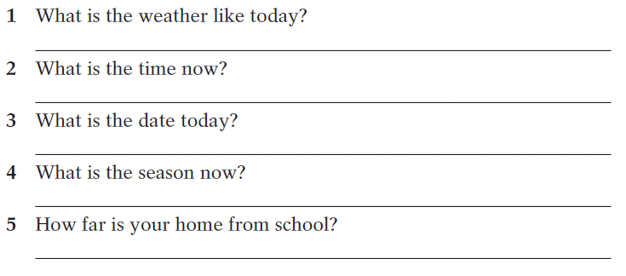
A Answer these questions using it as the subject.
It’s cool and comfortable.
It’s ten o’clock in the morning.
It’s 21 March, 2018.
It’s spring now.
(walk for 20 minutes)
It is about 20 minutes’ walk.
It is a 20-minute walk .

Slide 5
We can also use it as the empty subject of a sentence to
replace a to-infinitive.
It’s important to stick with it.

Slide 6
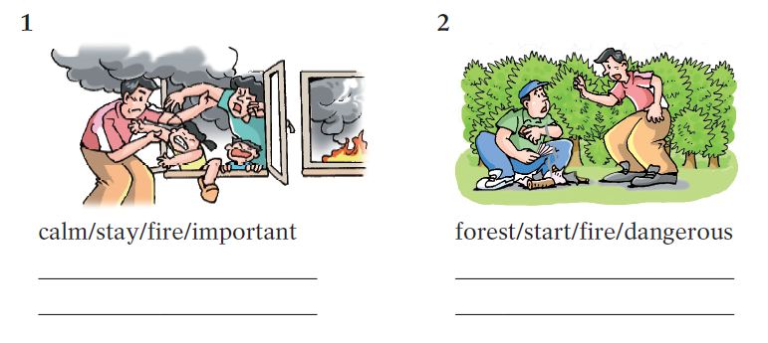
C Write a sentence using it and a to-infinitive under each picture below.
It is important to stay calm when there is a fire.
It is dangerous to start a fire in the forest.

Slide 7
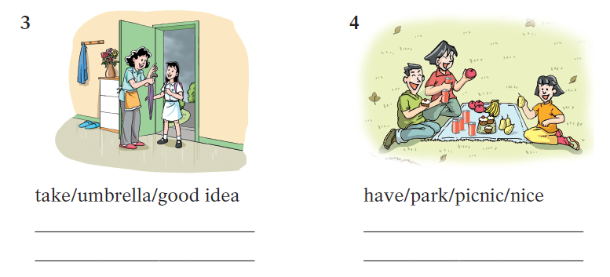
C Write a sentence using it and a to-infinitive under each picture below.
It is a good idea to take an umbrella.
It is nice to have a picnic in the park.

Slide 8
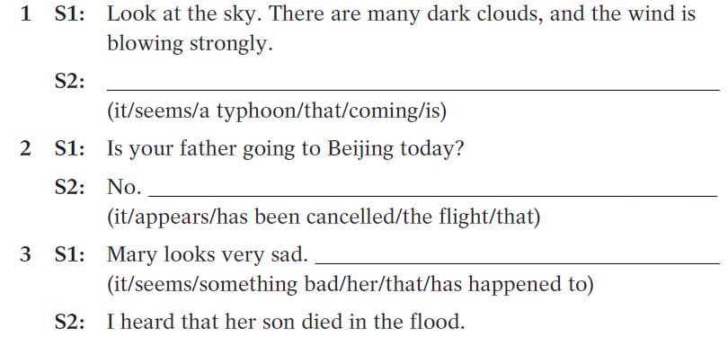
We can also use it as the empty subject in the following sentence pattern: It seems/appears that …
It seems that a typhoon is coming.
It appears that the flight has been cancelled.
It seems that something bad has happened to her.

Slide 9
一、用it及be的适当形式填空。
1. __________ very expensive to travel by plane.
2. __________ easier to keep the environment clean if we don’t throw so much rubbish away.
3. He warned us that __________ dangerous to go out alone at night.
4. __________ a good idea to eat everything slowly?
5. __________ said that Jim has gone to America for further study.
It is
It will be
it was
Is it
It is

Slide 10
二、选择最佳答案填空。
1. It is generally considered unwise to give a child ____.
he or she wants.
A. however B. whatever
C. whichever D. whenever
2. In fact ____ is a hard job for the police to keep order
in an important football match.
A. this B. that C. there D. it
3. ____ is a fact that English is being accepted as an
international language.
A. There B. This C. That D. It
B
D
D

Slide 11
4. Is ___ necessary to take off our shoes when we
enter the lab?
A. everyone B. this C. her D. it
5. ____ will take you a lot of time to find him in the
crowd.
A. It B. I C. We D. They
6. It is no use ____ there, the situation is hopeless
now.
A. to go B. to be going
C. going D. having gone
D
A
A

Slide 12
7. It is never too late to learn, ____?
A. is it B. isn’t it
C. does it D. doesn’t it
8. ____ is known to all that Shenzhou VI launched
successfully.
A. As B. What C. It D. That
9. ____ is reported in the newspaper, the Earthquake
in East China's Jiangxi Province killed 13 people.
A. It B. As C. That D. What
A
C
A

Slide 13
10. ____ certain that his invention will make people’s
life convenient.
A. That’s B. This is C. It’s D. What’s
11. ____ that there is another football match on
the air this evening.
A. It says B. It was said
C. It is said D. What was said
12. ____ that their daughter got an opportunity
to study abroad.
A. It’s a exciting news B. This is an exciting news
C. This is exiting news D. It’s exciting news
C
C
D

