Slide 1
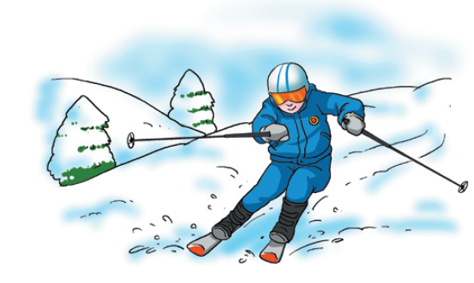
Unit 5 Sport
Reading

Slide 2
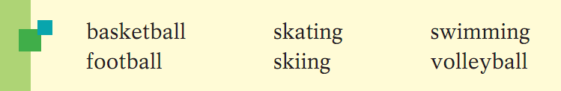
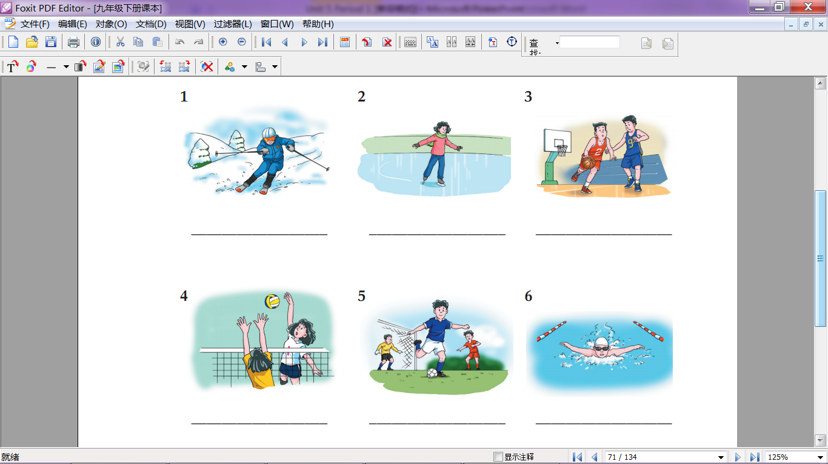
What do you know about …?
A1 Write the correct name of the sport under each picture.
skiing
skating
basketball
volleyball
football
swimming

Slide 3
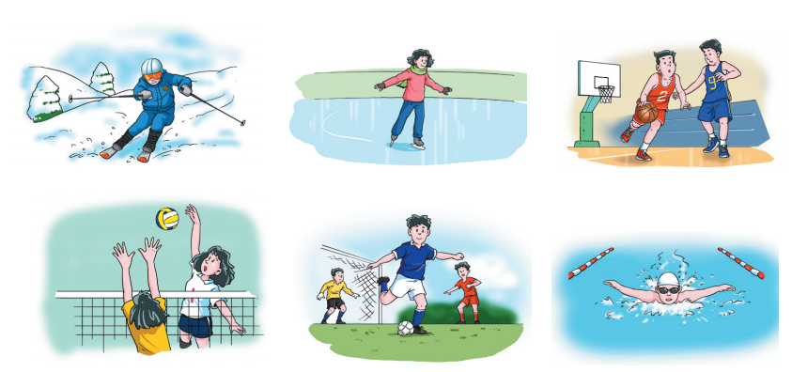
A2 Which sport(s) do you like or dislike? In pairs, discuss this with your classmate.

Slide 4


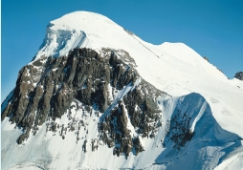
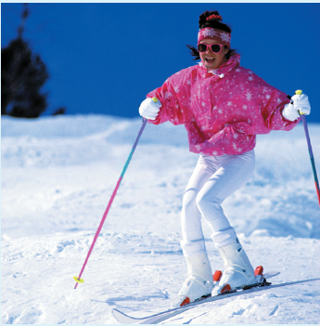
Before you read
Look at the photos, the title and the first paragraph of the article on page 67. Then answer the questions below.
What does the writer think of skiing?
Who took her on a special holiday?
What did they probably do during the holiday?
She probably likes it very much.
Her parents.
They probably went skiing in the mountains.

Slide 5
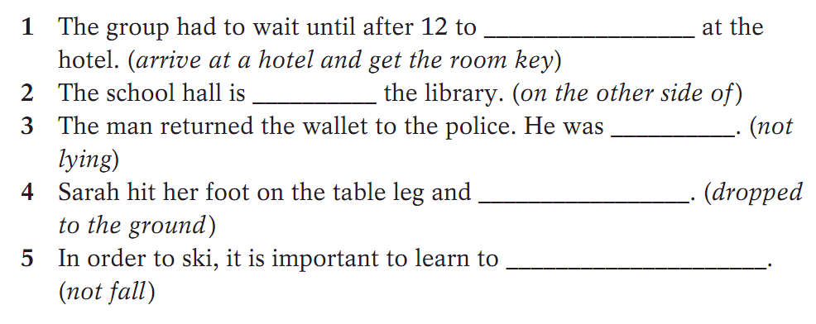
Vocabulary
C1 The words in italics explain the meanings of some words on page 67. Find these words to complete the sentences. Change their forms if necessary.
check in
opposite
honest
fell over
keep your balance

Slide 6
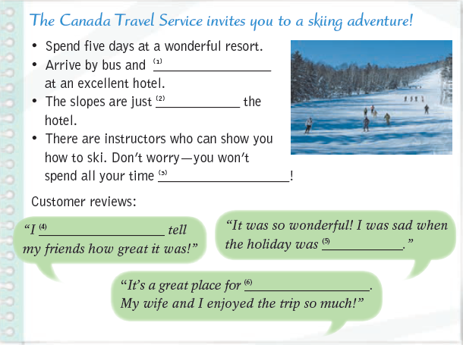
C2 Complete the article below with the words from the box. Change their forms if necessary.
can’t wait to couple opposite
check in fall over over
check in
opposite
falling over
can’t wait to
over
couples

Slide 7
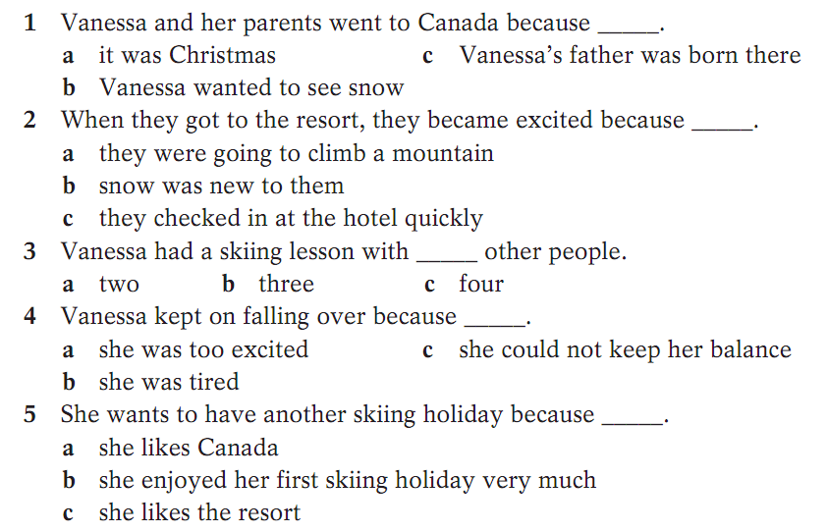
Comprehension
D1 Read the article on page 67 and circle the correct answers.

Slide 8
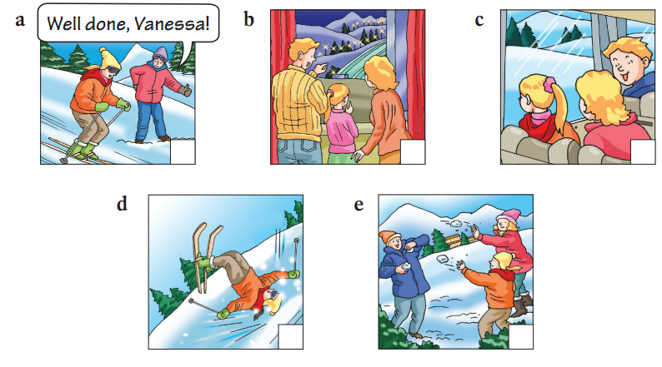
Comprehension
D2 Find sentences from the article to go with these pictures. Then arrange the pictures in the correct order. Write the numbers 1-5 in the boxes.
5
3
1
4
2

Slide 9
一、从下面每小题的A、B、C三个选项中选出可以替换划线部分的最佳选项。
( )1. What a shame! I thought she was going to win the game.
A. surprise B. pity C. day
( )2. He runs so well that he wants to enter some races.
A. get into B. put in
C. take part in
( )3. I am dying to spend the holiday with my family.
A. am too busy to B. really want to
C. have time to
B
C
B

Slide 10
二、选择填空
1.Be gentle _____ her.
A. on B. about C. with D. at
2. it is honest _____ you to tell me the truth.
A. of B. to C. for D. with
3. I rushed for the door and ____ the cat in the hallway.
A. fell over B. fell down C. fell of D. fell to
4. I won the game and I felt ____ with myself.
A. pleas B. pleased
C.pleasant D. pleasure
C
A
A
B

Slide 11
5. _____ my experience, very few people really understand the problem.
A. At B. On C. With D. In
6. He is _____ to meet his mother.
A. dead B. died C. dying D. die
7. Please ______ in for Flight 636.
A. fill B. check C. add D. come
8. The children can’t _____ for Christmas to come.
A. expect B. wait C. hope D. want
9. we all try and help one____.
A. other B. another
C. others D. the other
D
C
B
B
B

Slide 12
三、用括号内所给动词的适当形式填空。
1. After three years of hard work, I managed
________(enter) a key senior school.
2. She kept on ________(sing) the song until she
was good at it.
3. The disabled boy is dying ________(study) with
the normal children in the classroom.
4. Unluckily, when I went out, I found the poor dog
________(die) in the garden.
to enter
singing
to study
dead

Slide 13
四、根据汉语意思完成句子。
1. 他抓着一块木板在水中漂浮了两个钟头，最后得
救了。
He _____ _____ _____a wood block and
floated in the water for two hours. At last he was
saved.
2. 站稳了，保持平衡!
Keep your feet and _____ _____ _____!
3. 请快点办理登机手续，飞机很快要起飞了。
Please _____ _____ quickly. The plane is going
to take off soon.
held on to
keep your balance
check in

Slide 14
4. 她住在我家对面。
She lives _________ our home.
5. 在非洲生活是一次非同寻常的经历。
Living in Africa was quite____ ____ .
6. 说实在的，那是我读过最差的书。
____ ____ _____, it was one of the worst books
I’ve ever read.
7. 他们不能来了，真遗憾！
____ ____ _____ they couldn’t come.
8. 整天学习使我很很疲惫。
studying all day long ____ ____ _____ .
opposite
an experience.
To be honest
It’s a shame
makes me tired

