Slide 1
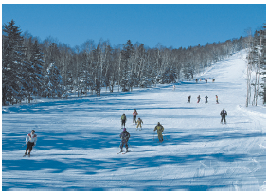
Unit 5 Sport
Grammar

Slide 2
目录
Lead-in
1
While-Learning
2
Post-Learning
3
Review
4

Slide 3
Part I Lead-in

Slide 4
Read the story and find out the tense
Can dogs and cats live in perfect harmony in the
same home? People who are thinking about adopting a
dog as a friend for their cats are worried that they will
fight. A recent research has found a new recipe of
success. According to the study, if the cat is adopted
before the dog, and if they are introduced when still
young (less than 6 months for cats, a year for dogs), it is
highly probable that the two pets will get along
swimmingly. Two-thirds of the homes interviewed
reported a positive relationship between their cat and
dog.

Slide 5
1. Can dogs and cats live in perfect harmony
Simple present
2. People who are thinking about adopting a dog as a
friend.
Present continuous
3. their cats are worried
Simple present
4. that they will fight.
Simple future

Slide 6
5. A recent research has found a new recipe of success.
Present perfect
6. they are introduced when still young.
Simple present
7. Two-thirds of the homes interviewed reported a positive relationship between their cat and dog.
Simple past

Slide 7
What is the tense?
汉语的时态大多是通过副词来表达，而英语的
时态是靠动词的变化和时间状语来表达。英语中的
时态共有十六种，初中阶段学习8种，但是常考的或
较常用的只有6种。 要掌握英语的时态和语态，核
心是助动词(do, be, have)和时间状语。

Slide 8
动词的五种形式(do、 work)
原形 | 第三人称单数 | 过去式 | 过去分词 | 现在分词
do | does | did | done | doing
work | works | worked | worked | working

Slide 9
常用的助动词有be, have, do, will
原形 | 现在式 | 过去式 | 过去分词 | 现在分词 | 作用
be | am is are | was were | been | being | 构成各种进行时态和被动语态
have | has have | had | had | having | 构成各种完成时态
do | do does | did | done | doing | 构成疑问句和否定句、加强语气，代替前面相同的动词
will | will | would |  |  | 构成各种将来时态

Slide 10
Part II While-Learning

Slide 11

Grammar A
Review of tenses

Slide 12
A Review of tenses
We have learnt the following tenses:
Tense |  | Examples
Present | Simple present | I/You/We/They swim every day. He/She/It swims every day.
 | Present continuous | I am swimming now. You/We/They are swimming now. He/She/It is swimming now.
 | Present perfect | I/You/We/They have been here since 3p.m. He/She/It has been here since 3 p.m.
Future | Simple future | I/You/We/They/He/She/It will swim tomorrow morning.
 |  | I am going to swim tomorrow morning. You/We/They are going to swim tomorrow morning. He/She/It is going to swim tomorrow morning.
Past | Simple past | I/You/We/They/He/She/It swam yesterday afternoon.
 | Past continuous | I/He/She/It was swimming at 3 p.m. yesterday afternoon. You/We/They were swimming at 3 p.m. yesterday afternoon.

Slide 13
Simple present
定 义 | 时间状语 | 使用语境 | 例句
I learned that the earth goes around the sun when I was in primary school
2. If he accepts the job, he will get more money soon.
3. The harder you study, the better results you will get.
主要用来表示人、事物的现在状况和特点；表示经常或习惯性的动作，
often, always,
Sometimes
everyday
from time to time
1.永恒的真理
2.在时间和条件状语从句中，代替一般将来时
3.在the more… the more … (越……越……) 句型中, 若主句是一般将来时, 从句通常用一般现在时。

Slide 14
Present continuous
定 义 | 常用时间状语 | 使 用 的 语 境 | 例句
1.在时间状语或条件状语从句中表示将来正在进行的动作。
2.表示在最近按计划或安排要进行的动作
表说话时或目前一段时间内正在进行的活动：或表感情色彩，加强语气
now
1. Look out
when you are
crossing the
street.
2. Marry is
leaving on
Friday.

Slide 15
Present perfect
定 义 | 常用时间状语 | 使 用 的 语 境 | 例句
表示动作发生在过去，完成在过去，但强调与现在情况仍有联系，其结果或影响仍存在
1.for + 时间段；
since + 时间点
2. lately;recently,
just, already
, yet, up to now;
till now; so far,
these days
3. in the past
few years；
over the past
few years;
1. “最近几世纪/ 年/ 月以来……”
2. 表示“第几次做某事,或在 “It is the best (worst, most interesting ) +名词 ＋that” 后面跟现在完成时
1.They have lived
in Beijing for
five years.
2.They have lived
in Beijing since
1995.
3. This is my first
time that I have
visited China.

Slide 16
Simple future
定 义 | 常用时间状语 | 使 用 的 语 境 | 例句
1.Beijing will host
the 29th Olympic
Games in 2008.
2.I am leaving for
Beijing tomorrow.
3. Use your head
and you will find
a way.
4. We will begin
our class as soon
as the teacher
comes.
1.一般将来时总是用在一些时间状语从句或条件状语从句的主句中
2.某些表示短暂性动作的动词如arrive, come, go, leave, start等，用现在进行时形式表示将来
3. “祈使句 + and/or + 句子”，这种结构中and后面的句子谓语用一般将来时。
表在将来某个时间会发生的动作或情况
tomorrow
next year
in 2008等
表示将来
的时间状
语

Slide 17
Simple past
定 义 | 常用时间状语 | 使 用 的 语 境 | 例句
表在过去某个特定时间发生且完成的动作，或过去习惯性动作,只说明，过去
Yesterday
last week
in 1945,
at that time
once;
during the
war;
Before;
a few days
ago;
1在确定的过去时间里所发生的动作或存在的状态。
2.表示在过去一段时间内，经常性或习惯性的动作。
1.He used to
smoke a lot.
2. Where did you
go just now?
3. When I was a
child, I often
played football in
the street.

Slide 18
Past continuous
定 义 | 常用时间状语 | 使 用 的 语 境 | 例句
在过去某个时候或某段时间内正在进行的动作
1过去某个时间点或时间段发生的事情
2.在复合句中，如果主要动作和背景动作都是延续的或同时发生的，那么主从句的动词都可用过去进行时
1.What was he
researching all day
last Sunday？
2. What was she
doing at nine o'clock
yesterday？
3. While he was
waiting for the bus，
he was reading a
newspaper.
This morning
the whole
morning，
all day
yesterday，
from nine to
ten last
evening

Slide 19
现在完成时与一般过去时区别
 | 现在完成时 | 一般过去时
时态范畴 | 现在时态,过去的动作对现在造成的影响 | 过去时态，过去动作，与现在无关
例句 | Li Lei has read the book．（说明李雷了解那本书的内容） | Yesterday l went to the zoo.（仅说明昨天去了动物园，与现在无关）
时间状语 | already，yet，still，just，so far，in the last( past)，before，ever，never，since+时间点，for+时间段 | ago，yesterday，last，in 2000，just now
例句 | Have you ever picked flowers in a park? 你们曾在公园里摘过花吗？ | Father bought that watch ten years ago. 爸爸十年前买了那块手表。

Slide 20
现在完成时中常见瞬间性动词和延续性动词的转换
动词与动词的转换 | buy--have, borrow- keep
动词变为be+adj | begin --be on , go—be off, arrive--be there close/open--be closed/open, die --be dead, finish--be over , get up --be up, marry --be married come--be here return --be back
动词变为be+ prep | come/go--be in/at join-- be in(或he+成员) put on-- wear(或be in)

Slide 21
Complete the paragraph below using the correct forms of
the verbs in brackets.
My best friend James (1) (be) a fan of Manchester United
since he was 12 years old. He (2) (watch) TV one day
when a football match came on. Manchester United (3)__________
(play) against another team and (4) (win). He enjoyed the
game a lot. Now he (5) (watch) every game they play. He
always (6) (wear) his red football shirt too. This weekend
is very special for him. He (7) (travel) to Manchester to
watch a live match. After the match, he (8) (meet) some
of the players. He is very excited!
has been
was watching
played
won
watches
wears
is going to
/will travel
is going to
/will meet

Slide 22
Grammar B
Review of the passive voice

Slide 23
We have learnt the passive voice in different tenses.
Tenses | Active voice | Passive voice
Simple present | They play a basketball match every weekend. | A basketball match is played every weekend.
*Present perfect | They have played the basketball match for two hours. | The basketball match has been played for two hours.
Simple past | They played the basketball match last month. | The basketball match was played last month.
Simple future | They will play the basketball match next week. | The basketball match will be played next week.
 | They are going to play the basketball match on Sunday morning. | The basketball match is going to be played on Sunday morning.

Slide 24
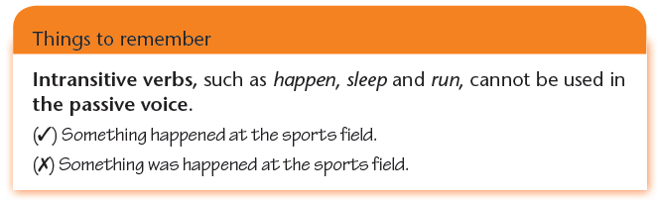

Slide 25
Change the sentences below into the passive voice.
We can finish the work in two days.
• They produce silk in Suzhou.
• The children will sing an English song.
• He made me do that for him.
• Did they build the bridge here one year ago?
• We must water the flowers every day.
The work can be finished in two days by us.
Silk is produced by them in Suzhou.
An English song will be sung by the children.
I was made to do that for him.
Was the bridge built here by them one year ago?
The flowers must be watered by us every day.

Slide 26

B1 In pairs, ask and answer questions about the pictures below and on the next page. Follow the example.
S1: Where is bread baked?
S2: Bread is baked in a bakery.
bread baked?
S1: Where are reference books
stored?
S2: Reference books are stored in a library.
reference books stored?

Slide 27
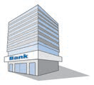
S1: Where is money kept?
S2: Money is kept in a bank.
money kept?
S1: Where are cars made?
S2: Cars are made in a factory.
cars made?

Slide 28
S1: Where are football
matches played?
S2: Football matches are
played in a stadium.
football matches played?
S1: Where are films shown?
S2: Films are shown in a
cinema.
films shown?

Slide 29

B2 In pairs, ask and answer questions. Follow the example.
In 1879, Thomas Edison invented the first
practical light bulb.
S1: Who invented the first practical light bulb?
S2: It was invented by Thomas Edison.
S1: When was it invented?
S2: It was invented in 1879.

Slide 30
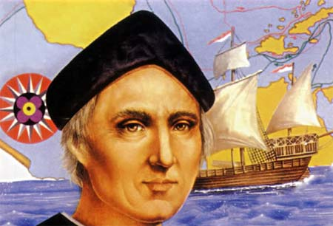
2. In 1492, Columbus discovered America.
S1: Who discovered America?
S2: It was discovered by Columbus.
S1: When was it discovered?
S2: It was discovered in 1492.

Slide 31
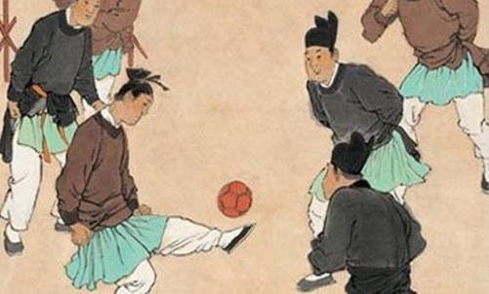
3. The Chinese people played an ancient form of football more than 2,000 years ago.
S1: Who played an ancient form of football?
S2: It was played by the Chinese people.
S1: When was it played?
S2: It was played more than 2,000 years ago.

Slide 32
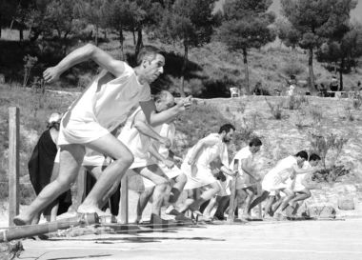
4. The ancient Greeks held the first Olympic Games more than 2,700 years ago.
S1: Who held the first Olympic Games?
S2: They were held by the ancient Greeks.
S1: When were they held?
S2: They were held more than 2,700 years ago.

Slide 33
B3 Change the sentences below into the passive voice.
Paul scored a goal in the last minute.
She threw the ball high into the air.
Our school will hold the Sports Day on 15th March.
He cleans his gloves after every game.
Millions of people will watch the Olympic Games.
He is going to make a poster about popular sport.
A goal was scored by Paul in the last minute.
The ball was thrown high into the air by her.
The Sports Day will be held by our school on 15th March.
His gloves are cleaned by him after every game.
The Olympic Games will be watched by millions of people.
A poster about popular sport is going to be made by him.

Slide 34
Part III Post-Learning

Slide 35
夜雨寄北
君问归期未有期，
巴山夜雨涨秋池。
何当共剪西窗烛，
共话巴山夜雨时。
How many tenses are there in the poem?

Slide 36
“ 君问”： simple past
“归期”： simple future
“未有期”： simple present
“巴山夜雨涨秋池”： simple present
“何当共剪西窗烛”： simple future
“却话”： simple future
“巴山夜雨时”： future continious
时光如斑驳琉璃的珍珠，散落各处，营造了一时光隧道，任情感穿梭回旋。

Slide 37
Part IV Review

Slide 38
一、 用括号内所给词的适当形式填空。
1. I ________(finish) cleaning my room in 30 minutes.
2. Last night they ________ (hold) a big party to
celebrate Mary’ s birthday.
3. Lucy will call me as soon as she ________ (reach) her home.
4. Mary ________ (write) an email when I came into her room.
5. Do you know when the telephone ________ (invent)?
will finish
held
reaches
was writing
was invented

Slide 39
6. — How many times ________ you ________ (be) to Canada?
— Only once.
7. The task will ________ (finish) before 5 o’ clock this afternoon.
8. Tom ________ (go) swimming every day in summer.
9. He ________ (sit) down and began to read a book.
10. Listen! Helen ________ (sing) in the classroom.
have been
be finished
goes
sat
is singing

Slide 40
二、改错
1. The teacher told that the Sun rose in the east.
rose--rises
2. I will speak to him when I will see him next
Sunday.
will see---see
3. I will get everything ready before my boss come back.
come--comes

Slide 41
4. Does your mother has lunch at home?
has--have
5. The volleyball match will be put off if it rain.
rain--rains
6. Mary is making a dress when she cut her finger..
is---was
7. This is the first time I had been here..
had--has

Slide 42
8. I haven't seen her since two months.
句末添加ago
9. She has gone to Beijing several times.
has gone to –has been to
10. Jane is doing some cleaning this time yesterday.
is---was

Slide 43
Thank you!

