Slide 1

Words & Expressions
Module 3
Qing Su

Slide 2

Unit 1

Slide 3
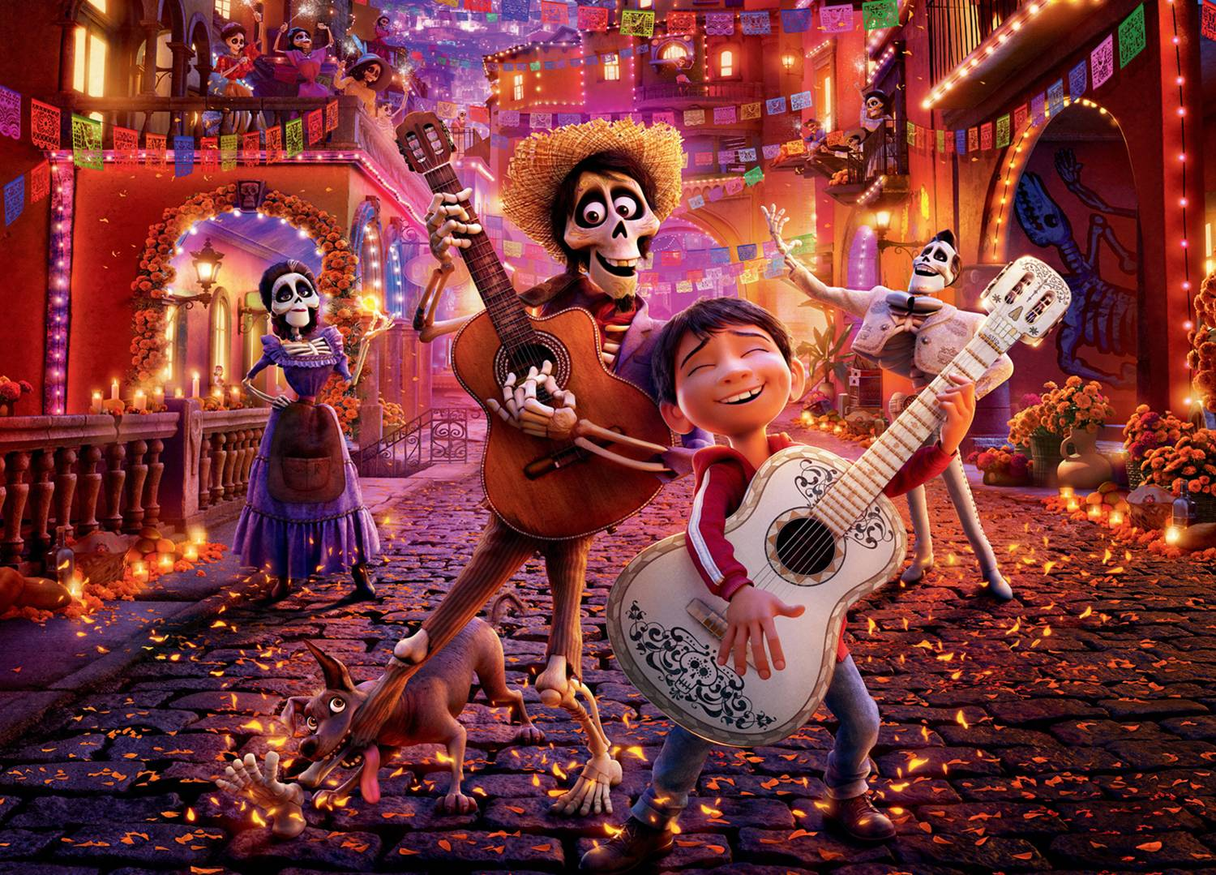
Unit 1
Festivals around the world

Slide 4

发生，进行
1.take place意为“____________”，无_____语态。
被动
[辨析] take place & happen
★ take place常指某事按规律、预先安排
或计划而发生或进行。如：
The next meeting will take place
tomorrow.

Slide 5
2. starve
1) vt. & vi. (使)饿死；(使)饥饿；挨饿。
e.g. Many people starved to death because of
the famine.
那次饥荒中有许多人饿死了。
They would rather starve than give in.
他们宁愿挨饿也不妥协。

Slide 6
2) vi. 渴望；需要，常跟for短语或动词不定式。
e.g. I think these flowers are starving for
water.
我觉得这些花需要浇水。
3) vi. 饿得要死（用在口语中）。
e.g. Please prepare some food for me. I’m
starving!
给我准备些吃的！我快饿死了！

Slide 7
3. Today’s festivals have many origins, some religious, some seasonal, and some for special people or events.
现在的节日有很多由来，一些是宗教上的，一些是季节性的，一些是纪念特殊的人和事件的。

Slide 8
[寓词于境]
阅读下列句子，猜测origin的意思。
1) It’s a book about the origin of the
universe. ____________
2) This particular custom has its origins
in Wales. ____________
3) She tries to hide her upper-class
origins, but her accent gives her away.
____________
起源，源头
来源，由来
出身，血统

Slide 9
[拓展]
original adj. 原来的，最初的；独创的
n. 原作；原型
originally adv. 原来，起初；新颖地
originate v. 发源，来自；创始，开创

Slide 10
[即学即练]
用以上词的适当形式填空。
1) He’s writing a dictionary that explains
the _______ of words.
2) My job is to think up creative and
_______ advertising ideas.
3) __________ it was a bedroom, but we
turned it into a study.
4) How did the tradition of wearing
costumes on Halloween ________?
origin
original
Originally
originate

Slide 11
4. For the Japanese festival Obon, people should go to clean graves and light incense ____________ their ancestors.
在日本的盂兰盆节，人们要扫墓、烧香，以缅怀祖先。
in memory of是介词短语，意为“纪念；追念”。如：
The library was built in memory of the scientist.
2) The building was named Ford Hall in memory of a man named James Ford.
in memory of

Slide 12
5. It is now a children’s festival, when they can dress up and go to their neighbours’ homes to ask for sweets.
万圣节如今成了孩子们的节日，这天他们可以乔装打扮上邻居家要糖吃。
dress up 打扮；穿上盛装
e.g. Do we have to __________________
__________________? 参加她的
生日宴会，我们得打扮打扮吗？
dress up to attend her birthday party

Slide 13
6. If the neighbours do not give any sweets, the children might play a trick on them.
如果邻居什么糖也没给，那么孩子们就 可以捉弄他们了。
play a trick on
总结play a trick on的意思。搞恶作剧，开玩笑

Slide 14
【拓展】
The teacher plays a very active part in this type of classroom activity.
She wondered if the others were playing a joke on her.
① play a part (in)意为“_________________________________”;② play a joke / jokes on意为“________________________”。
扮演一个角色；参与；起……的作用
开（某人的）玩笑；戏弄

Slide 15

7.[寓词于境] 阅读下列句子，注意award的意思和用法。
1. She was awarded the first prize for her
excellent performance.
2. The judge awarded her 200 dollars.
3. His horse was given the highest award
at the show.
[自我归纳] award作动词，意思是___________, 常见搭配是award sb. sth., award后跟双宾语；award 还可作_____词，意思是______。
授予、判定
名
奖品

Slide 16
选择 It is the first time that she has been ____ second prize in the English Speaking Competition.
A. rewarded B. awarded
C. included D. harvested
B

Slide 17
8.[自我归纳] admire意思是___________；常用搭配是admire sb. for (doing) sth.。
[拓展] admirer n. 仰慕者
admiration n. 钦佩
钦佩、赞赏

Slide 18

10. The most energetic and important
festivals are the ones that look forward
to the end of winter and the coming of
spring.
最富生气而又最重要的节日，就是告
别冬天，迎来春天的日子。

Slide 19
阅读下列句子，并试着归纳look forward to的意思及用法。
1) We are all looking forward to our
holiday.
2) Jim has been working hard and looks
forward to spending his vacation lying
on the beach doing nothing.
【自我归纳】
look forward to意为“期待，盼望”，其后跟名词（句1）或___________（句2）。
动词-ing形式

Slide 20
11. The country, covered with cherry tree flowers, looks as though it is covered with pink snow.
as though 仿佛，好像
as though / if引导的从句中, 谓语动词一般用虚拟语气, be动词常用were; 但是当从句描述的情况与事实相符时, 常用陈述语气。
e.g. I’ve loved you as though / if you were my
son.（虚拟语气）
It looks as though / if it is going to rain.
（陈述语气）

Slide 21
【自我归纳】
have fun意为“__________”，相当于enjoy
oneself。______________表示“玩……玩得
很开心”；have fun后可接in doing
sth., 其中in可省略。
玩得开心
have fun with
【拓展】
for fun 为了高兴
in fun 开玩笑地，不是当真的
make fun of sb. 取笑某人，嘲弄某人

Slide 22
Unit 2

Slide 23
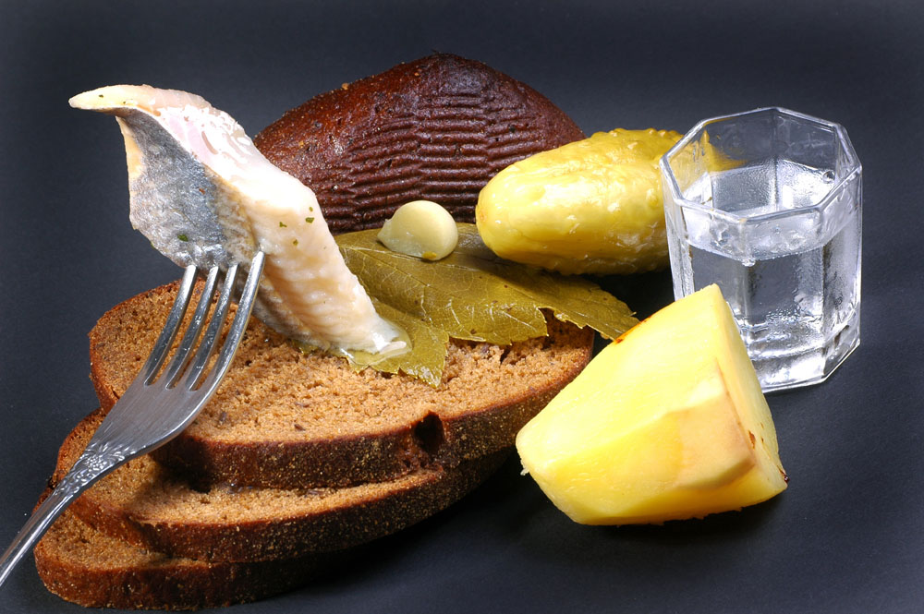
Unit 2 Healthy eating

Slide 24
Language points
1. Everybody has to eat, but do you eat a _____________?
所有人都要吃饭，你的饮食健康吗？
healthy diet
diet n. 饮食，食物
in one’s diet 在某人日常饮食中
have a balanced / healthy diet
有均衡的/健康的饮食
go / be on a diet 节食

Slide 25

2. What will you happen to you if you don’t eat a balanced diet?
如果没有均衡的饮食你会怎么样？
balance作动词，意为“均衡，权衡，保持平衡”。

Slide 26
frustrated是形容词，意为“失望的，失意的”。
e.g. He feels frustrated and angry.
他感到既失意又恼火。
frustrate v. 使挫败, 使不成功
e.g. The bad weather frustrates our
hopes of having a picnic.
坏天气使我们野餐的愿望无法实现。

Slide 27
6. Tired of all that fat? Want to lose weight?
肥腻的东西吃厌了吧？想变瘦吗？
这是省略的句子，完整的句子应当是：
__________________________________
__________________________________
be/ get tired of 对……厌倦
e.g. I am tired of the same food every
day. Can’t we have something
different? 天天吃同样的食品让人
厌倦, 难道我们不能换些花样吗？
Are you tired of all that fat? Do you want to lose weight?

Slide 28
was amazed at
7. Wang Peng ______________ (amaze) this and especially at the prices.
王鹏对此感到吃惊，特别是对价格。
be amazed at 对……感到惊讶；惊愕
e.g. Everybody was amazed at his design.
大家都对他的设计感到惊讶。
amazed adj. very surprised (人)感到惊奇
amazing adj. very surprising, especially in a way that makes you feel pleasure or admiration 令人惊奇的；(尤指)令人惊喜的

Slide 29
get away with doing sth.
不因某事受惩罚；携带……跑掉
e.g. For that serious accident, he got
away with only a fine.
那么严重的事故，他缴了罚款就完事
了。
They got away with damaging the
car.
他们损坏了汽车却逃之夭夭。

Slide 30
9. Perhaps with a discount and a new
sign he could win his customers back.
也许写个新的招牌、打点折，能够赢
回顾客。
win sth. / sb. back
win back sb./ sth. 赢回；重新获得
e.g. How can I win back her trust?
我怎么才能重新赢得她的信任？

Slide 31
11. The strength of the diet in Wang
Peng’s restaurant was that ...
王鹏餐馆的饮食的优势在于……
strength
阅读下列各句，并观察strength在句中的含义。
1) He pushed against the rock with all his
strength.
他使出全力推岩石。
2) The new weapon’s strength lies in its accuracy.
这种新型武器的优势在于其精确性
她有出众的意志力。
力量；力气
优势

Slide 32
[拓展]
on the strength of sth.
在……的影响或帮助下
e.g. I got the job on the strength of
her recommendation.
在她的推荐下，我得到了这份工作。

Slide 33
strengthen vt. & vi. 加强；强化
e.g. The organization’s aim is to
strengthen the cultural ties
between China and France.
这个组织旨在加强中法两国之间的
文化联系。

Slide 34
Unit 3

Slide 35
Unit 3
The Million Pound Bank Note

Slide 36
【自我归纳】
permit用作名词，意为“_______ ”；用作动词时，意为“允许 ”，可用于如下结构：permit sb. to do sth.允许某人做某事； permit doing sth.允许做某事；permit sb. sth.允许某人某事；permit sb. in （sth.）允许某人进入某处；weather permitting在句7中，相当于if weather permits。
许可

Slide 37
【即学即练】根据括号内的汉语提示补全下列句子。
1. In the past, blacks
____________________________
(不准进入) certain public places.
were not permitted to enter
2. You cannot park here
_____________________ (没有停车许
可证).
3. _______________ (如果时间允许的话),
we will listen to your questions.
without a parking permit
If time permits

Slide 38
5. Go right ahead. 请问吧。
go ahead主要有以下三种含义：
1) 走在前面；先走。
e.g. You go ahead and tell them that we
will be there shortly.
2) 发生；进行。
e.g. The building of the new school will
go ahead as planned.
3) 主要用于口语中，表示“可以；往下说；开始吧”等，高考主要考查这一用法。

Slide 39
【即学即练】look，stare，glare
1. 男孩问我问题的时候，盯着我的眼睛。
2. 老师叫我们看黑板。
3. 他们没打架，只是站在那里怒目相视。
The boy stared at my eyes when asking me some questions.
The teacher told us to look at the blackboard.
They didn’t fight, but stood there glaring at one another.

Slide 40
7. ... when I was spotted by a ship.
一艘船发现了我。
spot n. & v.
阅读下列句子，在括号内填出与spot相对
应的词性及含义。
v. 发现；认出
n. ①斑点 ②污点 ③地点

Slide 41
[常见搭配]
on the spot 当场；当下
in a (tight) spot 处于困境
put sb. on the spot（提出难题）使某人尴尬，使某人为难
be spotted with 满是……斑点

Slide 42
3) 短语account for，表示“说
明……原因，解释”。
[即学即练]
用account (for)的适当形式完成下列句子。
1) His illness ____________ his absence
from school.
accounts for

Slide 43
9. On the contrary, in fact.
事实上，正好相反。
【语境展示】阅读下列句子，并试着归纳
contrary的意思及用法。
1) I was worried that it might be too
difficult for me but I found the
contrary.
2) The results were contrary to
expectation.

Slide 44
Unit 4

Slide 45

Unit 4
Astronomy:
the science of the stars

Slide 46
violent adj. 暴力的；强烈的；剧烈的，猛烈的；颜色鲜艳的
e.g. Children should not be allowed to
watch ______________.
不应该让小孩看暴力电影。
There was a violent storm at sea that
night and their ship sank.
Her dress was a violent pink.
她的连衣裙是非常鲜艳的粉红色。
violent movies

Slide 47
[拓展 ]
violently adv. 强烈地；激烈地；厉害地
e.g. She shook her head violently.
她拼命摇头。
violence n. 暴力；猛烈；强烈；狂热
e.g. He strongly opposes violence and
war.
他强烈反对暴力和战争

Slide 48
6. They produced young generally by ____________.
它们一般通过孵蛋繁衍后代的。
lay eggs 下蛋
lay-laid-laid-laying
放, 把......放在......; 产卵
e.g. He laid his books on the desk.
laying eggs

Slide 49
注意:
lay (laid; laid; laying) 放置; 产卵
lie (lay; lain; lying) 躺; 位于
lie (lied; lied; lying) 说谎

Slide 50

7. …, because they gave birth to young baby animals ...
因为它们能从体内生产出幼仔……
阅读下列句子，并试着总结give birth to的含义及用法。
1) Mrs. White gave birth to a fine healthy
baby in her late thirties.
2) Mary gave birth to a healthy baby girl.
3) It was this event that gave birth to the
peace movement.
分娩
分娩
产生

Slide 51
8. They are putting too much carbon dioxide into the atmosphere, which prevents heat from escaping from the earth into space. 他们把太多的二氧化碳释放到大气层中, 这就使得热量不能从地球上散发到太空中去。

Slide 52
制止、阻止、使……不做某事
prevent ... from的意思是 _____________
___________________。from后多跟动词-ing形式；有时可省略from。
[拓展] 近义短语有: stop ... from 阻止……干某事; keep ... from阻止……干某事。
注意: prevent和stop后的from都可以省略, 而keep ... from中的from则不能省略，如果省略了, 其意义将发生改变。

Slide 53
puzzle vi. 迷惑，为难 可构成短语：
puzzle over 苦苦思索，仔细琢磨
puzzle out 仔细思考，设法想出
e.g. I’ve puzzled over this question for a while, and I’m still not sure what the right answer is.
The teacher left the children to puzzle out the answer to the problem themselves.

Slide 54
Unit 5

Slide 55

Unit 5
Canada — "The True North"

Slide 56
4. People say it is Canada’s most beautiful city, surrounded by mountains and the Pacific Ocean.
人们说温哥华是加拿大最美的城市, 被大山和太平洋环抱。
【语境展示】阅读下列各句，并试着归纳surround的意思及用法。
1) The students surrounded their teacher,
asking the results of the competition.

Slide 57
2) They have surrounded the pool with a
fence.
3) The police surrounded the building and
didn’t let anybody enter it.
4) The whole town is surrounded with / by
water, making it very beautiful.
【自我归纳】surround是及物动词，意为：①围住，包围(1-3)；②环绕，围绕(4)。

Slide 58
【联想】 surrounding adj. 周围的 surroundings n. 环境
【小试】
用surround的适当形式填空。
1) Lucy was sitting on the floor ___________ by toys.
2) We decided to explore the ___________ countryside.
surrounded
surrounding

Slide 59
7. That afternoon aboard the train, the cousins settled down in their seats.
那天下午表姐妹上了火车落了座。
aboard作副词或介词, 意为“在(船、飞机、车等)上, 上(船、飞机、车等)”。
e.g. All the passengers aboard fell into the
river.
We were the last two to go aboard the
ship.

Slide 60

settle down
① 安稳地坐下来 如：
He settled down at his desk to work out the exact figures.
② 定居下来 如：
Many people settle down in San Diego because of the fine weather.
③ 安静下来, (使)平静下来 如：
The children settled down when their teacher entered.

Slide 61
[即学即练] 按要求完成下列各题。
1) 等孩子们安静下来再开始上课吧。(汉译英)
Please wait until the children settle down before you start your lesson.
2) I can’t settle down to my work.（英译
汉）
我不能安心工作。
3) Let us __________________ (静下心来
写) an article.
settle down to write

Slide 62
8. ..., they manage to catch sight of some mountain goats and even a grizzly bear and an eagle. 她们总算看到了野山羊，甚至还看到了一只大灰熊和一只鹰。
阅读下列句子, 注意manage to do的意思和用法。
1) Although he hasn’t received any formal education, Mr Wang managed to finish his task.
2) We should manage to realize our dream.

Slide 63
[归纳总结]
manage to do sth. (= succeed in doing sth.) 是“设法做、设法完成某事”的意思。
[辨析] manage to do与try to do
用manage时，成功的把握大些；用try时，成功的把握不大。
manage to do sth.设法成功地完成……，try to do sth. 尽力做……（但结果不一定成功）

Slide 64
9. Many of them have a gift for riding wild horses and can win thousands of dollars in prizes.
他们中学多人都有骑野马的才能，他们能赢得几千美元的奖金。
have a gift for … 在......方面有天分/天赋
gift特指与生俱来的天份或才能，如绘画、
音乐等。
e.g. Her gift for dancing amazed the teacher.
老师对她舞蹈的天份大感惊奇。

Slide 65
10. … most Canadians live within a few hundred kilometres of the USA border, …
大多数加拿大人居住在靠近美国数百公里以内的边疆地带……
[考点] within介词，在……(尤指时间、距离、范围、限度等)之内，以内；在……里头。

Slide 66
1) within与in表达时间的区别:
within指在时间范围之内, 不超过; 而in
是经过若干时间, 指期限之外。
e.g. I’ll be there within an hour.
（一小时之内）
I’ll be there in an hour.
（一小时之后）

Slide 67


