Slide 1
Discovering useful structure

Slide 2
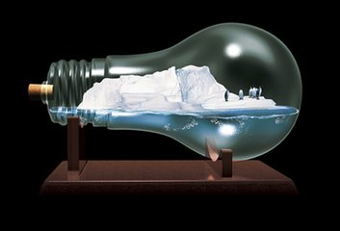
1.Compare the two sentences below.
1.Human activity has caused this global warming.
2.It is human activity that has caused global warming.
强调句型 It is …..who/that…

Slide 3
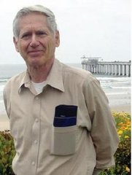
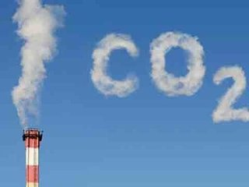
2. In the article there are two more sentences in which “it” is used for emphasis. Find them and then underline(划线) them.
It was a scientist called Charles Keeling, who made accurate measurements of the amount of carbon dioxide in the atmosphere from 1957 to 1997.
They also agree that it is the burning of more and more fossil fuels that has resulted in this increase in the carbon dioxide.

Slide 4
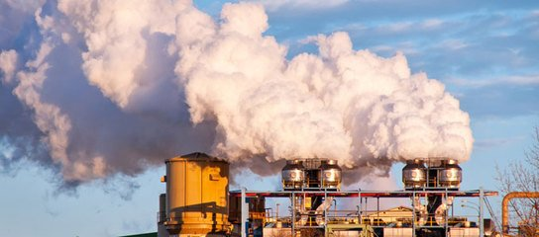
3. Rewrite each sentence with it is…that/who to give more emphasis to the underlined part.
Scientists warned that greenhouse gases would warm the earth by trapping heat energy in the atmosphere.
It was scientists who warned that greenhouse gases would warm the earth by trapping heat energy in the atmosphere.

Slide 5
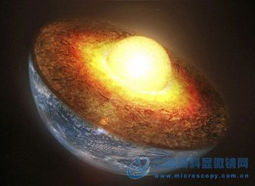
2. The greenhouse effect gives the earth’s surface the average temperature of 15℃.
It is the greenhouse effect that gives the earth’s surface the average temperature of 15℃.

Slide 6
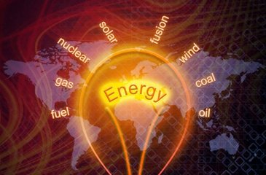
3. Much of the energy used to light and heat our homes comes from fossil fuels.
It is fossil fuels that much of the energy used to light and heat our homes come from.

Slide 7

4. The developed countries consume the most energy in the world.
It is the developed countries that consume the most energy in the world.

Slide 8
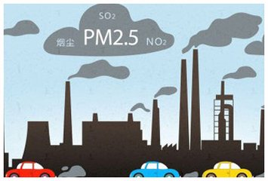
5. Carbon dioxide has the tendency to stay in the atmosphere for centuries while other greenhouse gases stay in the atmosphere only for a day or less.
It is for centuries that carbon dioxide has the tendency to stay in the atmosphere while other greenhouse gases stay in the atmosphere only for a day or less.

Slide 9
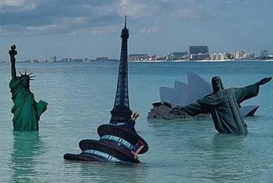
6. Low-lying countries feel their very existence is in danger from rising sea levels.
It is their very existence that low-lying countries feel is in danger from rising sea levels.

Slide 10

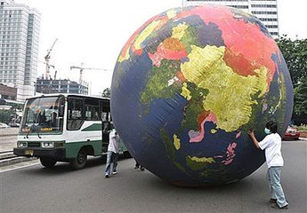
7. Environmentalists have tried to stop the earth’s temperature rising.
It is environmentalists who have tried to stop the earth’s temperature rising.

Slide 11
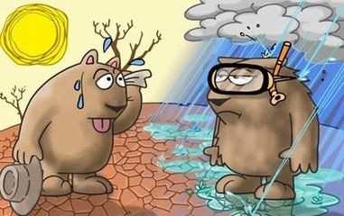
8. Scientists want to find out about future climate changes and their effects on our environment.
It is future climate changes and their effects on our environment that scientists want to find out about.

Slide 12
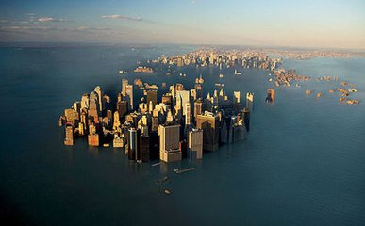
9. In the years ahead, the level of the sea could rise by several meters because of global warming.
It is several meters that the level of the sea could rise in the years ahead because of global warming.

Slide 13
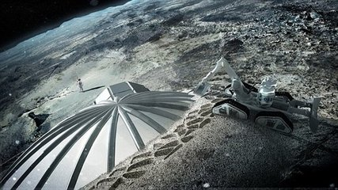
10. In the future outer space might provide us with new energy sources.
It is out space that might provide us with new energy sources in the future.

Slide 14
4. Rewrite your letter of advice.
Use “it is …that/who” structure to rewrite one of the sentences in your writing.

