Slide 1
Unit 3 The Earth
Listening

Slide 2
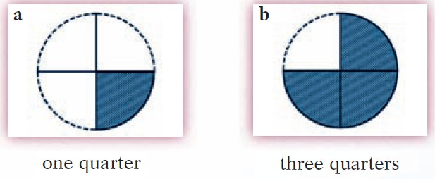
观察选项，预测题目。
1/4
3/4
How much of the Earth is water/land?

Slide 3
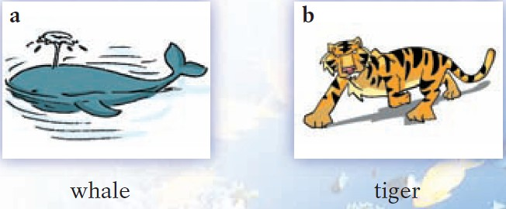
观察选项，预测题目。
Which animal is the largest on Earth?
Whic animal lives in the sea?

Slide 4
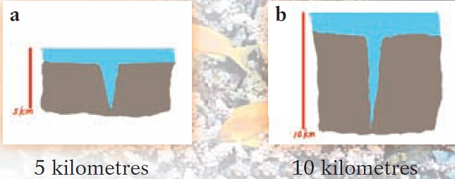
观察选项，预测题目。
How deep is the deepest part of the sea?

Slide 5

1.
Miss Liu: OK, class. Let's do a quiz together.
Danny: What's the quiz about, Miss Liu?
Miss Liu: It's about the sea.
Danny: I love the sea! Let's start.
Miss Liu: OK. Number one. How much of the Earth
is covered by water?
Danny: I know. The answer is three quarters!
Miss Liu: That's correct.

Slide 6
2.
Miss Liu: Number two. Which animal lives in the sea? Give me one example.
Jane: The whale!
Miss Liu: That's right. You're a clever girl, Jane.

Slide 7
3.
Miss Liu: Now number three. How deep is the deepest
part of the sea?
Peter: Five kilometres?
Miss Liu: No. Try again, Peter.
Peter: More than 10 kilometres?
Miss Liu: Correct!

