Slide 1
Unit 3 The Earth
Speaking

Slide 2
是字母 u 在闭音节、字母 o 或字母组合 ou 等在单词中的读音。
请朗读下列含有 的单词和例句。注意划线部分的读音。
bus just sun
come money some
country enough young
Nothing is impossible.
Come to the front on the double.

Slide 3
是字母 a 或字母组合 ar，au，ear 等在单词中
的读音。
朗读下列含有 的单词和例句。注意划线部分的读
音。
class father glass
art car park
aunt heart
It's far to the farm from the park.
A car is passing by the park.

Slide 4

是字母 o 在重读闭音节单词中的读音或 a 在/w/
后的读音。
朗读下列含有 的单词和例句。注意划线部分的读音。
box lot pot
want wash what
The little pot is so hot.
Bob robbed his boss’s office.
I want to watch TV first, and then wash my clothes.

Slide 5

是字母组合 or，al，ar，au，aw，oor 等在单词中的读音。
朗读下列含有 的单词和例句。注意划线部分的读音。
for horse short
ball small tall
quarter ward warm
August autumn daughter
draw law saw
bought door
My forty-four-year-old daughter is a lawyer.
Babies usually learn to crawl before they can walk.

Slide 6

是字母 o，u 或字母组合 oo，ou 等在单词中的读音。
朗读下列含有 的单词和例句。注意划线部分的读音。
wolf woman
full put sugar
book football good
could should would
Look at the cookbook. It’s really good.
The bull stood in the bushes.

Slide 7
/u:/ 是字母 o，u 或字母组合 oo，ue，ui，oe 等在单词中的读音。
朗读下列含有/u:/ 的单词和例句。注意划线部分的读音。
lose move who
ruler pollute
food school tooth
fruit juice
blue shoe
How do you do? You look really cool.
What food would you like to eat? A bowl of noodles, please.

Slide 8

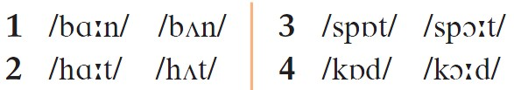
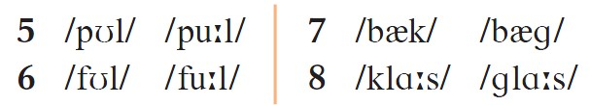
A1 Listen carefully and circle the word you hear from each pair.

