Slide 1
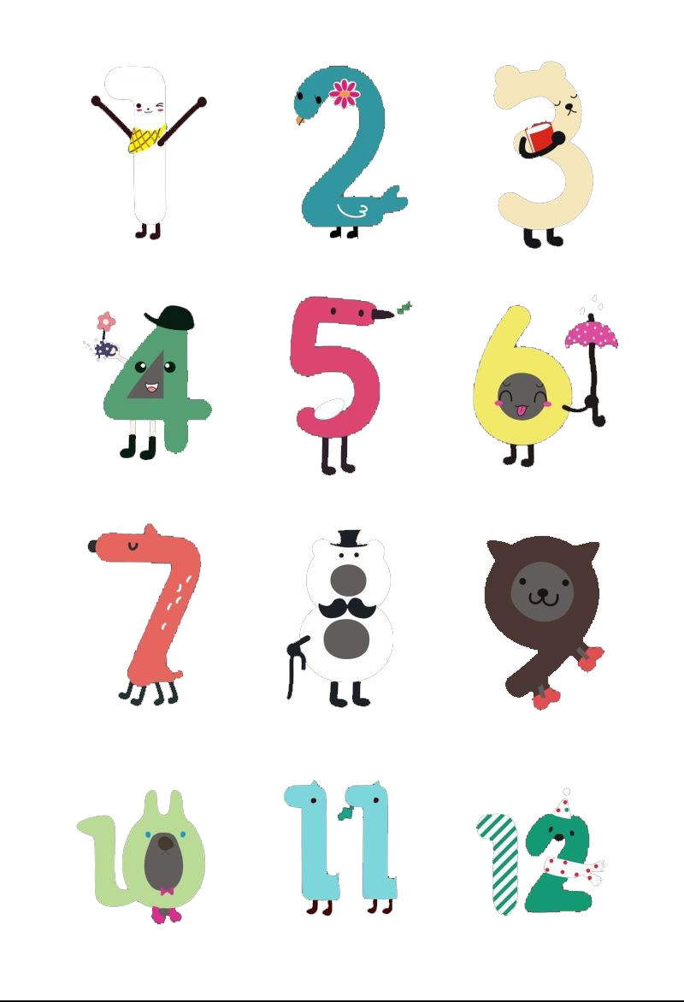
Unit 2 Numbers
Writing：Graph writing

Slide 2
Part I Pre-Learning

Slide 3
Task One: Draw a line graph according to the short passage. Before you draw, decide what the vertical axis and horizontal axis are about.
Rainfall in Guangzhou
In 2008, the rainfall in Guangzhou was 2,300 millimetres. In 2009, it fell to 1,900. Then in 2010, it grew to 2,000. In 2011, the rainfall decreased to 1,600. It increased to 2,600 in 2012. It then went down again to 2,300 in 2013. In 2014, it rose to 2,700. In 2015, it dropped to 2,400. It stayed the same in 2016. In 2017, it jumped to 3000.

Slide 4
What is the vertical axis(纵坐标) about?
It’s about rainfall in millimetres.
What is the horizontal axis(横坐标) about?
It’s about year.

Slide 5
Task One: Draw a line graph according to the short passage.
Rainfall in Guangzhou
In 2008, the rainfall in Guangzhou was 2,300 millimetres. In 2009, it fell to 1,900. Then in 2010, it grew to 2,000. In 2011, the rainfall decreased to 1,600. It increased to 2,600 in 2012. It then went down again to 2,300 in 2013. In 2014, it rose to 2,700. In 2015, it dropped to 2,400. It stayed the same in 2016. In 2017, it jumped to 3000.

Slide 7
Pay attention to the verbs in the passage.
Can you divide them into three groups?
Change the verbs in past tense into base form.
Rainfall in Guangzhou
In 2008, the rainfall in Guangzhou was 2,300 millimetres. In 2009, it fell to 1,900. Then in 2010, it grew to 2,000. In 2011, the rainfall decreased to 1,600. It increased to 2,600 in 2012. It then went down again to 2,300 in 2013. In 2014, it rose to 2,700. In 2015, it dropped to 2,400. It stayed the same in 2016. In 2017, it jumped to 3000.

Slide 8
a.
b.
c.
To describe picture a, we can use verbs like:
_______________________________and so on.
To describe picture b, we can use verbs like:
_______________________________and so on.
If describe picture c, we can say:
_________________ and so on.
grow, increase, rise, jump(数量激增)
fall, decrease, go down, drop
stay the same

Slide 9
Part II While-Learning

Slide 10
Writing
A report with numbers
May found some figures about traffic accidents in her city. She drew a line graph and wrote a report. Look at the line graph and answer the following questions.
What’s the line graph about?
What does the vertical axis stand for?
What does the horizontal axis stand for?
How many accidents were there in July?
What’s the number of accidents in August?
Traffic accidents.
The number of accidents.
The month.
208.
234.

Slide 11

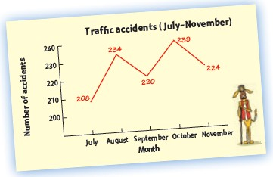
A report with numbers
A May found some figures about traffic accidents in her city. She drew a line graph and wrote a report. Complete the report below.
Write the numbers in
figures, not in words.

Slide 12

Traffic accidents (July-November)
The graph shows that there were(1)____ traffic accidents in our city in July. In(2)_______, the number(3) _______ to (4)________ and then(5) ________ to (6)________ in (7)_________. In (8)__________, the number(9)__________ again
to (10)__________. It (11)_________ to (12)_________in (13)____________.
208
August
rose
234
fell
220
September
October
rose
239
fell
224
November

Slide 13
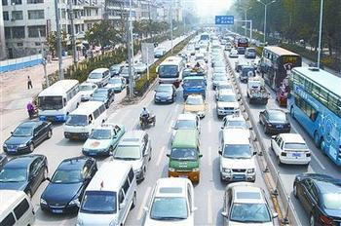
Notes (Writing)
1. traffic [U] 交通
【固定搭配】
heavy traffic 交通拥挤
traffic lights 交通信号灯
traffic accident 交通事故
direct traffic 指挥交通
traffic jam 交通阻塞

Slide 14
2. accident n. (交通)事故
traffic accident 交通事故
by accident 意外地；偶然地
accidental adj. 意外的；偶然的
accidentally adv. 意外地；偶然地
他在交通事故中没有受伤。
He wasn’t hurt in the traffic accident.

Slide 15
3. In August, the number rose to 234 and then fell to
220 in September.
rise vi.上升；升起；增加
注意rise和raise 的区别：
两者都可表示“提高；上升；增加”，但用法不同。
raise 是及物动词，后面必须加宾语；
rise是不及物动词，后面不能直接加宾语。

Slide 16
我认为我必须对该计划中所做的修改提出反对。
I feel I must ______ my voice against the changes in the plan.
太阳升起，普照大地。
The Sun ______ and bathes the Earth.
raise
rises

Slide 17
Practice
一、根据中文意思完成句子。
1. 她早晨起得早。
She ______ ______ in the morning.
2. 她的嗓门因激动而提得越来越高。
Her voice ______ ______ ______ ______ with
excitement.
判断句子正误，如有错误请改正。
3. He rose his hand to ask a question.
( )______________________________________
4. It will slowly start to overheat and its temperature will start to rise.
( )______________________________________
rises early
rose higher and higher
×
把rose改为raised
√

Slide 18
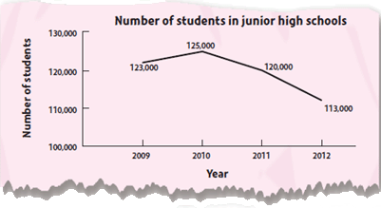
B Look at the line graph on p. 28 about the number of students at junior high schools in May’s city. Then write a report by following the example in A.

Slide 19
Number of students in junior high schools
The graph shows that there were 123,000 students at junior high schools in May’s city in 2009. In 2010, the number rose to 125,000, and then fell to 120,000 in 2011. In 2012, the number fell again to 113,000.

Slide 20
Thank you!

