Slide 1
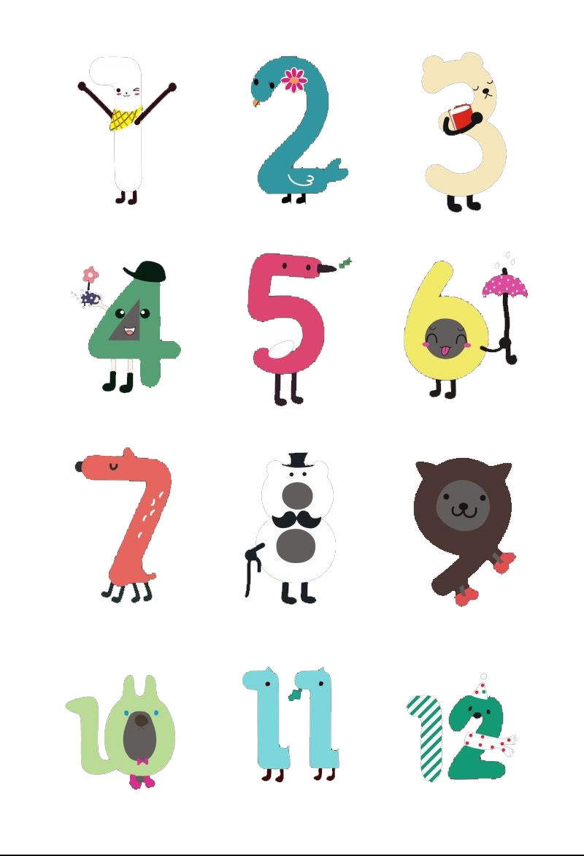
Unit 2 Numbers
Grammar

Slide 2
Grammar A
Numbers consist of cardinal numbers and ordinal numbers.
表示数目多少的数词叫_____；表示顺序的数词叫_____。
基数词
序数词
Cardinal [ˈkɑ:dɪnl]
基数词
Ordinal [ˈɔ:dɪnl]
序数词

Slide 3

基数词的构成
1）1－12, 独立成词。
one two three four five six
seven eight nine ten eleven twelve
2）13--19, 由3－9 + teen构成。读时，重音落在最后一个音节。
14–fourteen 16--sixteen 17--seventeen 19—nineteen
特殊拼写: 13– 15-- 18—
thirteen
fifteen
eighteen

Slide 4
3）20－90, 以-ty结尾。
正常拼写： 60---sixty 70---seventy 90—ninety
特殊拼写：20— 30---
40— 50— 80---
4）21－99， 两位数，十位与个位之间必须有 “-”。
21 twenty-one 55 fifty-five 99 ninety-nine
twenty
thirty
forty
fifty
eighty

Slide 5
5）101—999，三位数，百位与十位之间加and，若十位上数字为0，则百位与个位之间加上and。
111
one hundred and eleven
182
one hundred and eighty-two
101
one hundred and one
102
one hundred and two

Slide 6


Practice
432
four hundred and thirty-two
170
one hundred and seventy
865
eight hundred and sixty-five
109
one hundred and nine

Slide 7

6) 若位数在四位及以上，每三位数加一个逗号，从右往左数，第一个逗号前的数为_________，第二个逗号前的数为_________（百万）, 第三个逗号前的数为__________（十亿），第四个逗号前的数为____________（万亿）。
thousand
million
billion
trillion
trillion [ˈtrɪljən] 万亿
billion [ˈbɪljən] 十亿
million [ˈmɪljən] 百万
thousand ['θaʊznd] 千
hundred [ˈhʌndrəd] 百

Slide 8
How to read “888888888888888”?
888,888,888,888,888
eight hundred and eighty-eight trillion,
eight hundred and eighty-eight billion,
eight hundred and eighty-eight million,
eight hundred and eighty-eight thousand,
eight hundred and eighty-eight

Slide 9
Practice
and
,
,
6
500
431
,
7
29
hundred
thousand,
million,
billion,

Slide 10
6 500 431 729
six billion, five hundred million, four hundred and thirty-one thousand, seven hundred and twenty-nine

Slide 11
4,321
four thousand, three hundred and twenty-one
4321
7,654,321
seven million,six hundred and fifty four thousand, three hundred and twenty-one
1,987,654,321
one billion, nine hundred and eighty-seven million,six hundred and fifty-four thousand, three hundred and twenty-one

Slide 12
写出下面数字：
1. three thousand eight hundred and sixty-two
2. eighteen thousand nine hundred and seventy-two
3,862
18,972
3. four hundred and eighty-nine thousand, nine hundred and thirty-two
4. one thousand, twenty-nine
5. eight thousand, four
489,932
1,029
8,004

Slide 13
基数词的用法
1、表示具体数目,hundred, thousand, million等不用复数
表示不确定数目, 则用hundreds of,
thousands of, millions of+ 名词复数。
我们国家有14亿人口。
1) Our country has a population of 1,400 million people.
战争过后，成千上万的人无家可归。
2) After the war, thousands of people became
homeless.

Slide 14
序数词的构成
1) 1－3, first, second, third
2) 4－19, 相应基数词+th,
特殊拼写：
第五：
第八：
第九：
第十二：
fifth
eighth
ninth
twelfth

Slide 15
3) 20－90, y变成ie +th。
twenty-twentieth,
sixty-sixtieth,
ninety-ninetieth
4) 21－99, 十位数用基数词，个位数用序数词，中间必须有连字符“-”。
twenty-first, sixty-eighth, ninety-ninth
5) 百、千、万等序数词由hundred， thousand等加-th，
前面加有关的基数词构成。
one hundredth two thousandth
6) 序数词缩写：数字＋最后两字母
['twentɪəθ]
['sɪkstɪəθ]
['naɪntɪəθ]
如1st, 2nd, 3rd ,4th…

Slide 16
review：基数词、序数词
基数词 | 序数词 | 基数词 | 序数词
one |  | twelve
two |  | twenty
three |  | twenty-one
four |  | forty
five |  | one hundred
six |  | one hundred and five
eight |  | one hundred and twenty-nine
nine |  | nineteen
twelfth
first
second
twentieth
twenty-first
third
fourth
fortieth
fifth
one hundredth
one hundred and fifth
sixth
one hundred and twenty-ninth
eighth
ninth
nineteenth

Slide 17
序数词的用法
(1)序数词作定语，前面要加the；若序数词前有别的修饰词，the省略。
The first truck is carrying a food basket．
John lives on the fifteenth floor．
She is my first English teacher.
(2)有时序数词前加a/an，表示“再一”，“又一” 。
When I sat down, a fourth man rose to speak．
They had a second child in 1988.

Slide 18
A Cardinal and ordinal numbers
We use cardinal numbers to count things.
3 three 13 thirteen 20 twenty 70 seventy
11 eleven 15 fifteen 30 thirty 82 eight-two
12 twelve 18 eighteen 50 fifty 98 ninety-eight
100 one hundred
200 two hundred
375 three hundred and seventy-five

Slide 19
1,000 one thousand
4,189 four thousand one hundred and eighty-nine
15,362 fifteen thousand three hundred and
sixty-two
100,000 one hundred thounsand
285,643 two hundred and eight-five thousand six
hundred and forty-three
1,000,000 one million
3,367,982 three million three
hundred and sixty-seven
thousand nine hundred and eighty-two

Slide 20
p23
Work out the rule
In the cardinal numbers, we do not add-s to hundred, _________and__________.
With large numbers, we put _________ between hundred and ten.
thousand
million
and

Slide 21
We use ordinal numbers to show the order of things.
1st first 7th seventh 13th thirteenth 19th nineteenth
2nd second 8th eighth 14th fourteenth 20th twentieth
3rd third 9th ninth 15th fifteenth 21st twenty-first
4th fourth 10th tenth 16th sixteenth 33rd thirty-third
5th fifth 11th eleventh 17th seventeenth 40th fortieth
6th sixth 12th twelfth 18th eighteenth 100th hundredth

Slide 22
Work out the rule
We form most ordinal numbers by adding ________to the cardinal numbers. There are exceptions, like first, second and third.
-th

Slide 23
p24 The students are standing in a line. They each have a number (from 1 to 28). Fill in the blanks with cardinal numbers on the left and ordinal numbers on the right.
1 May May is the(1)_____.
(2)_____ Alan Alan is the second.
3 Danny Danny is the (3)_____.
4 Jane Jane is the(4)_____.
12 Peter Peter is the(5) ______.
(6) _____ Alice Alice is the nineteenth.
23 Steve Steve is the(7)______.
28 Zoe Zoe is the(8)_______.
first
2
third
fourth
twelfth
19
twenty-third
twenty-eighth

Slide 24
Exercises
一、根据句意，填入适当的数词
Thursday is the ______ day of a week in the
West.
2. Autumn is the ______ season of a year.
3. Christmas is on December the _______
each year.
4. August is the ______ month in a year.
5. June the ______ is Children’s Day.
fifth
third
twenty-fifth
eighth
first

Slide 25
二、用括号内所给单词的正确形式填空。
1. This is his __________(thirty) novel.
2. This happened at the beginning of the
__________(twenty-one) century.
3. Mother’s Day is on the __________ (two)
Sunday in May.
4. Although he got the _______ (four) place in
the competition, that was good enough for him.
5. Tomorrow is my grandmother’s
__________ (eighty-nine) birthday.
We will have a big party for her.
thirtieth
twenty-first
second
fourth
eighty-ninth

Slide 26
三、选择最佳答案填空。
( )1. July is ____ month of a year.
A. six B. the sixth
C. seven D. the seventh
( )2. Five ____ dollars is a lot of money.
A. million B. millions
C. the million D. the millions
( )3. The beautiful hotel is about ____ years old.
A. hundred of B. a hundred
C. a hundred of D. hundreds
D
A
B

Slide 27
B Instructions about numbers
加减乘除表达法（2种）
1. 没有给出结果的加减乘除英文表达法
3+9
2. 给出结果的加减乘除英文表达法
3+9=12

Slide 28
B Instructions about numbers
1. 没有给出结果的加减乘除英文表达法
3+9
Add 3 and 9.
祈使句，以v.原开头。
add： v.原
A+B
Add A and B.
Add 8 and 3.
8+3.
Add 12 and 14.
12+14.

Slide 29
9-3
Subtract 3 from 9.
祈使句，以v.原开头。
Subtract…from：[səbˈtrækt] v.从…中减去
A-B
Subtract B from A
8-3
Subtract 3 from 8
Subtract 4 from 18
18-4

Slide 30
3 x 9
Multiply 3 by 9.
祈使句，以v.原开头。
multiply ：[ˈmʌltɪplaɪ] v.乘
A x B
Multiply A by B
Multiply 4 by 5
4 x 5
Multiply 6 by 9
6 x 9

Slide 31
9 ÷ 3
Divide 9 by 3.
祈使句，以v.原开头。
divide ：[dɪˈvaɪd] v.除
A ÷ B
Divide A by B
14 ÷ 2
Divide 14 by 2.
15 ÷ 5
Divide 15 by 5.

Slide 32
小结
1. 没有给出结果的加减乘除英文表达法
（1）要用祈使句，以v.原开头。
Add A and B.
A+B
A-B
Subtract B from A.
A x B
Multiply A by B.
Divide A by B.
A ÷ B

Slide 33
B Instructions about numbers
2. 给出结果的加减乘除英文表达法
3+9=12
用陈述句。
3 plus 9 equals/is 12.
谓语动词是哪个？
equals/is
plus
equal
介词，“加”
v.等于
A+B=C
A plus B equals/is C.
4+5=9
4 plus 5 equals/is C.
12 plus 1 equals/is 13.
12+1=13

Slide 34
B Instructions about numbers
9-3=6
用陈述句。
9 minus 3 equals/is 6.
谓语动词是哪个？
equals/is
minus
介词，“减”
A-B=C
A minus B equals/is C.
5-1=4
5 minus 1 equals/is 4.
12 minus 1 equals/is 11.
12-1=11

Slide 35
B Instructions about numbers
3 x 9 =27
用陈述句。
3 multiplied by 9 equals/is 27.
谓语动词是哪个？
equals/is
Multiplied by
过去分词，“乘以”
A x B=C
A multiplied by B equals/is C.
4x1=4
4 multiplied by 1 equals/is 4.
12 multiplied by 2 equals/is 24.
12x2=24

Slide 36
B Instructions about numbers
9 ÷ 3 =3
用陈述句。
9 divided by 3 equals/is 3.
谓语动词是哪个？
equals/is
divided by
过去分词，“除以”
A divided by B equals/is C.
A ÷ B=C
4 ÷ 1=4
4 divided by 1 equals/is 4.
12 ÷2=6
12 divided by 2 equals/is 6.

Slide 37
小结
2. 给出结果的加减乘除英文表达法
要用陈述句，谓语动词是equals/is。
A plus B equals/is C.
A+B=C
A minus B equals/is C.
A-B=C
A multiplied by B equals/is C.
A x B=C
A divided by B equals/is C.
A ÷ B=C
用作运算的数词作主语，谓语动词常用单数。

Slide 38
Read the instructions aloud.
2+10
Add 2 and 10.
10-2
Subtract 2 from 10.
2 × 10
Multiply 2 by 10.
10÷2
Divide 10 by 2.

Slide 39
Read the statements aloud.
2+10 = 12
2 plus 10 equals/is 12.
10-2 = 8
10 minus 2 equals/is 8.
2 × 10 = 20
2 multiplied by 10 equals
/is 20.
10÷2 = 5
10 divided by 2 equals
/is 5.

Slide 40
选择题
1. 4 5 is 9.
plus B. minus C. multiplied by D. divided by
2. 63 9 equals 7.
plus B. minus C. multiplied by D. divided by

Slide 41
In pairs, complete the sentences like those in Table I and Table II.
dd
and
1 S1: A 11 _____ 1.
S2: p equals/is .
( )
2 S1: S__________ 5 __________ 13.
S2: _____ m_____ ______ equals/is ___.
( )
3 S1: M__________ 7 _____8.
S2: _____m_________by_____ equals/is____.
( )
11
lus
1
12
11+1=12
ubtract
from
13
inus
5
8
13-5=8
ultiply
by
7
ultiplied
8
56
7x8=56

Slide 42
ivide
4 S1: D_________ 16 ____ 4.
S2: ____d _______ by ____ equals / is ____.
( )
5 S1: A ____ 9 ______6.
S2: ____ p ____ _____ equals / is ____.
( )
6 S1: A______14 and 4 and d_____ the answer
by 2.
S2:_______ p____ ____ and d_____ the
answer by ______ equals / is ______.
( )
by
16
ivided
4
4
16÷4= 4
dd
and
9
lus
6
15
9+6= 15
dd
ivide
14
lus
4
ivide
2
9
(14+4) ÷2= 9

Slide 43
Play a math game!
Group 1: ask math questions in English(用英语问问题）
Group 2: answer math questions in English(用英语回答问题）
If group 2 answers the question correctly, it can get 1 point. If not, group 1 can get 1 point.
当答题组答对问题时，答题组得一分。答不对时，出题组得一分。
When one group gets a point, the other group must find another group member to ask or answer questions.
当任意一组的得分时，另一组要换人问/回答问题。
Group 1: Add 6 and 8
Group 2: 6 plus 8 is/equals 14.
Group 1: Subtract 2 from 8
Group 2: 8 minus 2 is/equals 6.
Group 1: Multiply 2 by 8
Group 2: 2 multiplied by 8 is 16.
Group 1: Divide 8 by 2
Group 2: 8 divided by 2 is 4.

Slide 44
Part III Review

Slide 45
Exercises
一、根据句意，填入适当的数词
Thursday is the ______ day of a week in the
West.
2. Autumn is the ______ season of a year.
3. Christmas is on December the _______
each year.
4. August is the ______ month in a year.
5. June the ______ is Children’s Day.
fifth
third
twenty-fifth
eighth
first

Slide 46
二、用括号内所给单词的正确形式填空。
1. This is his __________(thirty) novel.
2. This happened at the beginning of the
__________(twenty-one) century.
3. Mother’s Day is on the __________ (two)
Sunday in May.
4. Although he got the _______ (four) place in
the competition, that was good enough for him.
5. Tomorrow is my grandmother’s
__________ (eighty-nine) birthday.
We will have a big party for her.
thirtieth
twenty-first
second
fourth
eighty-ninth

Slide 47
三、选择最佳答案填空。
( )1. July is ____ month of a year.
A. six B. the sixth
C. seven D. the seventh
( )2. Five ____ dollars is a lot of money.
A. million B. millions
C. the million D. the millions
( )3. The beautiful hotel is about ____ years old.
A. hundred of B. a hundred
C. a hundred of D. hundreds
D
A
B

Slide 48
in
We are going to the Mars a spaceship.
= We are going to the Mars spaceship.
By+交通工具=in a/an/the +交通工具
The courses I took part in during the summer holiday i maths, English and physics.
I can speak a lot of languages, i Latin, English, French and Chinese.
by
ncluded
ncluding

Slide 49
Thank you!

