Slide 1

Oxford English
Unit
2
Daily life
Speaking
1. Read an article about Fang Fang's daily life
2. Practice speaking
3. To talk about others' daily lives
4. To learn how to plan the time table

Slide 2

Fang Fang's daily life
Fang Fang is a Grade 7 student. She gets up at 6:30 a.m. every day. Then she washes her face and brushes her teeth. At 7 a.m., she has breakfast. She often eats some bread and drinks a glass of milk. She never eats noodles in the morning.
Fang Fang lives close to school, so she always goes to school on foot at 7:30. a.m. She has classes from 8:30 a.m. to 4 p.m.
After school, she plays basketball with her friends three times a week. She goes home at 4:45 p.m.
Fang Fang usually has dinner at 6:30 p.m. She sometimes watches TV in the evening. She always goes to sleep and seldom goes to bed too late.

Slide 3
Fang Fang's daily life
Fang Fang is a Grade 7 student. She gets up at 6:30 a.m. every day. Then she washes her face and brushes her teeth. At 7 a.m., she has breakfast. She often eats some bread and drinks a glass of milk. She never eats noodles in the morning.
Fang Fang lives close to school, so she always goes to school on foot at 7:30. a.m. She has classes from 8:30 a.m. to 4 p.m.
After school, she plays basketball with her friends three times a week. She goes home at 4:45 p.m.
Fang Fang usually has dinner at 6:30 p.m. She sometimes watches TV in the evening. She always goes to sleep and seldom goes to bed too late.

Slide 4

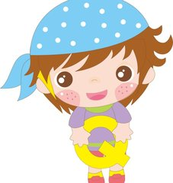
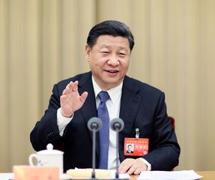
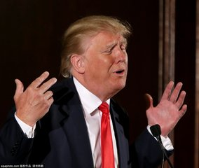
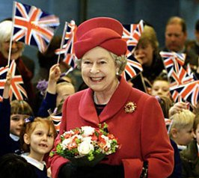
Group work
Making an interview
For example: one reporter and three leaders
Reporter: What do you usually do in the morning, Mr. Trump?
Trump: I uaually get up at 7:00 a.m. and ....
Reporter: What do you sometimes do in the afternoon?
Trump: I sometimes...
Reporter: What do you never/ seldom do in the eveving?
Trump: I never...
Reporter: How often do you visit China?
Trump:...

Slide 5
Role-play
Assessment(评价)
fill in the time table | 1 point
teamwork | 2 points
content(内容) | 3 points
intonation(语调) | 3 points
volume(音量) | 1 point

Slide 6

Retell your partner's ideal daily life.
Pair work
Pair work
Discuss with your partner about his/ her ideal（理想中的）daily life.
My partner is Doris. She gets up at 6:00 a.m.. She always previews Maths at 7:20 a.m.
At 8:00 a.m., she often has Maths class....
Time | Activity
at 6:00 a.m. | gets up
at 7:20 a.m. | previews Maths
at 8:00 a.m. | has Maths class
at 12:30 p.m. | does Maths homework
... | ...
... | ...
at 10:00 p.m. | goes to sleep
Time | Activity
at 11:00 a.m. | gets up
at 1: 10 p.m. | has breakfast
at 2:00 p.m. | eats snacks and watches TV
at 3:p.m. | sleeps
... | ...
... | ...
at 11:50 p.m. | goes to bed
 | Assessment
content(内容) | 3 points
intonation(语调) | 3 points
teamwork | 2 points
volume(音量） | 2 points

Slide 7
Sum up
1. Different people have different daily lives.
We should respect(尊重) the differences.
2. Daily life is common(平凡的), but we are not common.
Everyone plays an important role in his daily life.
3. Plan our time well and we will be a better Junior High School student.
4....

Slide 8
Homework
1.Write down the daily life of the people your group have talked about.
2. Make your partner's ideal time table for daily life.

Slide 9

】】】】】】】】】】】】】】】】】】】】】】】】】】】】】】】】】】】】】】】】】】】】】】】】】】】】】】】】】】】】】】】】】】】】】】】】】】】】】】】】】】】】】】】】】】】】】】】】】】】】】】】】】】】】】】】】】】】】】】】】】】】】】】】】】】】】】】】】】】】】】】】】】】】】】】】】】】】】】】】】】】】】】】】】】】】】】】】】】】】】】】】】】】】】】】】】】】】】】】】】】】】】】】】】】】】】】】】】】】】】】】】】】】】】】】】】】】】】】】】】】】】】】】】】】】】】】】】】】】】】】】】】】】】】】】】】】】】】】】】】】】】】】】】】】】】】】】】】】】】】】】】】】】】】】】】】】】】】】】】】】】】】】】】】】】】】】】】】】】】】】】】】】】】】】】】】】】】】】】】】】】】】】】】】】】】】】】】】】】】】】】】】】】】】】】】】】】】】】】】】】】】】】】】】】】】】】】】】】】】】】】】】】】】】】】】】】】】】】】】】】】】】】】】】】】】】】】】】】】】】】】】】】】】】】】】】】】】】】】】】】】】】】】】】】】】】】】】】】】】】】】】】】】】】】】】】】】】】】】】】】】】】】】】】】】】】】】】】】】】】】】】】】】】】】】】】】】】】】】】】】】】】】】】】】】】】】】】】】】】、】

