Slide 1
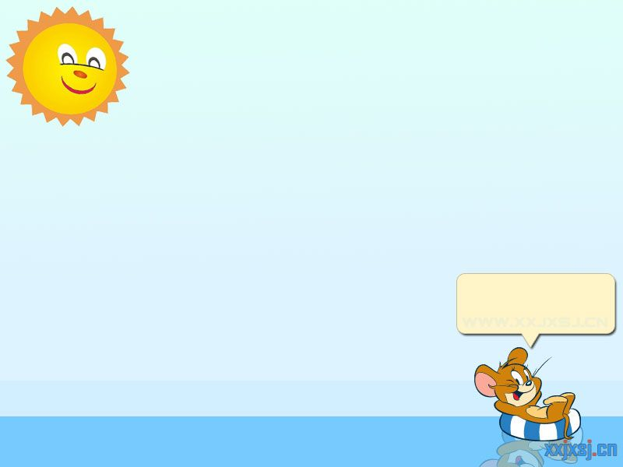
Unit 8 Writing
My collection
Miss Bear

Slide 2
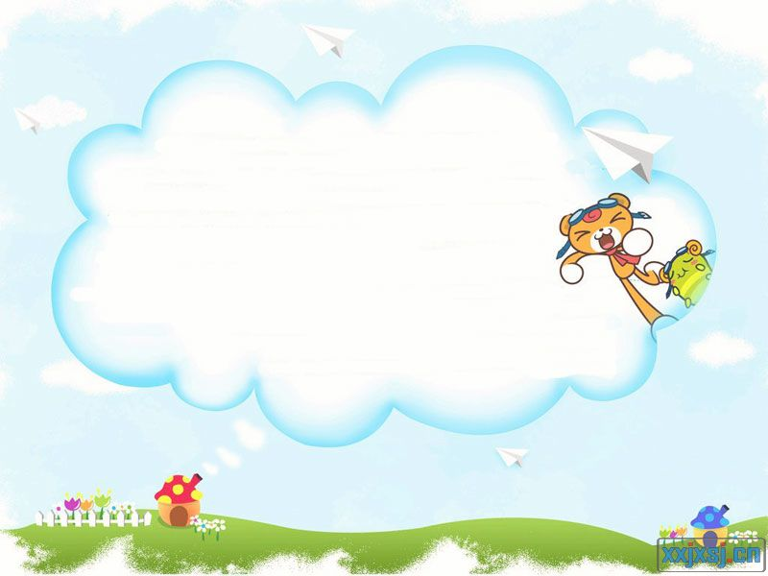
Let's recall!
Unusual collections

Slide 3
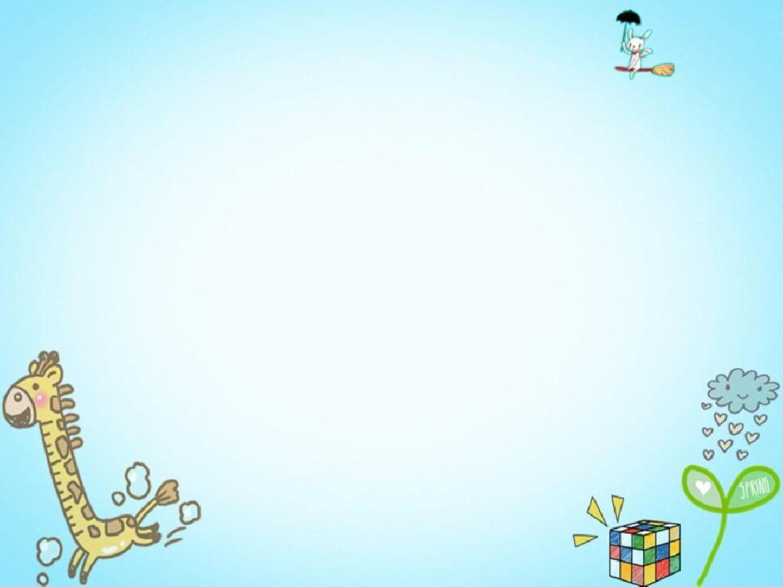
Read the article on page 109 and fill in the spidergram.
Fast-reading
My collection
...
__________
Topic?
__________
Personal pronoun
feelings
__________
Sentence pattern?
__________
Tense?
When?
Passage structure?
__________
__________

Slide 4
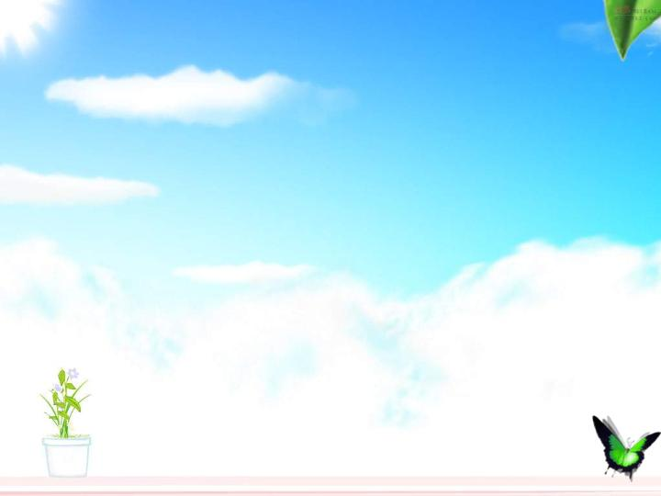
Detailed-reading the article: My collection
learn about
learn about
...
...
My collection
What?
What?
feelings
feelings
How?
How?
When?
When?
How many?
How many?

Slide 5
Write an article: My collection
...
6.learn about
1.What?
How to write
My collection
5.Feelings
2. When?
4.How?
Miss Bear
3.How many/...?

Slide 6
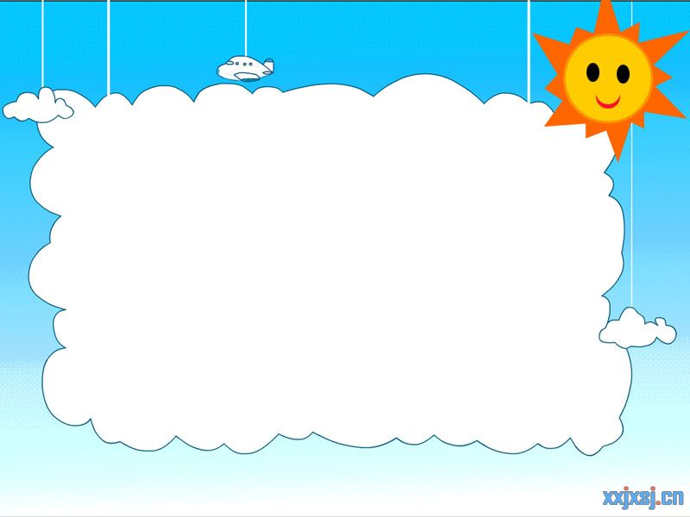
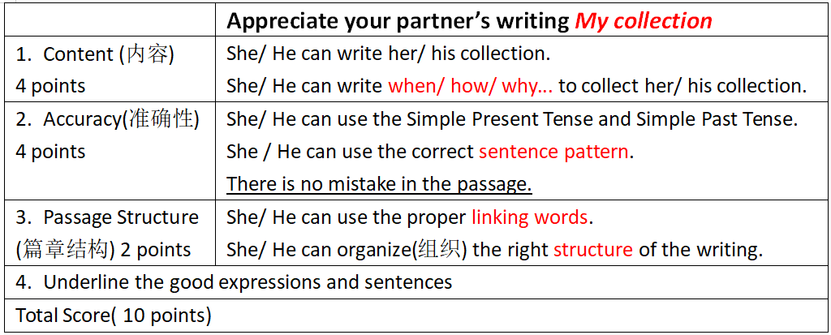
Appreciate partner's My collection
Listeners write down what you hear in the table.

Slide 7
Summary
My collection
...
Topic?
Personal pronoun
Sentence pattern?
Tense?
Passage structure?
Miss Bear

Slide 8
Summary
...
6.learn about
1.What?
How to write
My collection
5.Feelings
2. When?
4.How?
Miss Bear
3.How many/...?

Slide 9
Homework
Retell “My collection” you heard.
Pay attention to the personal pronoun.

