Slide 1
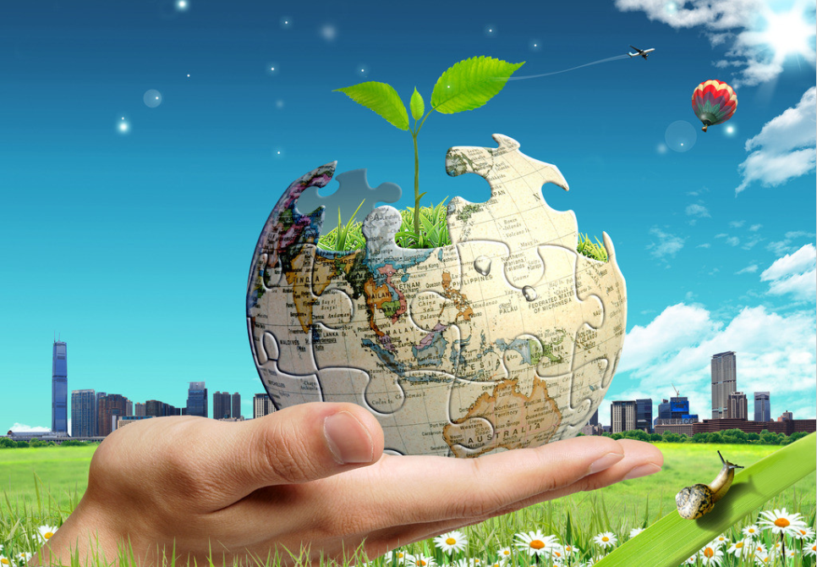
Unit 3 The Earth
Writing

Slide 2
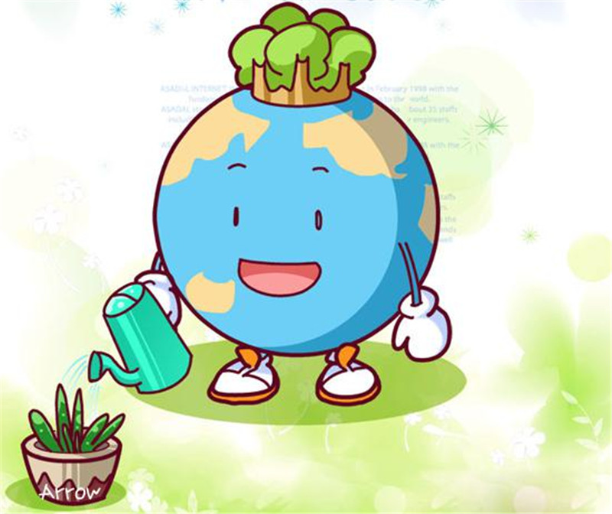
为什么要写作？
因为写作是最能考察出考生的综合能力。
综合能力指什么？
一、是否清楚有效地阐明自己的观点
二、是否用贴切的事理和事例支撑观点
三、语言的运用能力否胜任以上两点
考生的理解，分析和推理能力
＜
考生的语法，词汇，句型的运用能力

Slide 3
名词你学好了吗？
动词你真的会了吗？
1 白色污染随处可见。
White pollution is everywhere.
White pollution is all over the city.
White pollution can be found everywhere.
White pollution can be seen everywhere.
2 空气不是很好。
The air isn’t very good.
We can’t breathe the fresh air.
形容词、副词你理顺了吗？

Slide 4
名词你学好了吗？
动词你真的会了吗？
3 人们过多使用一次性用品，如塑料瓶，所料袋，塑料饭合等。
People use too many disposable things like plastic bottles, plastic bags and plastic lunch boxes.
People use too many disposable things such as plastic bottles, plastic bags and plastic lunch boxes.
People use disposable things too much such as plastic bottles, plastic bags and plastic lunch boxes.
形容词、副词你理顺了吗？
介词你又如何？

Slide 5
名词你学好了吗？
动词你真的会了吗？
4 马路上的汽车越来越多。
There are more and more cars on the road/ in the street.
More and more people drive their own cars.
5 人们应尽量使用自己的杯子。
People should use their own glasses as much as they can.
People should try to use their own glasses.
形容词、副词你理顺了吗？
介词你又如何？

Slide 6
名词你学好了吗？
动词你真的会了吗？
6 人们应多使用公共交通。
People should use public transportation as much as they can.
People should try to use public transportation.
7 乘公共汽车和使用共享单车是个不错的主意。
It is a good idea to take buses or use shared bikes.
It is a good idea to go out by bus or by shared bike.
Taking buses or riding shared bikes is a good idea.
形容词、副词你理顺了吗？
介词你又如何？

Slide 7
连词和连接词你会用吗？
现象句+ because + 原因句
White pollution is everywhere because people use too many disposable things like plastic bottles, plastic bags and plastic lunch boxes.
现象句. Why? Because + 原因句
White pollution can be found everywhere. Why? Because
People use disposable things too much such as plastic bottles, plastic bags and plastic lunch boxes.
现象句+ because of+ 原因名词
The air isn’t very good because of the gradual increase of cars.
现象句. It is because + 原因句
The air isn’t very good. It’s because there are more and more cars on the road.

Slide 8
连词和连接词你会用吗？
First of all, white pollution is everywhere because people use too many disposable things like plastic bottles, plastic bags and plastic lunch boxes. So I advise that people should use their own glasses as much as they can.
Also, we can’t breathe the fresh air. it’s because there are more and more cars in the street. The government should ask people to use public transportation more often. For example, taking buses or riding shared bikes is a good idea to reduce waste gases.

Slide 9
a few | “ 少数；几个”，修饰可数名词复数，表肯定。 | He left his house a few minutes ago . 她几分钟前离开了家。
few | “几乎没有的，很少的”修饰可数名词复数，表否定 | There are few people in the room . 房间里几乎没有人。
a little | “一点；少许”，修饰不可数名词，表肯定 | Could you give me a little milk ? 给我一点牛奶好吗？
little | “几乎没有的，很少的”，修饰不可数名词，表否定 | There was little rain all winter . 整个冬天几乎没下雨
 | 可数 | 不可数
肯定
否定
总结
a few
a little
few
little

Slide 10
problem 问题，难题
problem＆question
你能回答这个问题吗？
Can you answer this question？
你的问题(困难)是什么？你能自己解决吗？
What's your problem? Can you solve it by yourself?
生词 | 意思 | 搭配
problem | 须待解决的问题，就困难而言。 | solve the problem
question | 须待解答的问题，就疑问而言。 | answer the question

Slide 11
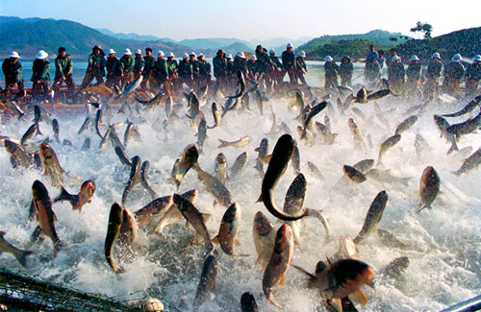
people/catch a lot of
fish every day/fewer
and fewer fish in the
sea each year

Slide 12
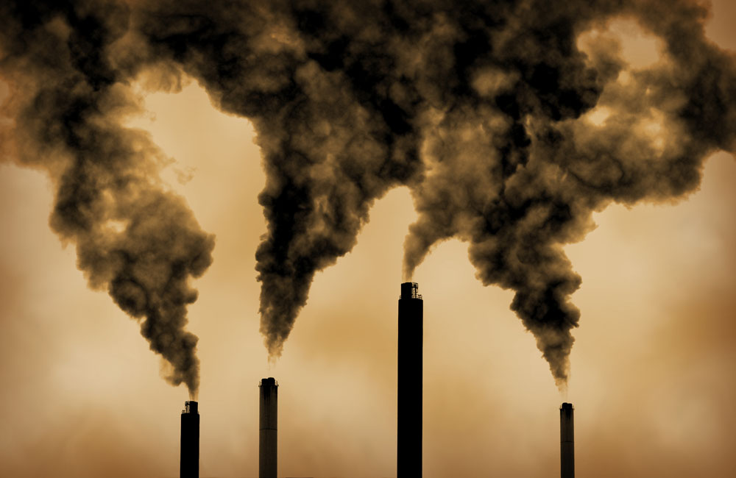
people/burn things to
make energy/pollute
the air

Slide 13
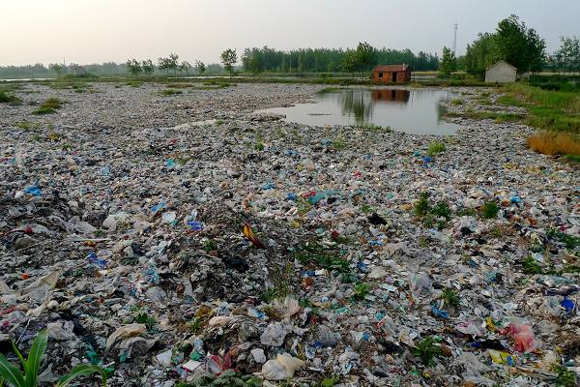
People/throw away a lot
of rubbish every
day/pollute the land

Slide 14
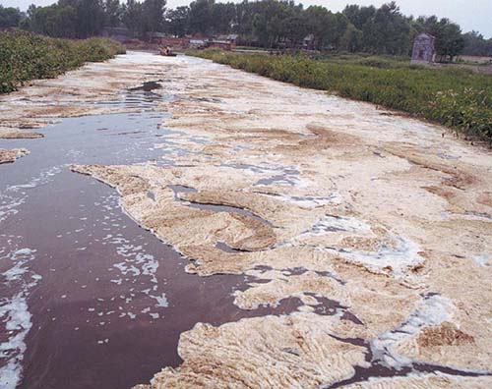
people/put waste
into rivers and
seas/pollute the
water

Slide 15
• We should eat less seafood/fish.
• We should not catch small fish.
• Some factories make a lot of pollution. We
should close them.
• We should not put rubbish into rivers and
seas.

Slide 16
What problems do we have?
People______________________________.
There are ___________________________.
People _____________________________.
This _______________________________.
People _____________________________.
This _______________________________.
People _____________________________.
This _______________________________.
catch a lot of fish every day
fewer and fewer fish in the sea each year
burn things to make energy
pollutes the air
throw away a lot of rubbish every day
pollutes the land
put waste into rivers and seas
pollutes the water

Slide 17
What can we do to protect the Earth?
We must stop ________________________.
___________________________________.
catching a lot of fish every day
We must stop burning things to make energy
(or) We must stop throwing away a lot of
rubbish every day.
(or) We must stop putting waste into rivers
and seas.

