Slide 1
UNIT5 EDUCATIONAL EXCHANGES
n
E
a
c
d
u
t
i
o
Grammar （present perfect tense）

Slide 2
1. 现在完成时的构成
Observe(观察) the following sentences and work out the basic structure of present perfect tense.
I have been to the Great wall and the Forbidden City.
He has visited the Summer Palace and the Temple of Heaven.
They have stayed in Beijing for 2 weeks.
have (has）+ 过去分词

Slide 3
动词过去分词的几种基本形式
The past participle(过去分词) of a regular verb is usually the same as its past tense. You can find the past participles of some irregular verbs on pages 141 and 142.
AAA型
ABB型
ABC型
hit-hit--hit
do-did-done
find-found-found
let-let--let
go-went-gone
feel-felt--felt
read-read--read
eat-ate-eaten
have-had--had
cost-cost--cost
be-was/were-been

Slide 4
动词过去分词的基本构成
ABA型
come-came-come
become-became-become
AAB型
beat-beat-beaten

Slide 5
I/You/We/They | have made | a lot of new friends.
 | have not made
Have | I/you/we/they | made | a lot of new friends?
Yes, | you/I/we/they | have.
No, |  | have not.
He/She/It | has made | a lot of new friends.
 | has not made
Has | he/she/it | made | a lot of new friends?
Yes, | he/she/it | has.
No, |  | has not.
negative sentence
question
positive answer
negative answer
third person singular
negative sentence
question
positive answer
negative answer

Slide 6
Work out the rule (p71)
We form the present perfect tense with _____ or _____ + the past participle (过去分词) of the main verb.
have
has
Things to remember
I / You / We / They have = I’ve/You’ve/We’ve/They’ve
He/She/It has = He’s/She’s/It’s
have not = haven’t has not = hasn’t

Slide 7
Write the words in the present perfect tense.
 | the simple present tense | the present perfect tense
1
2
3
4
5
6
7
8
9
you allow
you have allowed
he goes
he has gone
we are
we have been
you sing
you have sung
they teach
they have taught
I bring
I have brought
she sits
she has sat
we swim
we have swum
he opens
he has opened

Slide 8

(p72)Eric has been in Beijing for a week. Complete his email to his mother with the present perfect tense of the verbs in brackets.
To: Mum
From: Eric
Dear Mum,
I’ve been in Beijing for a week now. I ⁽¹⁾ ______
(meet) my host family. They’re really friendly.
My host brother Wei and I ⁽²⁾___________ (play)
a lot of football at a park near his home. We both
enjoy football very much. Mrs Li, my host
mother, ⁽³⁾ __________ (cook) me delicious
Chinese food.
have met
have played
has cooked

Slide 9
I ⁽⁴⁾______________ (study) Chinese with my
British classmates. We ⁽⁵⁾ ___________ (see)
some places of interest in Beijing too. However,
I ⁽⁶⁾ _______________ (not, visit) the Great Wall
yet, and I ⁽⁷⁾ ____________ (not, do) any
shopping either. I’ll do these things next week.
Love,
Eric
have studied
have seen
haven’t visited
haven’t done

Slide 10
2. 现在完成时的主要用法
1.表示过去发生的某一动作对现在造成的影响或结果。
-- It’s so dark.
-- Someone has turned off the light.
(有人刚把灯关了，现在很黑)
-- Are you free?
-- I have finished my homework. I am free.
(我已经完成了家庭作业，现在有空)

Slide 11
2.表示曾有过或到目前为止从未有过的经历.
我曾游览过颐和园。
I have visited the Summer Palace.
我从未去过太空旅行。
I have never travelled to space.

Slide 12
3.表示过去某一时间开始并一直持续到现在的动作或状态，常和表示一段时间的时间状语连用，谓语动词多用延续性动词。
他们已经在这儿住了30年。
They have lived here for 30 years. (for + 时间段)
(30年以前开始住在这儿，现在还住在这儿。)
我从五岁时就学英语。
I have learned English since I was five years old. （since + 时间点）
(五岁时开始学英语，到现在还在学。)

Slide 13
3. 现在完成时的时间状语
现在完成时常与①already, ② yet, ③ never, ④ ever, ⑤before, ⑥ up to now, ⑦ so far,
⑧ since+（过去）时间点/一般过去时的从句,
⑨ for+时间段等连用。

Slide 14
1. already & yet
yet表示某事还未发生，或者询问某事是否已经发生。用于否定句（“尚未，仍未”）和疑问句（“已经”）。一般用于句末，表强调时也可出现在句中。
Have you seen the Great Wall yet?
No, I have not seen the Great Wall yet.
already表示“已经”，强调某事已经发生，或者某种情况已经开始存在。用于肯定句。可位于句中助动词之后，实义动词之前。也可位于句末。
Sarah has already seen many places of interest in Beijing.
He has already got married.

Slide 15
2. ever & never
ever表示“在（以往）任何时候，在某时，曾经”，可用于疑问句、否定句、肯定句中，一般位于句中。
Have you ever visited the Summer Palace?
I haven’t ever forgotten what she did to me.
This is the most interesting film I have ever seen.
never表示“从来没有”，用于否定句，位于句中助动词之后，实义动词之前。
He has never been to Australia.

Slide 16
just表示“刚刚” ,常用于肯定句中，位于助动词have/has和动词过去分词之间。
3. just
他刚刚回来。
He has just come back.
他们刚刚完成那项工作。
They have just finished the work.

Slide 17
Work out the rule（p72）
We can use the adverbs already, ever and never
( before/after) have/has and (before/after) the main verb.
We often use yet at the ( beginning/end ) of a question or a negative sentence(否定句).

Slide 18
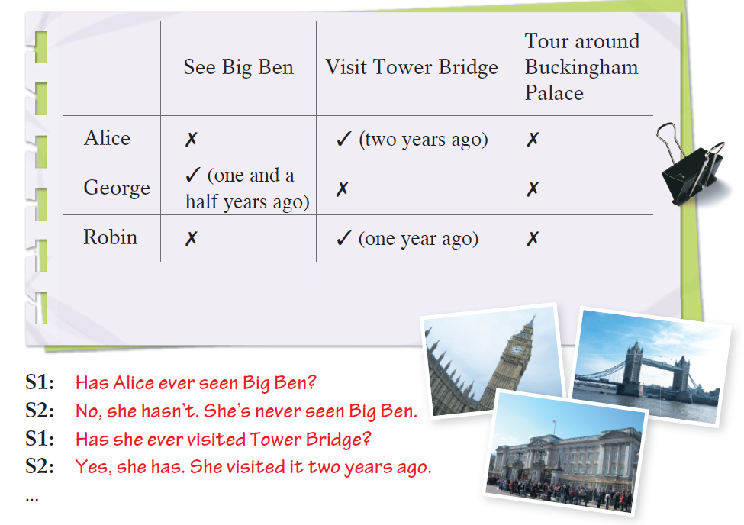
B1 (p73)Sarah wants to know whether the students from Beijing have visited any places in London before. Ask and answer questions in pairs.
[ˈbʌkiŋəm]
Can we say- ‘She has visited it two years ago?’

Slide 19
与一般过去时的用法比较
现在完成时，强调事情与现在保持的某种密切联系（如过去发生持续到现在并对现在产生了结果或影响等）;
一般过去时，则强调在过去已经发生并完成的的动作，与现在没有关系。
若文中出现明显的表示过去的时间状语，如one year ago, in 1999, last month, when I was five years old，just now(刚才)等，只能用一般过去时。
(注意：若时间状语为“since+表示过去的时间点”，则要用现在完成时)

Slide 20
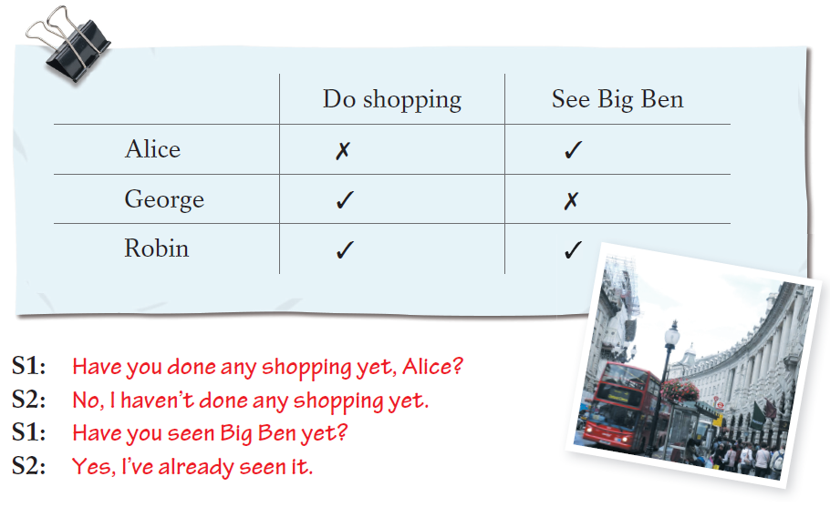
B2 Later Sarah is asking the students from Beijing about what they have and have not done in London. Ask and answer question in pairs. Follow the example.

Slide 21
Exercises
一、用所给动词的正确形式填空。
1. I _______ never _______(speak) to a foreigner.
2. — _______ Tom _______(return) the book to you？
— Yes, he has.
3. — Let’s go and see the film The Smurfs 2!
— No, thanks. I ______ already ______(see) it twice.
4. Please turn the radio down. Tim ______ just ______(fall) asleep.
5. — ______ you ever ______(sing) this song before?
— No, it is my first time.
have spoken
Has returned
have seen
has
fallen
Have sung

Slide 22
二、选择最佳答案填空。
( )1. — Have you ____ travelled by train?
— Yes, I have.
A. never B. ever C. just D. yet
( )2. — Have you finished your homework？
— Not ____.
A. yet B. already C. ever D. just
( )3. We haven’t studied Unit 6 ____.
A. never B. ever C. already D. yet
B
A
D

Slide 23
( )4. — Have you ____ learnt English?
— Yes, I’ve ____ learnt a lot.
A. never; ever B. ever; never
C. ever; already D. never; already
( )5. — Have you handed in your homework ____?
— Yes, I’ve done that ____.
A. yet; already B. already; yet
C. ever; never D. still; just
( )6. John’s father ____ borrowed some pictures.
A. have already B. has just
C. have ever D. has yet
( )7. He ____ returned the book to the library yet.
A. has B. hasn’t C. does D. doesn’t
C
A
B
B

Slide 24
三、完成下列练习。
1. I already (watch) the film. I
(watch) it last week.
2. he (finish) his work?
Not yet.
3. you ever (be) to Hong Kong?
Yes, I (be) there twice.
4. you ever (eat) a chocolate sundae?
No, never.
have watched
watched
Has finished
Have been
have been
Have eaten

Slide 25
Jim has gone to London with his family.
Have you been to Beijing before?
The Greens have been in China for two years.
What’s the difference?

Slide 26
比较：have been to, have gone to & have been in/at
have been to+地点 表示“某人曾经去过某地”，但现在已经不在那里了，后可接次数(once, twice, man times)，表示“去过某地几次”。
eg. My father has been to Guangzhou many times.
(去过广州很多次，现不在广州)
have gone to+地点 表示“某人到某地去”，现在人可能在去的途中或已在那儿了，但还未回来。
eg. – Where is Professor Wang?
-- He has gone to Netherlands. (去荷兰还未回来)

Slide 27
比较：have been to, have gone to & have been in/at
have been in/at +地点 表示“某人在某地(待了多久)”，后面常接表示一段时间的状语。
eg. The Greens has been in China for two years.

Slide 28
B
1. Mr. Li _______Kunming. He ______ the city three times. This time he ________ Kunming for three days.
has been to; has gone to; has been in
B. has gone to; has been to; has been in
C. has been in; has been to; has gone to
D. has gone to; has been in; has been to

Slide 29
Thank you!

