Slide 1
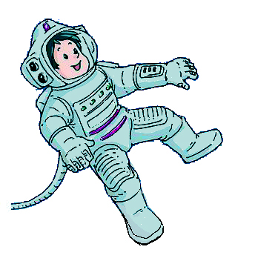

Unit 5 Visiting the Moon
Writing

Slide 2
目录
Review
1
Pre-Learning
2
While-Learning
3
Post-Learning
4

Slide 3
Part I Review

Slide 4
Look at Henry's notes about people's lives in the year 2050 after he watched a TV programme. Write sentences about what will or will not happen in 2050.
1. no more cars
2. people--travel by spaceship
3. robots--do housework
4. no more air pollution
1. There will be no more cars.
2. People will travel by spaceship.
3. __________________________________
4. __________________________________
Robots will do housework.
There won't be any more air pollution.

Slide 5
5. people--live longer
6. cities--more crowed
7. people--not use money
--have electronic credit cards
8. children--not go to school
--study at home by video
5. __________________________________
6. __________________________________
7. __________________________________
__________________________________
8. __________________________________
__________________________________
People will live longer.
Cities will be more crowded.
People won't use money. They will have
electronic credit cards.
Children won't go to school. They will
study at home by video.

Slide 6
Part II Pre-Learning

Slide 7
太空旅馆
2007年6月29日，由美国旅馆业大亨罗伯特·毕格罗投资建造的“太空旅馆”二号实验舱——“创世二号”，由俄罗斯“第聂伯”重型运载火箭发射升空并顺利进入预定轨道。此前，俄罗斯曾于2006年7月用同种火箭将“创始一号”实验舱送入太空。

Slide 8
太空旅馆的设计别具一格，主体是一个庞大环形室。环形室内部，设有居室、公园、运动场、游泳池、娱乐场、商店、医院、影剧院等。那里使用的交通工具是自行车和电动汽车。
在环形室主体外部，设置工业区和农业区。在工业区里，各类工厂生产太空旅馆工作人员和旅游者的生活必需品。在农业区里，则划分成若干个大大小小的区域，让它们之间的季节、时令、作物种类都穿插开来，以保证任何时候都有新鲜蔬菜和水果供应。农作物的生长是用阳光来控制的。

Slide 9
这里的阳光，是靠太阳光的照射、反射。在太空旅馆上设有一个巨大的天窗和反光镜，自行调节光的强度、照射时间和角度，从而形成分明的昼夜和四季的变化。
生活在太空旅馆里的人们，是从水的分解中获得氧气的，大片的植物光合作用提供给人类生存所必需的氧气。因此，除了水的原料需要从地球运外，其余资源都可向月球开发。

Slide 10
太空旅馆里的空气是新鲜的。因为它全身的结构是密封的，再加上太空旅馆是一个一个真正的电气化世界，一切动力都使用太阳能发的电，既没有燃烧煤、石油所引起的环境污染，也不会产生使人担心的核发电酿成的核辐射。
在环形室的另一头，还设有供航天客机停泊的机场。它一来接待来自地球的游客，二来也可以从这里乘航天客机去月球观光游览。

Slide 11
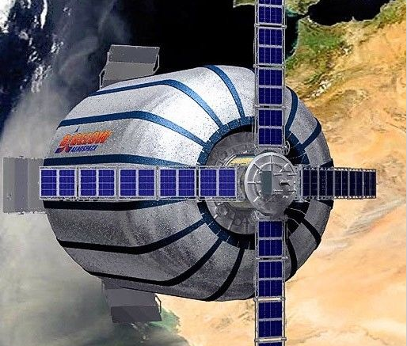
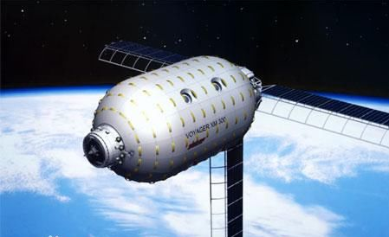
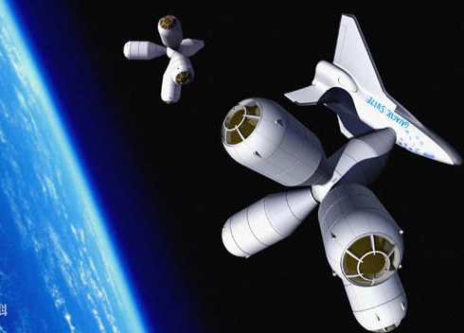
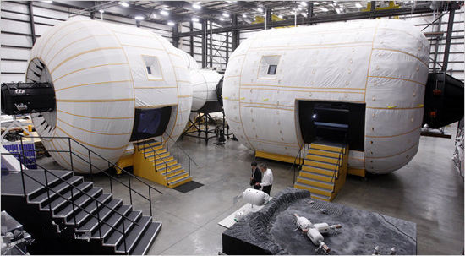

Slide 12
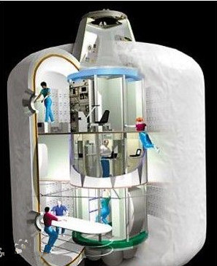
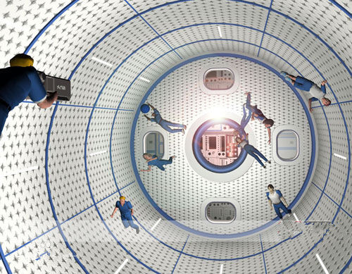
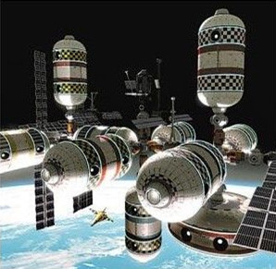
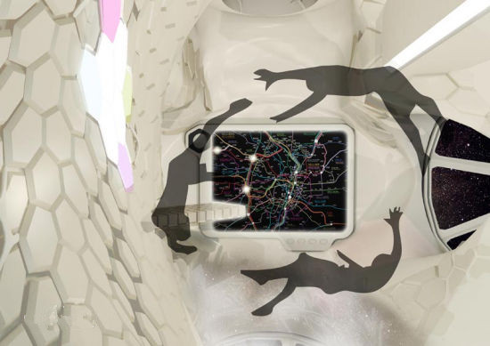

Slide 13
Part III While-Learning

Slide 14
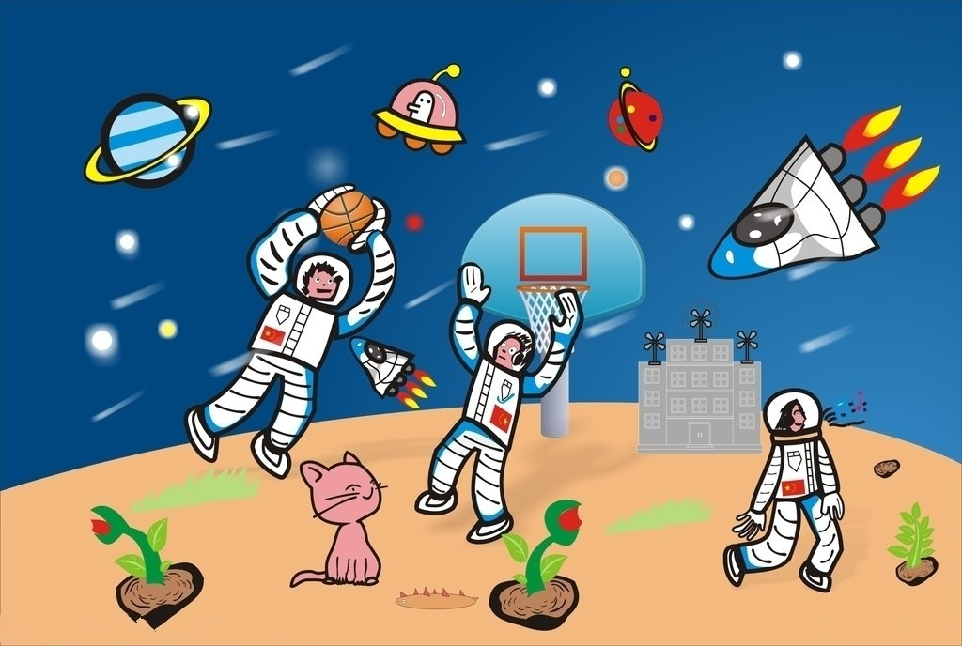
Visiting the Space Hotel
A Plan your first day at the Space Hotel. In pairs, complete the timetable. Use the picture below and the notes on page 62 to help you.

Slide 15
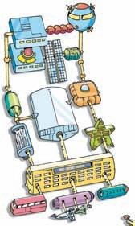
Sports Room
Shops
Moon Garden
Cinema
Space Room
Star Restaurant

Slide 16
Fill in the timetable.
Time | Where to go and what to do
8 a.m. | Have breakfast in the Star Restaurant
9 a.m. | Watch______________________________
10 a.m. | Visit________________________________
_______ | ____________________________

Slide 17
B Write a plan for your first day at Space Hotel. You can start like this:
We are going to have breakfast in the Star Restaurant
at 8 a.m. At 9 a.m., we are going to _____________
__________________________________________
__________________________________________
__________________________________________
__________________________________________
__________________________________________
__________________________________________
__________________________________________

Slide 18
Part IV Post-Learning

Slide 19
Read the notes about the trip plan to Happy Island. Then write an announcement to tell your classmates about the plan.
Trip to Happy Island(10 October)
Time | Activity
7:30 a.m. | meet at the school gate
8:10 a.m. | take a ferry to Happy Island
9:20 a.m. | arrive at Happy Island
10:00 a.m. | arrive at campsite(on foot)
10:00 a.m.-3: p.m. | study insects, have lunch go boating, go hiking
3:40 p.m. | take a ferry back to school
5:20 p.m. | arrive at school

Slide 20
Thank you!

