Slide 1

UNIT 7
Memory
Reading

Slide 2

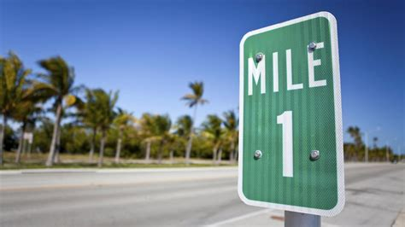
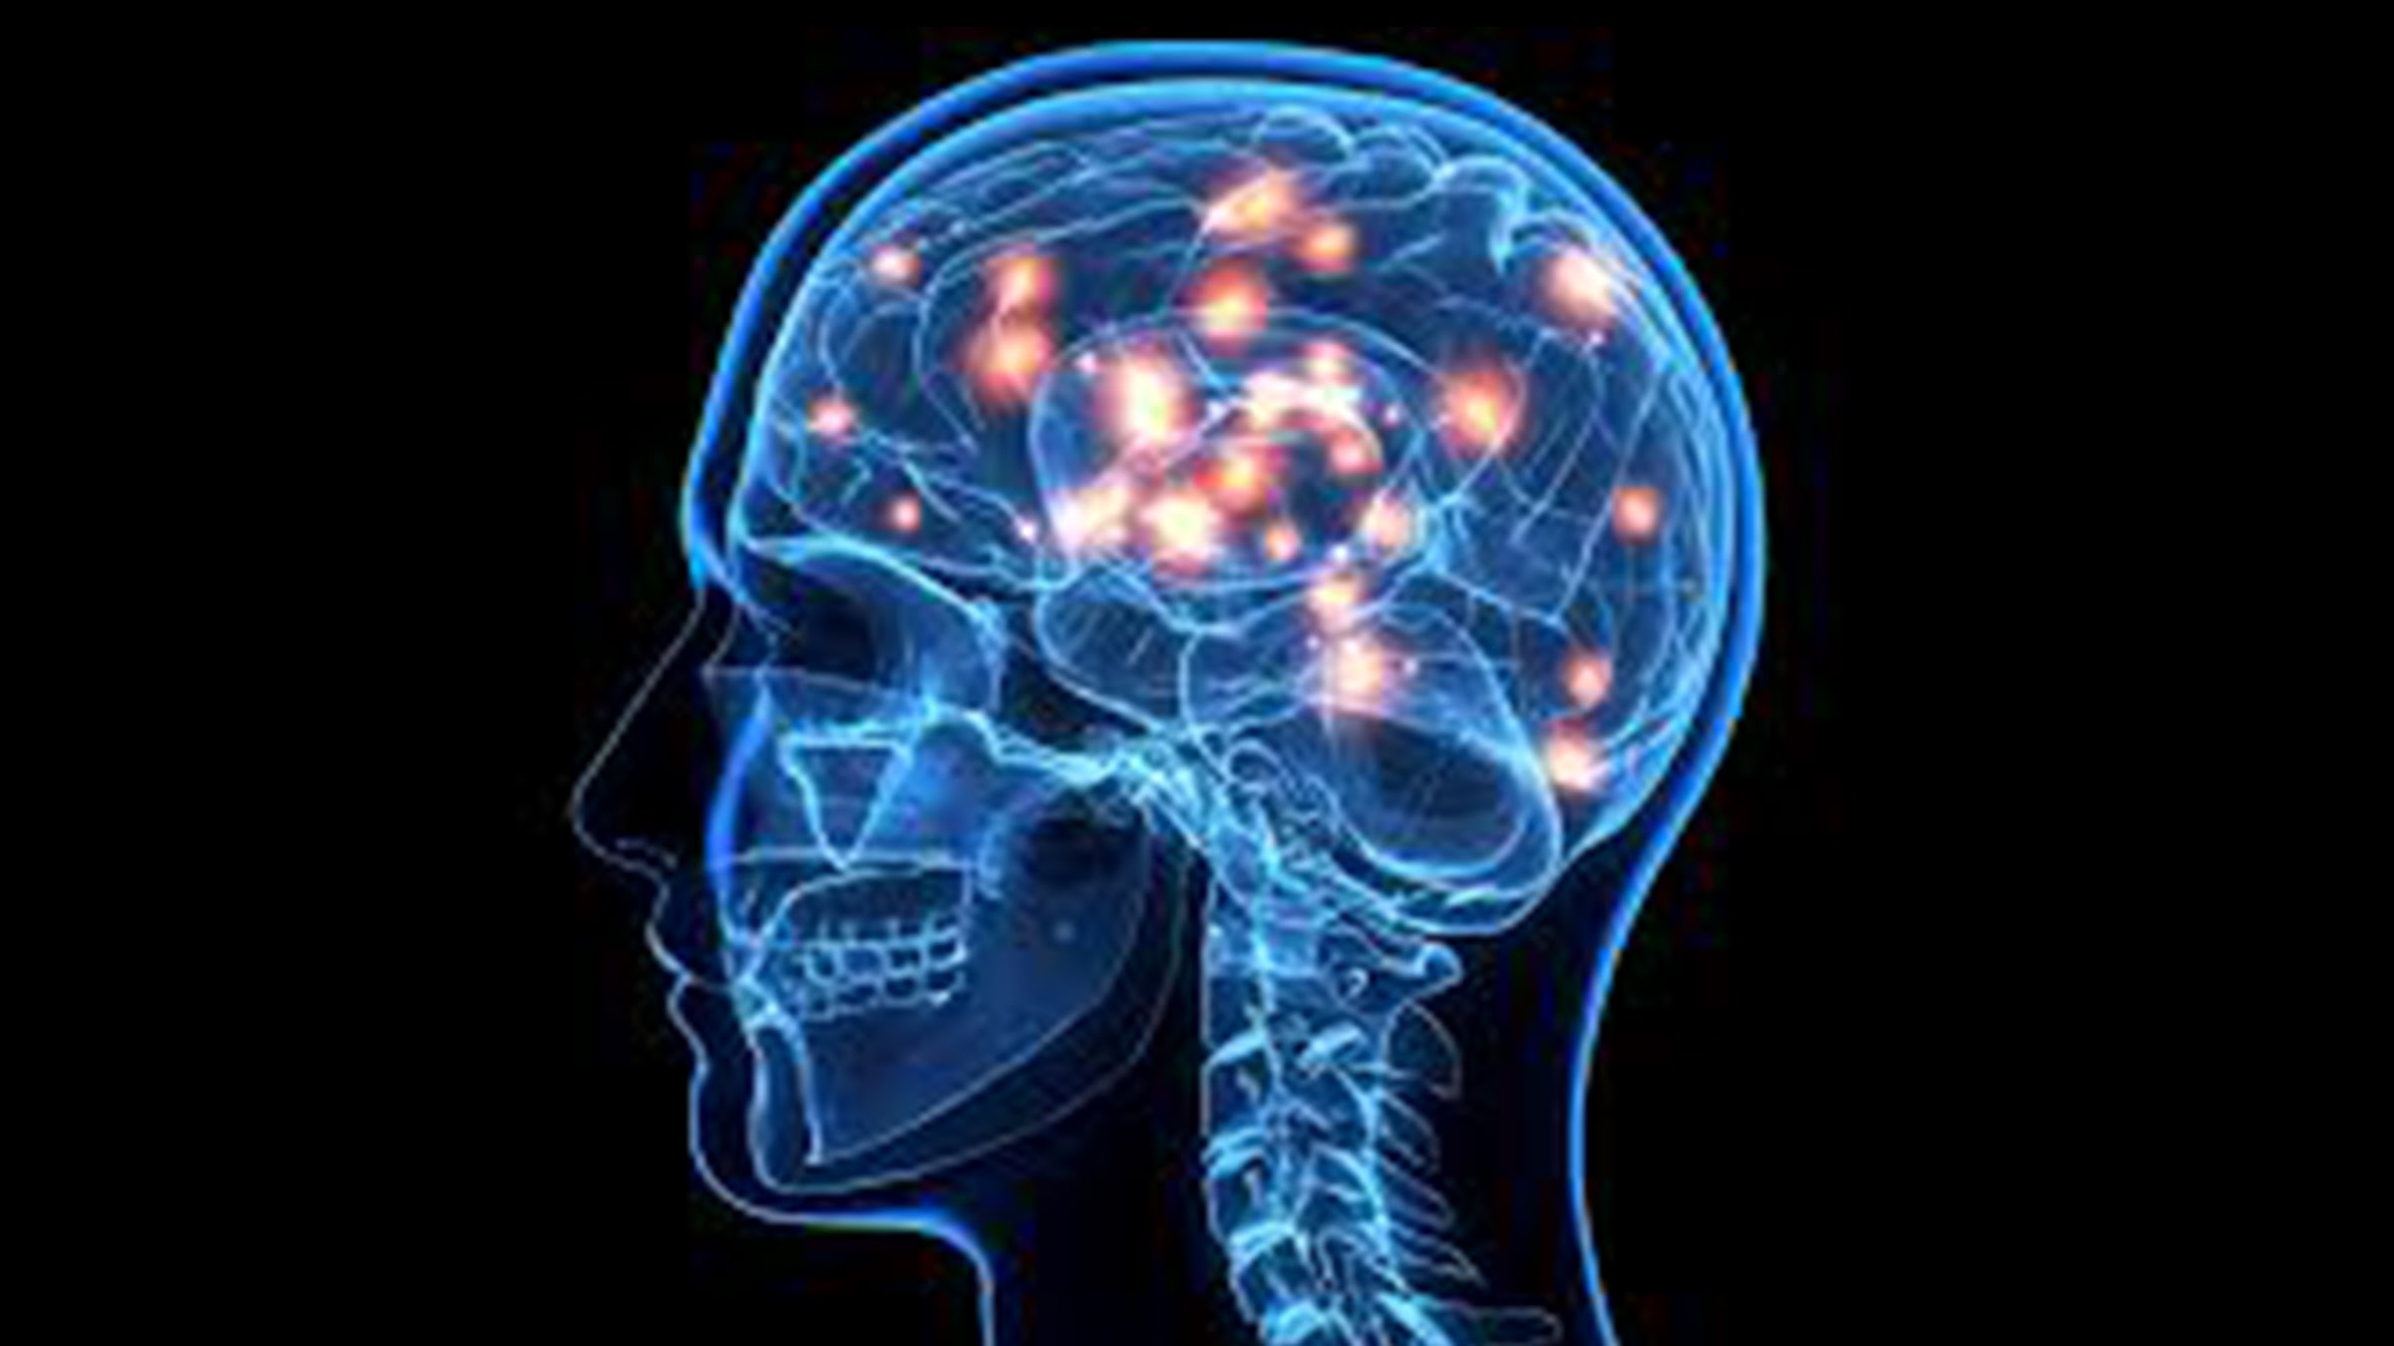
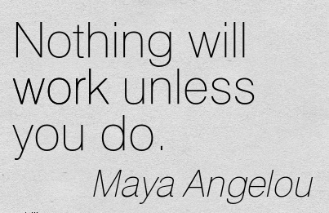
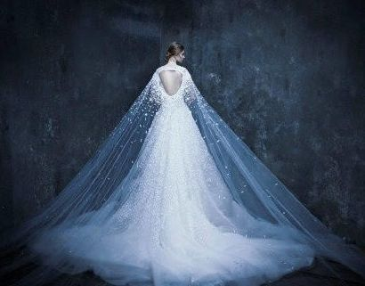
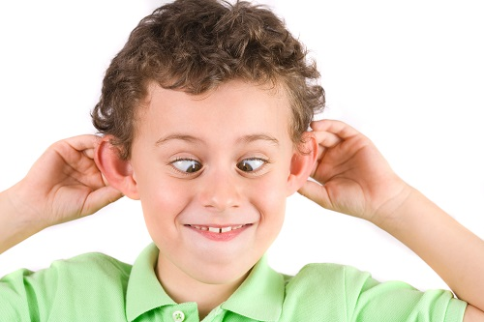
Remember the order of the pictures with 10 seconds.

Slide 3
1
2
3
4
6
5
cyan [ˈsaɪən]

Slide 4
method
mile
mind
silly
unless
worth

Slide 5

Read the words in the list below for 10 seconds. Then write down as many words as you can remember.
We can remember _______ better than _____.
pictures
words

Slide 6




2
What do you know about …?
A2
How much do you know about human memory? （p98）
Young people usually have better memory than
old people.
2. When we make new memories, we lose old ones.
3. We can remember pictures better than words.
4. Once we learn how to ride a bike, we
will never forget how to do it.
lose-lost-lost

Slide 7
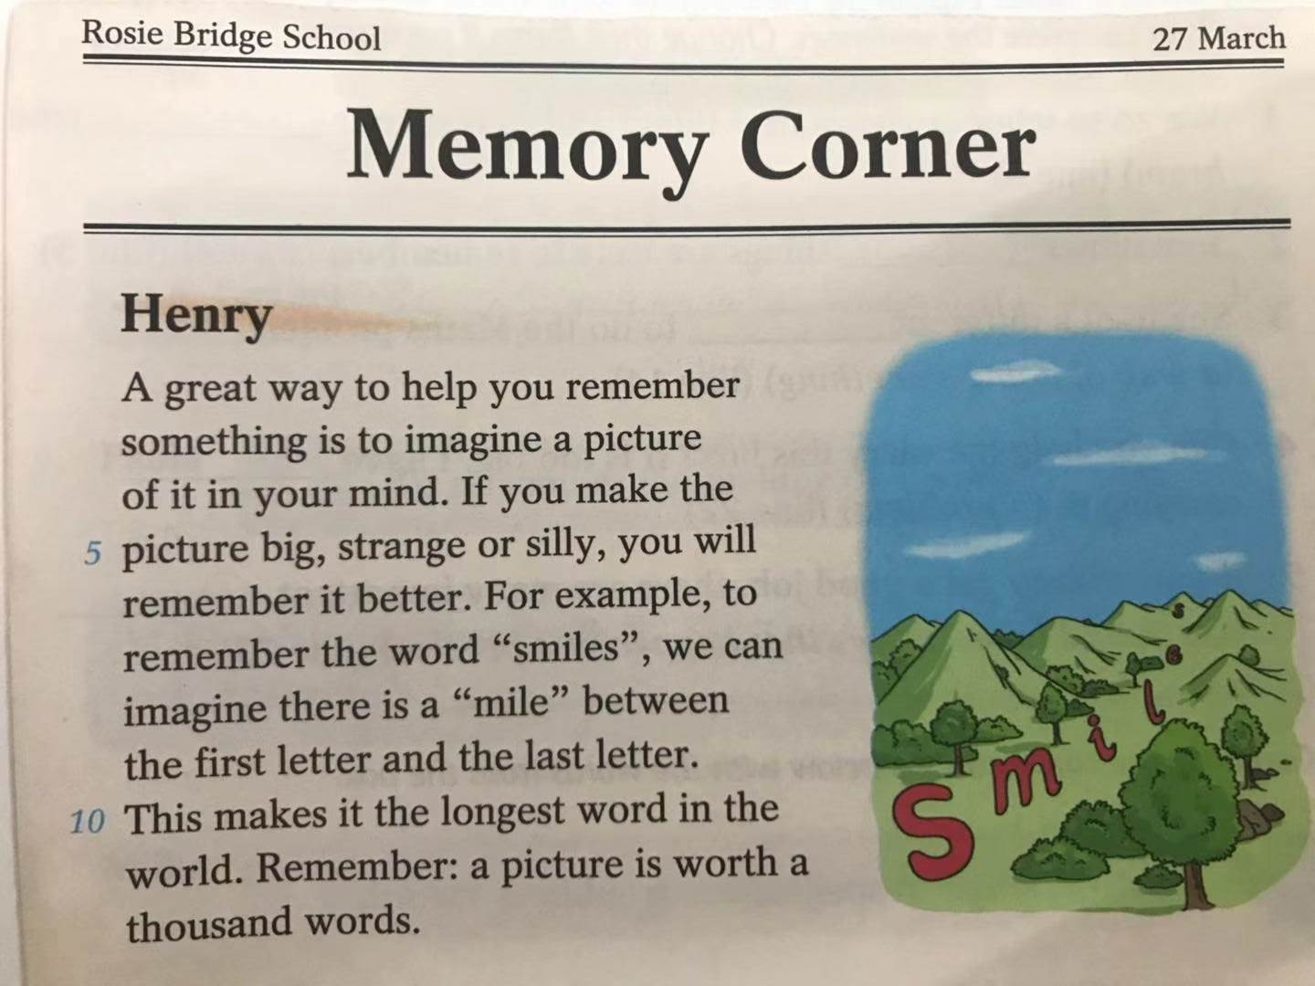
author
3
Reading(p99)
date
title
diary
magazine
school newspaper

Slide 8
Look at the introduction, the title and the first sentence of each article on page 99. Then circle the correct answers.
1 What do Henry, Paula and Millie do for the school newspaper?
a They write articles b They take photos
2 Why have Henry, Paula and Millie written these articles?
a Because they enjoy learning about memory.
b Because they want to help students improve their memory.
3 What way does Henry’s article mention to help students remember something?
a To imagine a picture. b To write it down.
4 What is Paula’s article mainly about?
a The importance of memory.
b A method for remembering the spelling of a word.

Slide 9
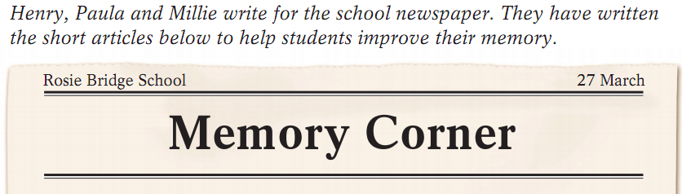
Reading
3
  Who wrote these articles?
  Who did they write these articles for?
  Why did they write these articles?

Slide 10
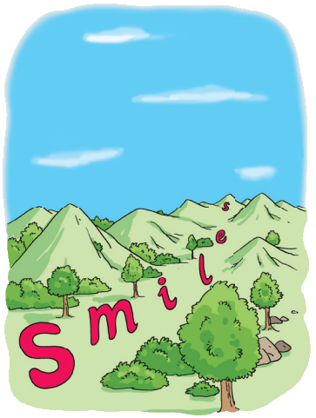
3
Henry's article
Remember Henry’s article carefully. Please fill in the blanks.
imagines
Henry a to
remember things.
The picture should be ,
or to
remember the word .
picture
big
strange
silly
“smile”
Why is the first letter so big
and the last one so small?
Notes:
Why is the first letter so big and the last letter so small? Because the first letter is far away from the last letter. Do you know this riddle: smiles is the longest word in the world because…

Slide 11
3
Paula's article
Remember Paula’s article carefully. Please fill in the blanks.
makes a short sentence
Paula to
remember the spelling of the word.
For example, to remember the word “because”, she makes the sentence with .
each letter of the word
How do you think the memory method?
It can help us to remember words, especially long and difficult words (eg. feminist), much more easily.
Notes:
Why is the first letter so big and the last letter so small? Because the first letter is far away from the last letter. How far is it? There is a mile between them. Riddle: What is the longest word in the world? Yes, smiles.

Slide 12
f
e
m
i
n
i
s
t
emale
quals
ale
Any other
examples?
I
ever
gnore (忽视)
ecret
hing

Slide 13
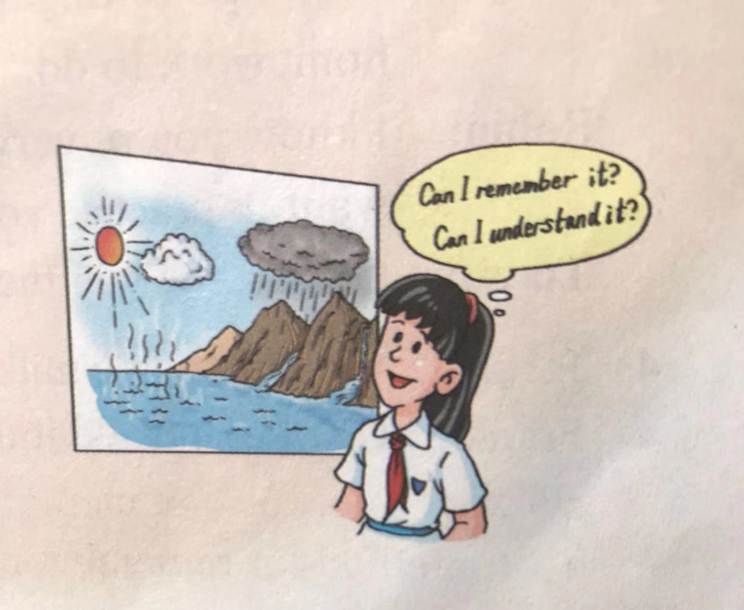
3
Millie's article
understand something well
Millie tries to to remember it. For example, to remember
, it will be easier if she understands how .
the list of steps in the water cycle
the water cycle works

Slide 14

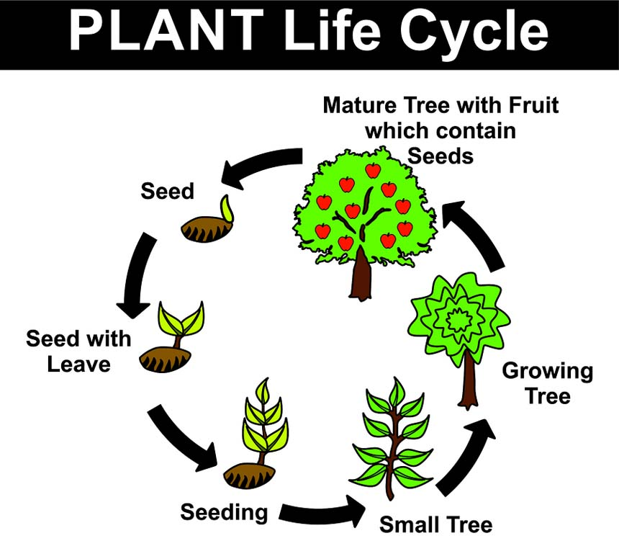
Match the examples with the memory methods.
You can use the sentence
“Father and mother I love you”
to remember the word “family”.
a. Imagine a
picture
b.Make a short
sentence
3. Understand the steps well

Slide 15
4
Post reading
Group discussion:
Complete the table
Share your methods for memorizing new words.
Methods | Examples
To add a prefix(前缀)/suffix(后缀) to a root(词根) | happy, success ,
To form a ’compound(合成词) | week+end, .
To use . | num-ber, un-der-stand, stu-pid
(Your method). | _______ ___ (Your example)
un
ful
butter+fly
syllables
similar sound
tofu, t’ai chi, Kung fu
category
apple, orange, pineapple

Slide 16
1. Use your memory methods to remember the following words.
2. Give at least 2 examples.
Mountain | Policeman | Doorbell | Possible
Father | Climbing | Impossible | Daughter
Possibly | Notebook | Mother | Son
Possibility | Weekday | Arm | Pizza
Wise | Sure | Expensive | Stupid
Cheap | Measure | Picnic | Pure
Head | Pleasure | Leg | Foot
Example 1: A good way to remember the four words “ , , , ”is to .
Example 2:…..

Slide 17
5
Summary
New words
2. The passage: three memory methods
Imagine a picture (smile)
Make a short sentence (because)
Understand it well (water cycle)
3. Other methods for remembering new words.

