Slide 1
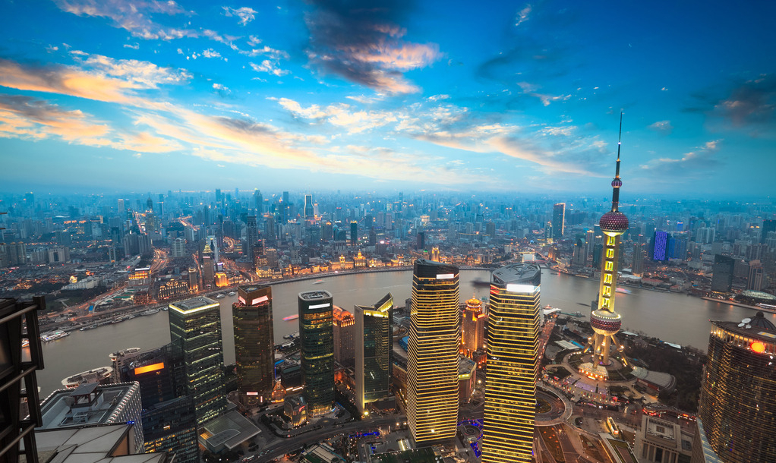
Unit 6 Travelling around Asia
Grammar

Slide 2



Conditional sentences
the if-clause
the main clause
,
.
If you are happy __________________
clap your hands
,
.
If you are angry __________________
step your feet
,
.
If you are scared __________________
say “Oh, no!”

Slide 3
Conditional sentences
the main clause
the if-clause
.
Clap your hands
if you are happy
.
Step your feet
if you are angry
.
Say “Oh, no!”
if you are scared

Slide 4
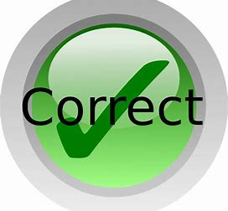
Correct the mistakes if there are.
1 You see many old buildings if you walk along the Bund.
2 If it won’t rain, I’m going to play badminton.
3 You will be allowed to watch TV only if you finish your homework by 9:00.
4 Even if we leave right now, we will still be late to the meeting.
5 Taking your umbrella with you in case it rains.
6 Sam won’t go to the party unless you don’t’ ask him.
will see
The verb in the main clause is in the simple future tense.
doesn’t
The verb in the if- clause is in the simple present tense.
only + if = 只要，用法和if一样
even + if = 就算，用法和if一样
Take
The main clause should be : Take your umbrella with you.
in case = 以防，用法和if一样
unless = 如果不，意思和if相反
ask

Slide 5
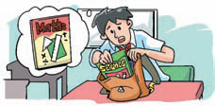
William's mum is giving him advice about his problems.
William's problems
1. I sometimes bring the wrong books to school.
If you check your timetable every night, you will know which books to bring.

Slide 6
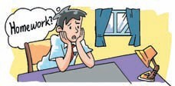
2. I was away from school today. I do not know what homework to do.
If you call your friends, they will tell you what homework to do.

Slide 7
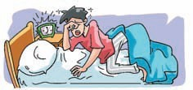
3. I hate getting up. I always feel tired in the mornings.
If you go to bed early, you will not feel tired in the mornings.

Slide 8
4. I do not know what this word means.
If you look it up in the dictionary, you will find out its meaning.

Slide 9
B Carol is giving advice to Henry. What is she saying? Use the pictures and the words in brackets to help you.
__________________ the wheels round, they_______________ easily. (make/turn)
If you make
will turn

Slide 10
2.The seeds ______________________
in the soil. (grow/plant)
will grow if you plant them

Slide 11
3. ____________ another wing, it ____________. (put on/ fly)
If you put on
will fly

Slide 12
4. ________________ your coat, you
__________ so cold. (put on/not feel)
If you put on
will not feel

Slide 13
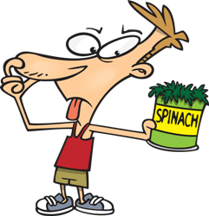
If you eat some spinach,

Slide 14
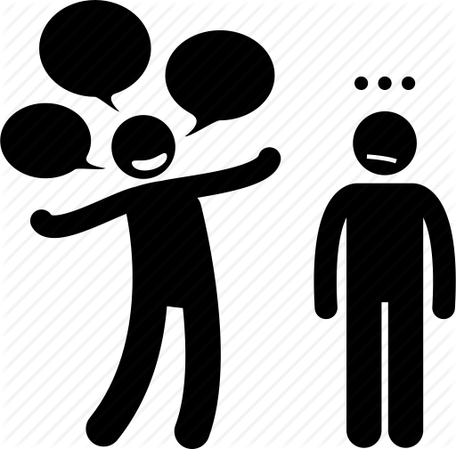
If you stop talking for a while,

Slide 15
5. The meat _______________________
in the fridge. (not go bad/put)
will not go bad if you put it

Slide 16
6. You __________________________
your classes. (see clearly/wear)
will see clearly if you wear

Slide 17
Part III Post-Learning

Slide 18

记住这个顺口溜吧！
“if条件句不一般, 几个要点记心间；
条件句，放在前, 逗号要放句中间；条件句
表可能，主句多用将来时；条件句表事
实，主句常用现在时。”

Slide 19
Part IV Review

Slide 20
一. 用括号内所给单词的正确形式填空。
1. If he ______(be) free tomorrow evening,
he will come to your birthday party.
2. I will tell her the answer if she ______(ask) me.
3. If we talk loudly in class, our teacher
______(be) unhappy with us.
is
asks
will be

Slide 21
二. 合并句子。
1. It is going to rain tomorrow.
We will not go out.
If it rains tomorrow, we will not go out.
2. She is going to post the letter now.
Her grandparents will receive it in three days.
If she posts the letter now, her grandparents will receive it in three days.

Slide 22
3. They are going to do more exercises.
They will be in better health.
If they do more exercises, they will be
in better health.
4. You are going to play with a knife.
You will hurt yourself.
If you play with a knife, you will hurt
yourself.

Slide 23
三. 选择最佳答案填空。
( )1. If it stops raining, we ____ out.
A. are go B. can go
C. goes D. to go
( )2. If you don't water the flowers, they ____.
A. died B. die
C. dying D. to die
( )3. We will go climbing ____ the weather is
fine.
A. while B. where
C. so D. if
B
B
D

Slide 24
( )4. My family and I will plant some trees in the
garden if it ____ tomorrow.
A. didn't rain B. isn't going to rain
C. won't rain D. doesn't rain
( )5. If you don't work hard, you ____ the exam.
A. can't pass B. can pass
C. will pass D. pass
( )6. If my father ____ back next Saturday, we will
go on a picnic together.
A. will come B. comes
C. is coming D. should come
D
A
B

Slide 25
Thank you!

