Slide 1
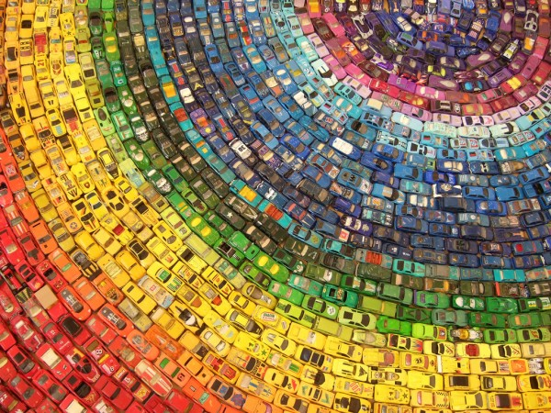
Unit 8 Collecting things
Listening

Slide 2


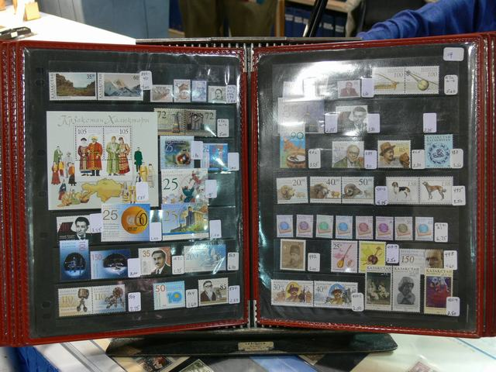
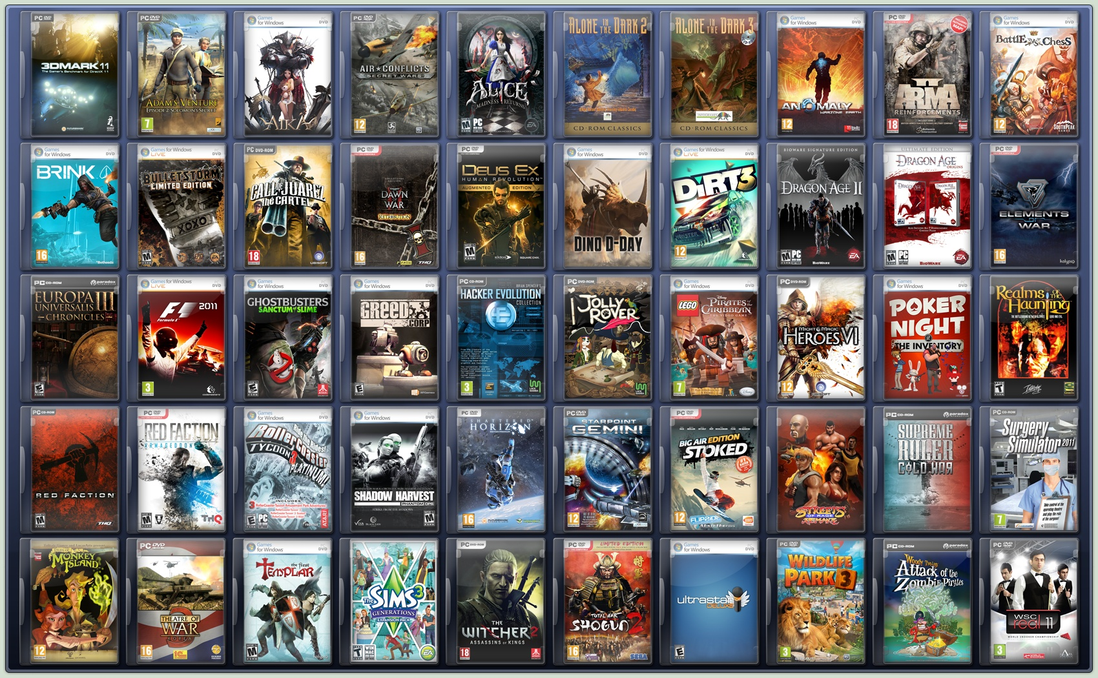
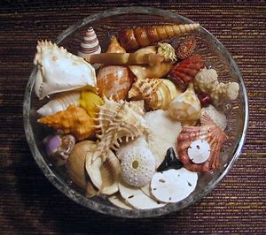
a collection of car magazines
a car magazine collection
a collection of stamps
a stamp collection
a collection of computer games
a computer game collection
a collection of shells
a shell collection

Slide 3
If you want to learn about other people’s collections,
you can
interview them.
an interviewer
一位采访者
three
interviewees
三位受访者

Slide 4

Listen to a TV reporter interviewing three people about students' collections.
Sentences | Alan | Ivy | A parent
1.Collecting computer games is a waste of time.
2.I collect car magazines.
3. My teacher told me it's bad for the environment.
4. I'm happy he's interested in something.
5. I collected shells from the beach.
6. I really love cars.
√
√
√
√
√
√

Slide 5
Tapescript(录音文本)
TV reporter: Good morning, it's Anne Ling here.
Today, I will find out more about
students' collections. Here's a student.
Hello, what's your name?
Boy: Alan.
TV reporter: Hi, Alan. Do you collect anything?
Boy: Yes, I do. I collect car magazines.
TV reporter: That's interesting. Why car magazines?
Boy: I really love cars.

Slide 6
TV reporter: Thanks, Alan. There's a girl. Hello,
what's your name?
Girl: Ivy.
TV reporter: Do you collect anything, Ivy?
Girl: When I was small, I collected shells from the
beach, but my teacher told me it's bad for the
environment.

Slide 7
TV reporter: I think your teacher's right, Ivy. Here's
a parent. Does your child collect
anything?
Man: Yes, my son collects computer games.
TV reporter: What do you think of this?
Man: I'm happy he's interested in something, but I
think collecting computer games is a waste of
time.
TV reporter: Thanks for your time.

Slide 8
If you want to know how many people have their own collections and how many parents agree on collecting, you can
carry out a survey.
A survey is an investigation(调查) to collect the amount(数量) of opinions usually done by asking people questions.

Slide 9
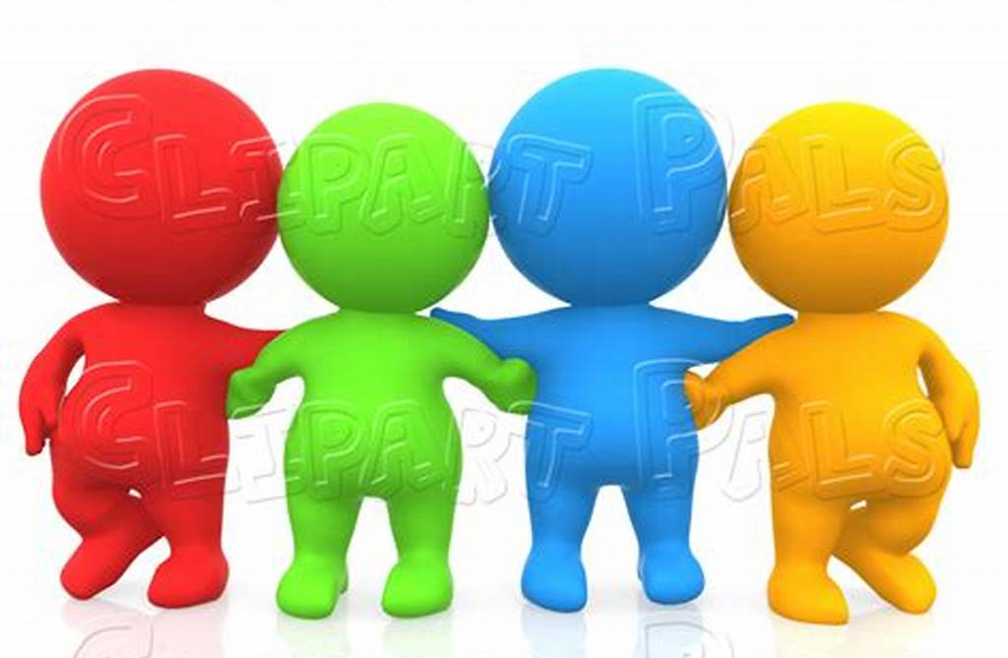
Work in groups of four (ABCD).
Interview each other and finish the survey.
One of group member do an oral report.
A B C D
Parents and children have disagreement(意见分歧)
Do an oral report
3
We asked ______ students about their collections. Here are the results(结果):
_____ students collect things, such as _______. ____ don’t collect anything because ____________.
For parents, ______ parents agree with their children about collecting. But ______ parents don’t agree because they think ______________________.

Slide 10
Work in groups of four (ABCD)
Role play to try to persuade(说服) each other and finally come to an agreement(达成一致)
Role play assessment
Show politeness | 2’
Come to an agreement | 1’
Useful expressions | 3’
Persuasive | 3’
Volume | 1’
Total | 10’
A B C D
Sab – the children
Scd – the parents

Slide 11

Role play assessment
Polite words 5’
Target expressions 5’
Performance 5’
Total 15’

Slide 12
Report presentation assessment
Good and clear writing 5’
Loud and fluent speaking 5’
Catch people’s attention 5’
Total 15’

