Slide 1
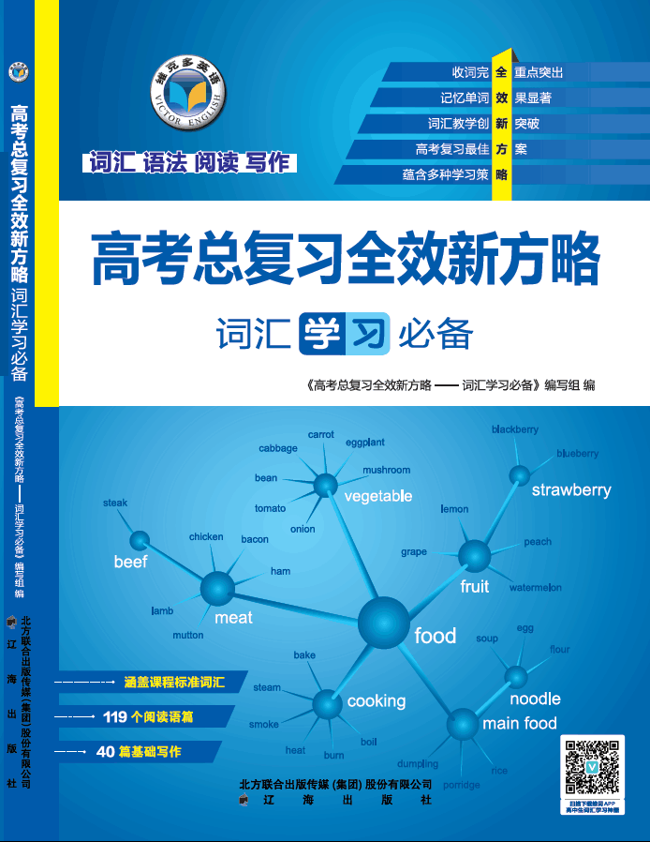

Unit 6 家人、朋友与周围的人

Slide 2


子话题词汇复现输入
Say & Guess!

Slide 3
Part I
基础训练

Slide 4
教学目录
重点词释义:
close，separate
“熟”词“生”义:
company，deliver
重点词用法专练:
marry，share, depend
重点词块专练:
have ... in common (with)，break up, keep / stay in touch (with) , make up, (be) familiar to, pass away

Slide 5
Close adj.
1. Our new house is close to the school.
我们的新家离学校很近。
2. All of them wanted to be the first to get a close look at Mount Vesuvius.
他们所有人都想第一个仔细看看维苏威火山。
3. Lauren is close to completing her study on shark’s ability to sense pressure.
劳伦快要完成她对鲨鱼感压能力的研究了。
4. a close friend
亲密的朋友

Slide 6
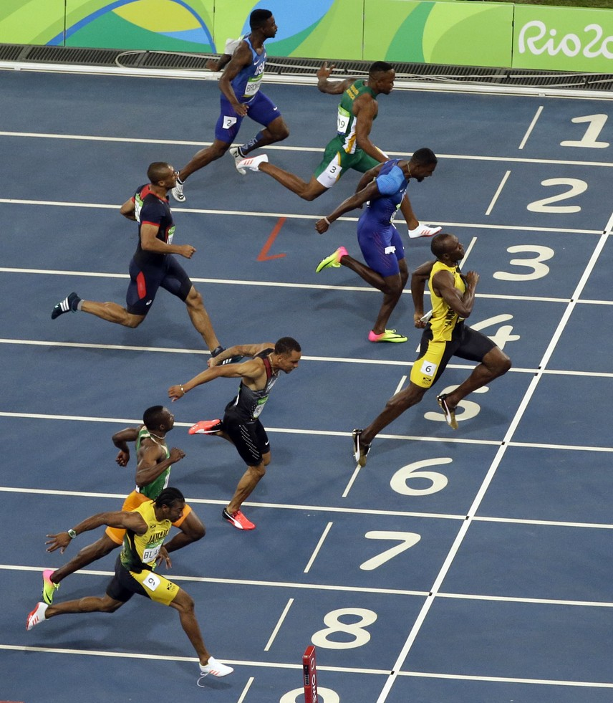
a close finish
势均力敌的结局

Slide 7

keep a close watch / eye on 密切注视
We kept a close watch on the prisoners.
我们严密监视犯人的行动。

Slide 8

Getting close to nature adds to the joy of life.
接近自然可增添生活的乐趣。
get close to 接近

Slide 9
【备考指导】
➔ close的形容词、及副词考频较高；
➔ close在高考各题型中均有出现。
Close
to
1. ______ ___ (接近) the school there was a beautiful park with many trees around it. (2015 浙江)
2. They should not feed the wild animals ___ ___ _______ _______(近距离) because they may attack people. (2014 江西)
3. There existed __ ______ _______(密切联系)between families and their milkmen. (2011 全国)
in a
close
distance
a close relationship

Slide 10
单句改错
We sat closely together reading and talking. (2014 湖北)
 Brazilians often stand close when talk. (2014 浙江阅读)
close
talking

Slide 11

separate
adj 单独的；分开的；不同的
两座独立的大楼
two separate buildings

Slide 12

Do you think Sarah and Hannah should try to be friends again or go their separate ways?
你认为莎拉和汉纳应尝试再做朋友还是断绝关系？译林⑤ – 1
go one’s separate ways 断绝关系；分道而行

Slide 13
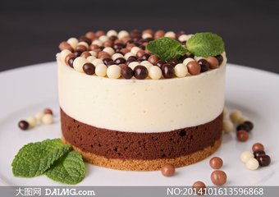
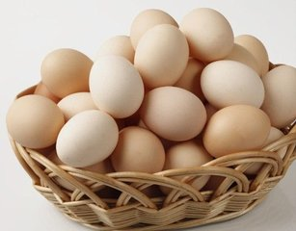
辨 divide, separate
divide (into) 把整体分为若干部分
The world is _______ into seven continents.
世界被分成七大洲。
separate from 把靠在一起的个体分开
We’d better _______the good ones from the bad ones. 我们最好把好的和坏的分开。
divided
separate

Slide 14
【拓展】
separately adv 分别地；独立地
separation [U] 分离；分开
1.They did arrive together, but I think they left_________. 2.___________from his family made him very sad.
3. She said good-bye and, for the first time, they went their _______ways.
4. The story was about a dog who was _______
from his family.
separately
Separation
separate
separated

Slide 15

巩固练习
学生用书P25—26
基础训练：第一题

Slide 16


“熟”词“生”义
① 一词多义中的衍生义
培养学生结合具体的语境由词汇的基本义推测其衍生义的能力。
② “生义”与基本义联系不紧密
教学侧重，需要在词汇学习时注意一些低义频的释 义，特别是与基本义联系不大的释义。

Slide 17
close adj.险
share v.共同拥有
company v. 陪伴
deliver v.接生
good company 好伙伴

Slide 18
巩固练习
学生用书P26
基础训练: 第三题

Slide 19
Marry
…marry with the sailor
…have married for…
…got married with…
been
to

Slide 20
Separate
from
1)separate, 2)divide, 3) divided
1) went their separate ways
2) on a separate piece of paper
3) be kept separate

Slide 21
Share
with
1)share some housework
2) share my opinion about this hot topic with you
3) with whom Jack shared

Slide 22
depend
with
1)depends much on the weather
2) depend on her
3)finishing/to finish the job
4) it depends

Slide 23
broke up 分手
make up 和好
Keeping in touch with 保持联系
be shared with 分享
brought up 抚养
are separated from 分离
have…in common 有共同点
depend on 依赖于
passed away 去世
is familiar to 为……所熟悉

