Slide 1
纸带处理

Slide 2
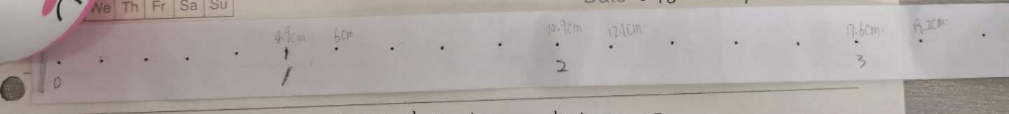

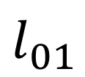
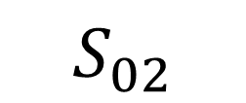
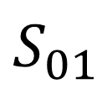
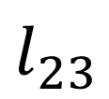
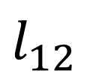
$$l_{01}$$
$$l_{12}$$
$$l_{23}$$
$$S_{01}$$
$$S_{02}$$
$$S_{03}$$

Slide 3
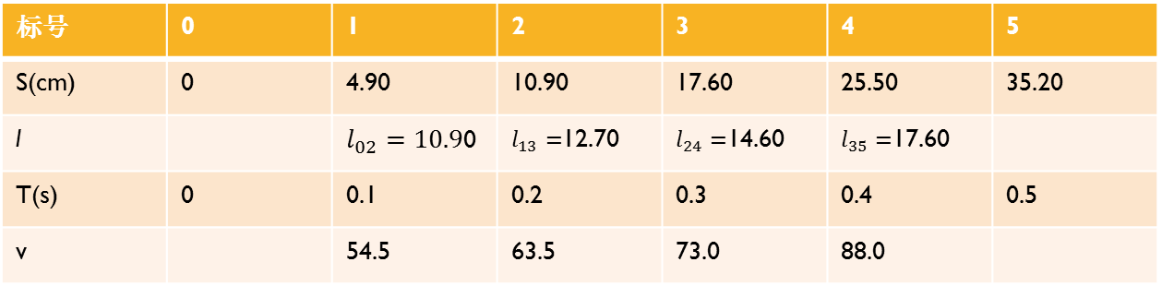
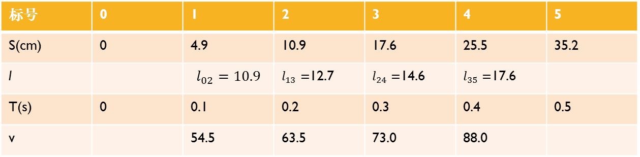
标号 | 0 | 1 | 2 | 3 | 4 | 5
S(cm) | 0 | 4.9 | 10.9 | 17.6 | 25.5 | 35.2
l |  | $$l_{02}=10.9$$ | $l_{13}=$12.7 | $l_{24}=$14.6 | $l_{35}=$17.6
T(s) | 0 | 0.1 | 0.2 | 0.3 | 0.4 | 0.5
v |  | 54.5 | 63.5 | 73.0 | 88.0
标号 | 0 | 1 | 2 | 3 | 4 | 5
S(cm) | 0 | 4.90 | 10.90 | 17.60 | 25.50 | 35.20
l |  | $l_{02}=10.9$0 | $l_{13}=$12.70 | $l_{24}=$14.60 | $l_{35}=$17.60
T(s) | 0 | 0.1 | 0.2 | 0.3 | 0.4 | 0.5
v |  | 54.5 | 63.5 | 73.0 | 88.0

