Slide 1

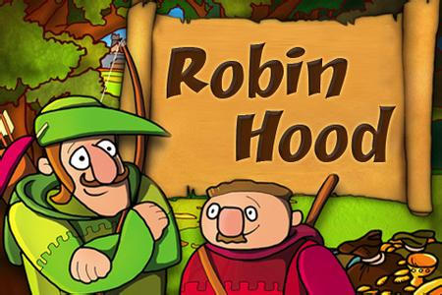

Listening
Unit 8

Slide 2
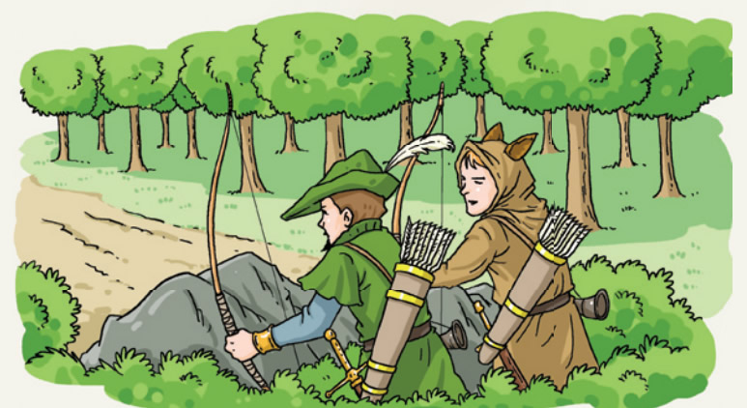
Pre-listening Students from Rosie Bridge School are putting on a play---the Robin Hood story ----Robin Hood and his friend little John
arrow /’ærəʊ/箭
bow/’bəʊ/ 弓
hood /hʊd/ 兜帽
When did the story happen?
It happened in antient times.
What were they probably doing?
They were _______ behind rocks in order to hunt or ________ somebody.
What kind of people are they like?
They should be bowmen or swordsmen.
hiding
attack
sword /sɔːd/ 剑

Slide 3
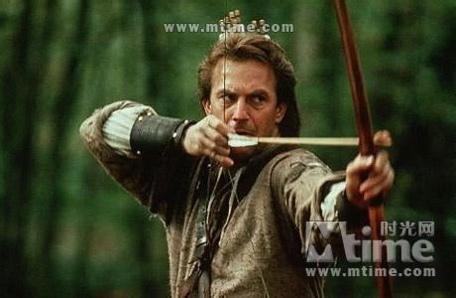

Robin Hood is a hero from English folklore民间传说.
He was an archer /'ɑːtʃə/弓箭手
= bowman /'bəʊmən/ and
a swordsman /'sɔːdzmən/ 剑客；武士
He was known for “__________________________________________”.
The group of people who helped him were called his “______________”.
劫富济贫
taking from the rich and giving to the poor
Merry Men

Slide 4
Video
Let’s learn something more about Robin Hood’s story!

Slide 5
While-listening(p118) A Students from Rosie Bridge School are putting on the Robin Hood Story. Listen to the first part of the play. Who said the following lines? Fill in the blanks with the correct names from the box.
[C] 台词
Little John Robin Hood White
1. I’m the largest and strongest of the Merry
Men！_______________
2. We take from the rich and give to the poor!
________________
Little John
Robin Hood
Notes:
Do you know want to know more details about Robin Hood story?
line： the words that an actor speaks in a play

Slide 6
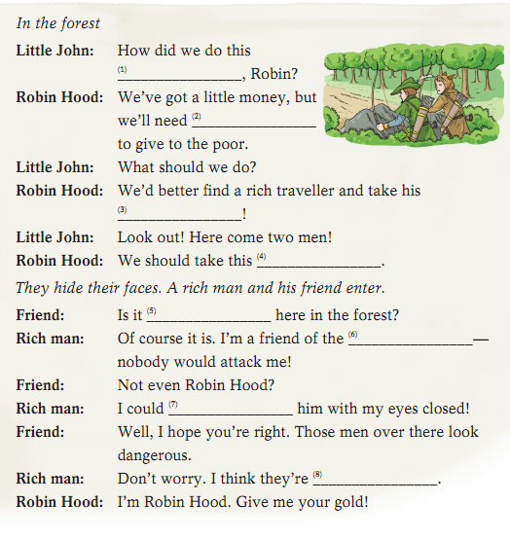
B Listen to the second part of the play. Write one word in each blank.

Slide 7
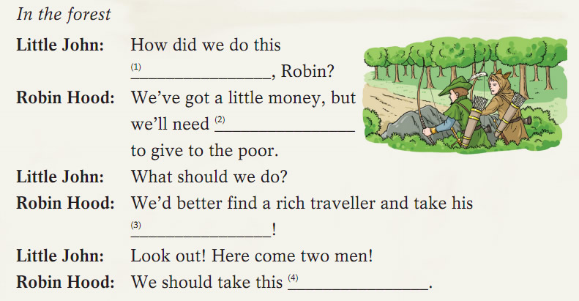
Listen to the second part of the play.
Write one word in each blank.
B
week
more
gold
chance

Slide 8
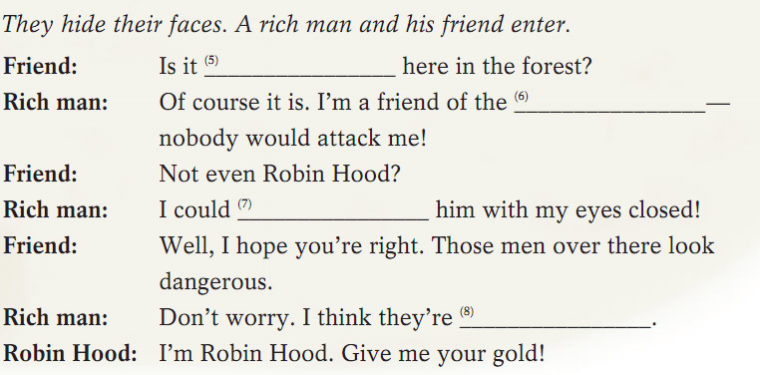
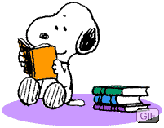
safe
king
fight
tourists

Slide 9
B In the forest
Little John: How did we do this week, Robin?
Robin Hood: We’ve got a little money, but we’ll need more to give to the poor.
Little John: What should we do?
Robin Hood: We’d better find a rich traveller and take his gold!
Little John: Look out! Here come two men!
Robin Hood: We should take this chance.
They hide their faces. A rich man and his friend enter.
Friend: Is it safe here in the forest?
Rich man: Of course it is. I’m a friend of the king—nobody would attack me!
Friend: Not even Robin Hood?
Rich man: I could fight him with my eyes closed!
Friend: Well, I hope you’re right. Those men over there look dangerous.
Rich man: Don’t worry. I think they’re tourists.
Robin Hood: I’m Robin Hood. Give me your gold!
Read after the tape.
Notes:
Read it with your feelings.

Slide 10
Post-listening(Task 2) Act out the story.
Requirements:
Work in groups (S1: Robin Hood; S2: little John; S3: rich man; S4: friend; S5: maybe _________?)
Give the story a reasonable(合理的) ending.
Introduce yourself.
the poor
without books | 1 point
be confident and speak loudly | 3 points
correct and fluent language | 3 points
reasonable and creative imagination | 3 points
Notes:
Who else do you think can be in the play? Maybe the poor.

Slide 11
Maybe you can introduce yourself in this way!
Robin Hood: I’m Robin Hood and I live in the forest with my Merry Men. We take from the rich and give to the poor!
Little John: I’m Little John, one of Robin Hood’s Merry Men. People call me Little John but I’m the largest and strongest of the Merry Men!
without books | 1 point
be confident and speak loudly | 3 points
correct and fluent language | 3 points
reasonable and creative imagination | 3 points

Slide 12
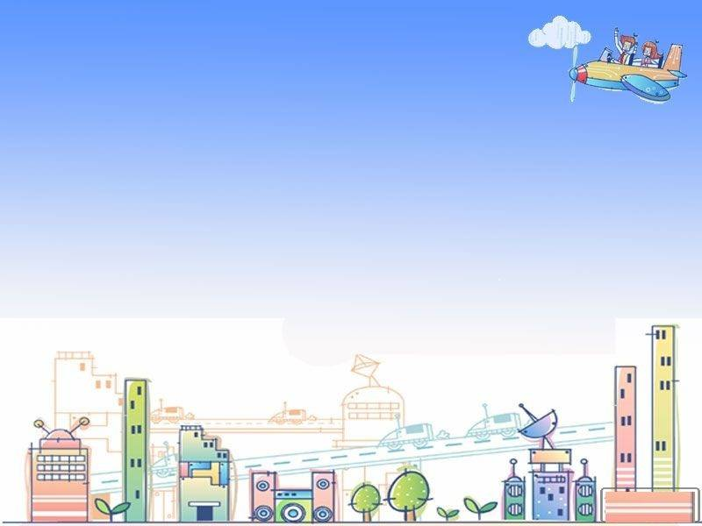
What do you think of people like Robin Hood?
Always be a friendly and helpful person!
Thank you!

