Slide 1
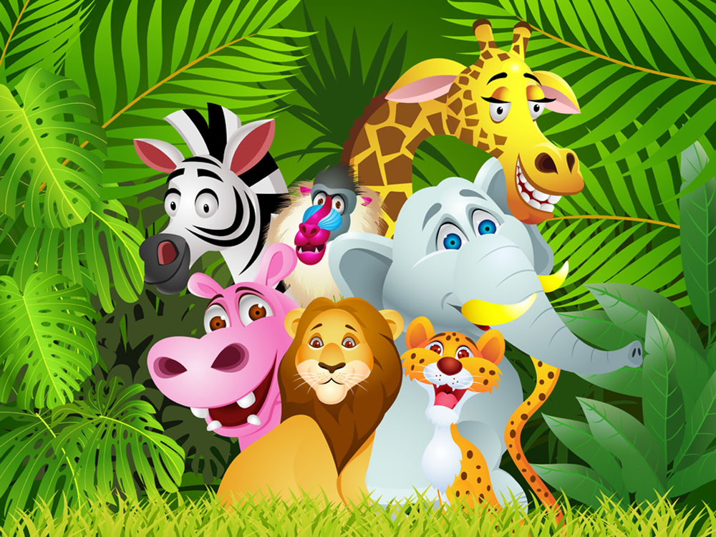
Unit 5 Save the endangered animals
Reading

Slide 2
目录
Lead-in
1
Pre- Learning
2
3
While- Learning
Post- Learning
4
5
Review

Slide 3
Part I Lead-in

Slide 4
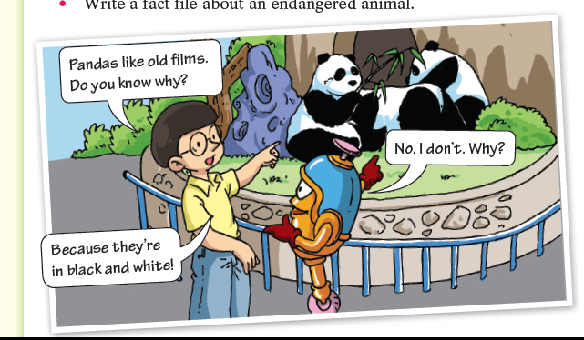
Getting ready
  What are Hi and Lo doing?
They are looking at giant pandas in the zoo.
  What are the pandas eating?
  They are eating bamboo. → pandas’ menu.
  Why does Hi say “Pandas like old films”?
  Because pandas are black and white and old films only have these two colours.

Slide 5
Play a game
B
C
A
D
E
How much do you know about animals?

Slide 6
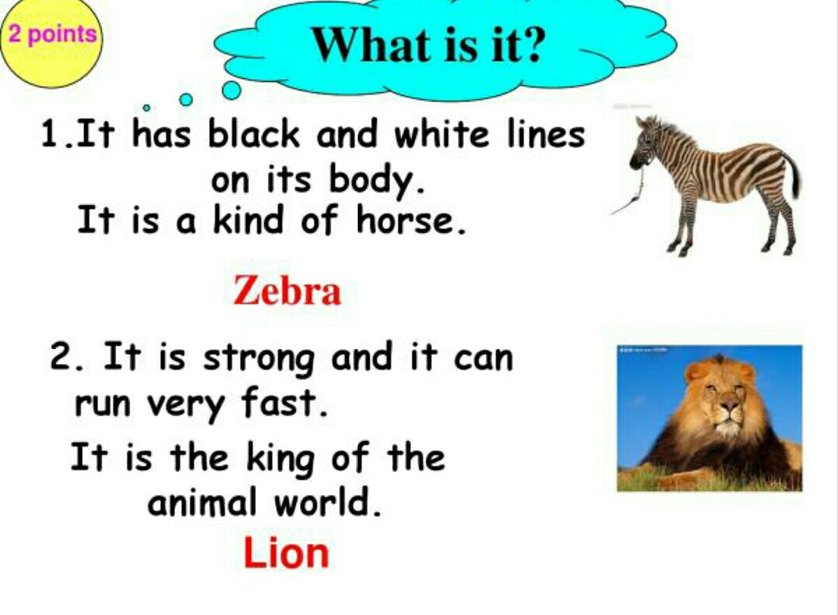
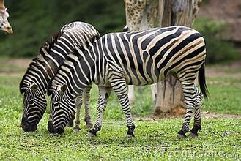
Brain twists 脑筋急转弯
A. It has black and white lines on its body
It is a kind of horse.
zebra

Slide 7
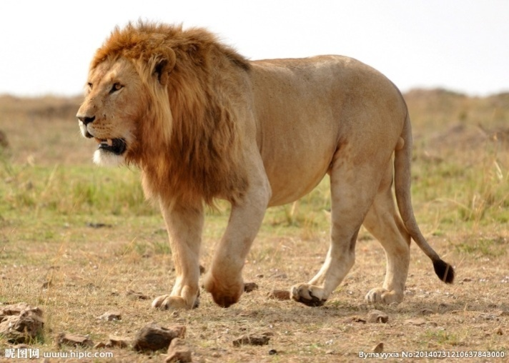
B. It is strong and it can run very fast.
It is the king of the animal world.
lion

Slide 8
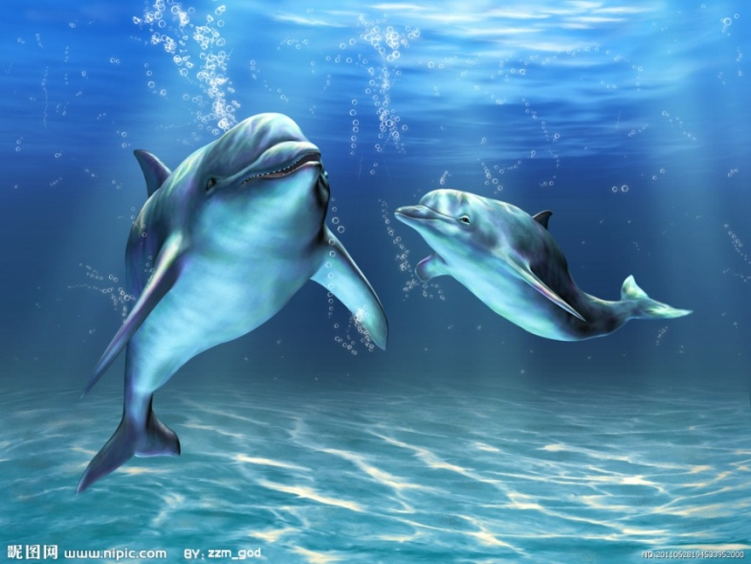
C. If the animals take part in the Voice of
China, which one will be the winner?
dolphin

Slide 9
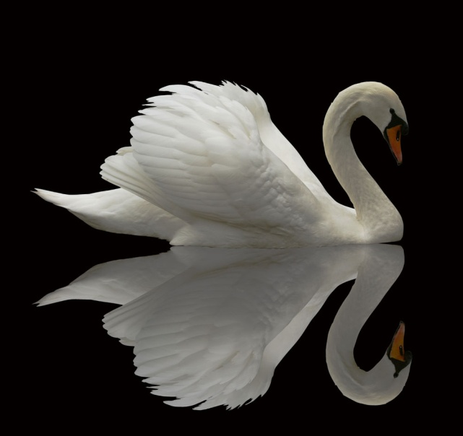
D. If the animals dance ballet, who can
dance better?
swan

Slide 10
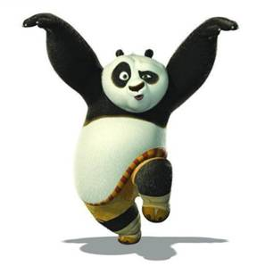
E. If they play Chinese Kung fu,
who will be the winner?

Slide 11
Watch the video clip. Think about:
Who are the main characters?
What do they look like?
Watch the video clip. Think about:
Who are the main characters?
What do they look like?

Slide 12
Part II Pre- Learning

Slide 13
What do you know about …?
How much do you know about pandas? Try the short quiz below. Circle the correct answers.
How many pandas still live in the
wild?
A. About 1,600.
B. About 160,000.
2. Can pandas climb trees?
A. Yes, they can.
B. No, they can’t.

Slide 14
3. What do pandas usually eat?
A. Bananas. B. Bamboo.
4. How long can pandas live in the wild?
A. About 20 years. B. About 50 years.
5. Where do pandas live?
A. In Sichuan. B. In Shaanxi
C. In Gansu D. In Jiangsu.

Slide 15
Before you read
Look at the article on page 67. Complete the facts about pandas.
Panda facts
100-150
Adult weight: about ___________ kilograms
Life: Pandas live for about _________ in the wild, but in
zoos they can live for .
Food: A panda eats about ___________ of bamboo a day.
Home: Pandas live high up in the mountains of _____________________________.
Population: There are about ________ panda in the wild.
Behaviour: Pandas spend more than _________ a day
eating.
20 years
up to 35 years old
30 kilograms
Central and Western China
1,600
12 hours

Slide 16
Part III While- Learning

Slide 17

First Reading

Slide 18
1. Look at the pictures, the title, the introduction and the sub-headings of the article on page 67. Then answer the questions below.
1. Where does this article most probably come from?
a A novel.
b A science magazine.
2. What information about pandas can you get from the article?
a Their numbers. b Their behaviour.
c Their food. d Their relationship with humans.
e Their future. f Their uses. g Their looks.

Slide 19

2. Complete the table.

Slide 20

Second Reading
Let’s learn the new words and expressions.

Slide 21
New words and expressions
P65-69
endangered adj.濒危的 p. 65
file n. 档案 p. 65
giant panda n.大熊猫 p. 65
*obligation n. 义务；责任 p. 65
wild n. 自然环境；野生状态 p. 66

Slide 22
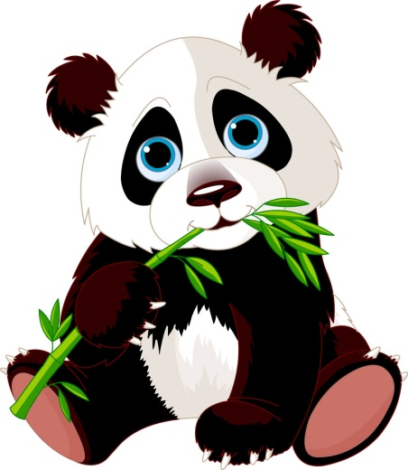
bamboo n. 竹；竹子 p. 66
adult n. 成年动物 p. 66
weight n. 重量 p. 66
kilogram n. 千克；公斤 p. 66
population n.(统称)某领域的生物；族群； 人口 p. 66
behaviour n. (动植物的)活动方式 p. 66
birth n. 出生；诞生 p. 67
*patch n. 色斑；斑点 p. 67
shoulder n. 肩；肩膀 p. 67

Slide 23
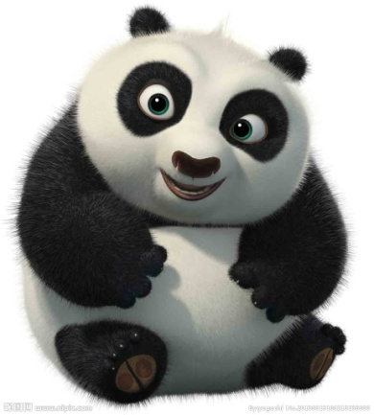
central adj. 在中心的；中央的 p. 67
menu n. 菜单 p. 67
fur n.（ 动物的）毛皮 p. 67
cruel adj. 残忍的；残酷的 p. 67
in the wild 在野生环境中 p. 66
at birth 出生时 p. 67
on one’s own 独自 p. 67

Slide 24
Colour
Weight at birth
Adult weight
What they eat
Where they live
Behaviour
How long they can live
Population
black and white
about 100-200 grams
about 100-150 kilograms
in the wild: bamboo
in zoos: bamboo, apples and carrots
high up in the mountains of Central and Western China
live on their own
spend more than 12 hours a day eating
good at climbing trees
strong enough to protect themselves
in the wild: for about 20 years
in zoos: for up to 35 years
in the wild: about 1,600

Slide 25
What's the style of the text?
poem essay(散文) dramma novel
argumentation exposition (说明文)
Order of the describtion:
Ways of describtion:

Slide 26
endangered
wild
weight
population
behaviour
at birth
the rest of
as much as
on their own
stay healthy
lose thier homes
killing for fur

Slide 27
Notes P65-69
endangered adj. 濒危的
endanger v. 使遭受危害，危及
danger n. 危险
in danger 处于危险之中
dangerous adj. 危险的
熊猫是濒危物种。
Pandas are an endangered species.

Slide 28
learn about 了解
帮助别人了解中国是我的荣幸。
It's my pleasure to help other people learn
about china.

Slide 29
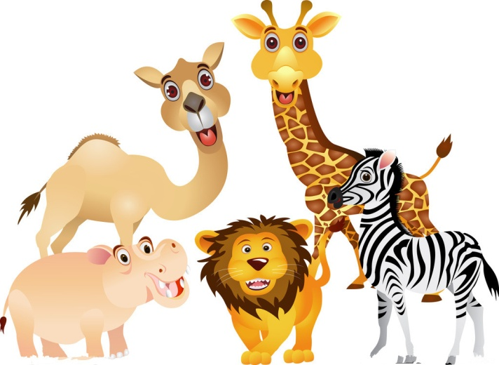
wild n. 自然环境；野生状态
wild adj. 野生的
in the wild 在野生环境中
动物园给人们展示了动物在野外的生活方式。
Zoos show people how animals live in the
wild.

Slide 30
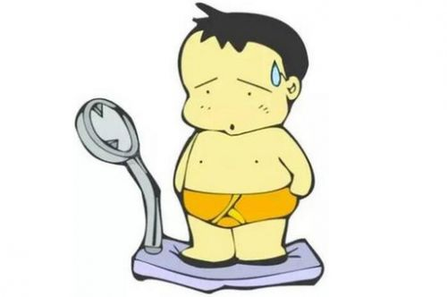
weight n. 重量（不可数名词）
weigh v. 有……重
put on weight 增重
lose weight 减肥
我将能弄清楚这头大象的体重。
I’ll be able to find out the weight of the elephant.
她怕发胖，她每天都称体重。
She is afraid of becoming fat. She weighs herself
every day.

Slide 31
population
n.(统称)某领域的生物；族群；人口
集合名词，作主语时谓语动词用单数。
① the population of …..的人口数量
这个城镇的人口大约是两万人。
The population of the town is about twenty
thousand.

Slide 32
②对人口提问用
中国有多少人口？
What’s the population of China?
=How large is the population of China?
③表示人口的多或少用
中国人口众多。
The population of China is large.
what或how large/ big。
large/small。

Slide 33
④表达“（某地/某范围内）有多少人口”时，用have/has a population of…
中国的人口超过13亿。
China has a population of more than 1.3
billion.

Slide 34
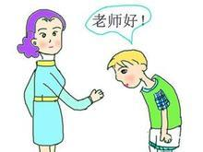
behaviour n. (动植物的)活动方式
behave v. 表现
规矩点！
Behave yourself！
孩子们行为良好。
The children behave well.

Slide 35
7. Weight at birth: about 100-200 grams
出生时体重：约100-200克
birth n. 出生；诞生
the day of one’s birth 某人出生的日子
at birth= when sb / sth was born 出生时
give birth to 生孩子；产仔
那个婴儿出生时有三公斤重。
The baby weighed three kilograms at birth.
= The baby weighed three kilograms when it was born.
苏珊生了一个健康的宝宝。
Susan gave birth to a healthy baby.

Slide 36
Practice
1. 选择最佳答案填空。
( ) ____, most babies weigh between 6 and 8
pounds.
A. By birth B. At birth
C. Having birth D. Giving birth
2. 同义句转换。
The monkey weighed 100 grams when it was
born.
The monkey weighed 100 grams ____ ____.
B
at birth

Slide 37
The rest of its body is white.
身体的其余部分都是白色的。
the rest of 其余的……；剩下的……
后面可以接可数名词，也可以接不可数名词。
修饰主语时，谓语动词的单复数形式由of 后
的名词决定。例如：
文章的剩余部分解释了作者为什么去美国。
The rest of the passage explains why the writer
went to America.
剩下的都是青苹果。
The rest of the apples are green.

Slide 38
Practice
1. 选择最佳答案填空。
( )The rest of the milk ____ drunk by me just
now.
A. was B. is C. were D. are
2. 根据中文意思完成句子。
一些学生在操场上，其余的在教室里。
Some students are in the playground, and _____ _____ _____ in the classrooms.
A
the
rest are

Slide 39
A giant panda can eat as much as 30 kilograms
of bamboo a day.
一只大熊猫一天能吃多达30千克的竹子。
as much as 在本句意为“多达；……之多”，表示数
量的程度，常与数词连用。
注意：as much as 用于表示具体的数量时，后面接在
意义上属于不可数的可数名词，如表示金钱、重量或
距离等的名词。例如：
它整整花了我100 美元。（dollar 表示金钱，形式上是
可数名词，但意义上属于不可数名词）
It cost me as much as 100 dollars.

Slide 40
【拓展】
as many as 也表示“多达；……之多”，也常
与数词连用，但其后面接表示可数概念的可数
名词复数。例如：
I read as many as 10 books this month.
我这个月读了十本书之多。
（10 books 表示的是可数概念）

Slide 41
Practice
选择最佳答案填空。
( )1. We walked ___ 30 miles today.
A. as much as B. as many as
C. much as D. many as
( )2. There are ___ 65 students in my class.
A. as much as B. as many as
C. much as D. many as
根据中文意思完成句子。
3. 这个婴儿出生时重达4公斤。
This baby weighed ____ ____ ____ 4 kilograms at birth.
A
B
as much as

Slide 42
Pandas like to live on their own.
熊猫喜欢独居。
on one’s own= (all) by oneself= alone 独自
例如：
那个小男孩可以独自完成这项工作。
The little boy can finish the work on his own.
= The little boy can finish the work all by himself.
= The little boy can finish the work alone.

Slide 43
Practice
同义句转换。
1. I live alone.
I live _____ _____ _____.
2. She said she could do it all by herself.
She said she could do it _____ _____ _____.
on my own / all by myself
on her own

Slide 44
They need to eat a lot to stay healthy, so they spend more than 12 hours a day eating.
他们需要大量进食以保持健康，因此它们一
天进食花的时间超过12个小时。
① stay healthy=keep healthy 保持健康
你应该多一点锻炼来保持健康。
You should exercise more to stay healthy.

Slide 45
②spend some time (in) doing sth 花时间做某事
例如：
我花了三个小时打扫我的房子。
I spent three hours (in) cleaning my house.
【拓展】spend 的常用结构还有
spend some time / money on sth
在某事物上花时间或金钱 例如：
汤姆花了三个小时在作业上。
Tom spent three hours on his homework.
她花了200美元买了这个钱包。
She spent 200 dollars on this purse.

Slide 46
Practice
选择最佳答案填空。
( )1. You shouldn’t spend too much time ____ TV.
A. to watch B. watch
C. to watching D. watching
( )2. My team spent half a year ____ this project.
A. in B. on C. at D. with
根据中文意思完成句子。
3. 他们花了三年的时间造这座桥。
They ______ three years ______ this bridge.
D
B
spent building

Slide 47
People are cutting down forests, so the
pandas are losing their homes.
人们一直在砍伐森林，因此大熊猫正不断失
去家园。
① cut down 砍倒
如：
对我来说用一把刀很难砍倒这棵树。
____ is hard ____ me ____ ____ ____ the tree.
It for to cut down

Slide 48
②lose one’s home 失去家园
如：
地震后，很多人失去了家园。
After the earthquake, a lot of people lost their
homes.

Slide 49
Some people are killing them for their fur.
有人猎杀大熊猫以盗取它们的皮毛。
① kill for 为了……而猎杀
过去，猎人杀动物是为了食物。
In the past hunters kill animals for food.
② fur n.（ 动物的）毛皮
狗咬狗，两嘴毛。
When dog bites dog, each gets a mouthful of fur.

Slide 50
the part of body between the arms and the neck(P68-C1)
between… and… 在…和…之间（两者）
房子与公路之间有条小路。
There is a path between the house and the road.

Slide 51
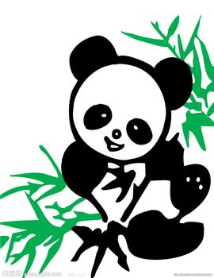
Vocabulary
C1 Circle the correct meanings.
1. The giant panda has a small population.
A. the total weight of animals in an area
B. the total number of animals in an area
2. Not many pandas live in the wild because there is not enough food for them.
A. a natural environment not controlled by people
B. a dangerous place
3. A giant panda is tiny at birth.
A. when it dies b. when it is born
B
A
B

Slide 52
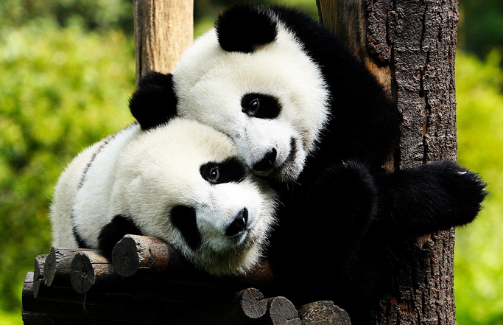
A
4. A giant panda is about two to three feet tall at the shoulder.
A. the part of body between the arms and the neck
B. the top of the head
5. Shanxi is in Central China. You can see pandas there.
A. the middle of b. the area around
A

Slide 53
C2 Complete the passage with the words from the box. Change their forms if necessary.
adult in the wild population at birth kilogram
Rabbit fact file
A rabbit weighs between 0.4 and 2 __________ and can live for up to 12 years. However, a rabbit _________ can seldom live for more than a year.
_______, a baby rabbit cannot see. An ______ rabbit cannot see very far, but it can see behind it self without turning its head.
Adult rabbits can give birth to many baby rabbits, and their __________ can grow very quickly. This can cause problems to farmers, because rabbits like to eat the farmers’ vegetables.
kilograms
in the wild
At birth
adult
population

Slide 54
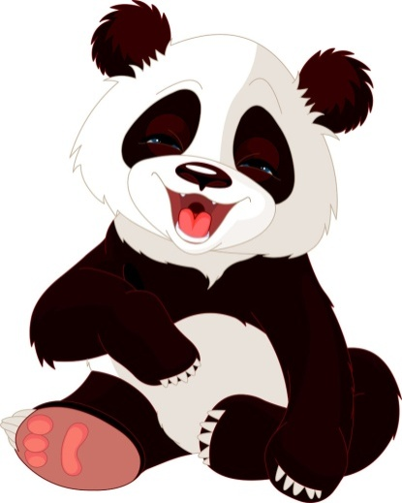
Comprehension
D1 Mandy wrote a passage about pandas for the school newspaper, but she has made some mistakes. Read the article on page 67 and help her correct the mistakes.

Slide 55
Please help us!
Hello. I am a panda. My home is in Central and Southern china. I live close to the mountains. I
have a black face with white patches around my eyes. I also have black ears, shoulders and legs. I love eating bamboo and I spend more than 18 hours a day eating.
There are about 3,000 of us in the wild. However, some people are still killing us for our teeth. Please help us!
Western
high up in
1,600
12
fur

Slide 56
D2 You are writing about the future of the giant panda. Read the article again and complete the notes below. You may also add some other facts.
Why are giant pandas endangered?
They are losing their homes because
people are cutting down forests.
Some people are killing them for their fur.
(Possible answer) People are polluting their homes.

Slide 57
D3. Discuss with your partners: How can we help the giant panda?
We should protect the environment by planting more trees and bamboo.
We human beings should be friendly to pandas.
We’d better not disturb（打扰） them by invading（侵入） their habitats（栖息地）.
And we can try our best to offer help when they are in trouble.
It is important for us to save them!

Slide 58
Part IV Post-Learning

Slide 59
I. Complete the sentences with the words you have learnt. The initial letters have been given.
A newborn baby usually weighs about three k_______.
Many people are working hard to keep e____________ animals from dying out.
We can find wild giant pandas in the mountains in C______ and Western China.
Now let’s read the fact f_______ about South China tigers.
I hurt my s_______ when I was throwing the ball.
Nowadays, we cannot see many giant pandas or South China tigers in the w_______.
ilograms
ndangered
entral
ile
houlder
ild

Slide 60
I. Complete the sentences with the words you have learnt. The initial letters have been given.
opulation
China has a large p___________.
Giant pandas mainly eat b_______ for food.
Millie was only 47 centimetres long at b_______.
Scientists keep giant pandas in reserves to learn about their b_______.
You are too fat. I think you have put on too much w_______.
Some people are c_______ to their pet dogs. We should be friendly to them.
Would you like to order now? This is today’s m_______.
amboo
irth
ehaviour
eight
ruel
enu

Slide 61
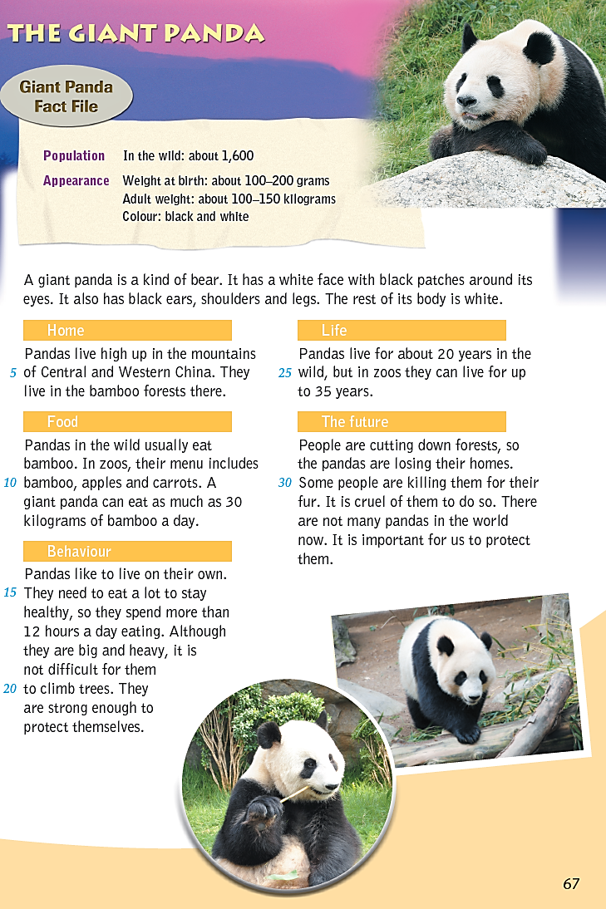
II. Retell the passage
Home:
High up in the mountains of …
Appearance:
Color:
Weight:
Food:
In the wild：
In zoos：
?
Behaviour
1.
2.
3.
4.
Life:
In the wild：
In zoos：

Slide 62
You may begin like this:
Hello, I am a giant panda. I have a white face with black patches around my eyes. I also have….

Slide 63
Part V Review

Slide 64
Dictation
endangered
file
giant panda
obligation
wild
bamboo
adult
weight
kilogram
濒危的
档案
大熊猫
义务；责任
自然环境；野生状态
竹；竹子
成年动物
重量
千克；公斤

Slide 65
某领域的生物；族群；人口
（ 动植物的）活动方式
出生；诞生
色斑；斑点
肩；肩膀
在中心的；中央的
菜单
（ 动物的）毛皮
残忍的；残酷的
population
behaviour
birth
patch
shoulder
central
menu
fur
cruel

Slide 66
一、根据句意和所给首字母写出所缺单词。
1. People often say that the g______ panda is our national treasure (国宝).
2. Animals should live in the w______ , not in zoos.
3. Cats are covered with soft f______.
4. It is c______ to kill animals.
5. My father came home with a heavy box on his s______.
6. My aunt gave b______ to a baby girl yesterday.
iant
ild
ur
ruel
houlder
irth

Slide 67
二、根据中文意思完成句子。
1. 那个婴儿出生时有4.5公斤重。
_____ _____, the baby weighed 4.5 kilograms.
2. 我经常和我的孩子在野外观察鸟类。
I often watch birds _____ _____ _____ with my child.
3. 晚上不要单独外出。
Don ’t go outside _____ _____ _____ at night.
4. 如果人们不停止砍伐森林，将会危害野生动植物。
If people don ’t stop ______ _____ forests, it will endanger the wildlife.
At birth
in the wild
on your own / all by yourself
cutting down

Slide 68
Thank you!

