Slide 1

Unit 7 The unknown world
Grammar

Slide 2
目录
Lead-in
1
While-Learning
2
3
Review

Slide 3
Part I While-Learning

Slide 4

Adverbial clauses of reason
原因状语从句
Read the following sentences and underline the conjunction in each sentence.
I am going to North Country Park because I want to go cycling.
I am going to North Country Park as I want to go cycling.
I am going to North Country Park since I want to go cycling.

Slide 5
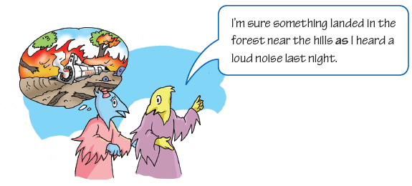
Adverbial clauses of reason tell us why things happen. We usually use because, as and since to start adverbial clauses of reason.

Slide 6
Adverbial clause of reason 从句 |  | Main clause 主句
Because | no one else saw these aliens, | I refuse to believe you.
As
Since
We can also put the adverbial clause of reason after the main clause.
We can also put the adverbial clause of reason after the main clause.
Main clause Adverbial clause of reason 主句 从句
I refuse to believe you | because | no one else saw these aliens.
 | as
 | since

Slide 7
Because no one else saw these aliens, I refuse to believe you.
As I like cycling, I am going to North Country Park.
原因状语从句放在句首时，与主句要用逗号隔开。
Things to remember
When we put the adverbial clause of reason at the beginning of the sentence, we often separate it from the main clause with a comma (,).

Slide 8
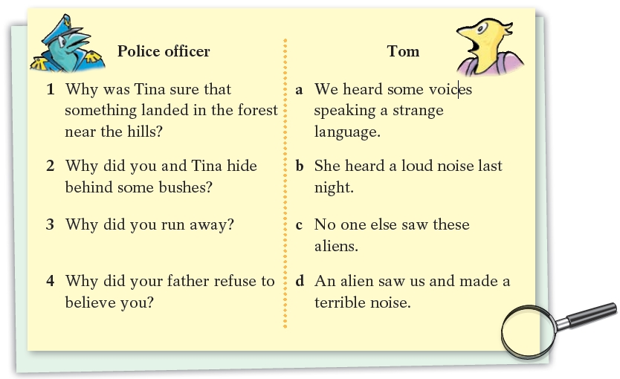
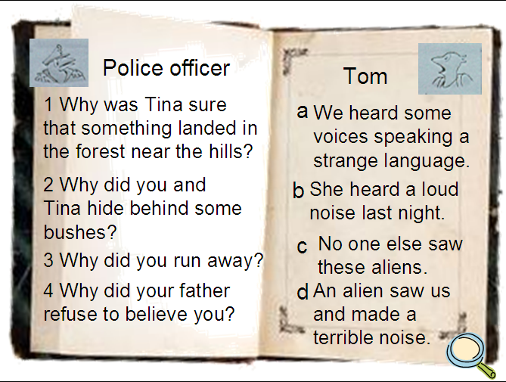

The police officer asked Tom some more questions about the aliens. Match the questions with the answers. Then use them to complete the police officer’s notes with as, since or because.

Slide 9
1 （because）Tina was sure that something landed in the forest near the hills because she heard a loud noise last night.
（as）
3（Because）
4 （Since）
Tina and I hid behind some bushes as we heard some voices speaking a strange language.
Because an alien saw us and made a terrible noise, we ran away.
Since no one else saw these aliens, our father refused to believe us.

Slide 10
because, as 与since三者的区别
【观察】
1. — Why is she so late?
— Because the bus didn’t come on time.
2. Since everyone is here, let’s start the meeting.
/ Let’s start the meeting since everyone is here.
3. As Xiao Wang was not ready, we went without
him. / We went without XiaoWang as he was not ready.

Slide 11

(1) because，since，as 都是表示“原因”的连
词，引导原因状语从句。从句既可以位于主句的前面，也可以位于主句的后面；从句位于主句前面时，要用逗号与后面的主句分开。这三个词所表达的语气由强至弱依次为：
because → since → as。

Slide 12
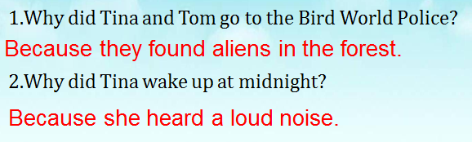
(2) because 表示直接原因，着重点在从句，它所指的原因通常是听话人所不知道的，语气最强。常用来回答why 的提问。如：
不用as和since

Slide 13
(3) since 侧重主句，从句表示明显的或已为人所知的理由，常译为“因为；既然”，语气比because 稍弱，可以放在主句后面，但通常放在句首。如：
Since the weather is so bad, we have to delay
our journey.
Since the rain has stopped, let’s go for a walk.
Since we are young, we shouldn’t be too afraid
of making mistakes.

Slide 14
(4) as 引导的原因状语从句语气最弱，它所表示的原因只是对结果的附加说明，可位于句首或句中。常译为“由于；鉴于”。如：
I left a message as Jim wasn’t here.
I’m sure something landed in the forest near the
hills as I heard a loud noise last night.

Slide 15
Practice
选用because，since或as填空。
1. — Why don’t you come to have dinner now?
— ___________ I am busy with my work.
2. ________________ it was raining, he took a bus.
3. __________________ I had a cold yesterday, I was absent from school.
Because
Since / As / Because
As / Since / Because

Slide 16
Pair work
One students write down a sentence and the
other student gives a reason for it.
e.g. S1:I love swimming
S2:I love swimming because it can help me build my body.

Slide 17
Because of
Read the following sentences and find the difference.
Tim didn’t go to school yesterday because he was ill.
Tim didn’t go to school yesterday because of his illness.

Slide 18
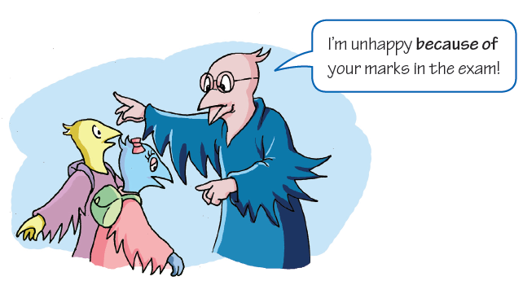
We can also use because of to give the reason for something.

Slide 19
They went to the forest because of their curiosity.
Tina woke up at midnight because of a loud noise.
She decided to explore the forest because of it.
Work out the rule
We can use a noun, a noun phrase or a (subject pronoun/object pronoun) after because of.

Slide 20
because与because of的区别
because 和because of 的意思都是“因为”，其区别为：
1. because 后面接从句；
2. because of后面接名词或名词短语。请对比：
They didn’t go to the museum because it rained. ( it rained是句子)
They didn’t go to the museum because of the rain. (rain是名词)
因为下雨，他们没去博物馆。

Slide 21
Practice
根据题目要求，完成下列句子。
1. The football match was put off. It rained.
(用because连接句子)
2. Jim couldn’t walk because his leg was
broken. (用because of改写句子)
Jim couldn’t walk _______________________ .
3. Many people give up smoking because smoking has
harmful effects. (用because of改写句子)
Many people give up smoking ___________________ .
The football match was put off because it rained.
/ Because it rained, the football match was put off.
because of his broken leg
because of its harmful effects

Slide 22
Complete thesentences.
Ben was nervous because __________________.
Ben was nervous because of __________________.
He had to speak so loudly because _____________.
He had to speak so loudly because of _____________.
She didn't buy that dress because ___________.
She didn't buy that dress because of ___________.
I was late because ___________.
I was late because of _____________.

Slide 23
due to
thanks to
as a result of

Slide 24
Part II Review

Slide 25
一、选择最佳答案填空。
( )1. I called the police ____ the terrible noise.
A. because of B. because
C. since D. as
( )2. ____ I’m very tired, I am going to bed early.
A. Until B. As C. Though D. While
( )3. ____ no one knows the truth, we don’t believe what
he said.
A. Whether B. When
C. While D. Since
( )4. We believe there are aliens ____ these photos of
UFOs.
A. since B. because
C. as D. because of
A
B
D
D

Slide 26
二、根据中文意思完成句子。
1. 因为下雨，运动会延期了。
The sports meeting was put off _______ _____ the rain.
2. 你既然错了，就应该道歉。
You should apologize _____ _____ _____ _____.
3. 我肚子痛，因为吃了太多冰淇淋。
My stomach hurts ______ I have ________ too much ice cream.
4. 由于你不在那儿，我就留了个口信。
______ ______ ______ there, I left a message.
because of
since you are wrong
because eaten/had
As / Because / Since you weren’t

Slide 27
Thank you!

